Slide 1

Dallas GiveCamp - Developer Bootcamp: WordPress @ GiveCamp
Shawn Weisfeld
shawn@shawnweisfeld.com
http://www.ShawnWeisfeld.com

Slide 2






About Me
Founder of UserGroup.tv
Technical Evangelist at Microsoft

Slide 3


Watch User Group presentations for FREE online!
All the topics you care about
Including:
Agile
C#
Entity Framework
HTML5
MVC
Silverlight
XAML
jQuery
and Much More!
Miss a User Group meeting?
Forget something that you learned?
Want to see content from a User Group not in your area?
Want to share with a buddy?
We know you cannot make it to every User Group meeting,
that is why we post them online for you!
We now have over 500 presentations online
That is over 100 GB of video
New Content added all the time!
Presentations from the thought leaders on the topic.
For new content announcements
@UserGroupTV
http://www.UserGroup.tv

Slide 4
Agenda
WordPress Basics
Tour of Divi
Shawn’s Tips
Q&A

Slide 5


Slide 6
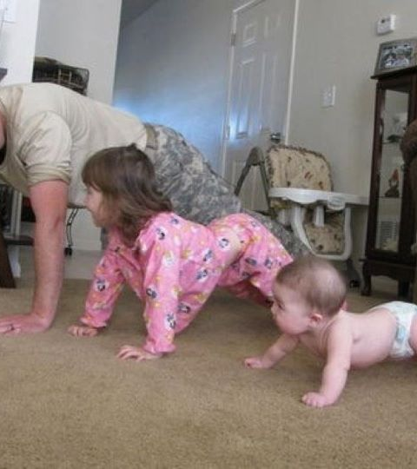
WordPress Basics

Slide 7
WordPress
A Content Management System (CMS) & Blogging platform.
One of the most popular platforms on the web.

Slide 8
Theme
Provide the look & feel and much of the functionality of your WordPress instance.

Slide 9
Plugin
Plugins extend and expand the functionality of WordPress.
Just under 50,000 to pick from. . .

Slide 10
WordPress Components
PHP Files
MySQL database

Slide 11
Do I need a local instance?
Great for testing out plugins before deploying them.
Great for learning.
Required if writing custom PHP code. ^{** very rare **}
Deploy content and layout pages directly in production

Slide 12
Create a Local instance
Get the Prerequisites
On Windows
https://webgallery.microsoft.com/apps/WordPress/install
WordPress, WebMatrix & MySQL
On Mac with MAMP
https://codex.wordpress.org/Installing_WordPress_Locally_on_Your_Mac_With_MAMP
Get the GiveCamp Distro of WordPress

Slide 13
What is in GiveCamp Distro of WordPress
WordPress 4.6
Divi Theme 2.7.10 **
https://www.elegantthemes.com/gallery/divi/documentation/
Plugins
Bloom - email opt-in plugin
https://www.elegantthemes.com/plugins/bloom/documentation/
Monarch – Social Sharing and Social Following plugin
https://www.elegantthemes.com/plugins/monarch/documentation/
Postman SMTP – for sending mail from your site
https://wordpress.org/plugins/postman-smtp/

Slide 14
Deploy GiveCamp Distro of WordPress
Create Database (aka Schema) in MySQL Locally
Unzip source
Open in WebMatrix
Run WordPress install Wizard
Set Divi Child as your default theme

Slide 15
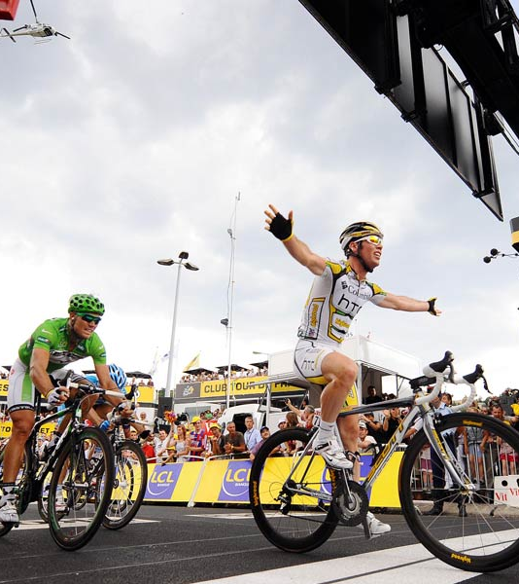
Tour de WordPress

Slide 16
Demo
Create WordPress Instance Locally
Create/Edit Page

Slide 17

Shawn’s Tips

Slide 18
Break the work into a few main goals
Overall Theme/Look and Feel
Home Page
About Us Page
Contact Us Page
Events Page
Blog
Etc…

Slide 19
Keep track of tasks
Know what you have to do, don’t get lost in the weeds
Post-its, Marker board, Digital Kanban board

Slide 20
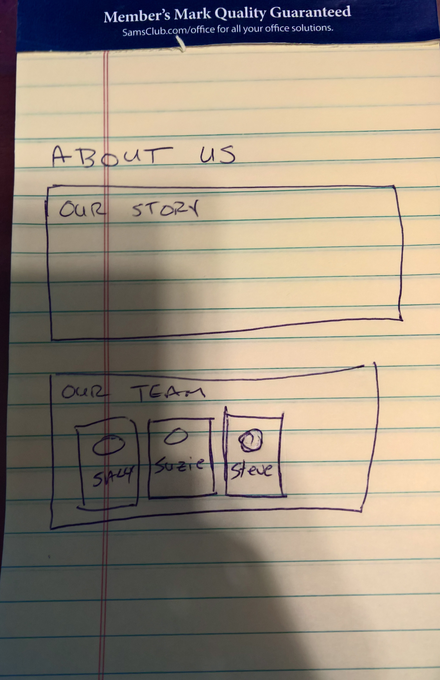
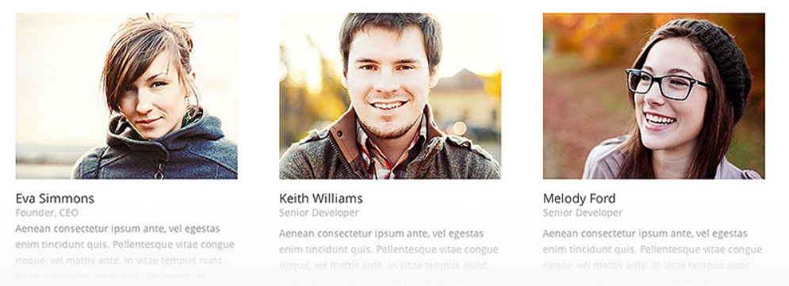
Decompose each into its parts
What parts of the page are static HTML Content?
What parts of the page require a plugin/module?
Divi Person Module

Slide 21
Can a Plugin Do it?
Before writing custom PHP code, review if a plugin can do what you need?
Plugins will be better tested and receive updates and bug fixes, your code will not.

Slide 22
Test Plugins
Test Plugins locally before deploying to production
Does it do what you need?
Is it easy to use/maintain?
Is it popular/recommended?
Look at scores/reviews in the WordPress Plugin Directory
Look for reviews comparing plugins by trusted authors

Slide 23
Can Divi do it?
Before installing a plugin, review if Divi can natively do what you want.
Every plugin you add
Increases your chances that the additional code will slow down the site
Increases your chances that there will be some strange interaction breaking things
Check out the Elegant Themes Blog: https://www.elegantthemes.com/blog/
Read/Review the docs: https://www.elegantthemes.com/gallery/divi/documentation/

Slide 24
Watch your URLs
Prefer relative URLs for local links over absolute
This will allow you to do a DNS Swing later and not break any links.
Watch your Images . . .

Slide 25
Is it Good Enough?
The requirements will ask for something.
There might be a popular plugin that does 90% of what the requirements are asking for…
Get the important work done and revisit less important hard things later.

Slide 26
Photos and Copyrights
Don’t use what you don’t have permission to use
Ensure that the charity is comfortable with the license of any code/photos you get from the web.

Slide 27
Before and After
Take pictures of the website before/after the weekend.
This will help with final presentations on Sunday.
Take backups of the website (code and database) before and after the weekend.
Talk to your Ninja, they might do this for you.

Slide 28
Keep the charity in mind!
The goal is not to demonstrate your technical prowess. The goal is to help the charity!
The charity will need to maintain this site going forward.

Slide 29
Share with your charity!
Document common scenarios
How to add an event
How to update a bio
Etc.

Slide 30
Get Help when you get stuck!
Search the web
Search the Tech Ninja/Tech Jedi Slack Channel
Ask your team
Ask a Tech Ninja/Tech Jedi

Slide 31
Q&A
?
Questions…

Slide 32
Thank you! Your Feedback is Important
Rate My Talk & Download Slides!
http://bit.ly/RateShawnsTalk
Contact Information
Email: shawn@shawnweisfeld.com
Blog: http://www.shawnweisfeld.com
Twitter: @shawnweisfeld

Slide 33

© 2016 Microsoft Corporation. All rights reserved. Microsoft, Windows, and other product names are or may be registered trademarks and/or trademarks in the U.S. and/or other countries.
The information herein is for informational purposes only and represents the current view of Microsoft Corporation as of the date of this presentation. Because Microsoft must respond to changing market conditions, it should not be interpreted to be a commitment on the part of Microsoft, and Microsoft cannot guarantee the accuracy of any information provided after the date of this presentation. MICROSOFT MAKES NO WARRANTIES, EXPRESS, IMPLIED OR STATUTORY, AS TO THE INFORMATION IN THIS PRESENTATION.

