Slide 1

Hello Azure Functions
Shawn Weisfeld
shawn@shawnweisfeld.com
http://www.ShawnWeisfeld.com

Slide 2







About Me
Founder of UserGroup.tv
Technical Evangelist at Microsoft

Slide 3


Watch User Group presentations for FREE online!
All the topics you care about
Including:
Agile
C#
Entity Framework
HTML5
MVC
Silverlight
XAML
jQuery
and Much More!
Miss a User Group meeting?
Forget something that you learned?
Want to see content from a User Group not in your area?
Want to share with a buddy?
We know you cannot make it to every User Group meeting,
that is why we post them online for you!
We now have over 545 presentations online
New Content added all the time!
Presentations from the thought leaders on the topic.
For new content announcements
@UserGroupTV
http://www.UserGroup.tv

Slide 4
Abstract
Azure functions is a solution for easily running small pieces of code, or "functions," in the cloud. You can write just the code you need for the problem at hand, without worrying about a whole application or the infrastructure to run it. In this talk we will provide an overview of the newest member to the Azure family, and then dig into to some code.

Slide 5
Agenda
Why Azure Functions
Azure Functions Overview
Some Code

Slide 6


Foo as a Service
Packaged Software
Infrastructure
(as a Service)
Platform
(as a Service)
Software
(as a Service)
You manage
Applications
Applications
Applications
Applications
Data
You manage
Data
Data
Data
Runtime
Runtime
Runtime
Runtime
Managed by vendor
You manage
Middleware
Middleware
Middleware
Managed by vendor
Middleware
O/S
O/S
O/S
O/S
Virtualization
Virtualization
Managed by vendor
Virtualization
Virtualization
Servers
Servers
Servers
Servers
Storage
Storage
Storage
Storage
Networking
Networking
Networking
Networking
Your Car
Rental Car
Taxi

Slide 7
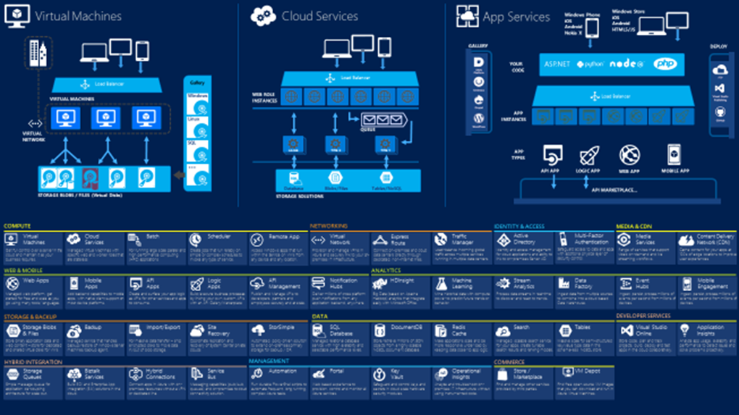

Slide 8

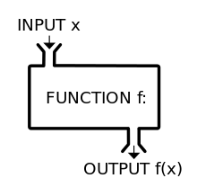
What is a Function?
Trigger
Image Source: https://en.wikipedia.org/wiki/Function_(mathematics)

Slide 9
Common Scenarios

Slide 10
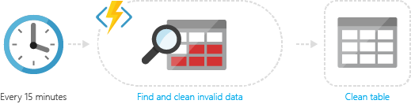
Timer-based processing
Azure Functions supports an event based on a timer using CRON job syntax.

Slide 11
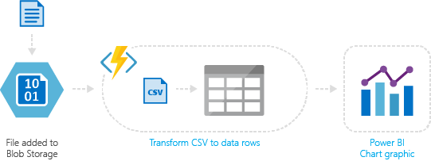
Azure service event processing
Azure Functions supports triggering an event based on an activity in an Azure service.

Slide 12
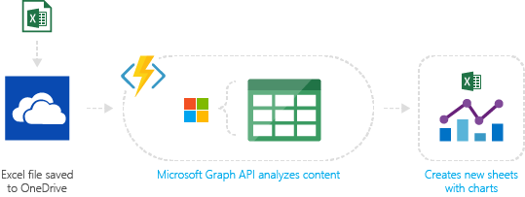
SaaS event processing
Azure Functions supports triggers based on activity in a SaaS service.

Slide 13
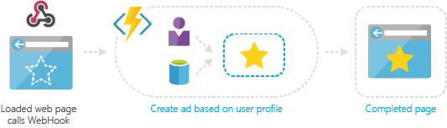
Serverless web application architectures
Azure Functions can power a single page app.

Slide 14
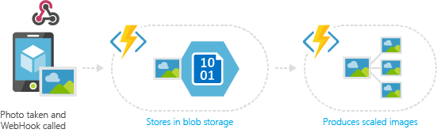
Serverless mobile backends
A mobile backend can be just a set of HTTP APIs that are called from a mobile client using the WebHook URL.

Slide 15
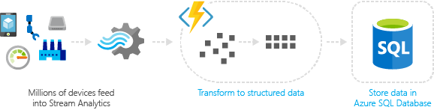
Real-time stream processing
IoT devices send messages to Azure Stream Analytics, which then calls an Azure Function to transform the message. This function processes the data and creates a new record in an Azure SQL Database

Slide 16
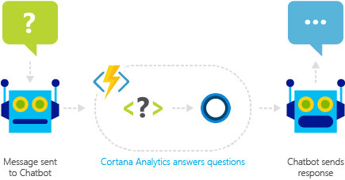
Real-time bot messaging
Azure Functions can be used to customize the behavior of a bot using a WebHook.

Slide 17

Example – Watermark an image
New watermark request
Fetch image from storage
Apply the watermark
Store the new image in storage
Image Source: TonyBearComic http://tonybearcomic.deviantart.com/art/Mario-Brothers-404300606

Slide 18
Demo
Hello World!

Slide 19
Functions in a nutshell

Slide 20



What is Azure Functions?
Code
Azure Functions
Events + data

Slide 21


Azure Functions
input
code
output

Slide 22
Groups of functions
“Function App”
foo()
bar()
baz()

Slide 23
Supported Languages
1st class support
Node/JavaScript
C#
F#
Experimental support
Python
PHP
Batch
Bash
PowerShell

Slide 24
Supported bindings
Type | Service | Trigger | Input | Output
Schedule | Azure Functions | ✔
HTTP (REST or webhook) | Azure Functions | ✔ |  | ✔*
Blob Storage | Azure Storage | ✔ | ✔ | ✔
Events | Azure Event Hubs | ✔ |  | ✔
Queues | Azure Storage | ✔ |  | ✔
Tables | Azure Storage |  | ✔ | ✔
Tables | Azure Mobile Apps |  | ✔ | ✔
No-SQL DB | Azure DocumentDB |  | ✔ | ✔
Push Notifications | Azure Notification Hubs |  |  | ✔
* - The http out binding requires an http trigger

Slide 25





Part of App Service

Slide 26
App Service Features and Capabilities
Enterprise Grade Apps
Designed for secure mission-critical applications
Fully Managed Platform
Optimized for Availability and Automatic scale
High Productivity Development
Agility through Continuous Deployment
Hybrid Connections / VPN / VLAN
Scheduled Backup
Azure Active Directory Integration
Site Resiliency, HA, and DR
Web Jobs
Role Base Access Control
Audit / Compliance
Enterprise Migration
Client Certs
Cache
IP Restrictions/ SSL
Web Sockets
SQL, MySQL, DocDB, & Mongo
Sticky Sessions
Authorization/ Authentication
Automated Deployment AutoScale
Built-in Load Balancing
Worldwide Datacenter Coverage
End Point Monitoring & Alerts
App Gallery
DR Site Support
WildCard Support
Dedicated IP address
HTTP Compression
CDN Support for Websites
Premium WordPress
App Services Environments
Remote Debugging w/ Visual Studio
Site Staging Slots
Testing in Production
Continuous Integration/Deployment
Git, Visual Studio Online and GitHub
App & Site Diagnostics
OS & Framework Patching
Site Extensions Gallery
NET, PHP, Python, Node, Java
Framework Installer
Browser-based editing
Auto-Healing
Logging and Auditing
Admin-Site
Support Site Extension

Slide 27
Supported Hosting Models
App Service
App Service Environment
Dynamic Hosting

Slide 28
Built around App Service
Runs on existing App Hosting plans
Run alongside Web, Mobile, and API Apps
Can deploy via existing App Service ARM APIs
All the features of App Service
Continuous Deployment
Deployment Slots
Remote Debugging
Run in your own isolated and dedicated environment
App Service Environment helps run dedicated App Services
Run inside of your own VNET, with your own frontend and firewall

Slide 29
Scaling on App Service
Scaling up to a larger VM for more resources
Scaling out as simple as a slider bar
Set up auto-scaling rules to handle additional load while you’re asleep

Slide 30
The details on dynamic hosting plans
Available today with limited capacity
Currently free in preview
Charged based on memory*sec
More details to come…

Slide 31
Demo
CI Deployment

Slide 32
Resources – Build 2016
Introducing Azure Functions
Speakers: Chris Anderson
https://channel9.msdn.com/Events/Build/2016/B858
Azure Functions Under the Hood
Speakers: Matthew Henderson
https://channel9.msdn.com/Events/Build/2016/T692

Slide 33
Azure Functions is open sourced
The runtime, “portal”, and templates are all on GitHub
https://github.com/Azure/azure-webjobs-sdk
https://github.com/Azure/azure-webjobs-sdk-extensions
https://github.com/Azure/azure-webjobs-sdk-script
https://github.com/Azure/azure-webjobs-sdk-templates
https://github.com/ProjectKudu/WebJobsPortal
Open roadmap
Use the cutting edge features
Transparency into priorities and velocity
Influence the direction of the project
Runtime is intended to be portable
MIT License

Slide 34
Call to Action
Try Azure Functions @ https://functions.azure.com
Try App Service @ https://tryappservice.azure.com
Fork us @ https://github.com/azure/azure-webjobs-sdk-script

Slide 35
Azure Functions Takeaway
Azure Functions lets you do more with less code
You focus on the core logic – we’ll take care of triggering, integrating, and parsing
Azure Functions is a part of App Service
You can use App Service features with your functions
Azure Functions is flexible
Edit in portal or use git. Leverage your favorite libraries.
Azure Functions is great for dev-ops workflows
Examples: monitoring, CI webhooks, workflow processing…

Slide 36
Q&A
?
Questions…

Slide 37
Thank you! Your Feedback is Important
Rate My Talk & Download Slides!
http://bit.ly/RateShawnsTalk
Contact Information
Email: shawn@shawnweisfeld.com
Blog: http://www.shawnweisfeld.com
Twitter: @shawnweisfeld

Slide 38
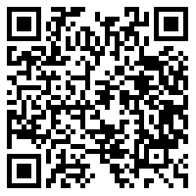
HTF Questionaire

Slide 39

© 2016 Microsoft Corporation. All rights reserved. Microsoft, Windows, and other product names are or may be registered trademarks and/or trademarks in the U.S. and/or other countries.
The information herein is for informational purposes only and represents the current view of Microsoft Corporation as of the date of this presentation. Because Microsoft must respond to changing market conditions, it should not be interpreted to be a commitment on the part of Microsoft, and Microsoft cannot guarantee the accuracy of any information provided after the date of this presentation. MICROSOFT MAKES NO WARRANTIES, EXPRESS, IMPLIED OR STATUTORY, AS TO THE INFORMATION IN THIS PRESENTATION.

