Slide 1

Little Rock Tech Fest
October 6 2017
Little Rock, AK

Slide 2


This Photo by Unknown Author is licensed under CC BY-NC-SA

Slide 3
CI/CD with VisualStudio.com and Azure
Shawn Weisfeld
Cloud Solution Architect
Microsoft

Slide 4








About Me
Shawn Weisfeld
Cloud Solution Architect
Microsoft – One Commercial Partner Technical Team
sweisfel@microsoft.com
Austin, TX

Slide 5


Watch User Group presentations for FREE online! We now have over 690 presentations online
Miss a User Group meeting?
Forget something that you learned?
Want to see content from a User Group not in your area?
Want to share with a buddy?
Presentations from the thought leaders on the topics you care about including:
Agile
Azure
C#
Entity Framework
HTML5
MVC
SQL
jQuery
and Much More!
We know you cannot make it to every session,
that is why we post them online for you!
New Content added all the time!
For new content announcements
@UserGroupTV
http://www.UserGroup.tv

Slide 6
Session Objective
In this talk we will take a simple ASP.NET MVC application and check it in to VisualStudio.com Source Control. We will then use the online Build tools to automate builds on check-in. Then using the online release management we will automate deploying it to our Dev, QA and Production environments. All the while ensuring that we keep all of the configuration for each of these environments safe.

Slide 7
Continuous integration
Continuous integration (CI) is the practice, in software engineering, of merging all developer working copies with a shared mainline several times a day. It was first named and proposed by Grady Booch in his 1991 method, although practices at this time did not yet support full automation, or the performance of integrations more than a few times a day.
Source: http://en.wikipedia.org/wiki/Continuous_integration

Slide 8
Continuous delivery
Continuous delivery (CD) is a software engineering approach in which teams produce software in short cycles, ensuring that the software can be reliably released at any time. It aims at building, testing, and releasing software faster and more frequently. The approach helps reduce the cost, time, and risk of delivering changes by allowing for more incremental updates to applications in production. A straightforward and repeatable deployment process is important for continuous delivery.
Source: https://en.wikipedia.org/wiki/Continuous_delivery

Slide 9
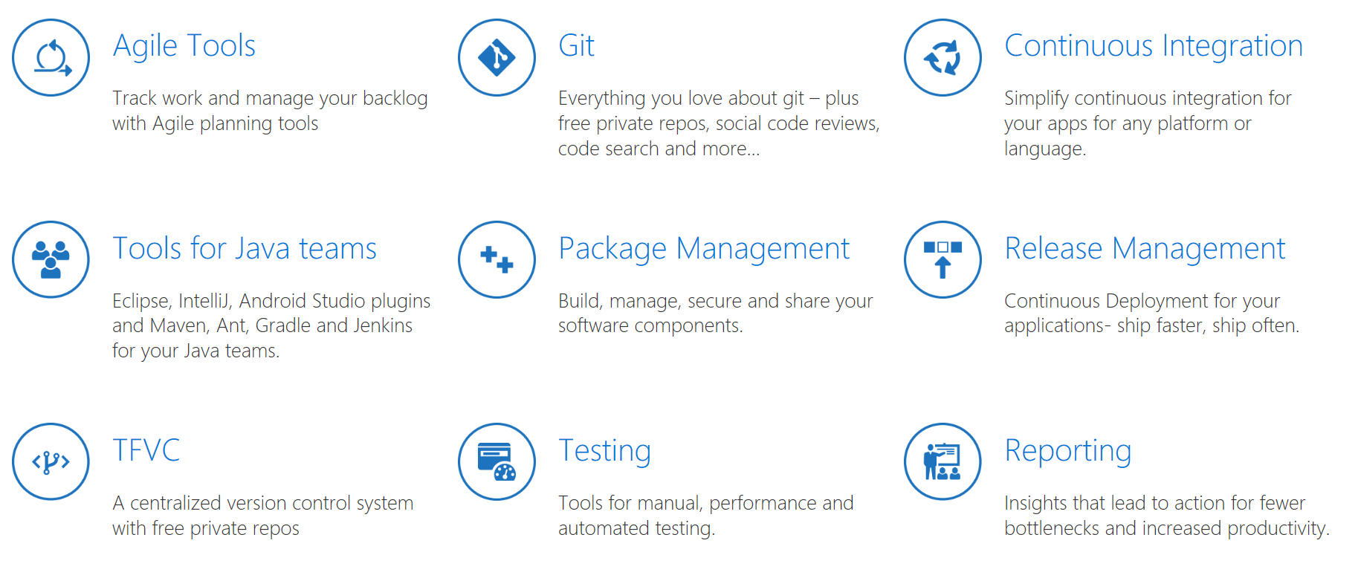
Visual Studio Team Services
https://www.visualstudio.com/team-services/

Slide 10
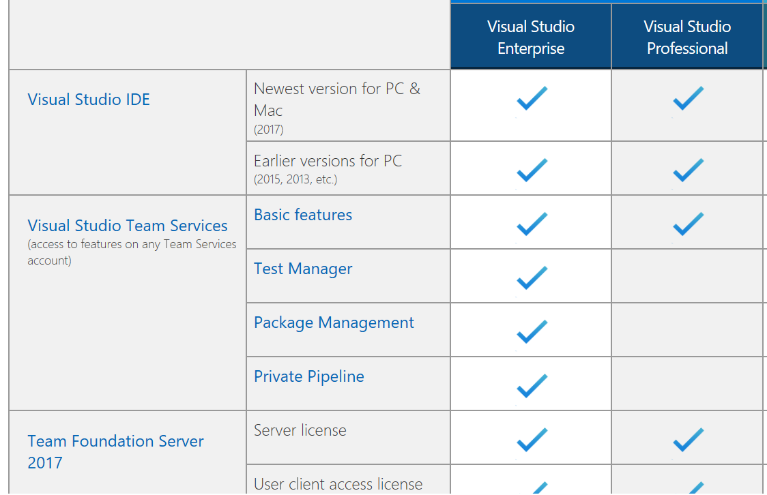
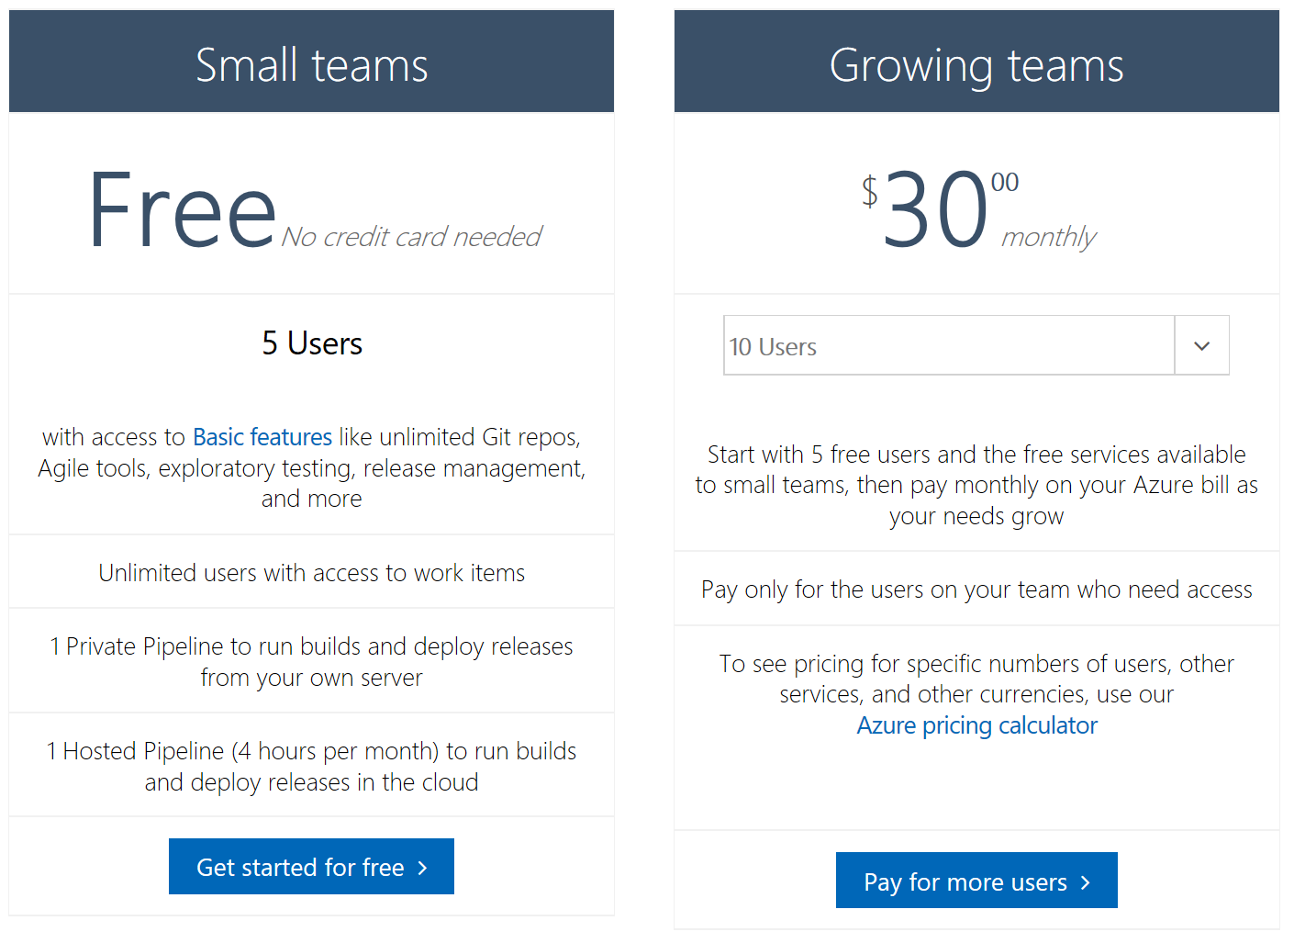
Visual Studio Team Services
Visual Studio (MSDN) Subscription
Stand alone license

Slide 11
Demo

Slide 12
Call to Action
Regardless of what tools you pick, automated your build & release pipeline
Give our tools a try
You can start for free with no servers to buy
Mix and match with your favorite tools
Let us know what you think
https://visualstudio.uservoice.com
http://feedback.azure.com

Slide 13

Thank you! Your Feedback is Important
Rate My Talk & Download Slides!
http://bit.ly/RateShawnsTalk
(case sensitive)
Contact Information
Email: sweisfel@microsoft.com
Blog: http://www.shawnweisfeld.com
Twitter: @shawnweisfeld

