Slide 1

Houston Tech Fest
May 5 2018

Slide 2
Azure in 60 minutes
Shawn Weisfeld
Cloud Solution Architect
Microsoft

Slide 3

About Me
Shawn Weisfeld
Cloud Solution Architect
Microsoft – One Commercial Partner Technical Team
sweisfel@microsoft.com
Austin, TX

Slide 4


Watch User Group presentations for FREE online! We now have over 750 presentations online
Miss a User Group meeting?
Forget something that you learned?
Want to see content from a User Group not in your area?
Want to share with a buddy?
Presentations from the thought leaders on the topics you care about including:
Agile
Azure
C#
Entity Framework
HTML5
MVC
SQL
jQuery
and Much More!
We know you cannot make it to every session,
that is why we post them online for you!
New Content added all the time!
For new content announcements
@UserGroupTV
http://www.UserGroup.tv

Slide 5
Overview & features

Slide 6

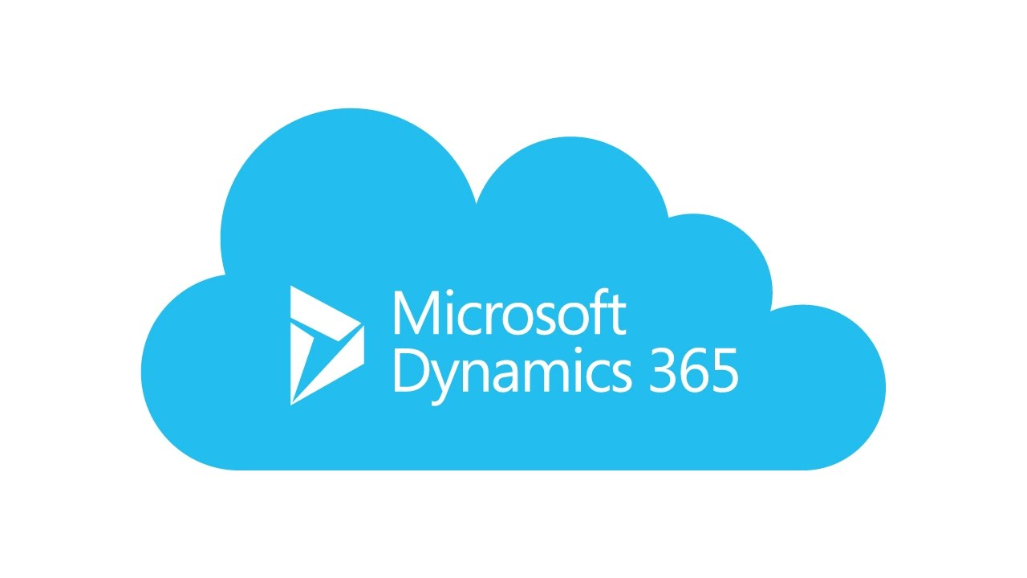

Overview Public Cloud Platform

Slide 7
Azure. Cloud for all.
Productive
Azure has more than 100 services with great end-to-end tools to make you successful.
Hybrid
Develop and deploy where you want, with the only consistent hybrid cloud on the market. Extend Azure on-premises with Azure Stack.
Intelligent
Create intelligent apps using powerful data and artificial intelligence services.
Trusted
Join startups, governments, and 90% of Fortune 500 businesses who run on the Microsoft Cloud today.
Productive
Hybrid
Intelligent
Trusted

Slide 8
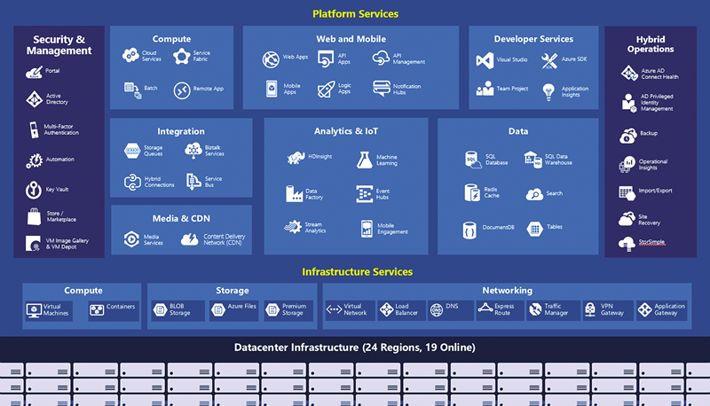
Productive
Hybrid
Intelligent
Trusted

Slide 9
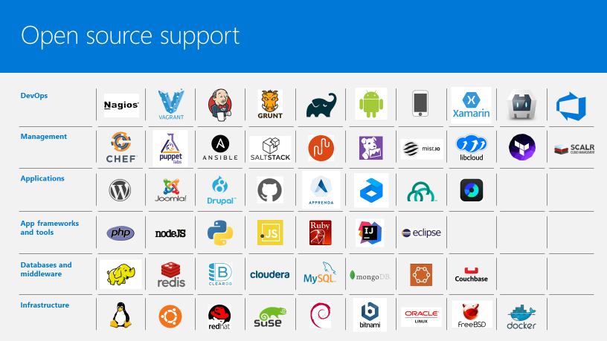


Productive
Hybrid
Intelligent
Trusted

Slide 10
The only consistent, hybrid cloud
Azure Active Directory
Azure services
Azure data services
Azure Security and Management
Productive
Hybrid
Common identity
Unified cloud platform
Data
platform
Security and management
Intelligent
Trusted
Active Directory
Azure
Stack
SQL
Server
On-premises infrastructure

Slide 11
Azure Stack: an extension of Azure
Productive
Hybrid
Intelligent
At the edge and disconnected
Meet every regulatory requirement
Cloud application model on-premises
Trusted

Slide 12
Comprehensive deep learning,
machine learning as a service
Productive
Hybrid
Customizable services
VS, ML STUB, Tensor, Caffe
Tools
Bots, Cognitive, ML
Infrastructure and compute
CPU, GPU, FPGA
Intelligent
Azure
Trusted

Slide 13




































More certifications than any cloud provider
GLOBAL
ISO 27001
ISO 27018
ISO 27017
ISO 22301
SOC 1 Type 2
Productive
SOC 2 Type 2
SOC 3
CSA STAR
Self-Assessment
CSA STAR
Certification
CSA STAR
Attestation
Hybrid
INDUSTRY
PCI DSS
Level 1
CDSA
MPAA
FACT UK
Shared
Assessments
FISC Japan
HIPAA / HITECH Act
Intelligent
HITRUST
GxP
21 CFR Part 11
MARS-E
IG Toolkit UK
FERPA
GLBA
FFIEC
REGIONAL
Argentina PDPA
EU
Model Clauses
UK
G-Cloud
China
DJCP
China
GB 18030
China
TRUCS
Singapore
MTCS
Australia
IRAP/CCSL
New Zealand
GCIO
Trusted
Japan My
Number Act
ENISA
IAF
Japan CS Mark Gold
Spain
ENS
Spain
DPA
India
MeitY
Canada
Privacy Laws
Privacy
Shield
Germany IT
Grundschutz
workbook

Slide 14
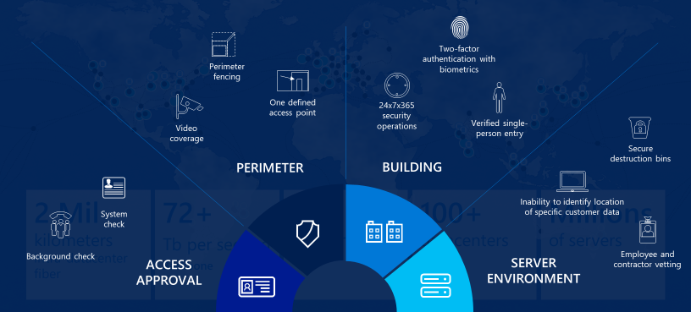
Datacenter Security
Productive
Hybrid
Intelligent
Trusted

Slide 15
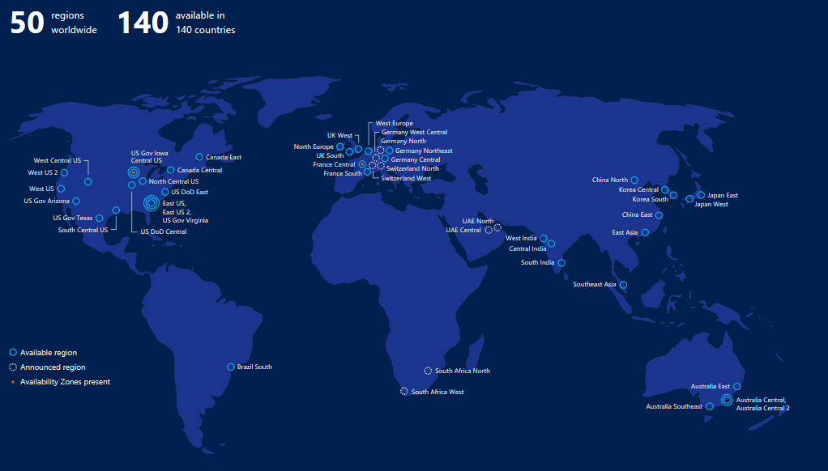
Azure Regions
Productive
Hybrid
Intelligent
Trusted

Slide 16
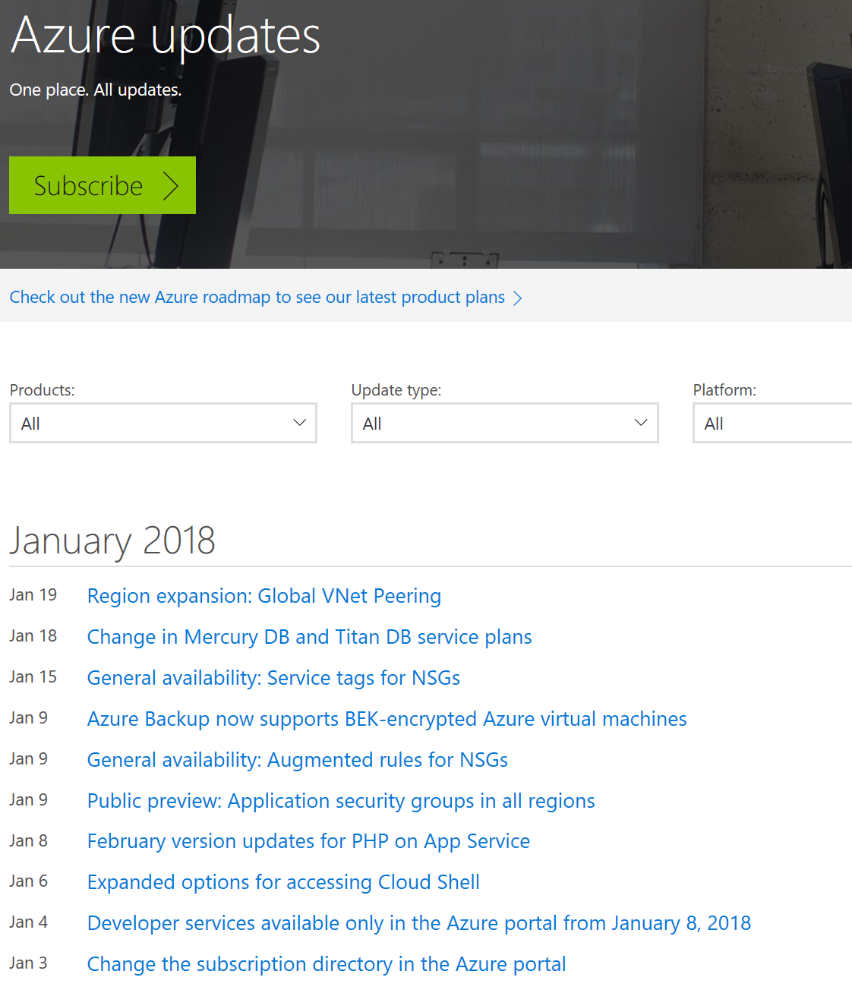
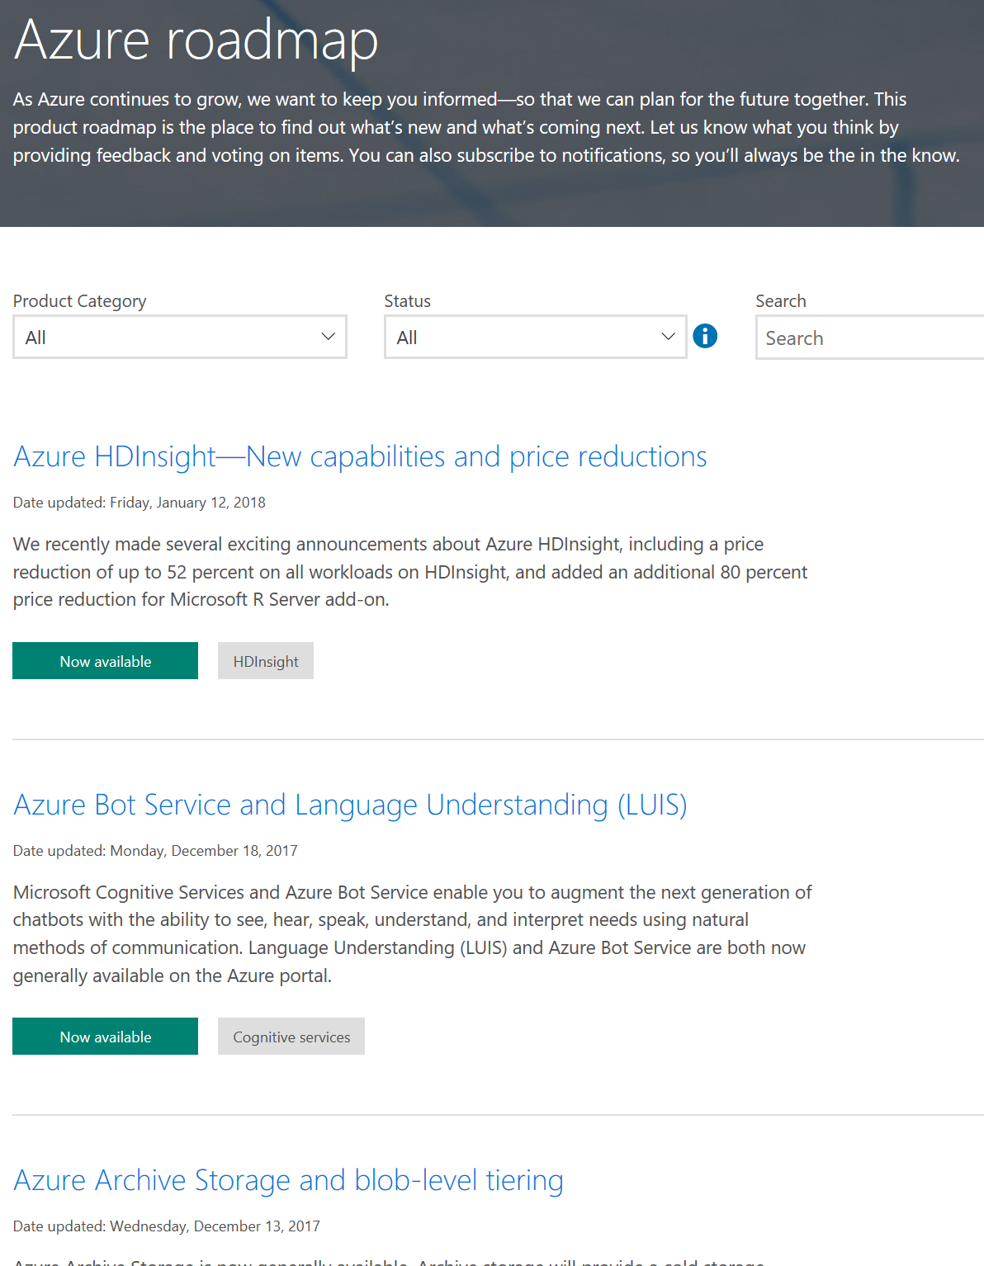
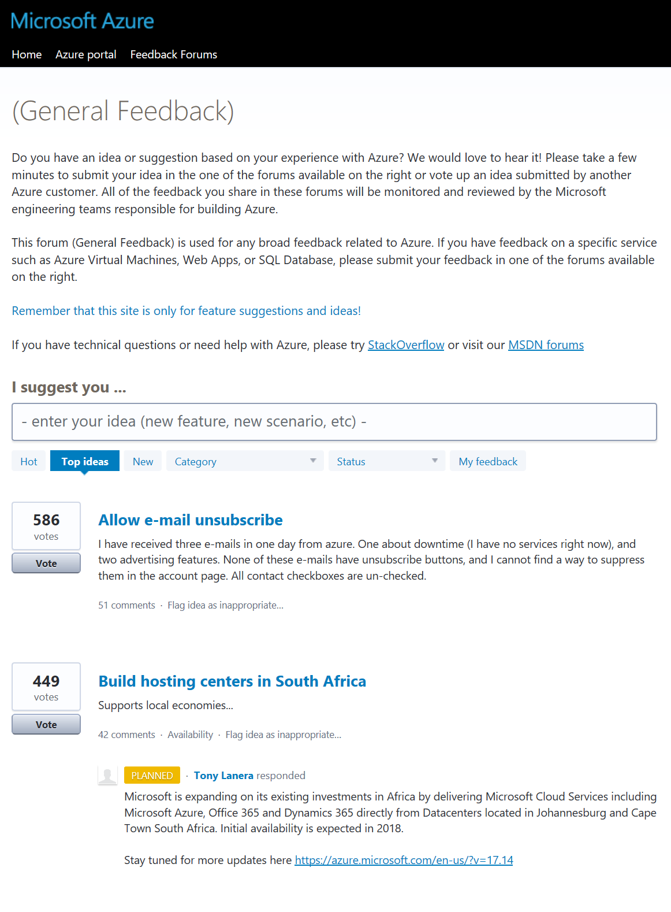
New Features
What we did…
What we are planning…
What you want us to do…
https://azure.microsoft.com/updates
https://azure.microsoft.com/roadmap
http://feedback.azure.com

Slide 17
OMG! What Should I Pick?
VMs
VM Scale Sets
Containers
Service Fabric
AppService
Functions
IaaS
PaaS
Control
Agility
https://docs.microsoft.com/en-us/azure/app-service/choose-web-site-cloud-service-vm

Slide 18
Common Options for working with Azure
Azure Home: https://www.azure.com
Docs, Pricing, Training & more
Azure Portal: https://portal.azure.com
Azure Online Shell: https://shell.azure.com
Windows PowerShell, Linux Bash CLI
Local
Windows PowerShell or CLI, Linux Bash CLI
ARM Template
Declarative JSON Template
Azure Resource Explorer: https://resources.azure.com

Slide 19
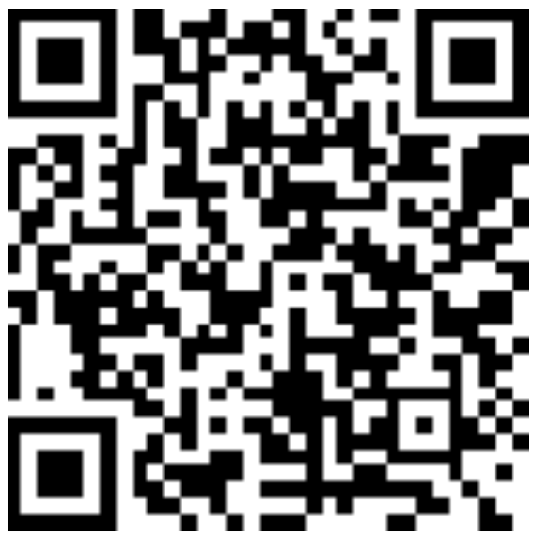
Thank you! Your Feedback is Important
Rate My Talk & Download Slides!
http://bit.ly/RateShawnsTalk
(case sensitive)
Contact Information
Email: sweisfel@microsoft.com
Blog: http://www.shawnweisfeld.com
Twitter: @shawnweisfeld

