Slide 1
Women Who Code & Tulsa Cloud Cooperative
August 26 2018

Slide 2
Azure Intro & Azure App Service Web Apps
Shawn Weisfeld
Cloud Solution Architect
Microsoft

Slide 3

About Me
Shawn Weisfeld
Cloud Solution Architect
Microsoft – One Commercial Partner Technical Team
sweisfel@microsoft.com
Austin, TX

Slide 4
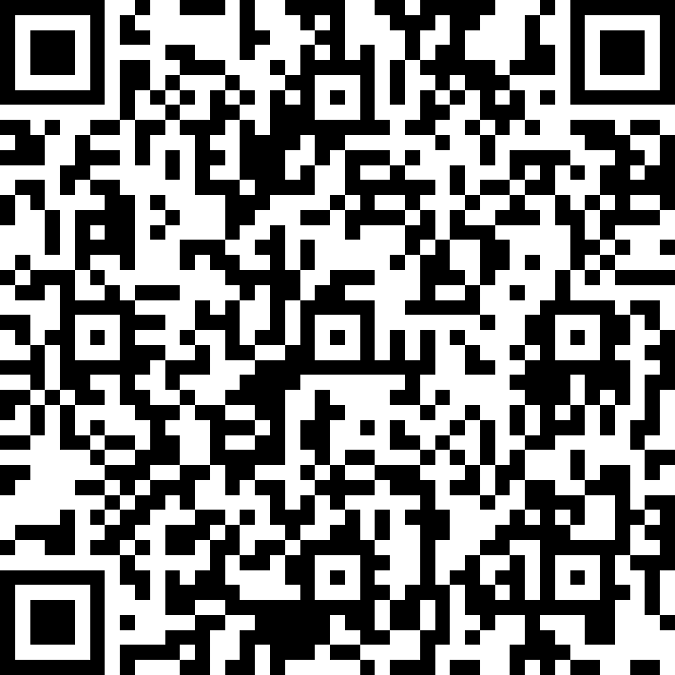
About you
Let me know a bit about you
https://aka.ms/201808Tulsa
or scan this

Slide 5
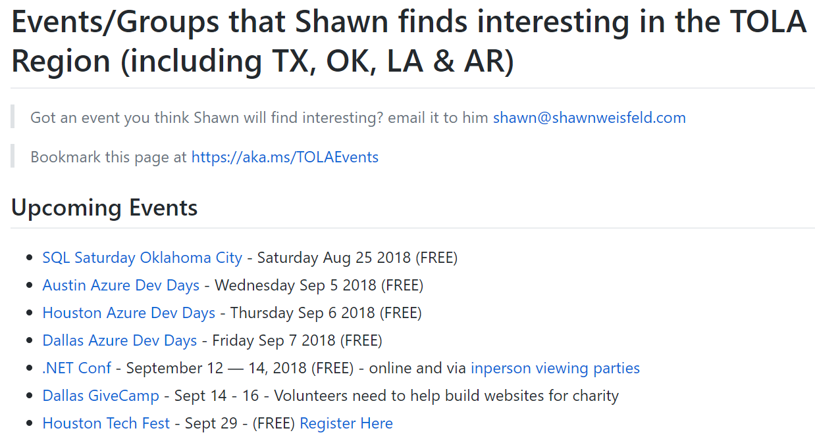
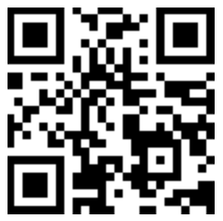
Regional Events
https://aka.ms/TOLAEvents

Slide 6


Watch User Group presentations for FREE online! We now have over 800 presentations online
Miss a User Group meeting?
Forget something that you learned?
Want to see content from a User Group not in your area?
Want to share with a buddy?
Presentations from the thought leaders on the topics you care about including:
Agile
Azure
C#
Entity Framework
HTML5
MVC
SQL
jQuery
and Much More!
We know you cannot make it to every session,
that is why we post them online for you!
New Content added all the time!
For new content announcements
@UserGroupTV
http://www.UserGroup.tv

Slide 7
Azure Intro

Slide 8
Azure. Cloud for all.
Productive
Hybrid
Intelligent
Trusted

Slide 9
Unparalleled developer productivity
Productive
Integrated tooling
Visual Studios Third parties | DevOps
100+ services
Azure Functions Kubernetes | Logic Apps
Unified management
Single cloud | Policy
Hybrid
Intelligent
PLAN
DEPLOY
INTEGRATION
CONTINUOUS DEVELOPMENT
Trusted
CONTINUOUS
BUILD
OPERATE

Slide 10
The only consistent, hybrid cloud
Azure Active Directory
Azure services
Azure data services
Azure Security and Management
Productive
Hybrid
Common identity
Unified cloud platform
Data
platform
Security and management
Intelligent
Trusted
Active Directory
Azure
Stack
SQL
Server
On-premises infrastructure

Slide 11
Comprehensive deep learning,
machine learning as a service
Productive
Hybrid
Customizable services
VS, ML STUB, Tensor, Caffe
Tools
Bots, Cognitive, ML
Infrastructure and compute
CPU, GPU, FPGA
Intelligent
Azure
Trusted

Slide 12




































More certifications than any cloud provider
GLOBAL
ISO 27001
ISO 27018
ISO 27017
ISO 22301
SOC 1 Type 2
Productive
SOC 2 Type 2
SOC 3
CSA STAR
Self-Assessment
CSA STAR
Certification
CSA STAR
Attestation
Hybrid
INDUSTRY
PCI DSS
Level 1
CDSA
MPAA
FACT UK
Shared
Assessments
FISC Japan
HIPAA / HITECH Act
Intelligent
HITRUST
GxP
21 CFR Part 11
MARS-E
IG Toolkit UK
FERPA
GLBA
FFIEC
REGIONAL
Argentina PDPA
EU
Model Clauses
UK
G-Cloud
China
DJCP
China
GB 18030
China
TRUCS
Singapore
MTCS
Australia
IRAP/CCSL
New Zealand
GCIO
Trusted
Japan My
Number Act
ENISA
IAF
Japan CS Mark Gold
Spain
ENS
Spain
DPA
India
MeitY
Canada
Privacy Laws
Privacy
Shield
Germany IT
Grundschutz
workbook

Slide 13
Productive
Hybrid
Intelligent
42
Azure regions
Trusted
Learn more: Microsoft.com/datacenter

Slide 14
Tools
Tools
Developer tools
DevOps
Portal + scripting
Advanced workloads
Web + mobile Internet of Things
Microservices
Containers
Serverless
Identity
Data + analytics
Artificial intelligence
Cognitive services
High performance computing
Advanced workloads
Trusted
Azure Stack + Hybrid
Productive
Intelligent
Hybrid
Azure Stack + Hybrid
Core infrastructure
Core infrastructure
Security
Management
Compute
Storage
Networking

Slide 15
Azure App Service Web Apps
10 FREE App Services included for use any time with every Azure Subscription http://azure.com/trial

Slide 16
Azure App Service
Quickly build, deploy and scale powerful cloud applications without worrying about infrastructure
High productivity
.NET, Node, Java, Docker, PHP, Ruby, Python
Staging & deployment
Testing in production
App gallery marketplace
Fully managed
Auto scale & load balancing
High availability w/ auto patching
Reduced operations costs
Backup & recovery
Enterprise grade
Global data center footprint
Hybrid support
AAD integration
Secure & compliance

Slide 17



























































550K active customers 1.7M apps & sites hosted >20B requests per day

Slide 18
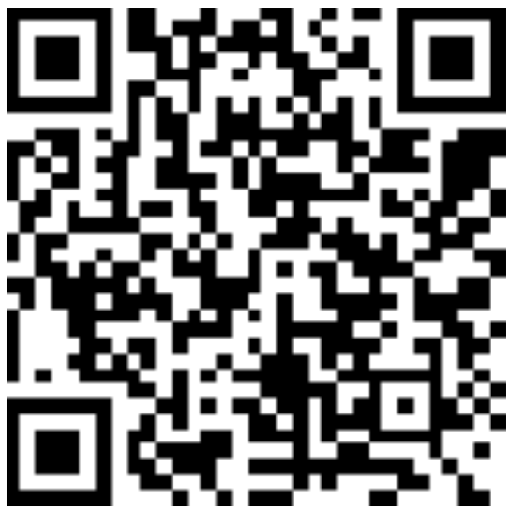
Thank you! Your Feedback is Important
Rate My Talk & Download Slides!
http://bit.ly/RateShawnsTalk
(case sensitive)
Contact Information
Email: sweisfel@microsoft.com
Blog: http://www.shawnweisfeld.com
Twitter: @shawnweisfeld

Slide 19
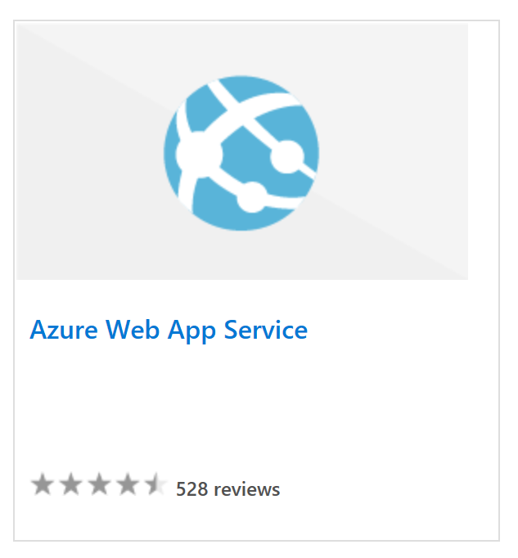
The Lab
Azure Web App Service Hands On Lab
https://aka.ms/201808TulsaLab
HINTs:
Don’t use Edge ☹
Use a personal Microsoft Account (not one tied to your work or school)
Follow the instructions in the lab manual
Extend - Deploy from local Git with Kudu builds
https://aka.ms/201808TulsaExtend
HINTs:
Use Bash version of the Cloud Shell
Use advanced settings when creating the cloud shell and put it in the existing resource group
Update the site locally with pico, commit and redeploy

