Slide 1



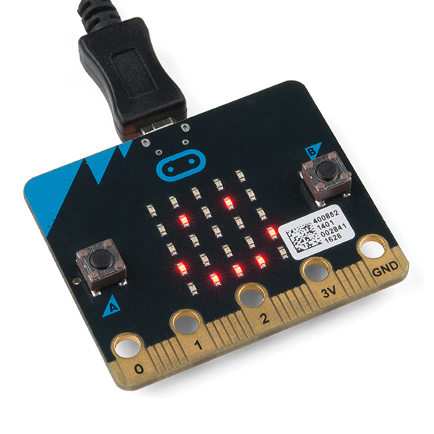
Making with the BBC micro:bit
https://aka.ms/ChickTechATX2018MicroBit

Slide 2
