Slide 1



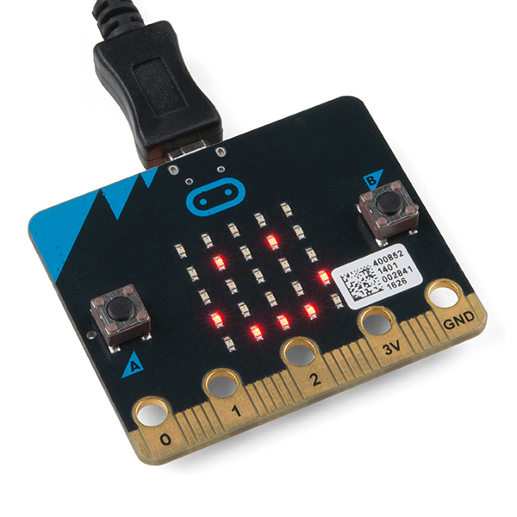
Wearables with the BBC micro:bit
https://aka.ms/ChickTechATX2018MicroBit

Slide 2
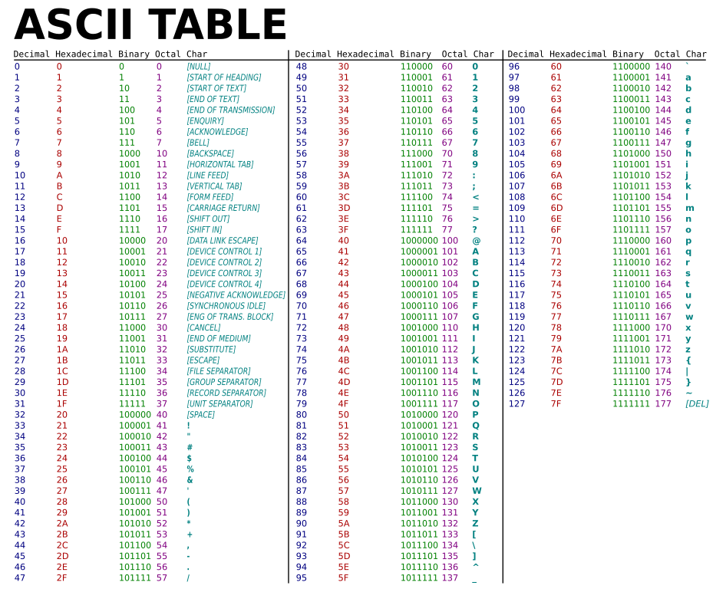

Slide 3
Name:
Name:
Write your name in the space provided
Fold on lines & place on desk in front of you.

Slide 4
Name:
Name:
Write your name in the space provided
Fold on lines & place on desk in front of you.

Slide 5
About me
Name:
School:
What I hope to learn:
Something in my life that uses computer code that I cannot live without:

