Slide 1
Search by sketch!
Mid-term update
D00942013 葉青峰
R00921033 溫宗憲
R00921048 王鏡嘉

Slide 2

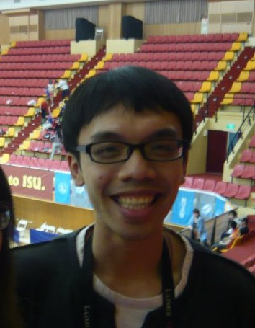
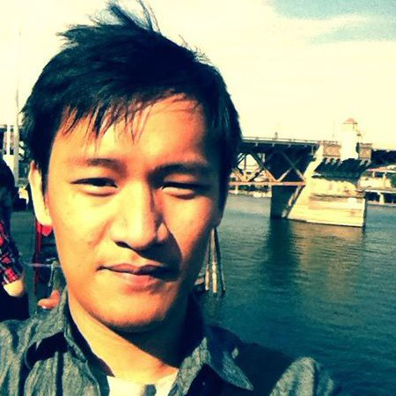
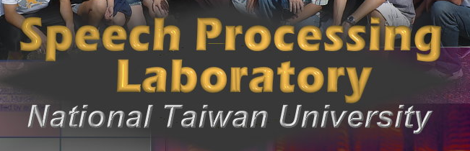

We are from ee
葉青峰
andrew.yeh.1987@gmail.com
Contour Man
溫宗憲
shawnwun@gmail.com
GUI Hacker
王鏡嘉
fitsky.bw@hotmail.com
Edgel Guy

Slide 3
Our goal

Slide 4

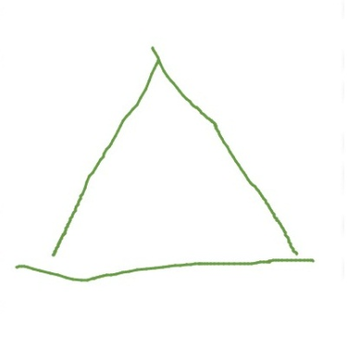
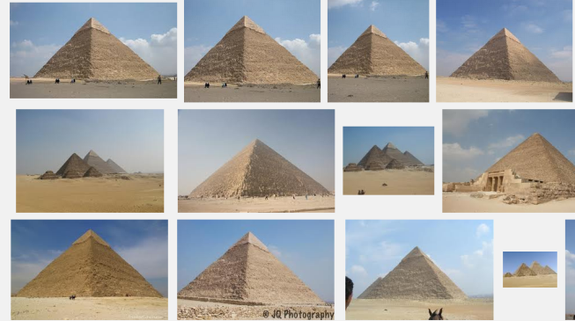

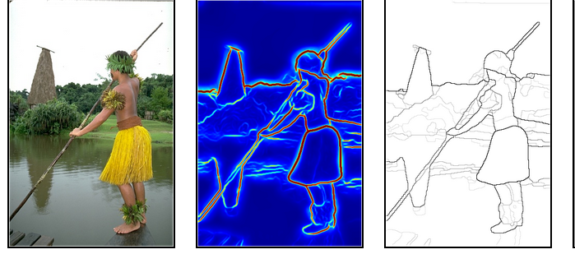
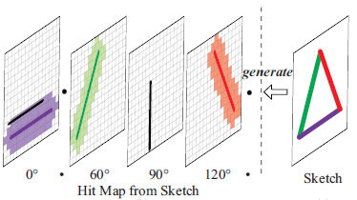
Aha!
Client
Sketch board
Real-time viewing panel
inde
Server
Sketch Based Image Retrieval System
Imagebase
Find contours
edgel indexing

Slide 5
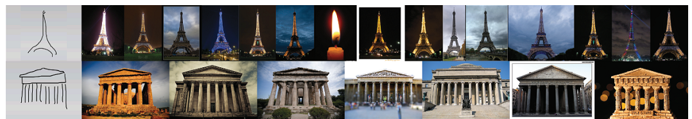
Project goals
Build up an interactive Search by Sketch system
Focus on retrieving “World Landmarks”
Functional blocks….(see next slide)

Slide 6
Aha!
Interactive Search by Sketch! GUI on webpage
Sketch board, real-time querying,
and interactive viewing panel
are built on HTML5 + Javascript
Sketch Based Image Retrieval System
Preprocessing server side
Crawl
Landmark
images from Google
Build edgel dictionary by algorithm from Mindfinder
Convert to contour images by Berkeley Contour Detector

Slide 7
Interactive Search by Sketch! GUI on webpage
Sketch board [4], real-time querying,
and interactive viewing panel
are built on HTML5 + Javascript
Sketch Based CBIR System
Preprocessing server side
Crawl
Landmark
images from Google and Flickr
Convert to contour images by Berkeley Contour Detector [3]
Build Edgel Indexing Dictionary by algorithm from Mindfinder [1][2]

Slide 8
Project goals(original)
Server side
Collect world landmarks
200+ world landmarks, millions of photos
Convert to contour images
Good and fast contour detector
Build edgel dictionary
Start from scratch
An efficient algorithm
Client side
Interactive GUI
Sketch board
Viewing panel
Communicate with server

Slide 9
Project goals(original)
Server side
Collect world landmarks
200+ world landmarks, millions of photos
Convert to contour images
Good and fast contour detector
Build edgel dictionary
Start from scratch
An efficient algorithm
Client side
Interactive GUI
Sketch board
Viewing panel
Communicate with server
FINISHED
Crawling Google image via query.
200 landmark queries. About 12,000 photos.
55 images / landmark
Size varies, potentially noisy
TODO
Crawl more if other parts
are completed

Slide 10
Project goals(original)
Server side
Collect world landmarks
200+ world landmarks, millions of photos
Convert to contour images
Good and fast contour detector
Build edgel dictionary
Start from scratch
An efficient algorithm
Client side
Interactive GUI
Sketch board
Viewing panel
Communicate with server
Berkeley Contour Detector
FINISHED – CPU version
Matlab by Berkeley Computer Vision Group
Running time varies!
Image size
Image Content
Normally 1~10 mins ( Intel E3-1230 v2, 3.3 GHz )

Slide 11
Project goals(original)
Server side
Collect world landmarks
200+ world landmarks, millions of photos
Convert to contour images
Good and fast contour detector
Build edgel dictionary
Start from scratch
An efficient algorithm
Client side
Interactive GUI
Sketch board
Viewing panel
Communicate with server
Berkeley Contour Detector
TODO – GPU version
CUDA package by Berkeley ParLab
Reporting 30x faster than MATLAB version
However, it’s on CUDA 2.1 with “SDK.” Compatibility is not guaranteed for SDK by new CUDA release
Reviewing and modifying the codes

Slide 12
Project goals(original)
Server side
Collect world landmarks
200+ world landmarks, millions of photos
Convert to contour images
Good and fast contour detector
Build edgel dictionary
Start from scratch
An efficient algorithm
Client side
Interactive GUI
Sketch board
Viewing panel
Communicate with server
Mindfinder Edgel Indexing algorithm
FINISHED
Complete a partial version by OpenCV
Retrieve image by sketch query from a small sub-set of our landmark photobase
Proved useful in Search by Sketch

Slide 13
Project goals(original)
Server side
Collect world landmarks
200+ world landmarks, millions of photos
Convert to contour images
Good and fast contour detector
Build edgel dictionary
Start from scratch
An efficient algorithm?
Client side
Interactive GUI
Sketch board
Viewing panel
Communicate with server
Mindfinder Edgel Indexing algorithm
TODO
Complete the whole algorithm. Significant speed-up expected.
Enhance performance further with GPU acceleration
(such as the time-consuming find-matching stage)

Slide 14
Project goals(original)
Server side
Collect world landmarks
200+ world landmarks, millions of photos
Convert to contour images
Good and fast contour detector
Build edgel dictionary
Start from scratch
An efficient algorithm?
Client side
Interactive GUI
Sketch board
Viewing panel
Communicate with server
GUI on webpage
See live demo!

Slide 15
Live demo

Slide 16
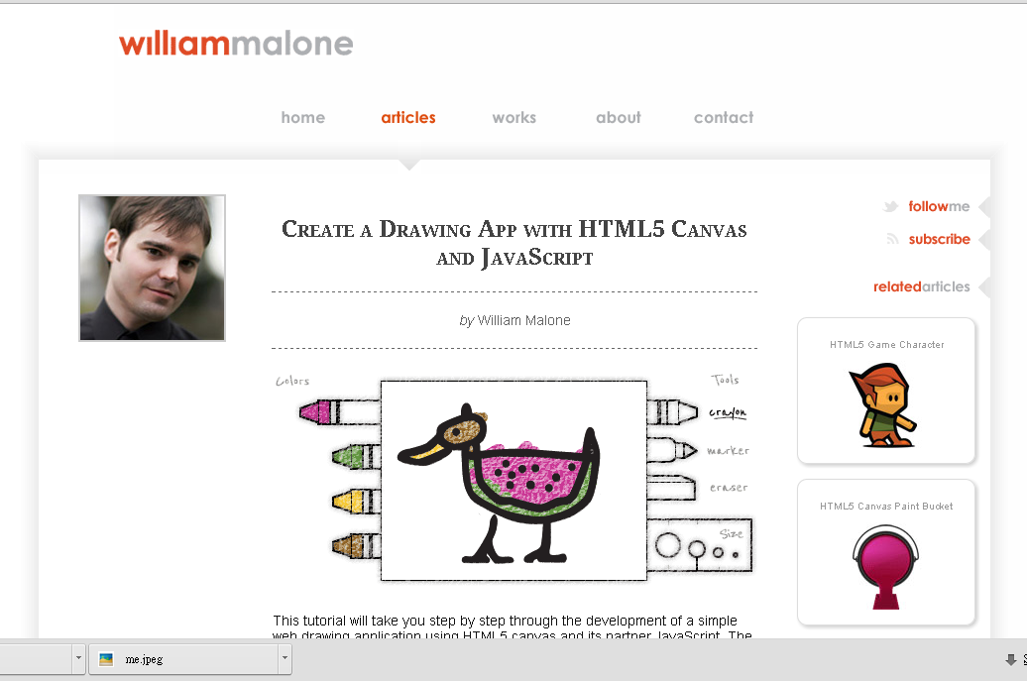
Current status
Webpage GUI
http://homepage.ntu.edu.tw/~r00921033/gpu/drawToRetrieve.html

Slide 17
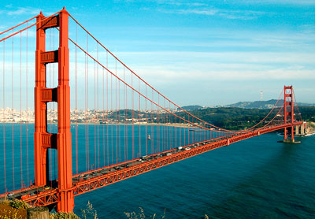
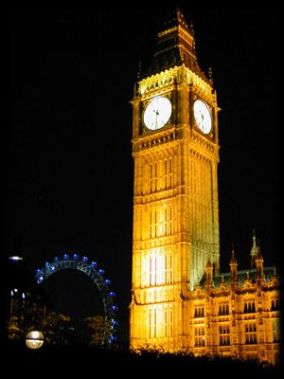
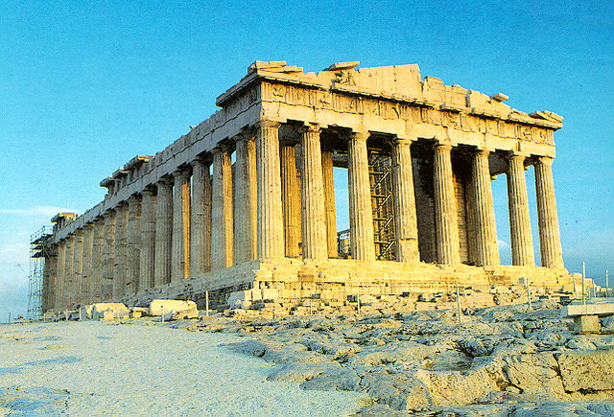
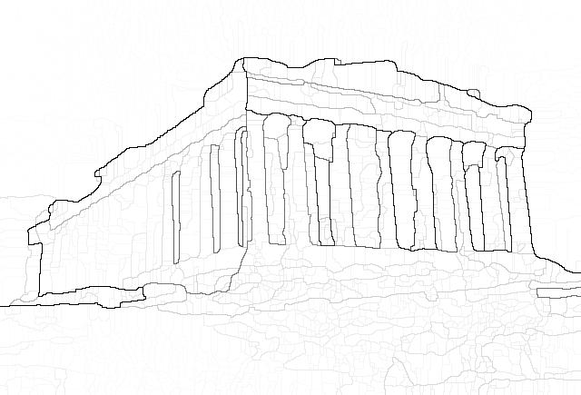
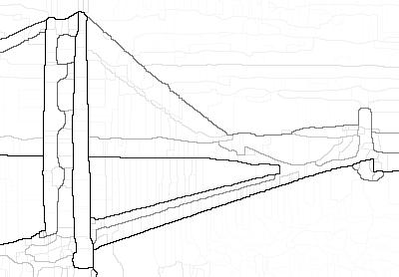
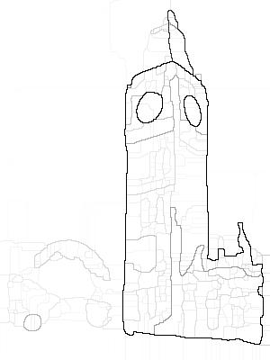
Current status
Berkeley Contour Detector(MATLAB)

Slide 18
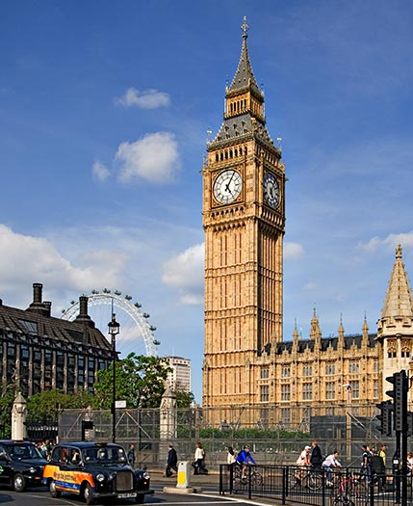
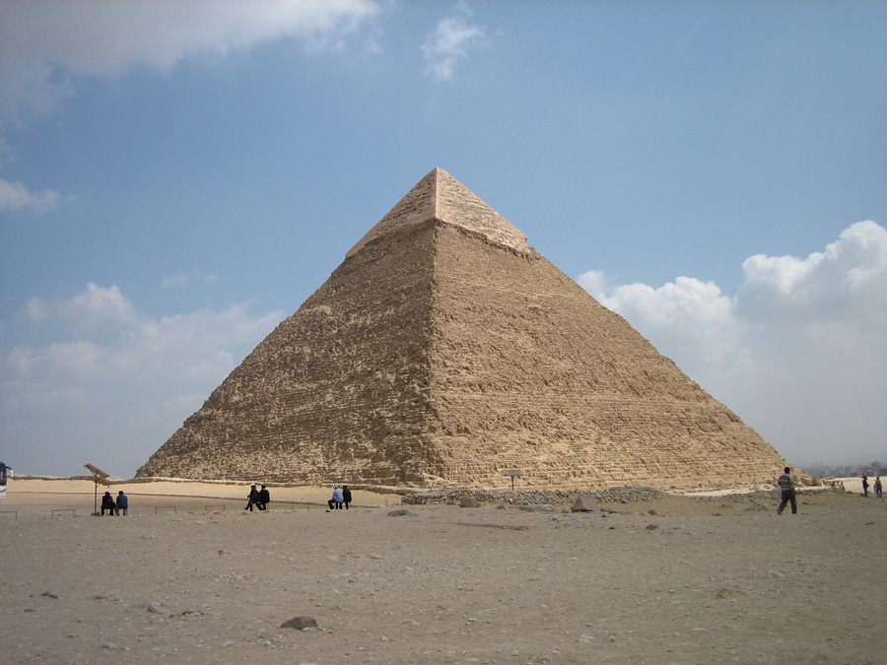
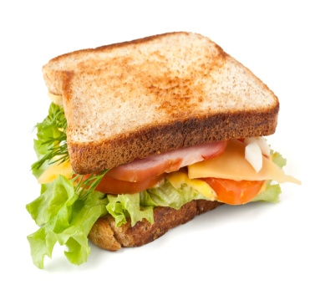
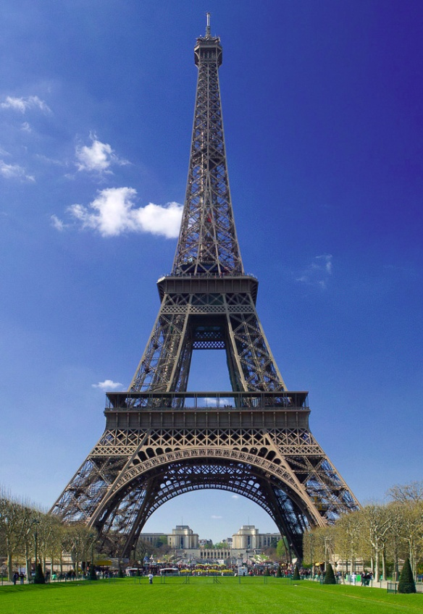
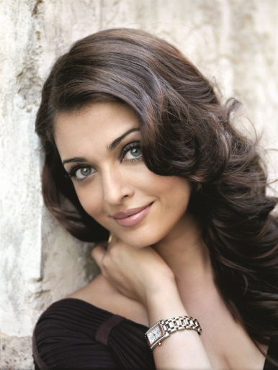
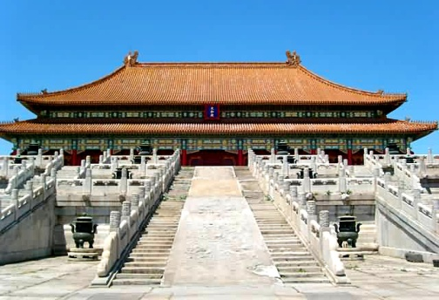
Current status
edgel.exe
Retrieve pyramid by sketch from a sub-set of world landmark photos

Slide 19

Request Introduction
Find the similarity between sketch hitmaps and photo contour hitmaps
Similarity
Hitmaps of sketch
Hitmaps of photo contour

Slide 20
Hitmap?
A hitmap is a layer containing edges of one particular quantified angle
8 quantified angles(0~45, 45~90…)
A sketch/photo generates 8 layers of hitmaps

Slide 21
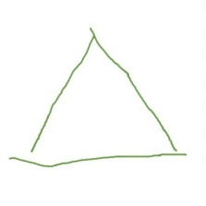
Request description
Given
A set of hitmaps from a sketch (8 hitmaps)
A number of sets of hitmaps from photo contour database
Require
Compute the similarity between the sketch hitmap set and each of the photo contour hitmap sets
Parallel computation

Slide 22
Any questions?
References and credits
GUI: William Malone’s work
http://www.williammalone.com/articles/create-html5-canvas-javascript-drawing-app/
2. Berkeley Contour Detector
MATLAB: Berkeley Computer Vision Group
CUDA: Berkeley Parallel Computing Lab
Edgel Indexing Algorithm
Mindfinder: Microsoft Research Asia

