Slide 1
Bioinformatics (NGS) WIKI, Q&A website
For both beginners and experienced users in the field

Slide 2
Significance
The current knowledge of NGS(bioinformatics) analysis method is severely fragmented, and quickly developing.
Beginners in the field needs a consensus knowledge/tutorial to quickly get started. (reading reviews is a way, but it does not provide an immediate picture of the actual pipeline, and lacks many essential practical details)
Advanced users needs a quicker way to identify the resources they need to tackle certain tasks/issues/bugs. “Google” is a solution, but sometimes it is not very efficient.
There lacks a community to share the codes for certain routine analysis ( e.g. assigning peaks to genes; converting bed files to bigWig files; convert gene IDs.)
Software/algorithm developers needs such a online community to know what has already been implemented, which part of pipeline is useful/which is not or obsolete, what is lacking and needs to be improved. Users of the same software needs a place to discuss their experience, report bugs.

Slide 3



Current resources
BIOSTARS : Q&A
SEQanswers : Q&A(no votes)
NGS wikiBook : wiki book, no Q&A
Bioconductor
StackOverflow
OmicTools

Slide 4
Aim of R25 (RFA)

Slide 5
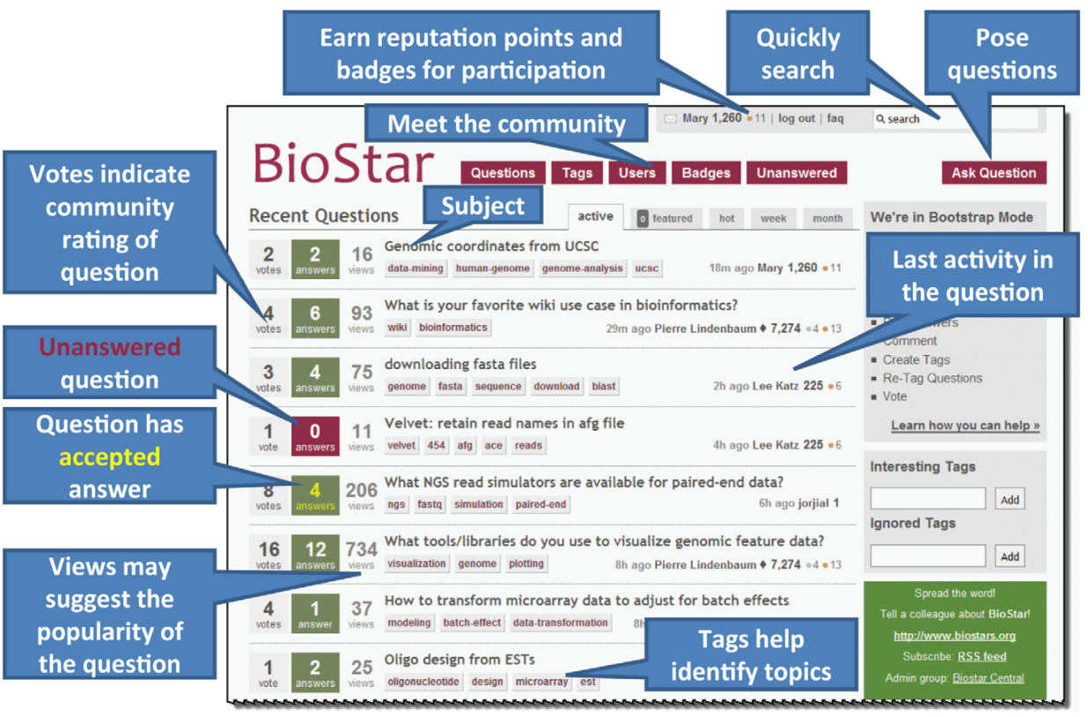
BIOSTARS

Slide 6
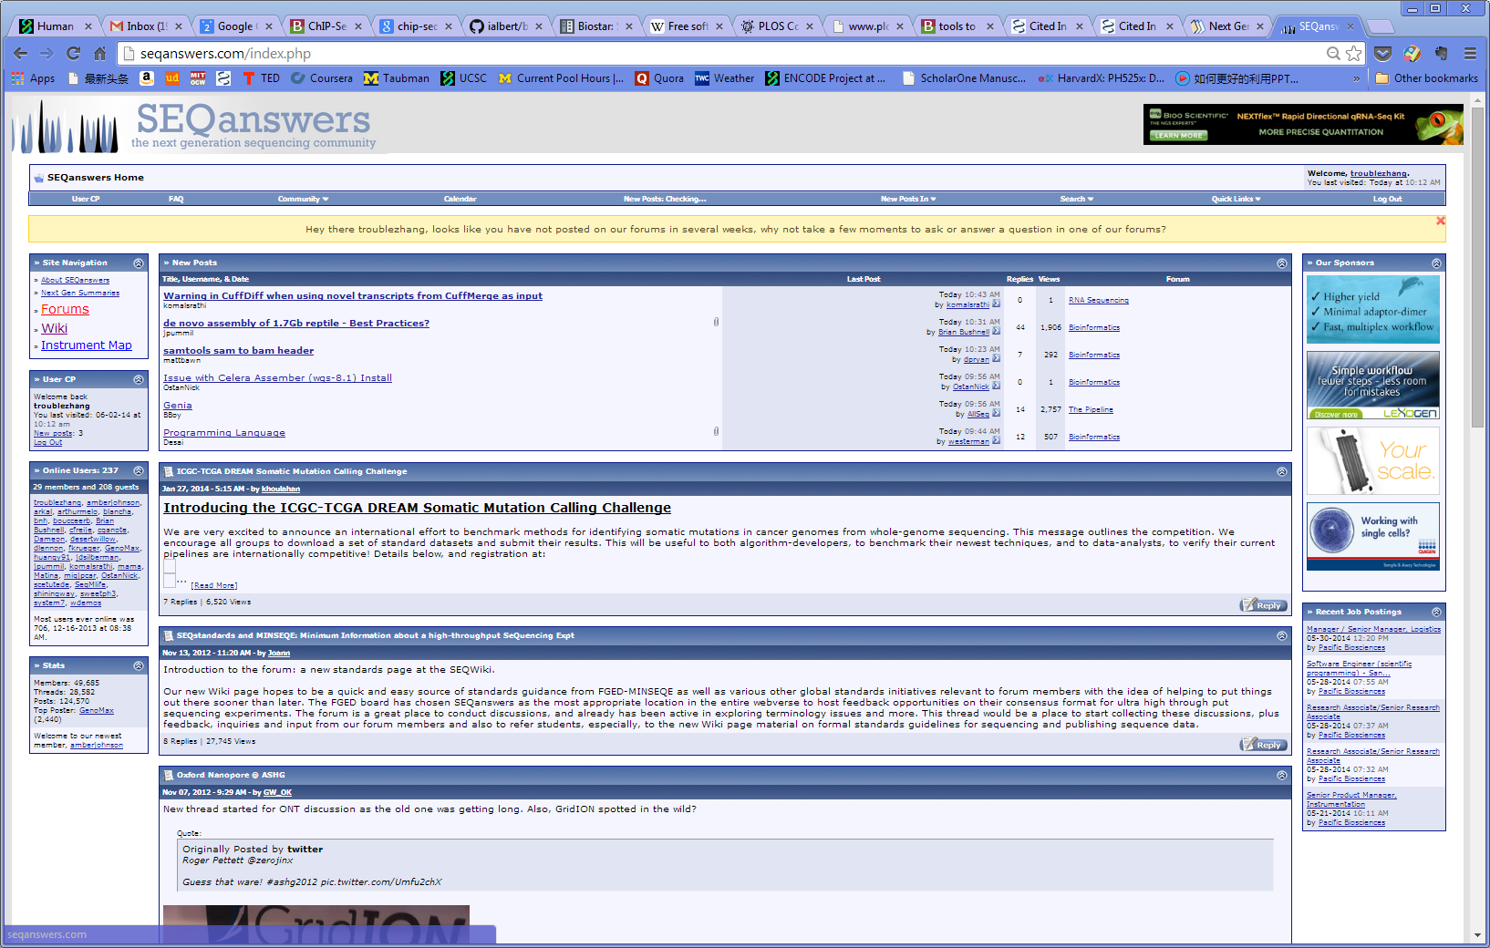
SEQanswers

Slide 7
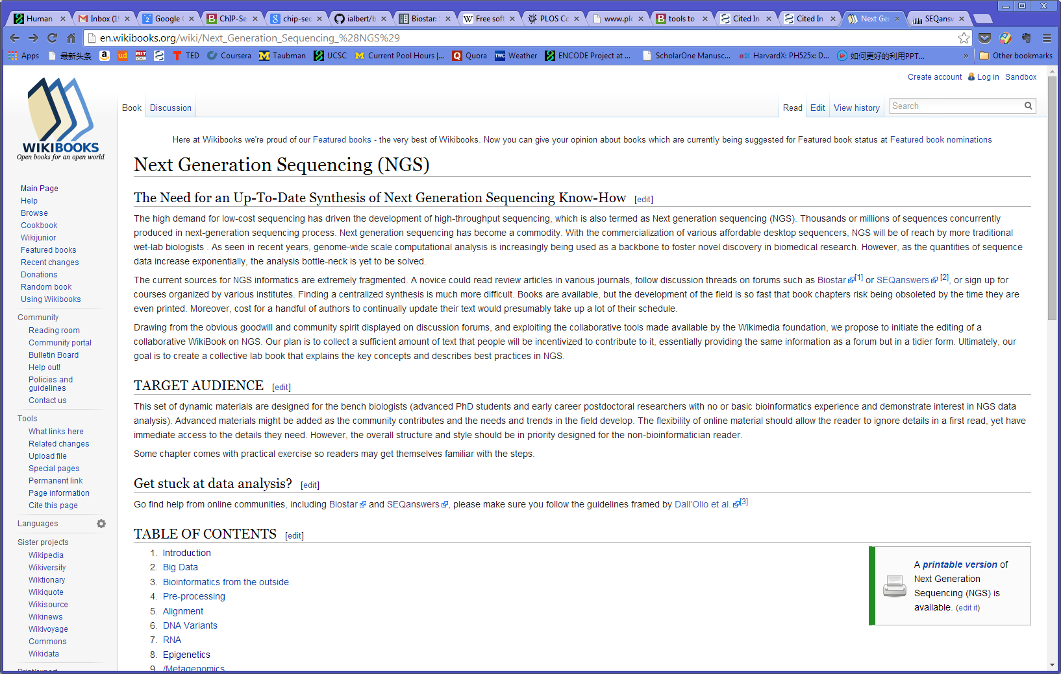
NGS wikibook

Slide 8
Comments
SEQanswers: Pros: a “well-established” community.
Cons: old-fashioned forum style. old (however useful) posts were left behind new posts; no votes for usefulness of contents; difficult to navigate. has SEQwiki, nothing beyond only listing currently available software.
BIOSTAR: Pros: Q&A with votes, great.
Cons: relatively small community: Questions not answered, or not answered in a timely manner. Some duplicated questions not flagged. No hierarchical structure, hard to navigate.
NGS wikibook: Pros: structured wiki.
Cons: Poor edited wiki; e.g. no content at all for ChIP-Seq. No Q&A.

Slide 9
What we need:
Structured wiki; hierarchically structured tag system
Software/database list
script repository for simple tasks
Q&A with votes
Wiki
Q&A
Tools
/scripts

Slide 10
User Profiles

Slide 11
Structured wiki
QC checks
Shift size estimation
Alignment
Normalization
ChIP-Seq
Statistical testing
RNA-Seq
Post-processing
NGS analysis
Variant calling
Blacklisted regions
…
Enrichment testing
Access to public data repository

Slide 12
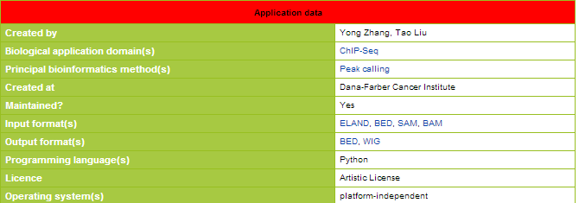
Software list
MACS
ZINBA
ChIP-Seq
PePr
Quest
…
Software wiki

Slide 13

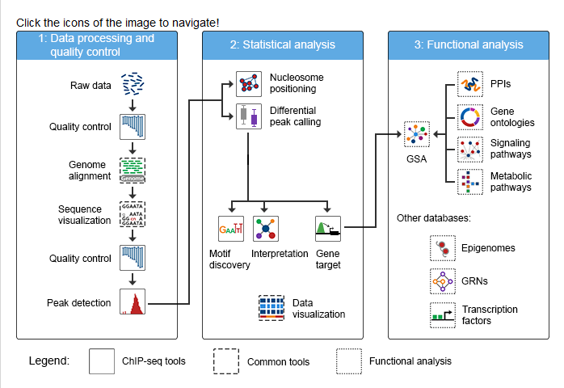
OMIC tools

Slide 14
Public script repository for simple tasks
How to assign peak to the nearest gene?
How to generate read profiles for ChIP-Seq peak regions?
How to randomly sample a subset of reads from a bed file?
…

Slide 15
Q&A with votes
Q&As with lots of votes can be considered to go into wiki.
Q&As can be associated with specific scripts or software.

Slide 16
Wiki
Link to FAQ for certain process
Link to tools performing the task
So important it becomes wiki
Link to task( to identify related tools)
Q&A
Tools
/scripts
Frequently Q?->new scripts/tools
Link to FAQ about this tool

Slide 17
Main page

Slide 18
Draft specific aims

Slide 19






Software list (checklist)
Features | Software1 | Software2
Input::bam
Input::bed
Input::sam
Removing duplicates
Handle replicates
Estiamte shift size
Differential binding
$$√$$
$$√$$
$$√$$
$$√$$
$$√$$
$$√$$
$$√$$
$$√$$
$$√$$

Slide 20
User Stories
Wiki Page

Slide 21
Post page

