Slide 1
BENEHOME
Team 16:
Shawn Zheng, Jack Xu, Harley Guan, Xin Heng, Samuel Jiang

Slide 2
Client & Problem
City of New Westminster
Patricia Jecks -- Intelligent City Project Coordinator
Carolyn Armanini -- Planning Analyst
Jonathan Coté -- Mayor of New Westminster
Problem
Where to get subsidized house information
How to apply for a subsidized house
People don't know their eligibility
It is hard to search them by current websites and apps

Slide 3
Solution
An Android app that can:
help people to find subsided housing.
To make the application process easier.

Slide 4
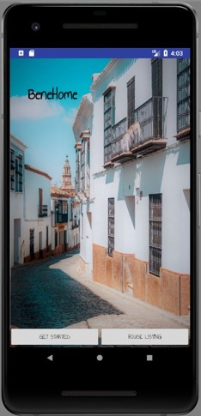
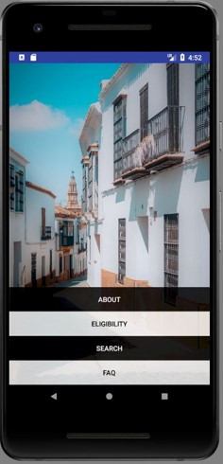
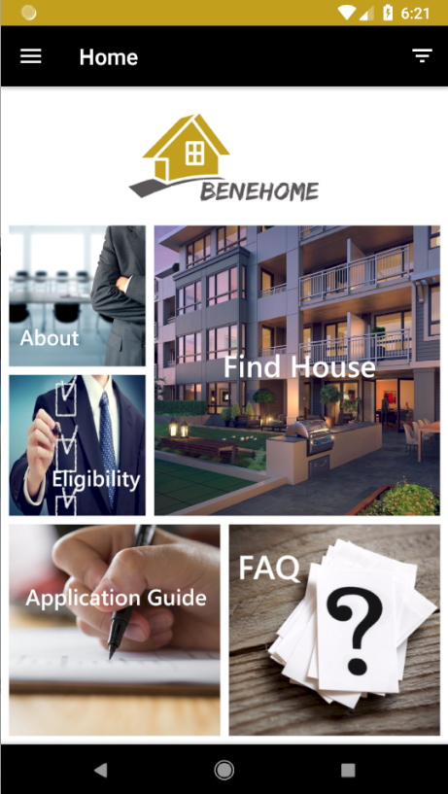
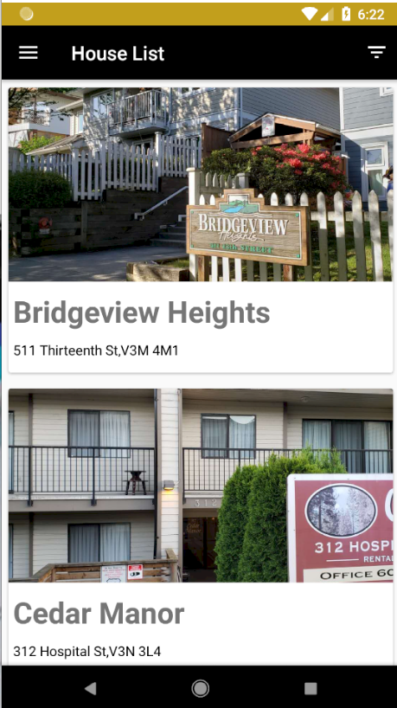
Where Do We Start
It is a continued project from Android Course COMP 3717

Slide 5
Demonstration

Slide 6



Resources
BC Housing
New Westminster Open Datasets
Stack Overflow
Firebase Documentation
Android Developer Documentation

Slide 7
Updates
UI design and interaction improvements
Implement real time Database
“Apply” Function
Add more detail information for each house
Change App structure

Slide 8





Technologies
Android Studio
Firebase
HTML
GitHub
Java

Slide 9
Schedule
Stage 1 - scope of the project, requirement of the project, learn firebase
Stage 2 - coding
Stage 3 - integration, and UI design
Stage 4 - testing, debugging and prepare presentation

Slide 10

Task Distribution
Samuel Jiang
House list page
House detail page
Splash screen
Jack Xu
FAQ page
Application guide page
Design splash screen and home page
Research information
Shawn Zheng
Implement Firebase
Take picture of each house
Design UI
User testing
Harley Guan
Eligibility page
Filer function
Home page
About page
Xin Heng
App structure
Navigation bar
Map boundary
Project Integration

Slide 11
Challenges
Limited data in the backend database
Limited house photos
Not familiar with Firebase
Started late
Handle multithreading
Data Collection
Adapt to Multiple Android Phones & Models

Slide 12
Estimates & Actuals

Slide 13
Thanks for Listening
Question & Answer

