Slide 1
Project proposal on Car Rental management system
Simple solution for booking cars

Slide 2
Consultant Md. Moshaidul Islam PWAD.idb-bisew IT scholarship Email : moshaidul@gmail.com
Developed by Name: Sharmony Hashem Shawon
ID:1285366
Round:62/NCLC-m/62/01
Instructor
Farhana Akter Lucky
PWAD.idb-bisew IT scholarship Email : farhanawdpf@gmail.com

Slide 3
5th January 2025 The Consultant PWAD, IDB-BISEW Sher-e-Bangla Nagar, Dhaka Subject: Project Proposal for Car Rental Management System Dear Sir, I am writing to propose an innovative project for the development of a Car Rental Management System. This project is aimed at providing an efficient and user-friendly solution to meet the growing demand for car rental services. The proposed system will allow customers to browse available cars, make reservations, and complete payments easily through an intuitive platform. The goal is to simplify the car rental process, making it more accessible for customers while helping businesses manage their rental operations effectively. Thank you for considering this proposal. I look forward to the opportunity to discuss this project further and explore the possibility of its implementation. Sincerely, MD. Al-Amin Trainee ID:1285366 Batch: PWAD/NCLC-M/62/01 Email: s.sawon2001@gmail.com

Slide 4
Introduction
The Car Rental Management System (CRMS) is an online platform that enables users to rent cars for short or long-term usage and provides rental businesses with an efficient way to manage their fleet, customers, and transactions. The system will streamline the process for both customers and car rental service providers, offering seamless booking, payment management, and tracking services.

Slide 5
Index of the project
Objective
Feature
ERD diagram
Interface and Landing page
Tools and Technology
Implementation steps
Project Timeline

Slide 6
Objectives:
For Customers:
Search and filter cars based on availability, type, and price.
Make online bookings and payments securely.
View booking history and manage upcoming rentals.
Receive booking confirmations via email.
For Rental Businesses(Admin):
Manage the car fleet (add, update, or remove cars).
View and manage customer bookings.
Process customer payments and track rental history.
Generate reports on revenue and car usage.

Slide 7
Software feature
Customer Module:
User Registration/Login
Car Search & Booking
Booking Details
Booking & Payment
Booking History
Rating & Review System
Admin Module (Car Rental Company):
Car Fleet Management
Booking Management
Payment Management
Reporting
Other Features:
Responsive Design
Email Notifications
Admin Dashboard

Slide 8
Gantt Chart
Task | DAY-10 | DAY-10 | DAY-10 | DAY-10 | DAY-10 | DAY-10
Requirement Analysis
System Design
Implementation
Testing
Deployment
Maintenance
Documentation

Slide 9
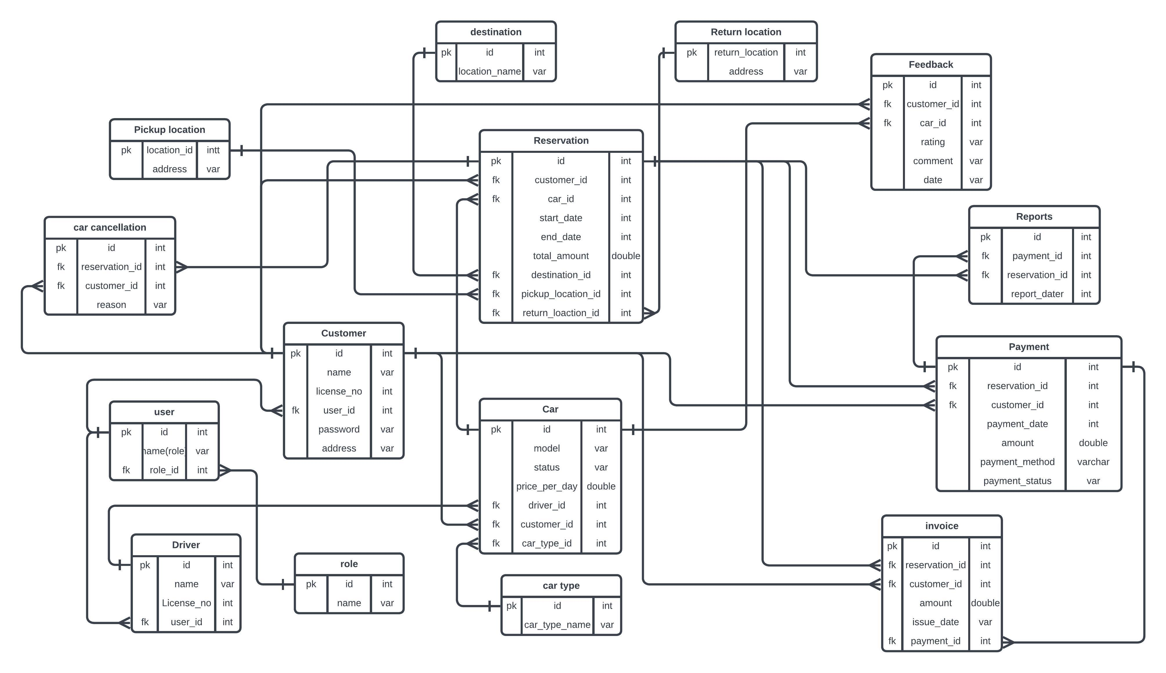
ERD Diagram of Car Rental System

Slide 10
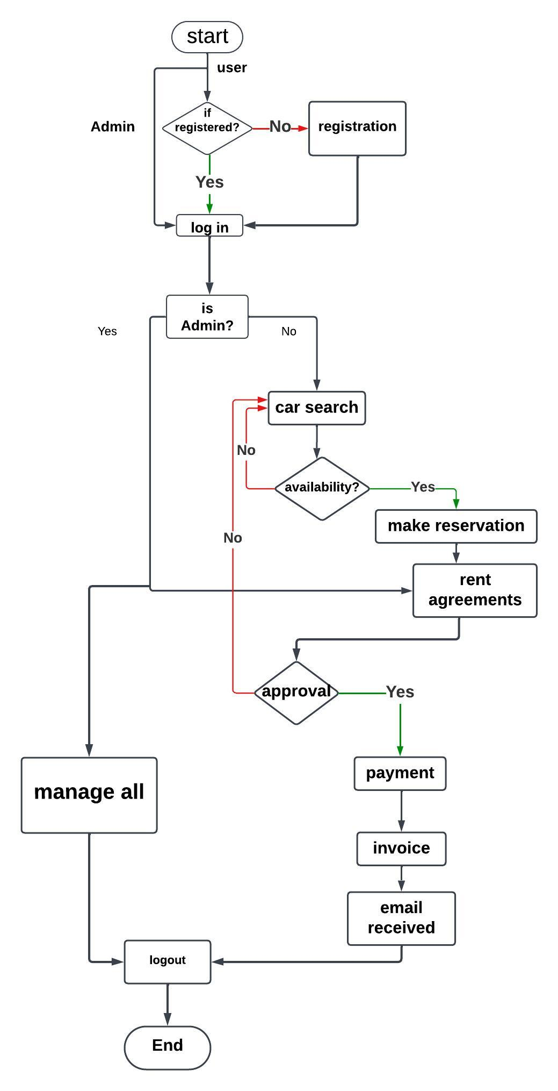
Flow chart of Car Rental System

Slide 11
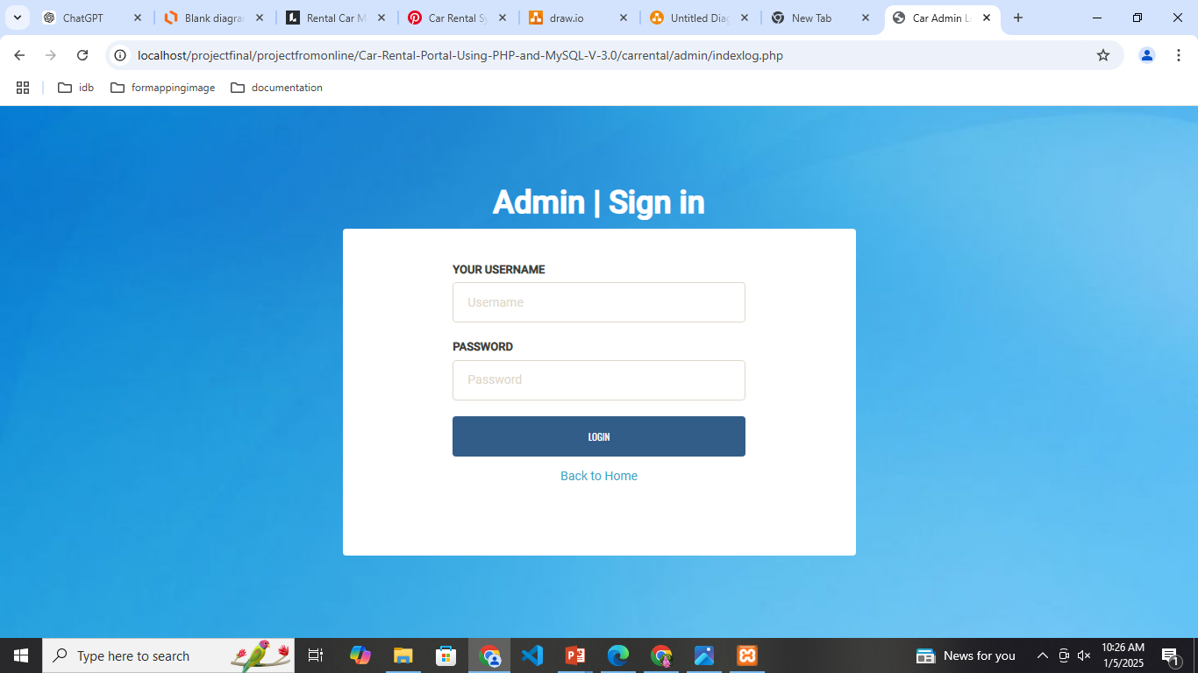

Slide 12
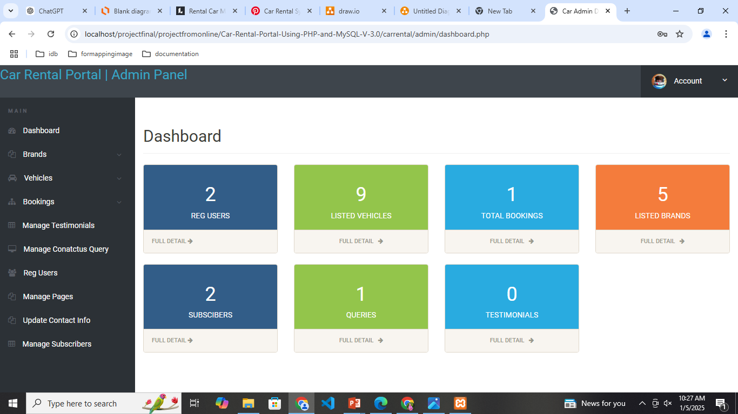

Slide 13
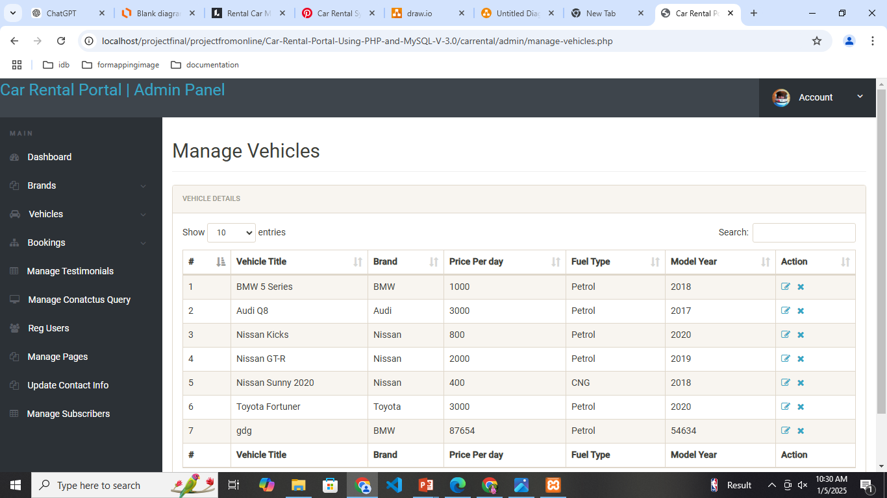

Slide 14
Technologies:
Fronted:Html,CSS,Bootstrap,Javascript
Backend:PHP
Database:MySQL
Implementation Steps:
Requirements Gathering
Database Design
Frontend Development
Backend Development
Payment Gateway Integration
Testing
Deployment
Post-Launch Support

Slide 15
Project Timeline:
Phase | Duration | Description
Phase 1: Requirements Analysis | 5 days | Gather and document user needs, car data, and requirements.
Phase 2: Design & Database Setup | 5 days | Create wireframes and implement the database schema.
Phase 3: Frontend Development | 4 days | Develop the user interface using HTML, CSS, Bootstrap, and JavaScript.
Phase 4: Backend Development | 8 days | Implement PHP scripts for user authentication, booking, and admin functionalities.
Phase 5: Payment Integration | 3 days | Integrate payment gateway and test transactions.
Phase 6: Testing | 3 days | Test all functionalities including usability and security.
Phase 7: Deployment | 2 days | Host the project and perform final checks.
Total Duration | 30 days

Slide 16

Thank you
For being with us ……

