Slide 1
Automated Resume Screening
COMP 4750: Natural Language Processing
Shawon Ibn Kamal

Slide 2
What is Resume Screening?
Resume screening is the process of determining whether a candidate is qualified for a role based on their education, experience, and other information captured on their resume.
The usual 3 steps to resume screening:
Minimum
Qualifications
Preferred
Qualifications
Shortlist for
Interview

Slide 3
Challenges to screen resume manually
The biggest challenge in screening resume is in handling the high volume of applications received.
On average, each corporate job offer attracts 250 resumes - upto 88% of them tend to be unqualified.
Of those candidates, 4 to 6 will get called for an interview, and only one gets the job.
Statistics: Glassdoor

Slide 4
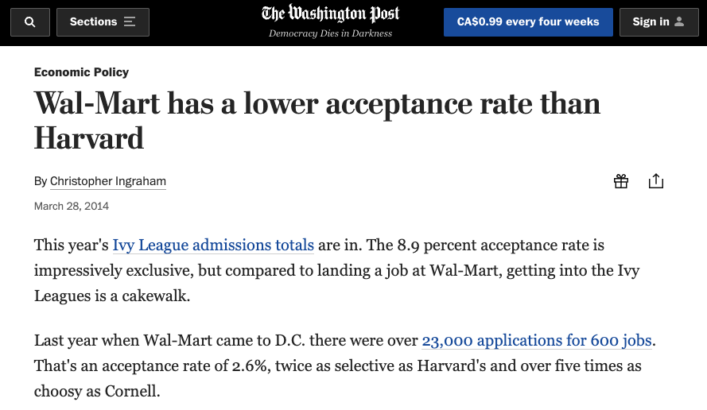

Slide 5
Challenges to screen resume manually
This high volume of resumes take up a lot of time for recruiters to make a single hire.
Average time-to-hire a new employee was 39 days in 2016, down from 43 days in 2015. Source: Jobvite 2017 Recruiting Funnel Benchmark Report
More time spend on hiring implies higher cost.
Average cost per hire statistics for companies is $4,129. Source: SHRM Human Capital Benchmarking Report 2016

Slide 6
Automated Resume Screening
Goal: The goal of this project is to built an automated resume screening application that tackles the challenges of screening manually
The application will consist of 2 main parts:
Parsing information from resume
Evaluation using ML and NLP

Slide 7
Parsing
The first step to parsing is to extract text from PDF files. This step is quite simple. We will do it using python pdfminer.
The second step is to extract specific entities from resumes: names, addresses, phone numbers, email addresses, education, experience, skills etc.
This will be done using a NLP technique called Named Entity Recognition (NER).

Slide 8
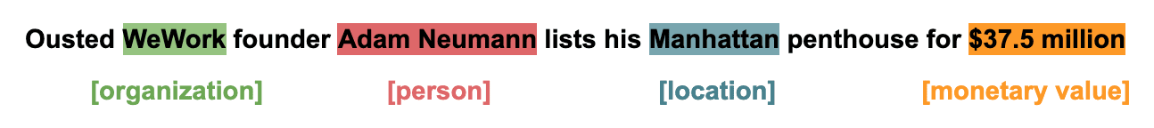
Parsing: Named Entity Recognition
A NER model will identify noun phrase with the help of dependency parsing and part of speech tagging (sometimes using CFG)
Then, it will classify the extracted noun phrase into respective categories using lookup tables and dictionaries
To avoid misclassification, we can create a validation layer on top. Using existing knowledge graphs can help get discrete result

Slide 9
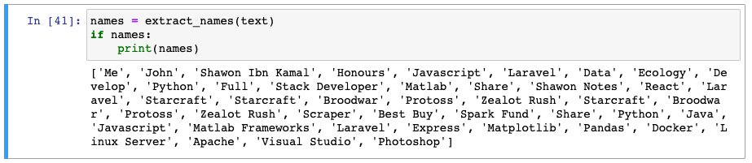
Parsing: Difficulties

Slide 10
Evaluation
In this part of the application, we need to rank the resumes by its relevance to the job description or requirements. It can be done using the ML process called Information Retrieval.
There are many ways to rank documents, here we will use an unsupervised method using vector space model.
The vectors representing the resume or query can be created using word2vec, Bag of Words, Inverse Document Frequency etc. In this example, we will use Inverse Document Frequency.

Slide 11
Evaluation
TF-IDF (term frequency-inverse document frequency) is a statistical measure that evaluates how relevant a word is to a document in a collection of documents. This is done by multiplying two metrics:
how many times a word appears in a document, and
the inverse document frequency of the word across a set of documents.

Slide 12
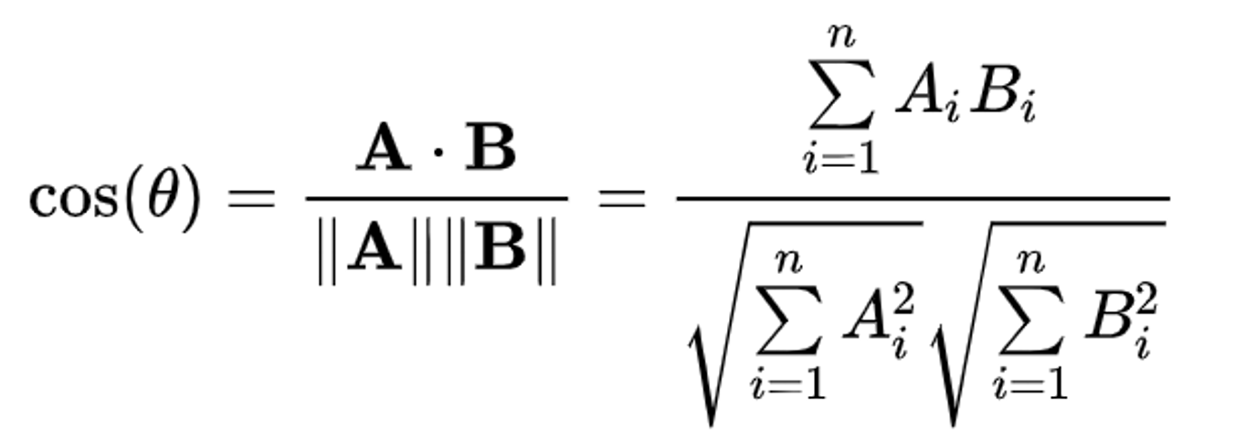
Evaluation
The vector space model will be based on similarity. Using cosine similarity, we can calculate a similarity score for each resumes which is given below:
A -> vector of resume (document) B -> vector of job description (query)

Slide 13
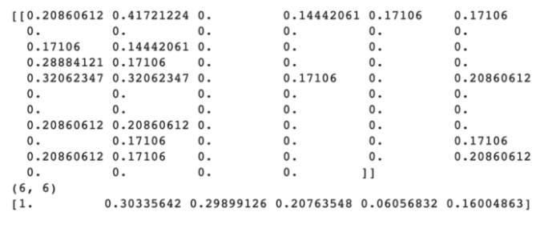
Evaluation

Slide 14
Evaluation: Other factors
Other factors to be considered while evaluating:
Place of location
Years of experience
Relevance of previous experience

