Slide 1



Yeagerists Verifier
Yeagerist’s Hackathon Project
Solutions in Cyber Security
Developed by:
Shawqi Hatem Fares and Maxwell Kei Farouk

Slide 2
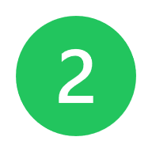
The Problem
Certificate Authenticity
Certificates and qualifications can be forged. In our modern era where digital qualifications are critical to hiring, education and security, it is imperative to ensure these accreditations are legitimate.
With constant new innovations and tool accessibility, it is easy than ever to forge an accreditation/certificate. Tools such as photoshop, metadata editors, and recently, AI, forging certificates can take just a few inputs.
Forged certificates undermine trust in educational and professional institutions. Employers can hirer unqualified candidates, and accrediting courses can lose value.

Slide 3
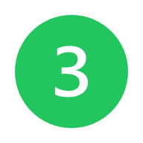
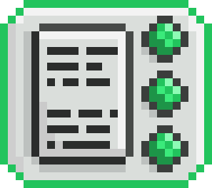
Our Solution
PDF Certificate Authentication
PDF Metadata
Blockchain
Once a public key is generated, it is first stored in the certificate PDF metadata in a newly generated field.
Along with other metadata, the certification data and its associated public key are hashed and stored in our blockchain simulation.
Key Pair Encryption
The certification verification policy consists of many measures to authenticate certificates.
One of which is a modular key pair encryption method. The generated certification data is used to create a public and private key. The private key is stored while the public key is used for verification.
Verification Gamification
A verification application is useless without users. Thus, the app consists of several gamified components to make verification fun and extra interactive.

Slide 4
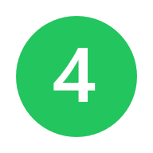
How it works
When user signs: Key Pair generated. Public key is embedded in PDF.
Hash generated.
Block Created and mined. --> Block added to blockchain.
Certification Architecture
User Uploads PDF.
Hash compared with blockchain.
PDF either verified or tagged as fraudulent.
Verification
Architecture

Slide 5

Tech Stack
Web Application Design
NextJS
React
Blockchain
JSX
Tailwind CSS
Postgres
Payload CMS
ShadCN

Slide 6
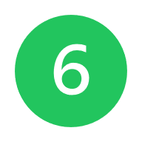
Why Blockchain?
Blockchain Solutions
Blockchain Solutions
Block Mining
Creates immutable signing history.
Adds a timestamp to the certification. (If issues of certification dates are in question.)
Block-Chain is public, anyone can verify that the pdf has not been tampered with.
The signer cannot deny that they signed the pdf.
A process of securing data in a blockchain. Each block is validated by solving a cryptographic challenge. This ensure the data is untampered with and linked to a trusted chain.
For our MVP, we use a ‘difficulty’ of 2 – 4 (hash length) . This implement added security while keeping runtime low for the purpose of presentations and demos.
Blockchain Simulation
When implementing external blockchain platforms into our MVP, we ran into numerous roadblocks. As a MVP solution we developed a feature-rich simulated blockchain. This simulation includes block mining, certificate verification, immutable storage and validation checks.

Slide 7
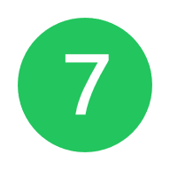

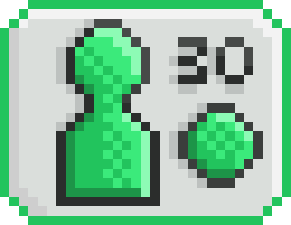

Gamification
Making Security Fun
Features
Achievement based badges
To reward users for logins and verifying files, unique badges are awarded as progress is made.
Levels.
The user’s level is determined by the number of verified certificates.
Badge Preview

Slide 8

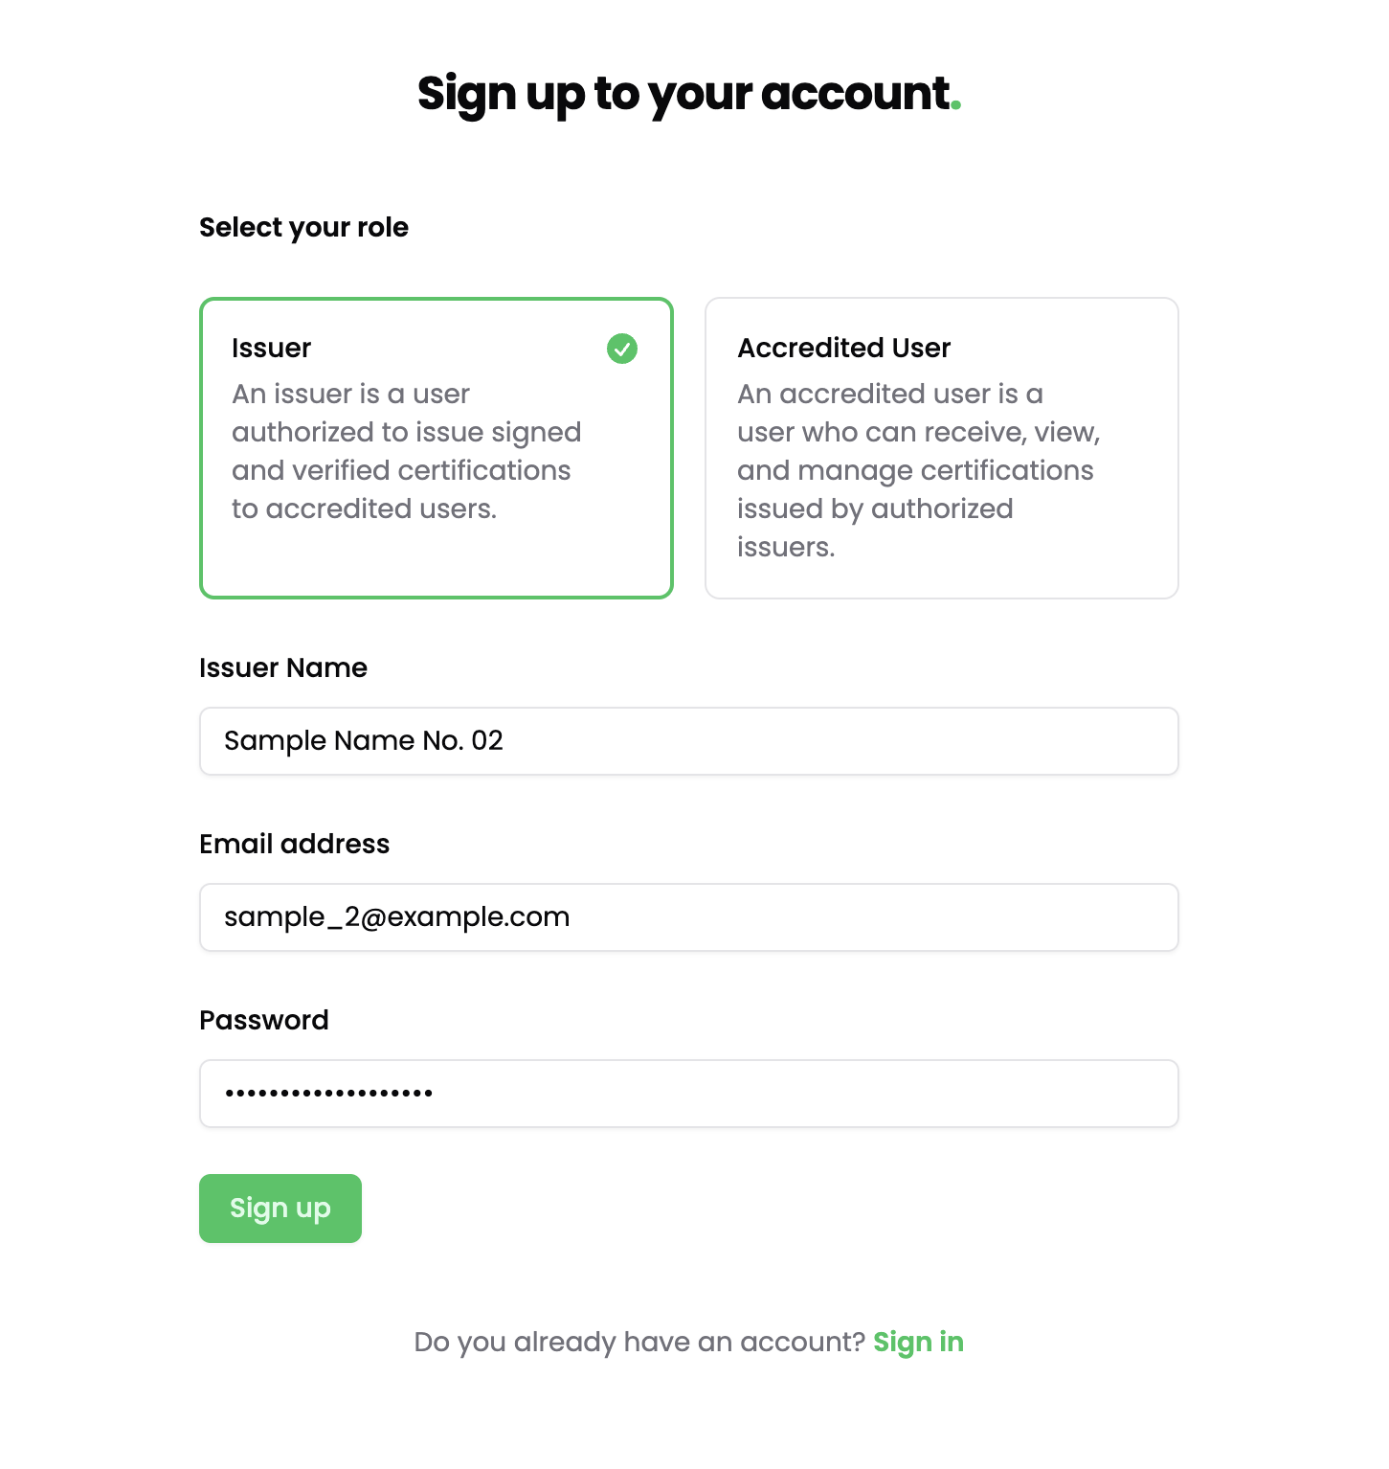
App Preview
Sign-In

Slide 9
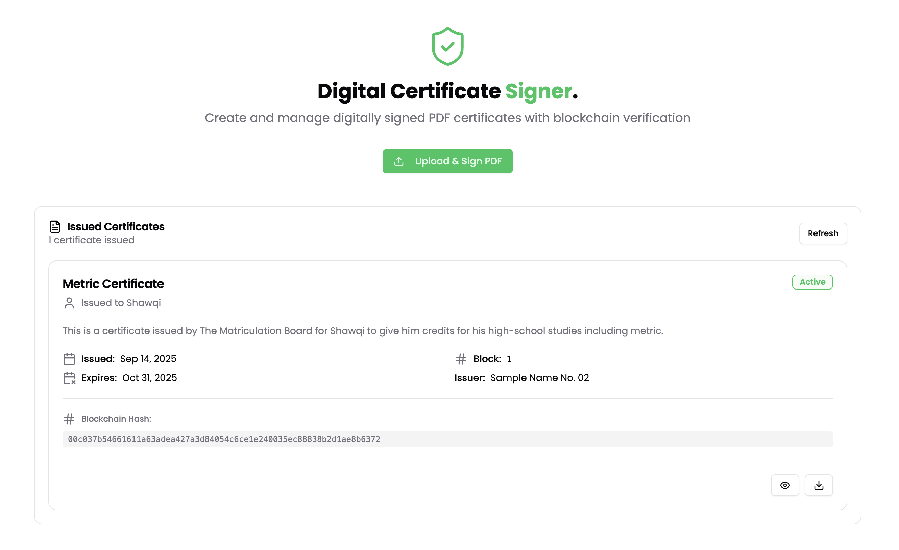
App Preview
Issuer Portal

Slide 10
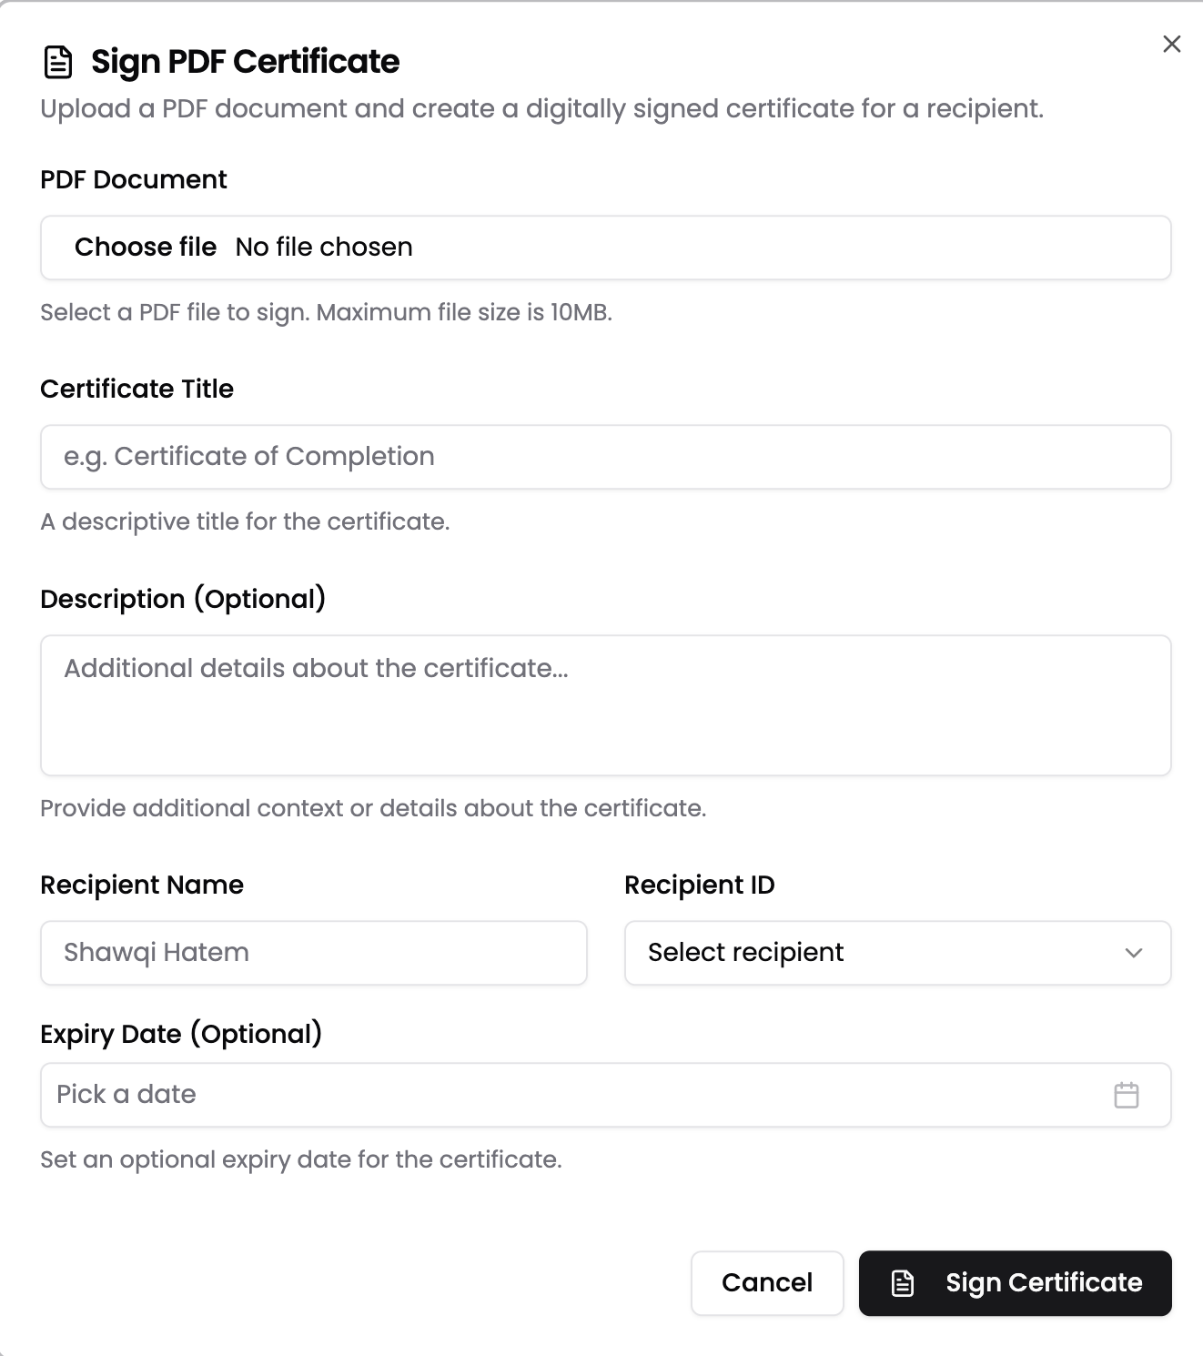
App Preview
Sign Pop-up

Slide 11
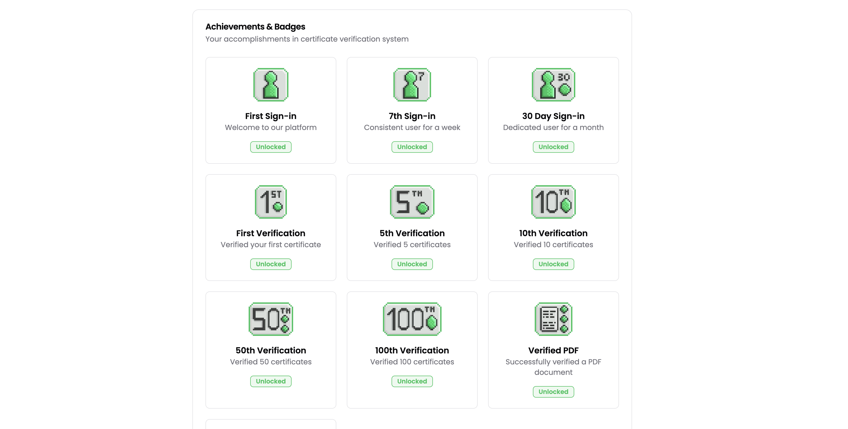
App Preview
Badges Portal

Slide 12
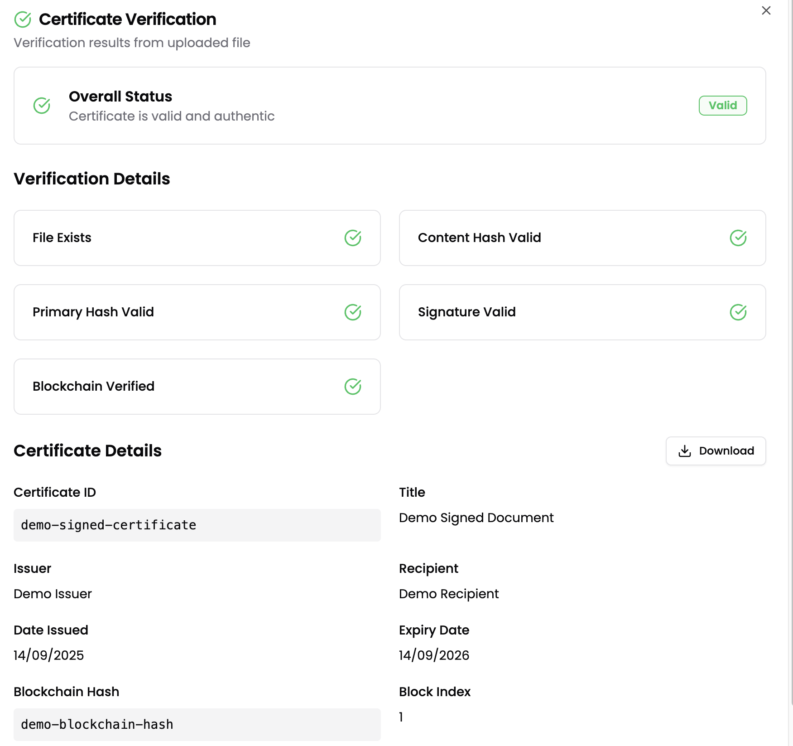
App Preview
Certificate Approved

Slide 13
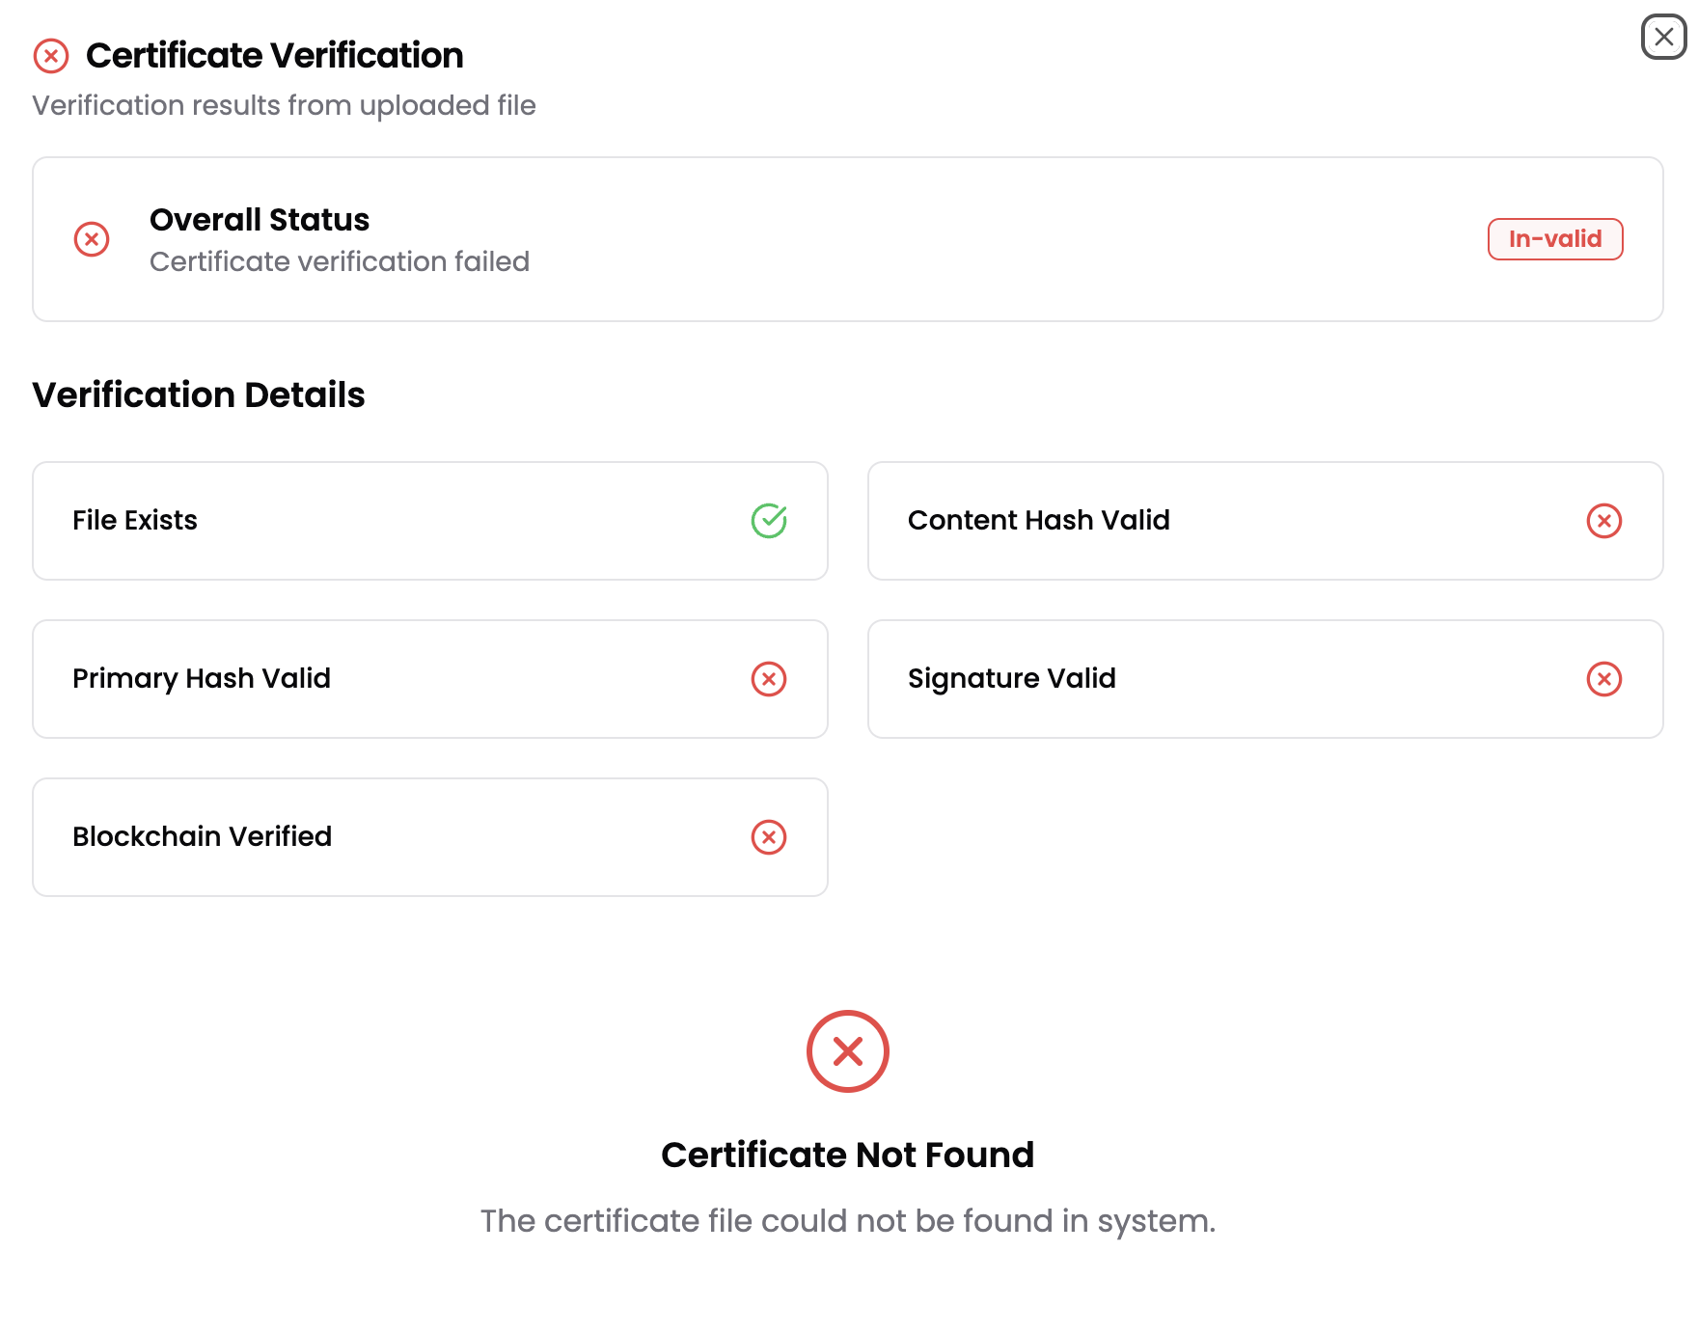
App Preview
Certificate In-valid

Slide 14

How our solution fits into cybersecurity
Digital Fraud Prevention
Our solution directly addresses a cybersecurity challenge. Using digital tools we act against fraudulence. We protect the integrity and authenticity of digital documents.
We address core cybersecurity principles:
Confidentiality: PDFs are verified by using encrypted public-private key pairs.
Integrity: Certificates are hashed and stored immutably on the blockchain.
Availability: By providing a public verification interface, our system makes certificate validation accessible anytime, anywhere.
Our project utilises blockchain to enhance trust in a digital framework.

Slide 15
Closing
Thank you for your time and the wonderful opportunity.
Yeagerists: Securing Accreditation.

