Slide 1

Autonomous Truck Platooning
DPS/ESE
Team 1
Bernard Widjaja
Md Saidur Rahman
Meghana Hemesh Kumar
Rajdeep Shaw
Notes:
Hello everyone. My Name is Mohammed Saidur Rahman. I am a first semester ESE student.
As international students in Germany, most of us are learning German alongside our studies. I have been living in Germany for almost 6 years. I thought my German learning experience and methods might help you in your journey.
In This presentation I will talk about how I practice German as part of everyday life without feeling bored, burned out, or overwhelmed. I’ll share some apps, media, and simple habits that helped me integrate German naturally into my daily routine.

Slide 2
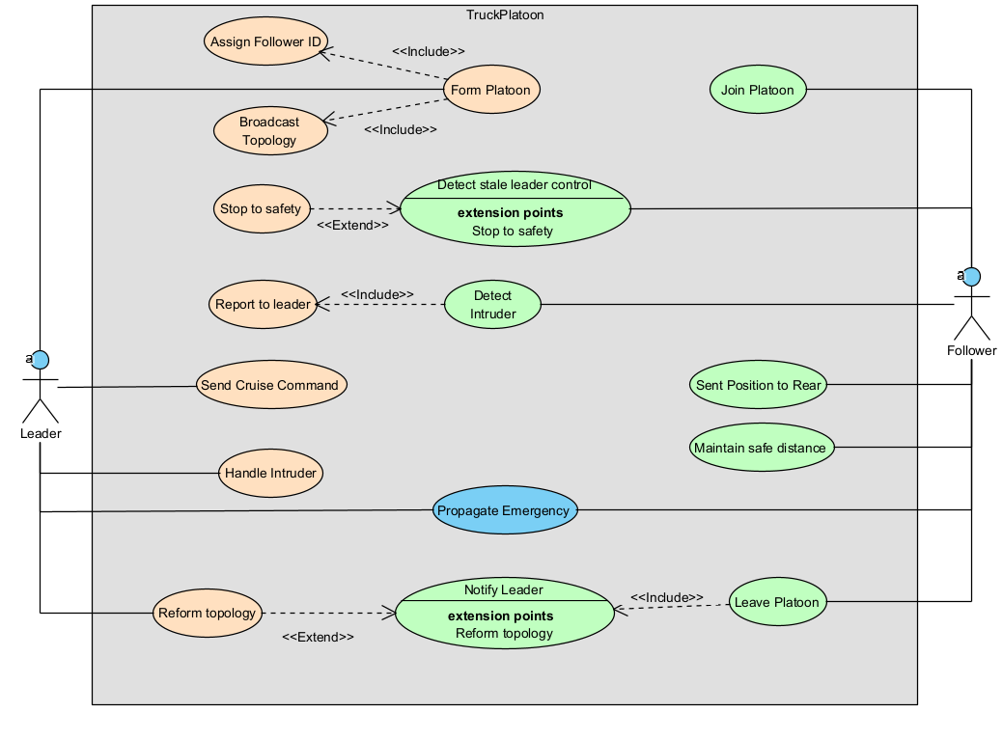
Use Case

Slide 3
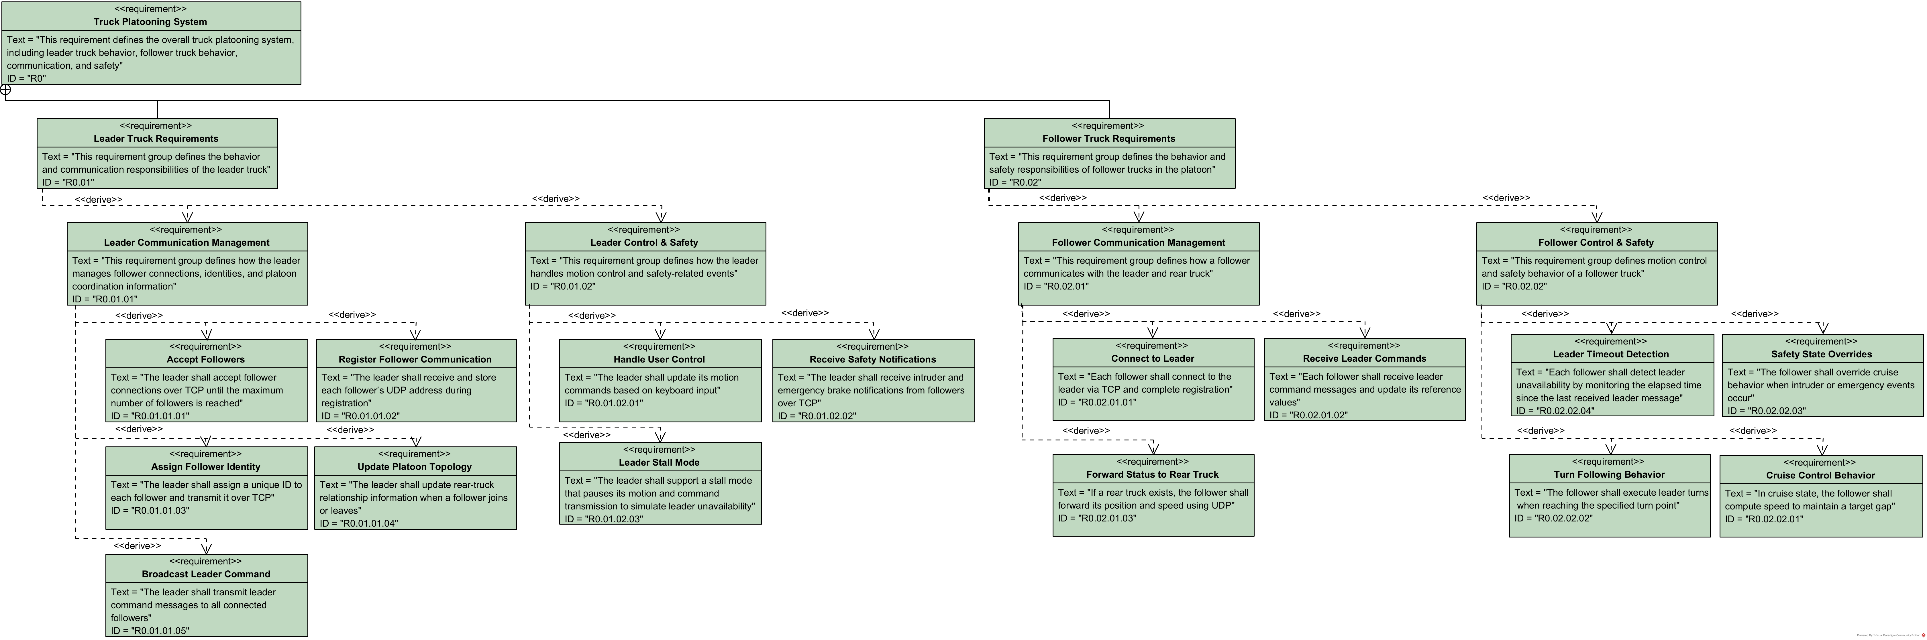
Requirement Diagram

Slide 4
Requirement Diagram

Slide 5
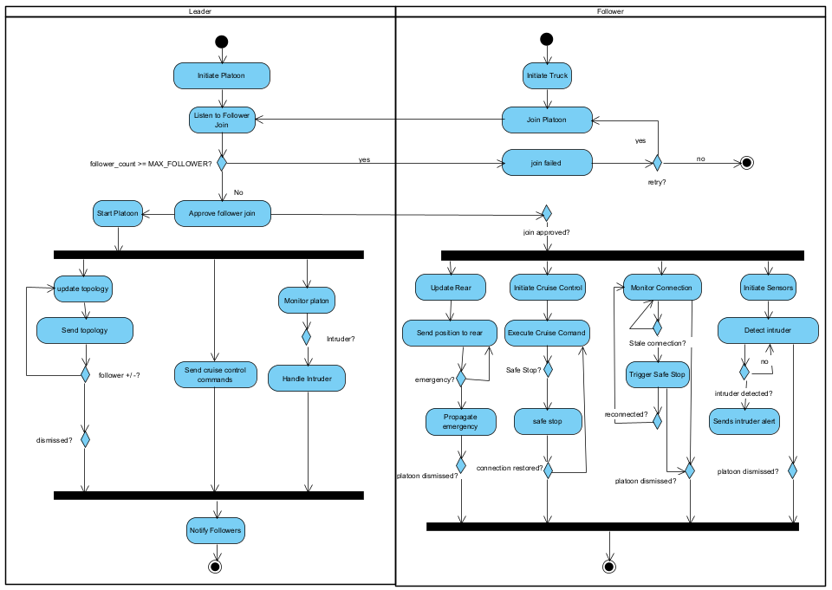
Activity – System

Slide 6
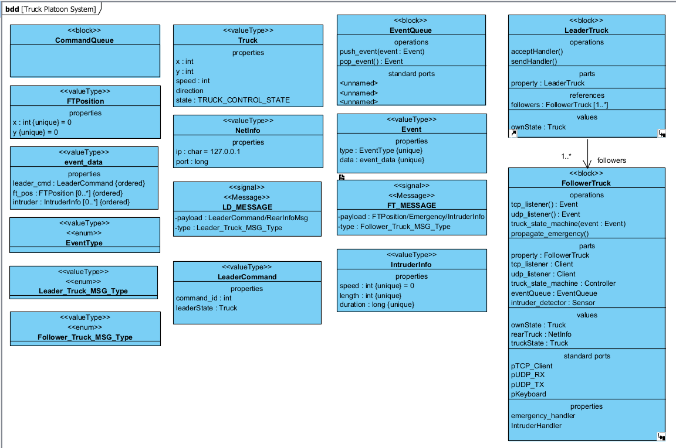
Block Definition Diagram

Slide 7
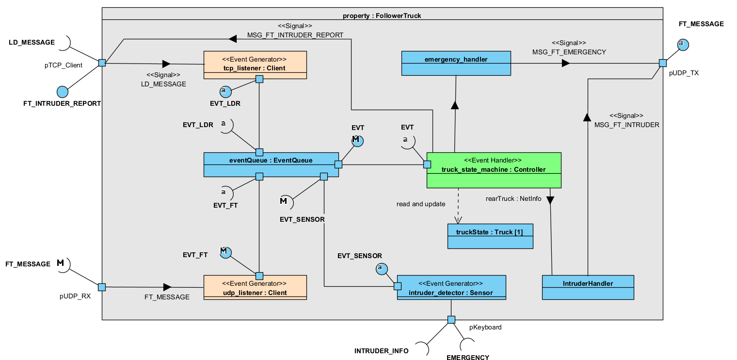
IBD – Follower

Slide 8
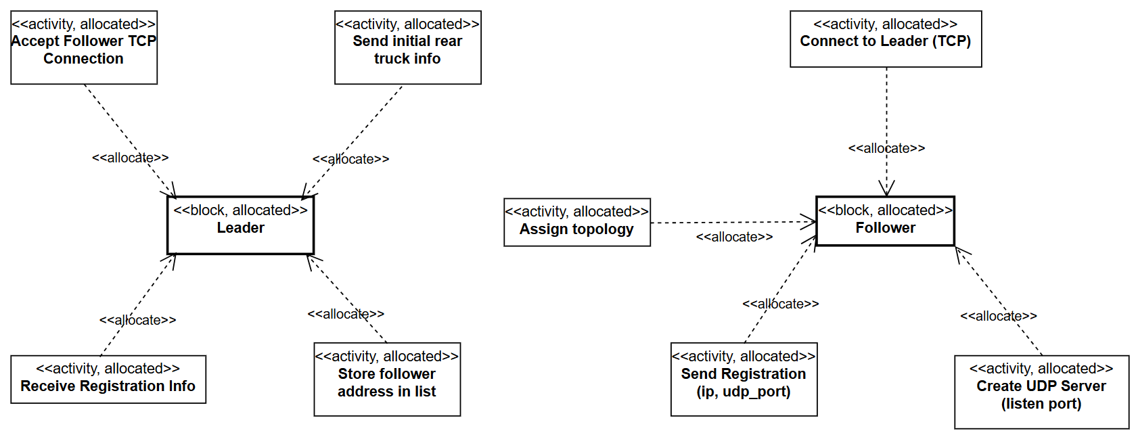
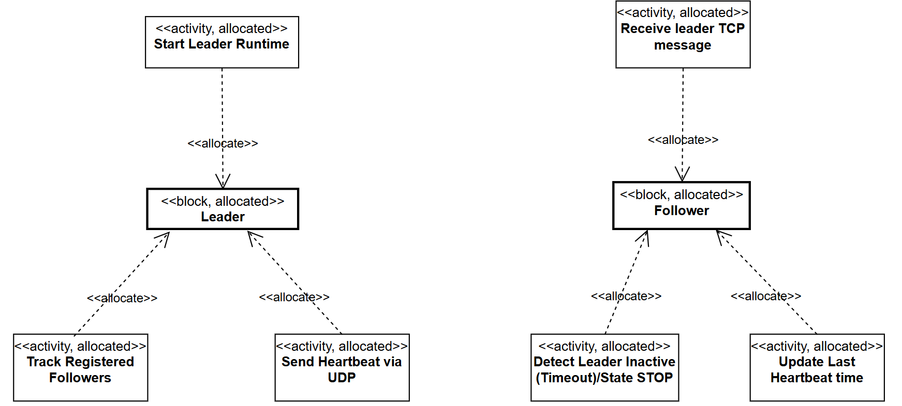
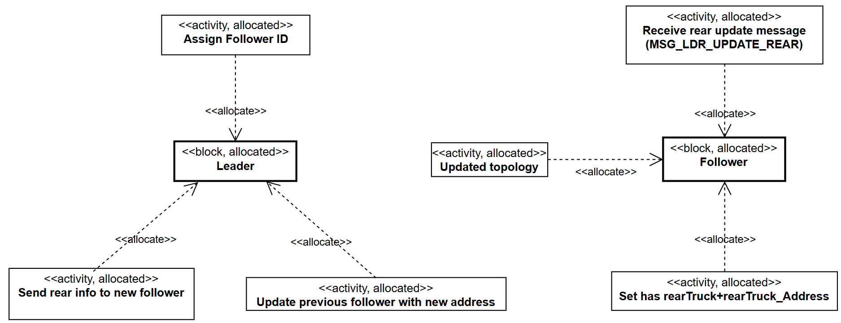
Allocation Diagram

Slide 9
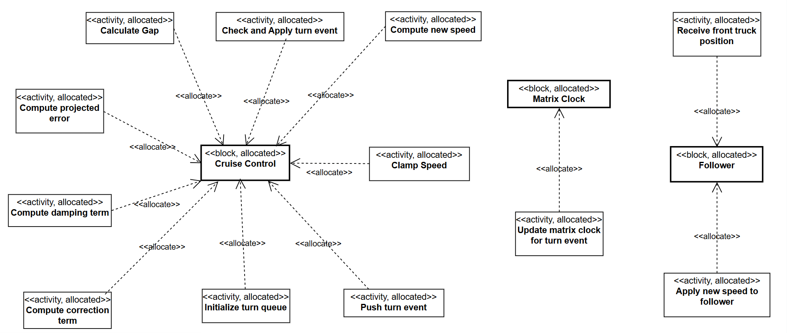
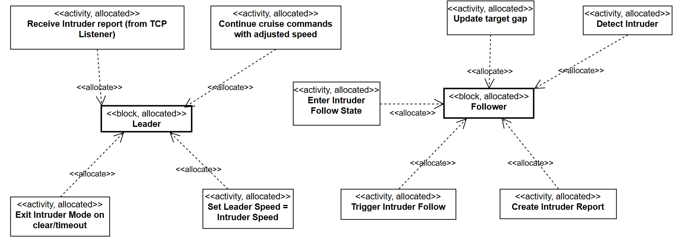
Allocation Diagram (Continue)

Slide 10
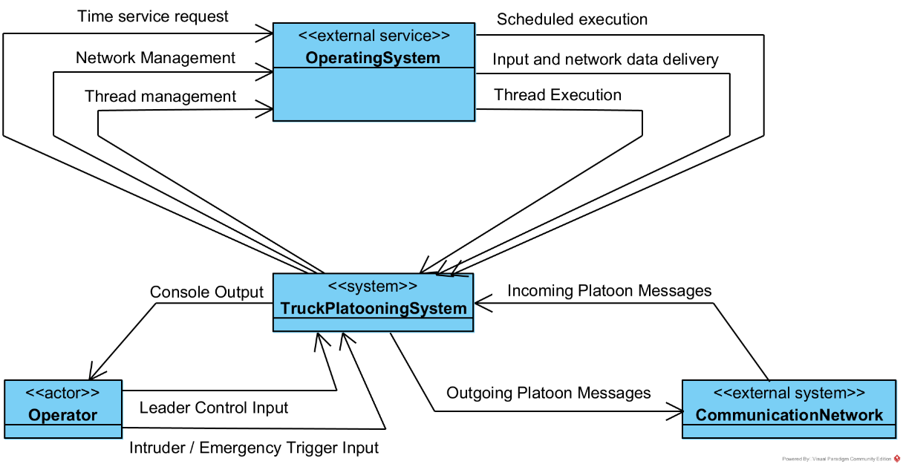
Context Diagram

Slide 11
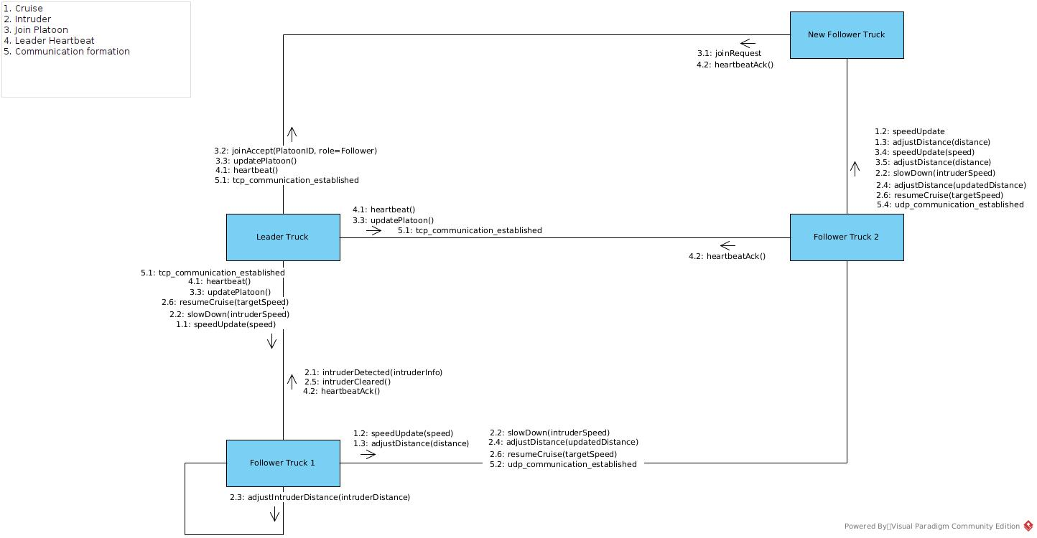
Interaction Diagram

Slide 12
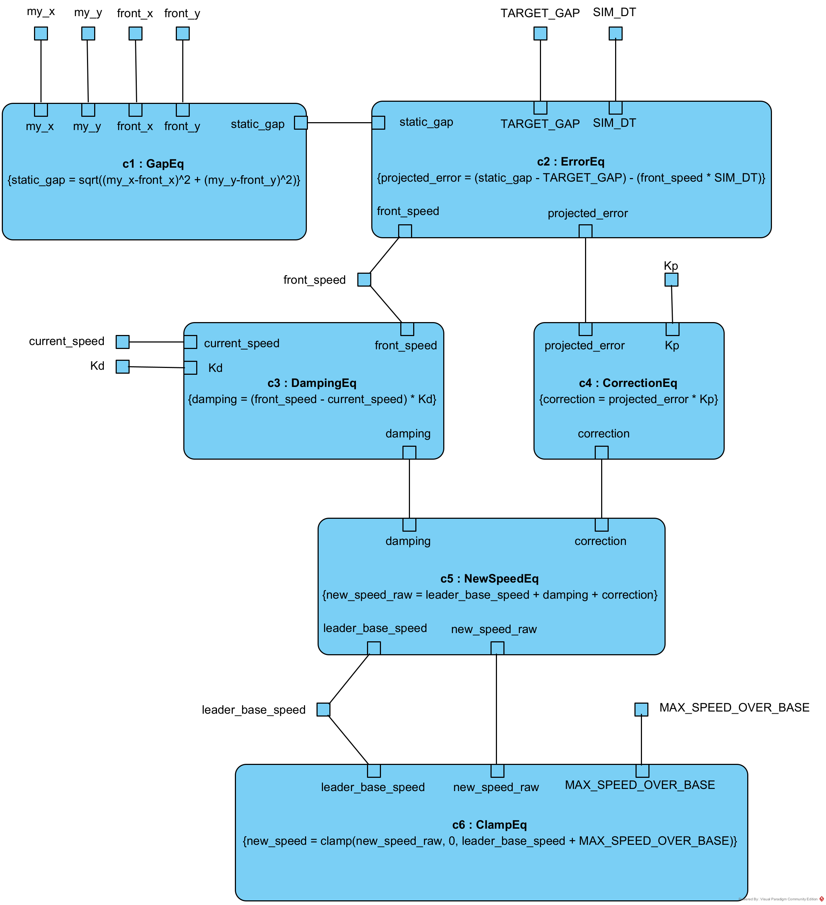
Parametric Diagram

Slide 13
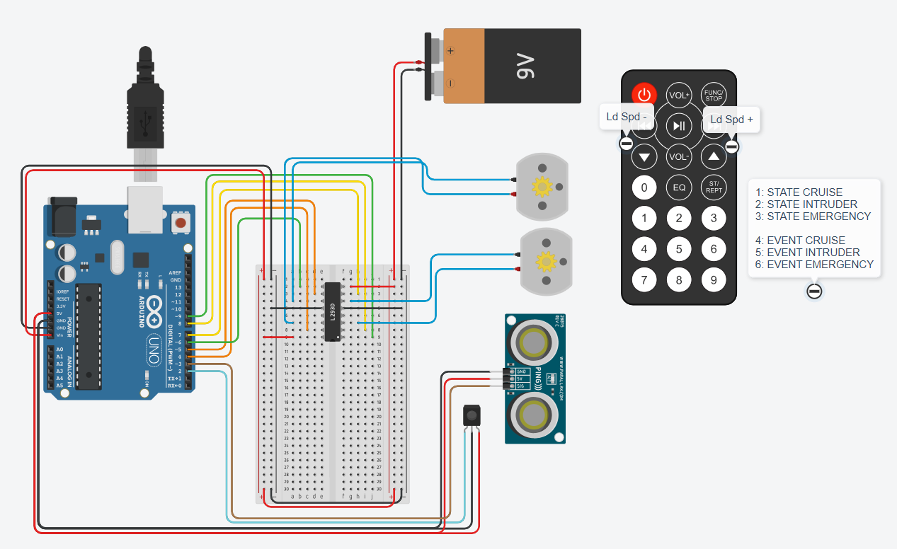
TinkerCad Simulation

Slide 14
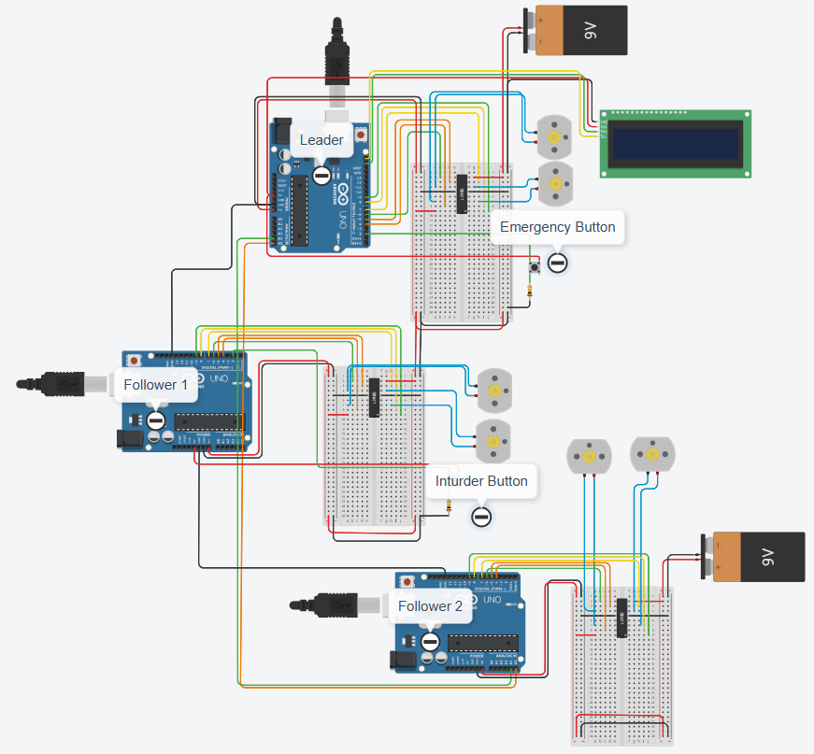
TinkerCad Simulation

Slide 15
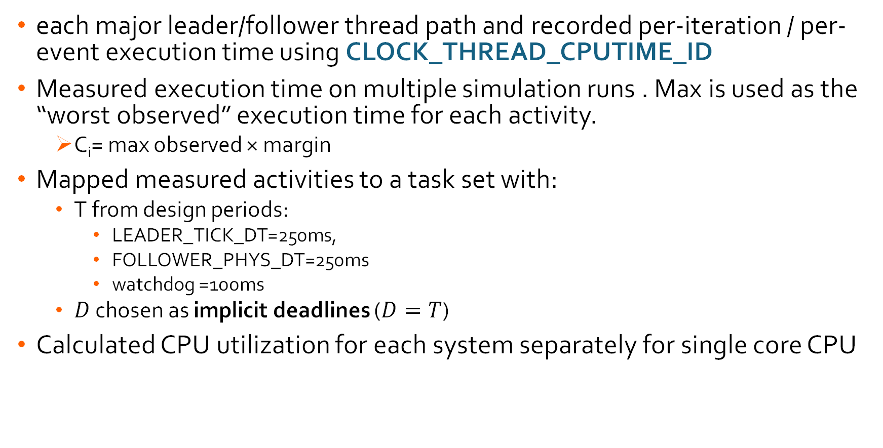
Scheduling
each major leader/follower thread path and recorded per-iteration / per-event execution time using CLOCK_THREAD_CPUTIME_ID
Measured execution time on multiple simulation runs . Max is used as the “worst observed” execution time for each activity.
  C_{i}= max observed × margin
Mapped measured activities to a task set with:
  T from design periods:
    LEADER_TICK_DT=250ms,
    FOLLOWER_PHYS_DT=250ms
    watchdog =100ms
  $D$ chosen as implicit deadlines ($D=T$)
Calculated CPU utilization for each system separately for single core CPU
​
Notes:
CLOCK_THREAD_CPUTIME_ID captures CPU time only (excludes blocking on sockets/sleeps) and is the right input for schedulability equations.
Margin: Used 2× for well-sampled counters (counts ~1000+) and 3× for rare events (small counts like accept/emergency/intruder).

Slide 16
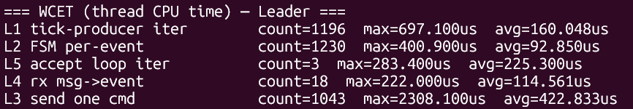
Scheduling
system | task | components | Observed (µs) | margin | C (ms) | T (ms) | D (ms) | Priority | U | R (ms) | EDF Status
Leader | L_tick | L1 tick-producer iter | 697.1 | 2 | 1.3942 | 250 | 250 | 6 | 0.0055768 | 7.4782 | YES
Leader | L_fsm | L2 FSM per-event | 400.9 | 2 | 0.8018 | 250 | 250 | 3 | 0.0032072 | 0.8018 | YES
Leader | L_send | L3 send one cmd | 2308.1 | 2 | 4.6162 | 250 | 250 | 4 | 0.0184648 | 5.418 | YES
Leader | L_rx | L4 rx msg->event | 222 | 3 | 0.666 | 250 | 250 | 5 | 0.002664 | 6.084 | YES
Follower | F_emergency | F4 UDP msg->event+F5 EVT_EMERGENCY | 1131.4 | 3 | 3.3942 | 50 | 50 | 1 | 0.067884 | 3.3942 | YES
Follower | F_watchdog | F2 watchdog iter | 160 | 2 | 0.32 | 100 | 100 | 2 | 0.0032 | 3.7142 | YES
Follower | F_timeout_fsm | F5 EVT_Leader_TIMEOUT | 150.8 | 3 | 0.4524 | 100 | 100 | 2 | 0.004524 | 4.1666 | YES
Follower | F_cruise | F3 TCP msg->event+F5 EVT_CRUISE_CMD | 503.5 | 2 | 1.007 | 250 | 250 | 5 | 0.004028 | 5.1736 | YES
Follower | F_distance | F4 UDP msg->event+F5 EVT_DISTANCE | 110.5 | 3 | 0.2224 | 250 | 250 | 5 | 0.0008896 | 5.396 | YES
Follower | F_physics | F1 physics iter | 572.4 | 2 | 1.1448 | 250 | 250 | 8 | 0.0045792 | 6.5408 | YES

Slide 17
CUnit Test Results
Validation tests:
Valid Intruder Detection : When an external vehicle enters the platoon gap, the follower correctly detects it and switches to Intruder Follow state.
Correct Matrix Clock Update : On receiving an event (join / intruder), the matrix clock is updated correctly to reflect causal ordering.
Cruise Control Speed Adjustment : When the gap reduces due to an intruder, cruise control reduces speed smoothly to maintain safe distance.
Leader Notification on Intruder : Once an intruder is detected, the follower successfully sends an intruder notification to the leader.
Safe Recovery After Intruder Exit : After the intruder leaves, the follower exits intruder mode and resumes normal platoon following.
Defect tests:
False Intruder Detection : System does not incorrectly enter intruder state when no intruder is present.
Matrix Clock Desynchronization : If an outdated matrix clock is received, the system ignores it and avoids incorrect event ordering.
Sudden Gap Reduction (Edge Case) : Extremely fast gap reduction triggers emergency handling instead of unstable cruise control behavior.
Missing Leader Acknowledgement : If leader does not acknowledge intruder notification, follower continues safe fallback behavior.
Invalid Sensor Input : Corrupted or invalid distance/speed values do not crash the system and are safely handled.
Components tests:
Intruder State Transitions : Proper entry and exit of Intruder Follow and Emergency states.
Speed Computation Function : Cruise control outputs valid speed for different gap inputs.

Slide 18
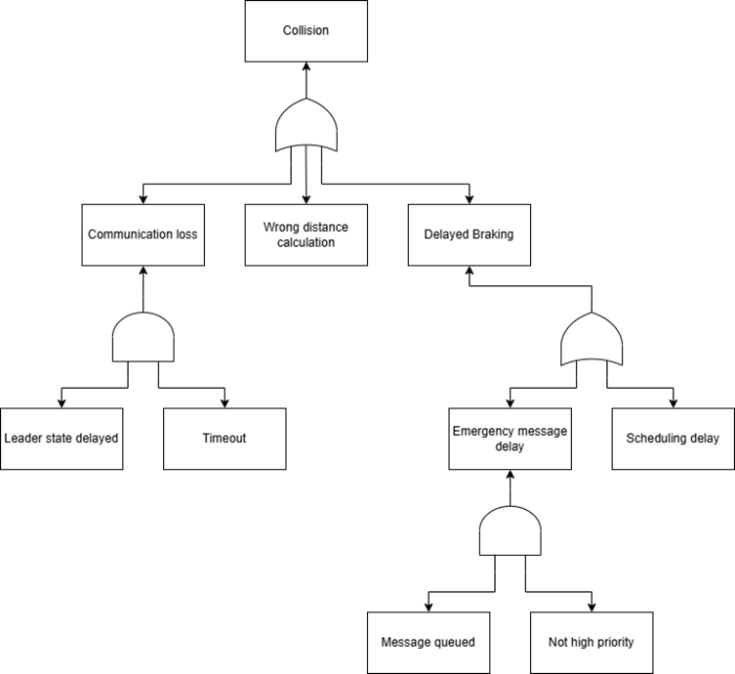
Fault Tree Analysis
Hazard 1: Collision within the platoon
Event: Follower truck collides with the preceding truck.
Hazard handling:
Design Level:
Time-bound V2V communication
Minimum safe fallback distance
Fail-safe braking logic independent of leader updates
Implementation level:
Watchdog timers for leader message reception
Timestamp and logical/matrix clock validation
Immediate local braking if leader state is missing or stale
Priority scheduling for emergency messages

Slide 19
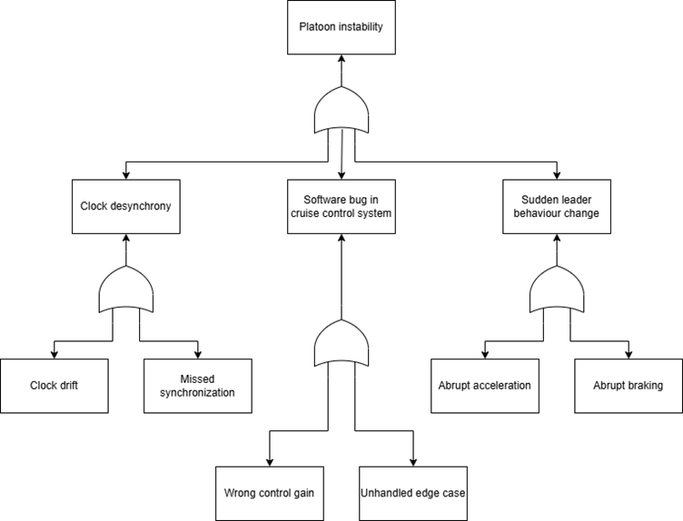
Fault Tree Analysis
Hazard 1: Platoon instability
Event: Oscillations in speed causing unsafe
inter-vehicle gaps.
Hazard handling:
Design Level:
Logical/matrix clock-based time synchronization
Stability-verified control parameters
Constraints on leader state change rates
Implementation level:
Matrix clock consistency checks before applying updates
Rate limiting on speed and acceleration commands
Smooth leader state propagation

Slide 20
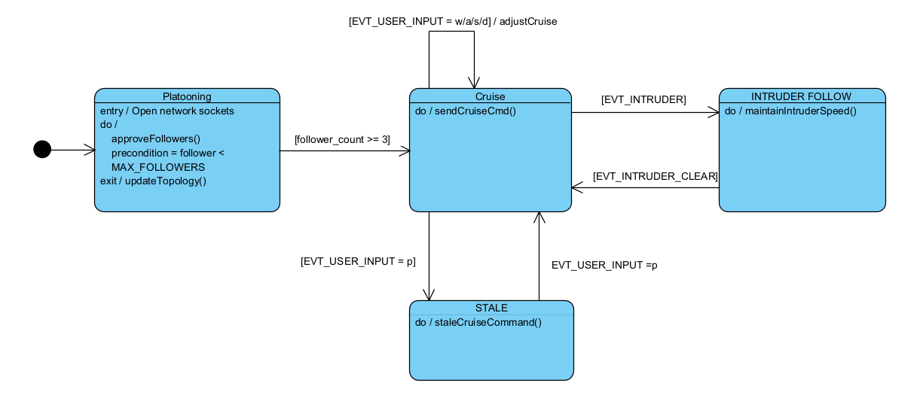
State Machine -Leader

Slide 21
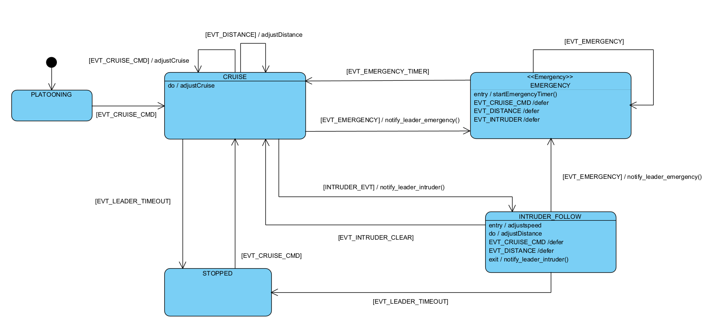
State Machine - Follower

Slide 22
Events and Signals
LEADER
Events | Signals
EVT_TICK_UPDATE EVT_USER_INPUT EVT_PLATOON_FORMED EVT_FOLLOWER_MSG EVT_SHUTDOWN | MSG_LDR_ASSIGN_ID MSG_LDR_SPAWN MSG_LDR_UPDATE_REAR MSG_LDR_CMD MSG_LDR_EMERGENCY_BRAKE
FOLLOWER
Events | Signals
EVT_CRUISE_CMD EVT_DISTANCE EVT_INTRUDER EVT_INTRUDER_CLEAR EVT_EMERGENCY EVT_EMERGENCY_TIMER EVT_LEADER_TIMEOUT EVT_SHUTDOWN | MSG_FT_POSITION MSG_FT_INTRUDER_REPORT MSG_FT_EMERGENCY_BRAKE

Slide 23
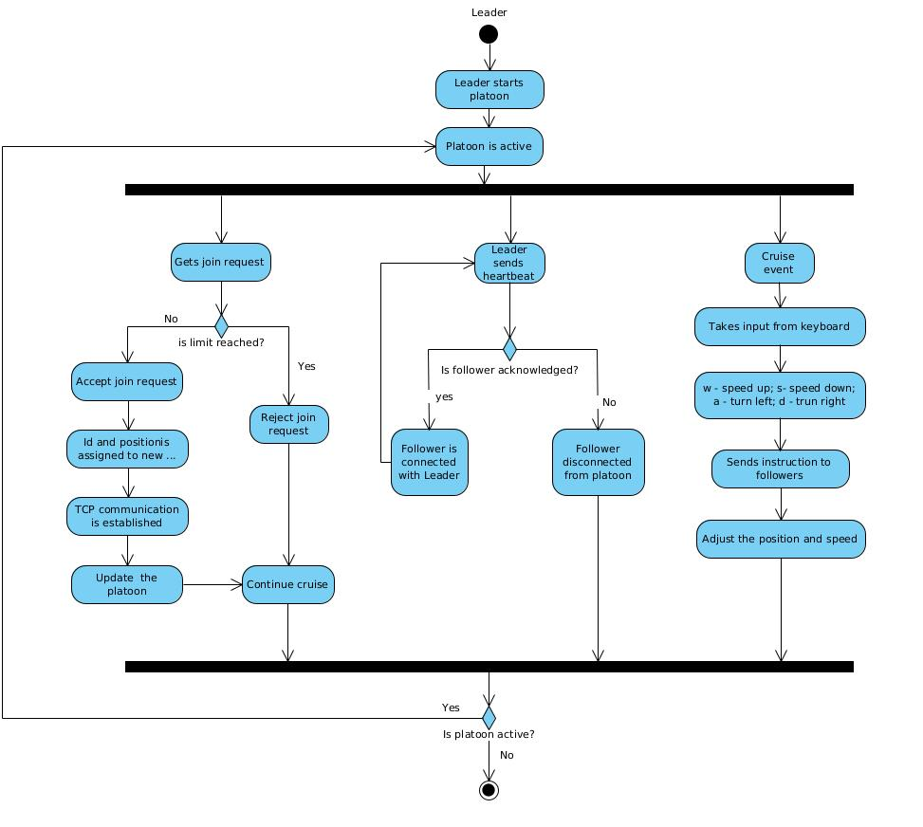
Activity Diagram

Slide 24
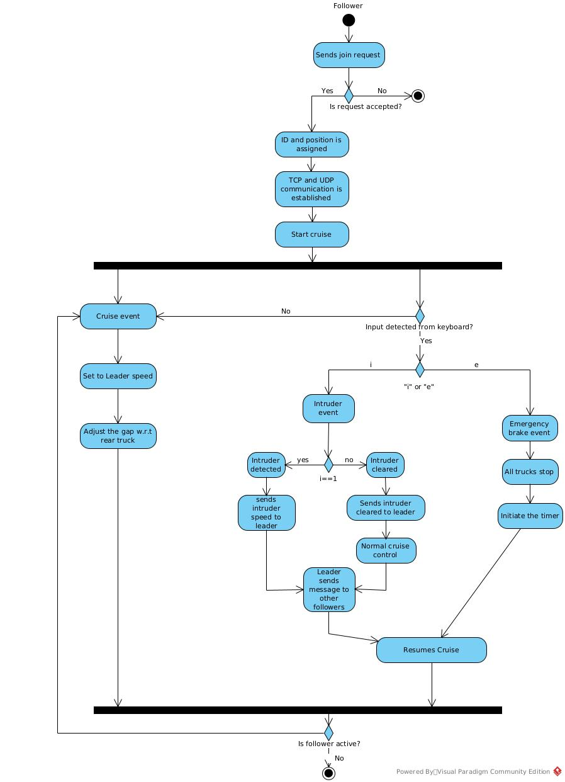
Activity Diagram

Slide 25
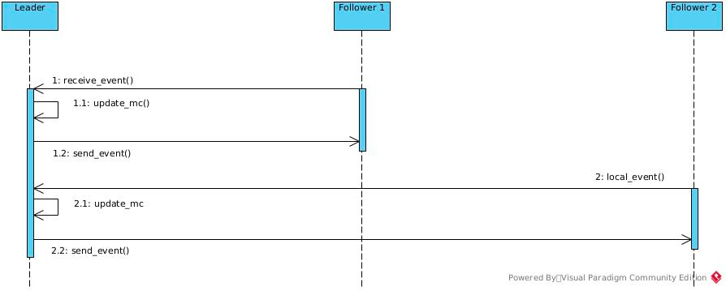
Sequence Diagram
Matrix clock sequence:

Slide 26
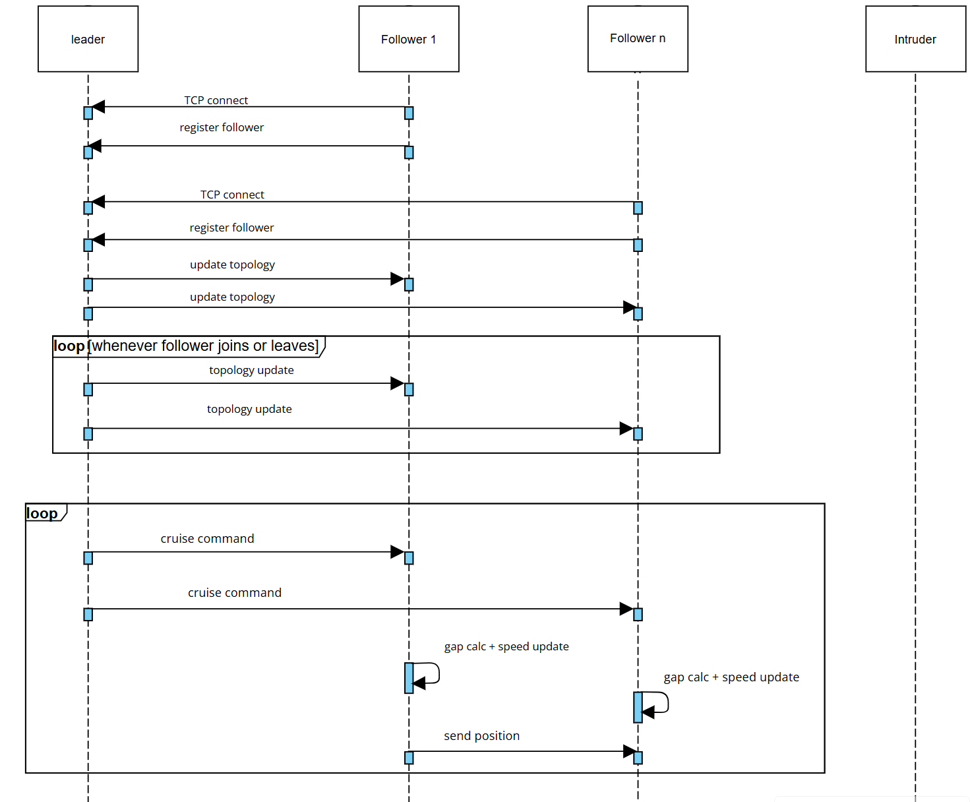
SysML Sequence Diagram

Slide 27
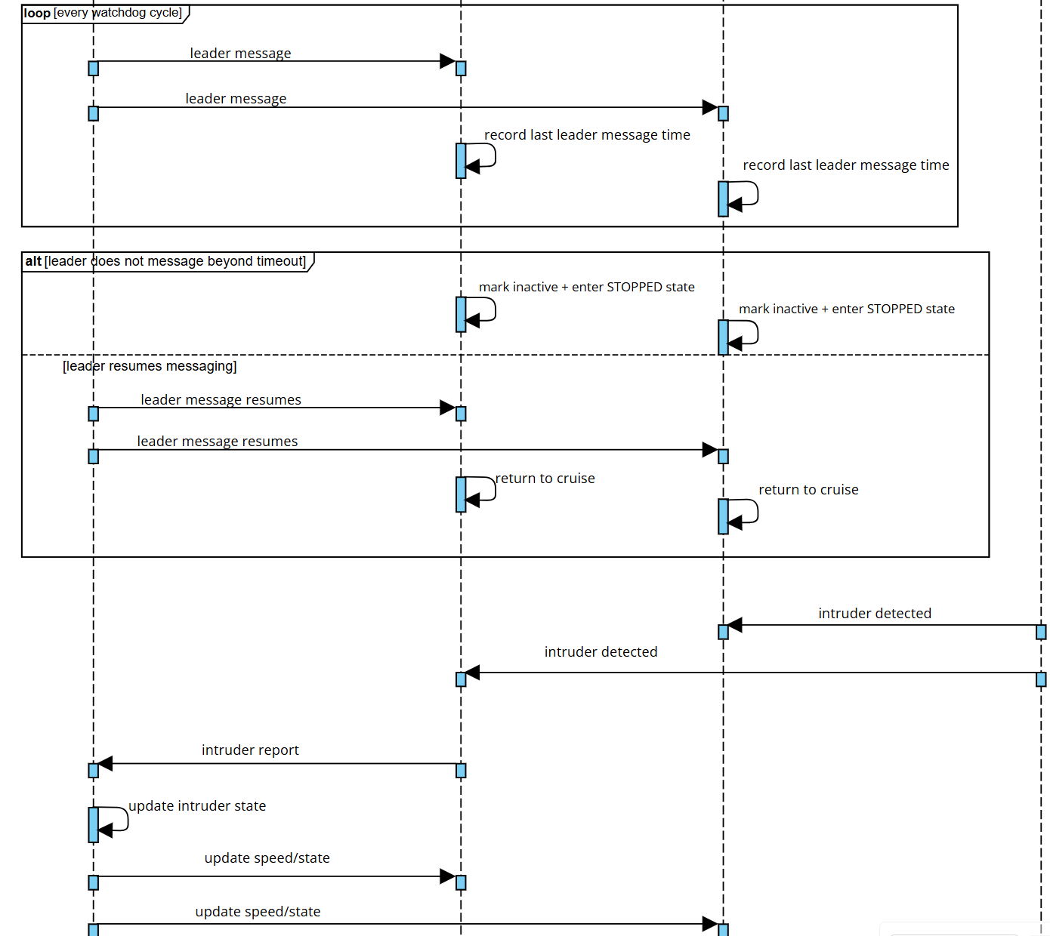
SysML sequence diagram (Continue)

Slide 28
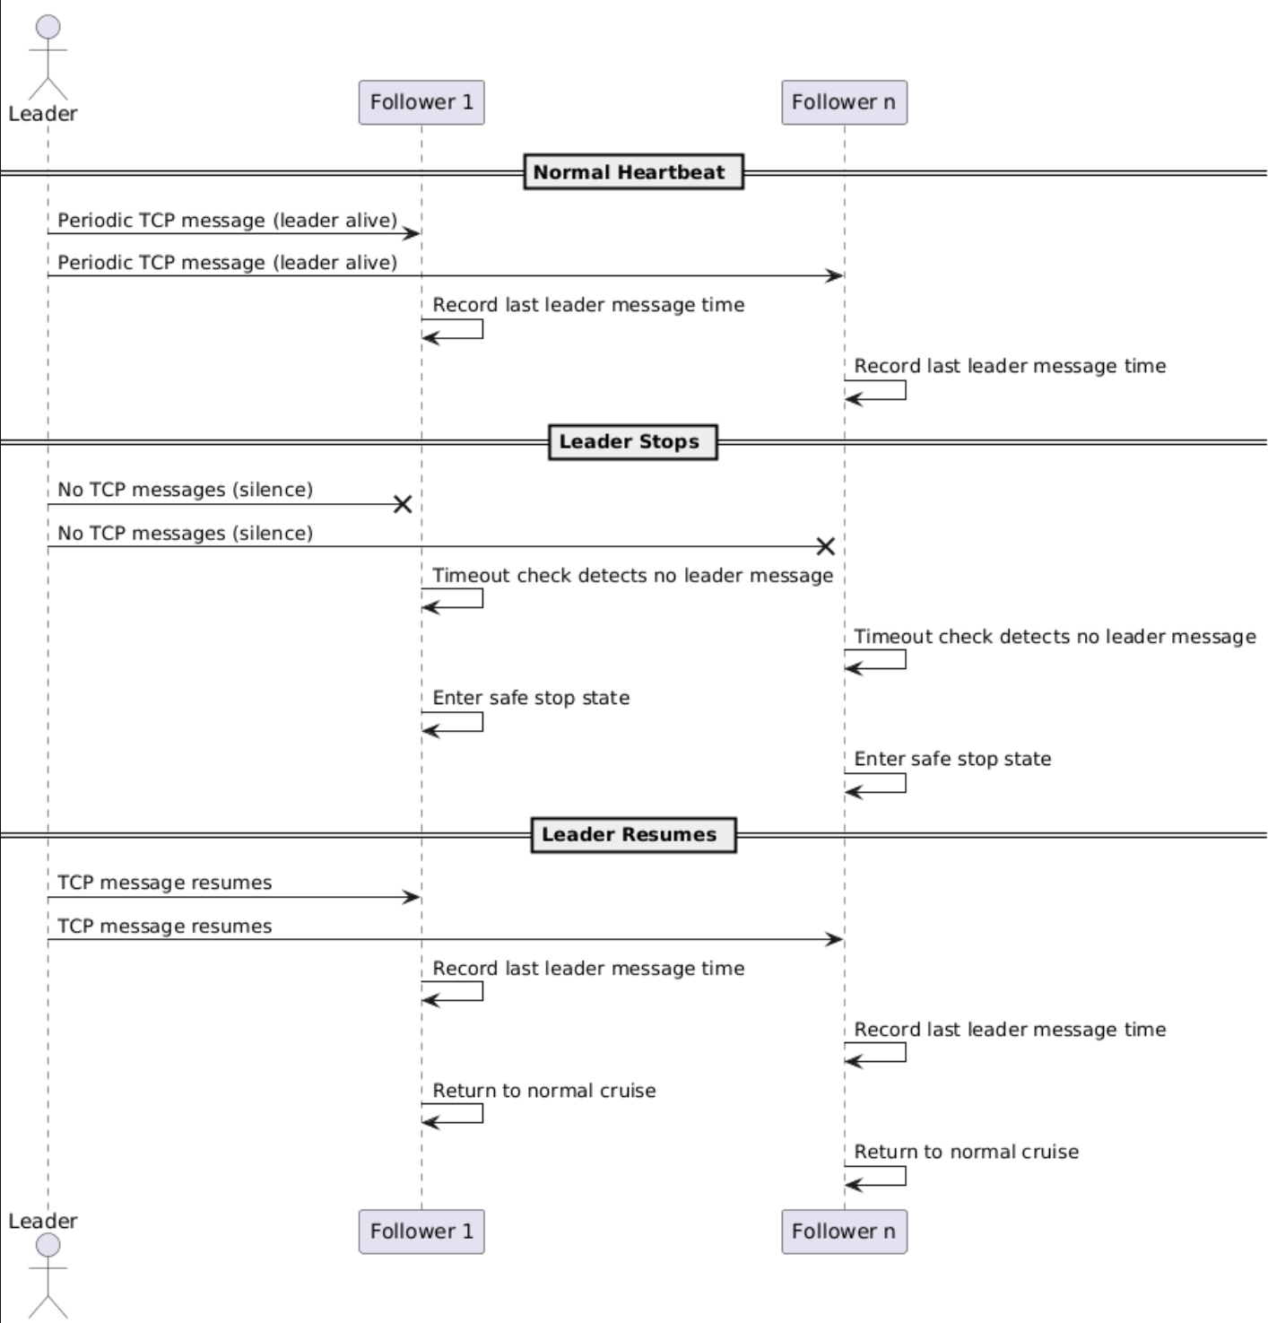
SysML sequence diagram (heartbeat)

Slide 29

State Machine Diagram

Slide 30
Programming Model
POSIX Threads (pthreads) for node-level parallelism
Role-based task concurrency
  Separated threads for communication, input, control
Event-driven execution
  Actions triggered by events
Message-based interaction
  Communication via messages

Slide 31
Simulation

Slide 32
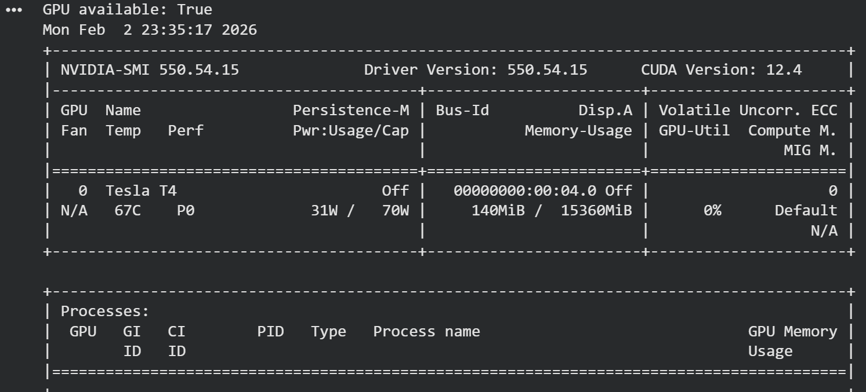
GPU
Goal is to demonstrate parallel programming
Re-runs Cruise control math (gap and new speed), and make 1000x 1000 Intruder grid.
Logs are getting parsed in Json file
Randomly spawns intruders near followers and check response.
GPU implemented in Google Colab repeatedly downloads the json data and runs computations. It sends data back via HTTPS post request.

Slide 33
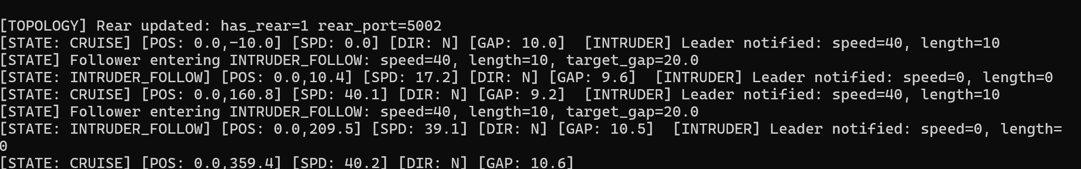
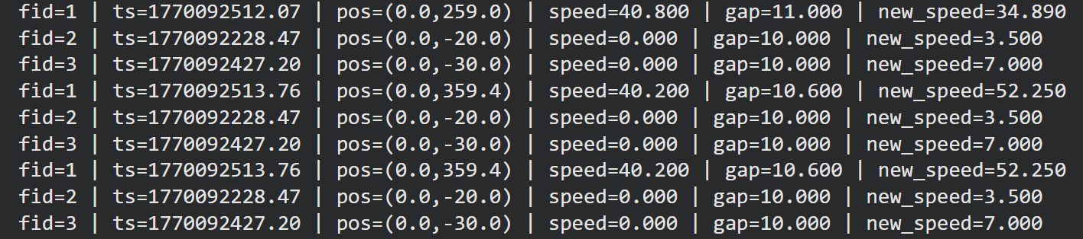
GPU
Intruder allocation
Mirror visualization of cruise functioning with timestamps

Slide 34
Questions ?
Notes:
Thank you for listening. If you have any questions I will be happy to answer

