Slide 1

Zero-shot Egocentric action Recognition
PHASE 2
TEAM SIGMA

Slide 2

PROBLEM STATEMENT
Given a video clip, the goal is to predict a single way label for the video in a zero-shot way. The challenge is to do it for egocentric video.

Slide 3

Zero Shot Learning
Zero-shot machine learning is used to construct recognition models for unseen target classes that have not labelled for training. It is done in two stages.
Training: Where the knowledge attribute is captured
Inference: The knowledge is then used to categorise instances among new sets of classes.
ZSL recognition relies on the existence of a labelled training set of seen classes and the knowledge about how each unseen class is semantically related to the seen class.

Slide 4

Related Work
Gaze Attention:
To address difficulties in incorporating gaze data in attention mechanism, probabilistic modelling method is used.
Ablation study and qualitative study is performed to demonstrate effectiveness of attention mechanism.
Use of external knowledge:
Both the verb and active objects were separately inferred.
In this method, the system would be capable of making predictions by combining the knowledge acquired from those two separated branches, as long as the verb and the object have been previously seen.

Slide 5

Open-world egocentric action recognition:
This approach integrates commonsense knowledge and symbolic reasoning with the representation learning capabilities of deep neural networks to overcome the dependence on annotated training data.
This approach uses a general-purpose knowledge base that is not specifically tailored for the specific domain and has no learned correspondence in the target domain.
Incorporating Visual Grounding in GCN:
Addresses the limitation of using only the language graph in zero-shot learning, ignoring the semantics of the visual graph.
The method outperforms the state-of-the-art methods on both datasets.

Slide 6

PROPOSED WORK

Slide 7

Using Concept Net for ZSL
Aim: improving current / existing ZSL models by using concept net as knowledge base to provide a common-sense Knowledge base.
Concept net : ConceptNet is a freely-available semantic network, designed to help computers understand the meanings of words that people use.
ConceptNet originated from the crowdsourcing project Open Mind Common Sense, which was launched in 1999 at the MIT Media Lab. It has since grown to include knowledge from other crowdsourced resources, expert-created resources, and games with a purpose.

Slide 8
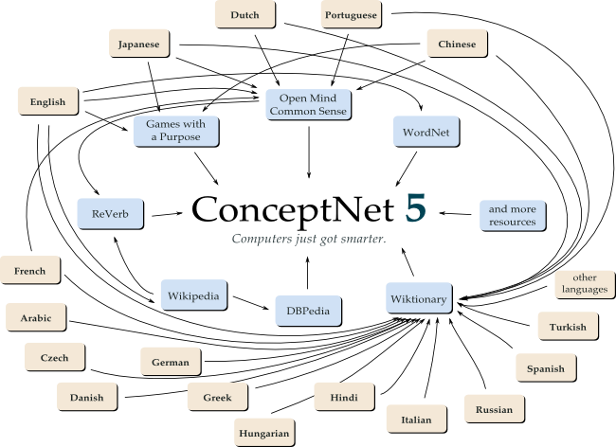
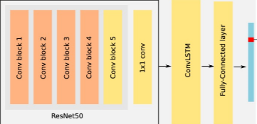

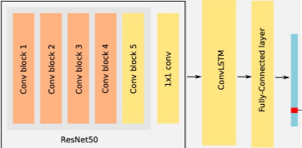
Verb Detector
P(verb-j)
P(iRj)
P(object-i)
P(verb-j object-i)= P(object-i)*P(verb-j)*P(iRj)
Uniformly Samples Frame
Object Detector
Architecture overview: two neural networks composed of a ResNet50 and a Con- vLSTM take as input a video (uniformly sampled frames) and output two probability distributions (verbs and objects). The resulting probability distributions are combined with a probability value from concept net infer the most probable action. The layers or blocks of layers in orange are frozen while the yellow ones are trained.

Slide 9

Explaining The model
Object and verb detection using a combination of ResNet-50 and LSTM.
Object classification involves identifying and classifying objects within an image or video sequence. Deep learning models, such as convolutional neural networks (CNNs), have achieved remarkable performance in object classification tasks. However, when dealing with video sequences, CNNs may struggle to capture the temporal dynamics of the video. This is where recurrent neural networks (RNNs), such as ConvLSTMs, come into play.
ResNet-50 is used for Feature Extraction.
ConvLSTM is used for temporal modeling.
In the model used, ResNet-50 is combined with the ConvLSTM and classification is being done by Fully Connected Layer.
The major benefits leveraged from this combination are: Spatial feature extraction, Capturing temporal dynamics and Improved classification accuracy.

Slide 10
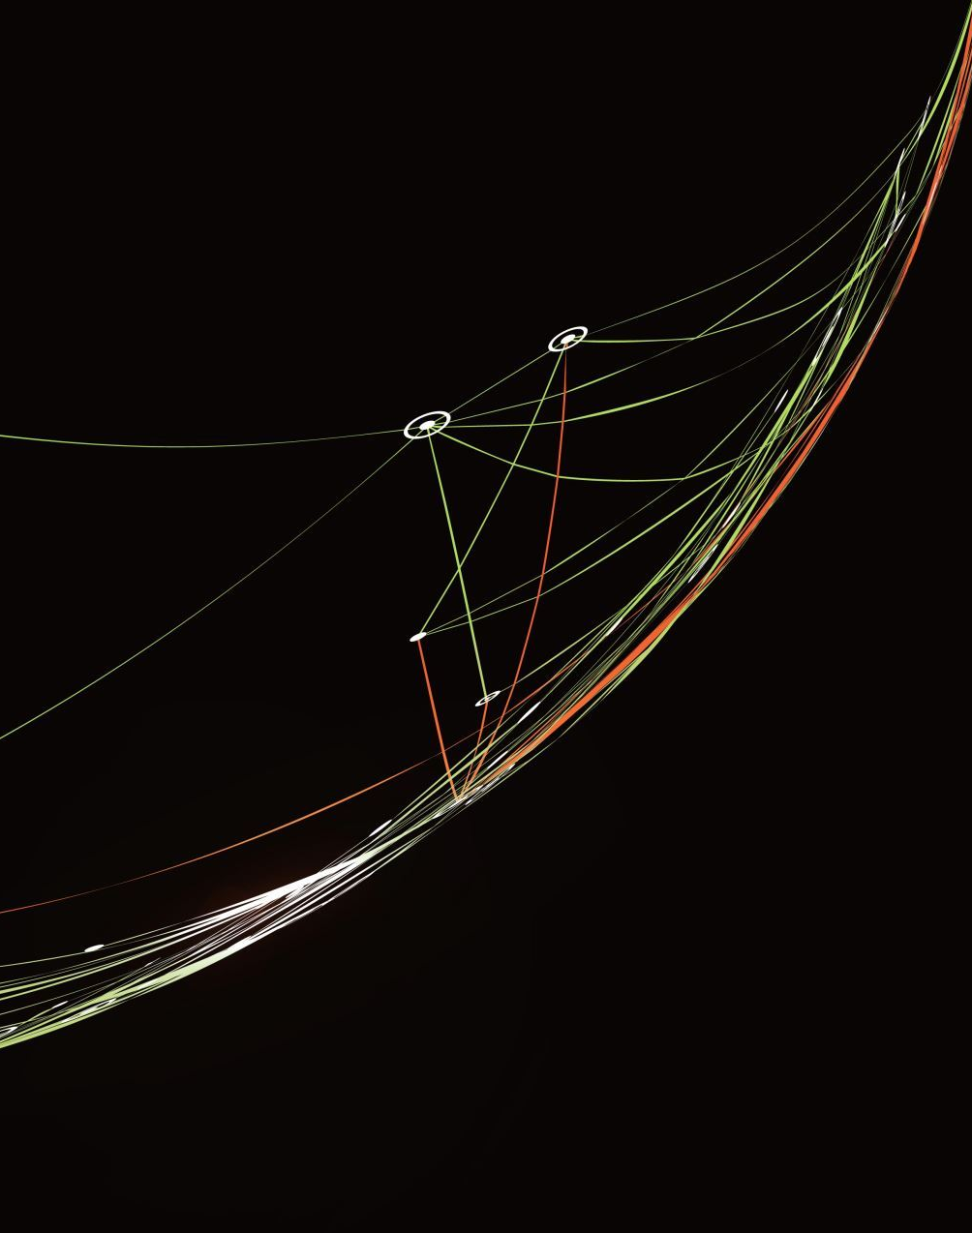
Using concept net.
We use concept net to provide a sense of common sense knowledge to the model.
Concept net is basically a relational knowledge graph.
We input object and verb into the concept net probability calculation code and obtain a probability indicating , how much sense the particular action make.

Slide 11

Datasets & Training Details

Slide 12
EGTEA and Splits:
We chose the EGTEA Gaze+10 dataset for our experiments. Launched in 2017, this dataset contains 28 hours of egocentric videos with 32 subjects performing cooking related actions. It is composed of 10,325 action segments, with 19 verbs, 53 nouns and 106 actions.
Official splits in EGTEA are not suitable for ZSL, since the actions in the test set are also represented in the train set. Therefore, in our experiments, we employ new splits.
First, we removed action videos containing verbs and objects that only appear once, as they are not appropriate for the zero-shot task, as formulated in given papers. This left us with 9 verbs and 29 objects.
Second, to generate the test set, we randomly took 20% of the action classes under the condition that any verb and object contained in that test set must appear in the training set (in any action). That is, all the verbs and objects must appear in the training set.
The validation set is created taking a stratified subset from the resulting training set, using the 10% of the videos in train. Note that the validation set is important not for the ZSL task itself, but to train and tune the detectors.
A video input is segmented into 25 frames uniformly.

Slide 13
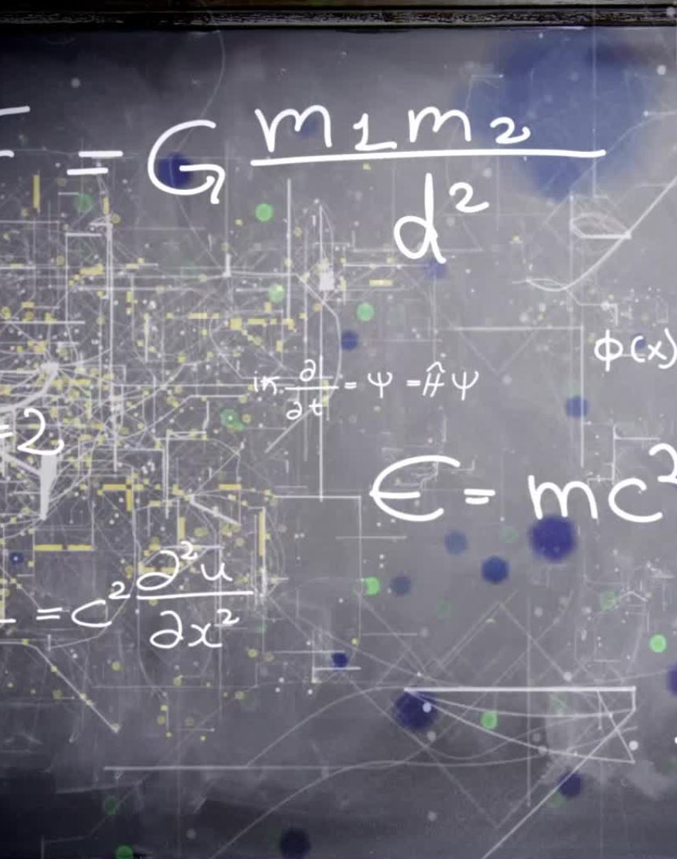
LOSS FUNCTION:
In our model, since ResNet-50 and ConvLSTM has been employed for the object classification, cross-entropy loss has been calculated.
The formula used is: L = -Σ y_true * log(y_pred)
Where;
L represents the loss
y_true is the true class distribution for the video sequence
y_pred is the predicted class distribution for the video sequence
The loss function is minimized by the standard gradient descent algorithm.
By minimizing the categorical cross-entropy loss, the model is effectively penalized for making incorrect classifications and encouraged to produce more accurate predictions.

Slide 14
EXPECTED IMPROVEMENTS ON EXISTING METHODS
Improving accuracy without effecting training time, over SOTA solutions, which don’t use concept net.
Giving model ability to avoid blunders by providing the base of common-sense knowledge.

Slide 15

Thank You
The end of the presentation has been reached!!

