Slide 1

Zero-shot egocentric action recognition
PHASE 1
TEAM SIGMA

Slide 2
PROBLEM STATEMENT
Given a video clip, the goal is to predict a single action label for the video in a zero-shot way. The challenge is to do this for egocentric videos.

Slide 3
Zero Shot Learning
Zero –Shot machine learning is used to construct recognition models for unseen target classes that have not labelled for training. It is done in two stages.
Training: Where the knowledge attribute is captured.
Inference: The knowledge is then used to categories instances among new set of classes.
ZSL recognition relies on the existence of a labelled training set of seen classes and the knowledge about how each unseen class is semantically related to the seen class.

Slide 4

HUMAN GAZE A CHALLENGE IN EGO CENTRIC VIDEOS

Slide 5
Gaze Attention
Based on- Integrating Human Gaze into Attention for Egocentric Activity Recognition by Kyle Min, Jason J Corso.
It is well known that human gaze carries significant information about visual attention.
However, there are three main difficulties in incorporating the gaze data in an attention mechanism of deep neural networks: (i) measurement errors due to blinking and rapid eye movements; (ii) unclear when and how much the gaze data is correlated with visual attention; and (iii) gaze data is not always available in many real-world situations.
To address such problems, probabilistic modeling method is used to integrate human gaze into spatiotemporal attention for egocentric activity recognition.
Specifically, the locations of gaze fixation points is represented as structured discrete latent variables and the distribution of gaze fixations is modelled using a variational method.
Then the predicted gaze locations are integrated into a soft attention mechanism to make the intermediate features more attended to informative regions.
An ablation study and qualitative analysis to demonstrate that attention mechanism is effective is also performed.

Slide 6
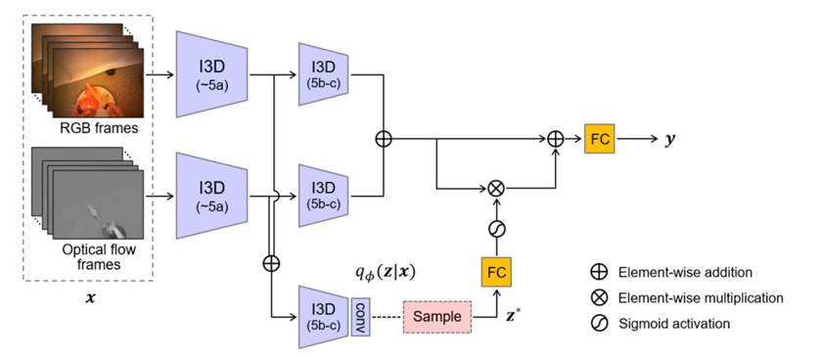
Architecture
•As a backbone network, the two-stream I3D (3D CNN) is used.
•To model the gaze distribution, the same convolutional blocks of the I3D is used and three convolutional layers are added on top of it.
•The two intermediate features at the end of the 4th max-pooling layer are added and the added feature map is used as an input to the network for gaze modeling.
•A sample is drawn, which is then applied with a fully connect layer and the sigmoid function to produce a soft attention map.
The two features at the end of the 5th convolutional block are added in an elementwise way, and the soft attention map is applied to the added feature map via a residual connection

Slide 7

LITERATURE REVIEW : EXPLORING WAYS TO IMPROVE ZSL FOR EGO CENTRIC VIDEOS.

Slide 8
Using External Knowledge to improve Zero Shot Egocentric Action Recognition
Adri´an N´u˜nez-Marcos, Gorka Azkune, Diego L´opez-de-Ipi˜na, Ignacio Arganda-Carreras
To improve Egocentric Action Recognition, the paper suggested using external knowledge from text corpora to improve the performance of EAR.
The paper also analyses the effects of different knowledge sources.
Here, both the verb and the active objects were separately inferred.
In this method, the system would be capable of making predictions by combining the knowledge acquired from those two separated branches, as long as the verb and the object have been previously seen.
Assuming |V | and |O| are the number of verbs and objects in the training set respectively, the system would be able to recognise |V | × |O| actions only requiring |V | + |O| labels

Slide 9
Naively combining verbs and objects may wind up with action predictions that do not exist, for example “cut fridge” which makes no sense.
Thus, we propose to add external knowledge to the system to address those problems and improve the performance.
The paper utilizes three external knowledge sources to estimate action priors: Cookbook wiki, Google searcher API, Phrasefinder searcher API.
N-grams of size 4 are created from the extracted data from the sources.
Actions are identified in N-grams based on the presence of both verb and object, not necessarily in adjacent positions.
The final prior for an action is the number of N-grams containing the action divided by the total number of N-grams.

Slide 10
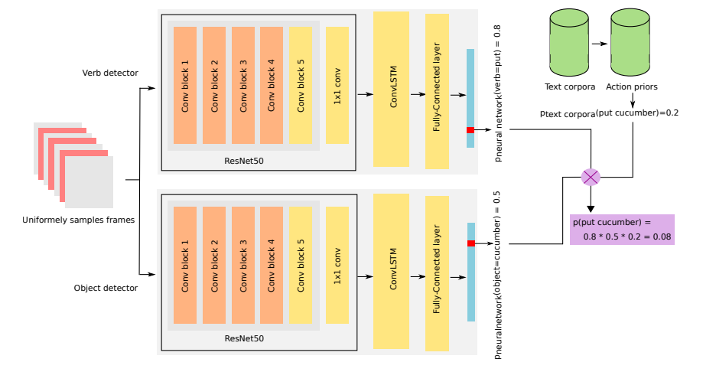
Architecture
Two separate neural networks, processed video inputs composed of ordered frames, with each frame represented as Fi ∈ R224x224x3.
The neural networks comprised of ResNet50 as CNN and ConvLSTM as RNN on top, and a single Fully-Connected (FC) layer as the classifier.
The networks output two probability distributions (verbs and objects) which are then combined with an action prior sampled from text corpora to infer the most probable action.
Limitations:
The choice of knowledge source is critical in improving the performance of the model.

Slide 11
Open-world egocentric action recognition with zero supervision
Sathyanarayanan N. Aakur∗, Sanjoy Kundu, Nikhil Gunti Department of Computer Science, Oklahoma State University, Stillwater, OK 74078, USA
This paper, presents one of the first works on open-world action recognition in egocentric video.
This paper formulates a novel approach that integrates commonsense knowledge and symbolic reasoning with the representation learning capabilities of deep neural networks to overcome the dependence on annotated training data.
This approach generalizes well across domains without any supervision, including access to target domain data. This is a key difference between this approach and other models (including ZSL approaches), which have access to the target domain data for other known classes and are only expected to learn correspondences for a small number of “unseen” classes.
This approach uses a general-purpose knowledge base that is not specifically tailored for the specific domain and has no learned correspondence in the target domain.
This model employs the concept Net as the source of graph-based commonsense Knowledge.

Slide 12
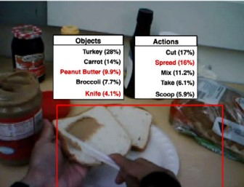
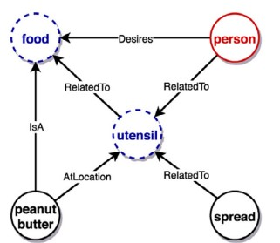
The model was able to arrive at the correct interpretation even when the target noun and verb were not the top-1 prediction.
The label peanut butter was not in the top-5 labels for the noun initially. Still, the inference process considered it as a possible object based on the presence of the verb spread and helped arrive at the
the final interpretation, which captures the semantics of the scene beyond semantic correspondences between nouns.
The limitation of this model is its dependancy on an external knowledge based which is not available locally and has to be accesed through web increasing response time and lack of full control on model.

Slide 13

Incorporating Visual Grounding in GCN for Zero-Shot Learning of Human Object Interaction Actions
Chinmaya Devaraj, Cornelia Fermuller, and Yiannis Aloimonos, University of Maryland
Introduction to the problem of zero-shot learning in human object interaction actions.
Proposed method to visually ground the language graph using the visual adjacency matrix.
Addresses the limitation of using only the language graph in zero-shot learning, ignoring the semantics of the visual graph.
Tested on the EPIC-Kitchens-55 dataset and the Charades dataset.
The method outperforms the state-of-the-art methods on both datasets.

Slide 14
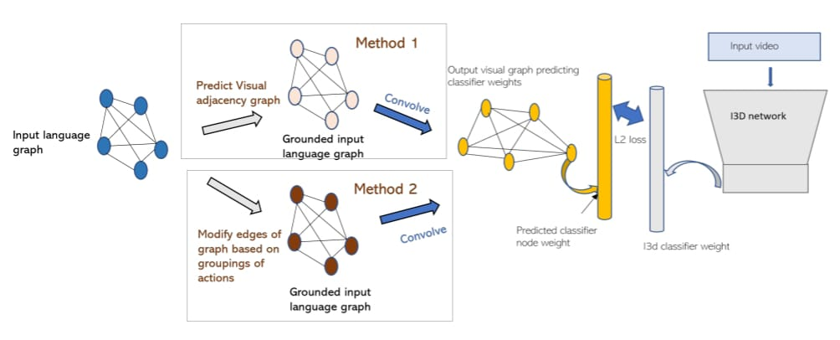
#Architecture:
- The network consists of:
1. An input language graph on the left, representing all the actions in form of language vector embeddings.
2. A vision graph, on the right, whose nodes are the embeddings of actions from the visual domain.
-The language graph nodes are initialized with the GloVe word embeddings.
-The weights on the edges originally are the cosine similarity distances between the GloVe vectors.
#Limitations:
-Reliance on the availability of a knowledge graph.
-Lack of generality.
-Training the transformer function F is hard and depends on accuracy of adjacency matrices.

Slide 15
Proposal to improve ZSL based on literature reviews.
The intuition is to make ZSL more knowledge driven by improving and expanding the knowledge base.
We could use a common sense knowledge graph for knowledge base giving the model a sense of reasoning. But the hurdle is to create a good enough locally available knowledge graph, and adding more layers to process the result from the graph.
We could use more than one external knowledge base to increase the knowledge of our model but the problem will be processing these external knowledge.

Slide 16

THANK YOU

