Slide 1

EARTH DAY · APRIL 22, 2026 · SAN FRANCISCO + GLOBAL LIVESTREAM
Unplugging Skynet for Earth Day.
Local AI. From Personal to Planetary.
globallocal.ai
Notes:
SLIDE 1 — TITLE · Hold while people settle. ~30 seconds silence is fine. SPOKEN: Say nothing. Let the image and tagline do the work. Walk to centre stage. Take a breath. Then open with one line: "Get your head out of the cloud." Pause. Look at the room. Then move to slide 2.

Slide 2
THE HOOK · 0:00 – 1:30
GET YOUR HEAD
OUT OF THE CLOUD.
I mean that literally. Not metaphorically. Literally.
globallocalai.org
2 / 12
Notes:
SLIDE 2 — THE HOOK · Target: 90 seconds SPOKEN: "Get your head out of the cloud." [PAUSE. Hold eye contact. Let it land.] "I mean that literally. Not metaphorically. Literally. Your AI — the one in your pocket, in your browser, in your workflow right now — is running in a server farm the size of several city blocks. Burning through enough electricity to power a small nation. Cooled by billions of gallons of water. Owned by five companies. And none of that was your choice." [Move to next slide — let the data centre image hit.]

Slide 3
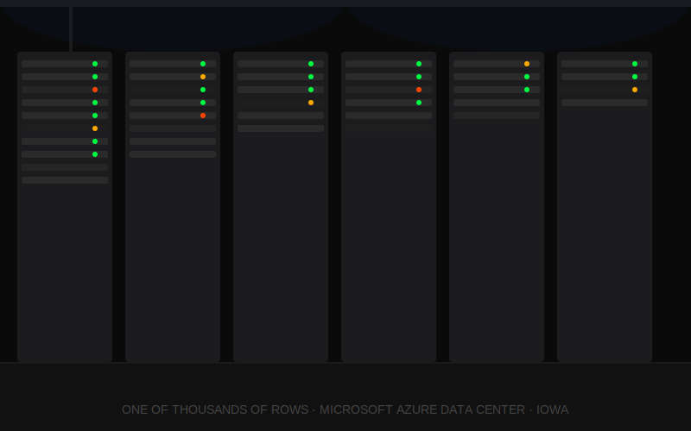
THE COST · INVISIBLE INFRASTRUCTURE
183 TWh
US data center electricity · 2024
= Pakistan's entire annual demand
17B gallons
water for cooling · US 2023
Doubling by 2030. IEA 2025.
globallocalai.org
3 / 12
Notes:
SLIDE 3 — THE COST · Target: still within first 90 seconds SPOKEN: "This is what powers your AI query. Not a metaphor. A physical place. Real racks. Real electricity. Real water. 183 terawatt-hours of electricity consumed by US data centers in 2024 — equal to Pakistan's entire annual demand. 17 billion gallons of water to cool them. And it doubles by 2030. Before agentic AI even arrives at scale. Most people using AI every day have no idea this is happening. The cloud is invisible. The cost is real." [Let the image sit. Then move on.]

Slide 4
ORIGIN STORY · 1:30 – 3:00
Where does
your AI live?
The moment I couldn't unsee it.
globallocalai.org
4 / 12
Notes:
SLIDE 4 — ORIGIN STORY · Target: 90 seconds. ONE moment only. SPOKEN — use your real founding moment here. Template: "I was [doing X] and I stopped and thought: where is this going? Who's reading this? Who owns this answer? And I realised I had no idea. None. I was trusting the most intimate layer of my thinking — my curiosity, my questions, my doubts — to a corporation whose business model I'd never examined. That was the moment GLAM started. Not a business plan. Not a deck. A question I couldn't answer about my own data. So I decided to build something different." TIMING TIP: Keep this to 60–90 seconds max. One moment. Not your CV. Then pivot to the Three Ps.

Slide 5
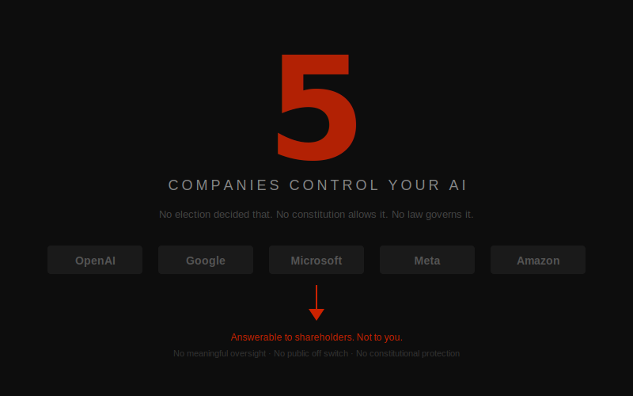
P1 · POWER · 3:00 – 4:00
globallocalai.org
5 / 12
Notes:
SLIDE 5 — P1: POWER · Target: 45 seconds. Fast and punchy. SPOKEN: "Five companies. Five. Control the most consequential decision-making systems ever built. No election decided that. No constitution allows it. No law governs it. Five companies decide what AI can say. What it won't say. Who gets access and who gets cut off. They are answerable to shareholders. Not to constitutions. Not to common law. Not to you. That is a concentration of power with no historical precedent. And we handed it to them by signing up for a free account." [Move immediately to Privacy — keep the momentum.]

Slide 6
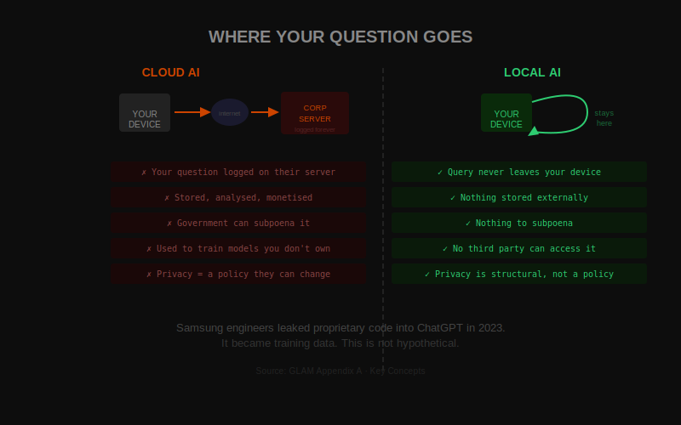
P2 · PRIVACY · 4:00 – 5:00
globallocalai.org
6 / 12
Notes:
SLIDE 6 — P2: PRIVACY · Target: 45 seconds. SPOKEN: "Everything you ask a cloud AI is logged. Stored. Analysed. Used. Your questions are a product. Your curiosity is a data point. Your health searches. Your family worries. Your business plans. Sitting on a server you've never seen, in a jurisdiction you didn't choose, owned by a company whose interests are not yours. In 2023, Samsung engineers pasted proprietary source code into ChatGPT. It became training data. That's not a hypothetical risk. It's a documented incident. Local AI changes this at the architecture level. Not a privacy setting. Not a policy document. The data never leaves your machine. Because there's nothing to leave to." [Move to Policy — the three Ps land as a trio.]

Slide 7
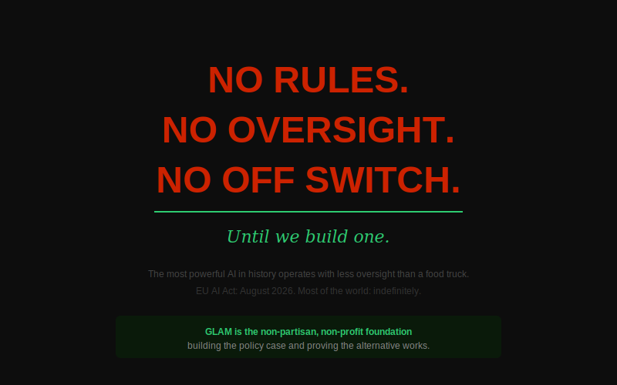
P3 · POLICY · 5:00 – 6:00
globallocalai.org
7 / 12
Notes:
SLIDE 7 — P3: POLICY · Target: 45 seconds. SPOKEN: "There are no rules. Right now, today, the most powerful AI systems in history operate with less regulatory oversight than a food truck. The EU AI Act kicks in August 2026. Until then — and in most of the world, indefinitely — there is no meaningful policy, no agency, no common law protection for what happens to your data, your decisions, your children's questions. GLAM is the non-partisan, non-profit foundation building that policy case — and proving the alternative works. We are not waiting for permission." [Brief pause. Then shift energy upward — the alternative is coming.]

Slide 8
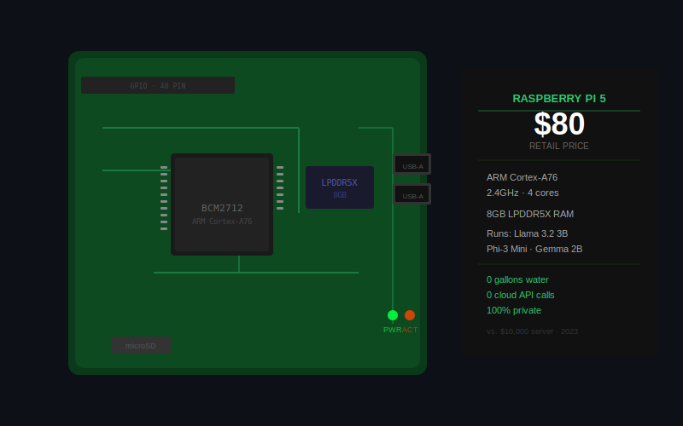
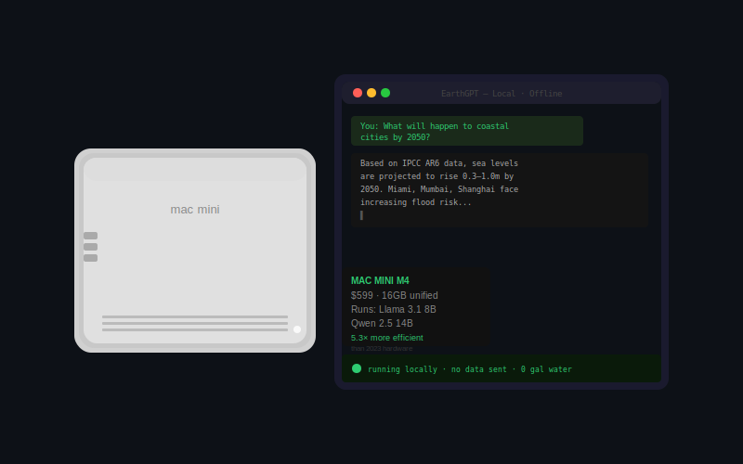
THE ALTERNATIVE · COMMODITY HARDWARE · 6:00 – 7:00
$80 Raspberry Pi · $599 Mac Mini · Running real LLMs · No cloud · No subscription · Zero water footprint
globallocalai.org
8 / 12
Notes:
SLIDE 8 — COMMODITY HARDWARE · Target: 60 seconds. SPOKEN: "Here is what most people in this room don't know yet. You don't need the cloud. You don't need a supercomputer. You don't need a server rack. You need a laptop. A mini PC. An $80 Raspberry Pi. The models that required a ten thousand dollar server in 2023 run on a six hundred dollar Mac Mini today. Intelligence-per-watt on local hardware improved 5.3 times in two years. That curve is accelerating. This is your AI infrastructure. It fits on your desk. It costs less than a phone. And it answers real questions — right now, offline — from IPCC climate reports, NASA data, whatever you feed it. Nothing leaves the machine. Ever." [Let the image pair breathe. Then move to the evidence slide.]

Slide 9
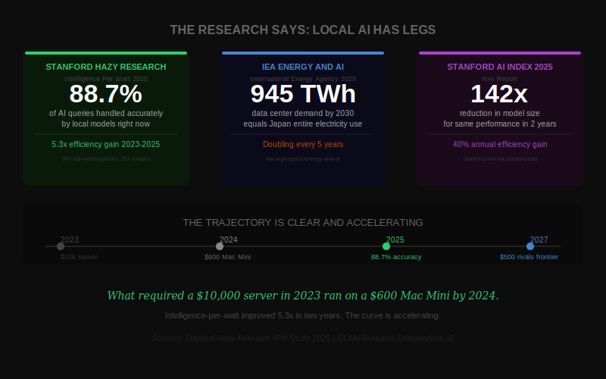
THE EVIDENCE · RESEARCH · 7:00 – 8:00
globallocalai.org
9 / 12
Notes:
SLIDE 9 — THE EVIDENCE · Target: 60 seconds. Reference studies, don't read them. SPOKEN: "And this isn't just our claim. The research backs it. Stanford's Hazy Research Lab studied over a million real-world queries across 20+ local models. Result: 88.7% of everyday AI queries can be handled accurately by local models right now. Today. On the hardware in this room. The IEA — the International Energy Agency — projects data center electricity demand will hit 945 terawatt-hours by 2030. That's Japan's entire electricity consumption. Driven almost entirely by AI. Stanford's AI Index found a 142-times reduction in the model size needed for the same AI performance — in just two years. The trend is clear. Local AI is not a future promise. It is a present capability. And the efficiency curve is only going one direction." [Move to the water slide or demo — whichever you have running.]

Slide 10
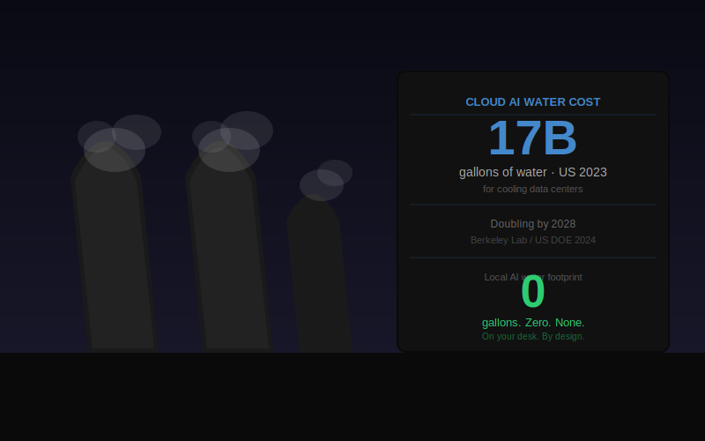
ENVIRONMENTAL · THE WATER COST · 8:00 – 9:00
globallocalai.org
10 / 12
Notes:
SLIDE 10 — WATER / ENVIRONMENT · Target: 45 seconds. Tight and pointed. SPOKEN: "And then there's the water. 17 billion gallons. Used to cool US data centers in 2023. Not for computation. For cooling. Doubling by 2028. The communities living closest to these facilities — often the least wealthy, least responsible for emissions — bear the environmental cost of the world's AI queries. Local AI eliminates that footprint at the source. No cooling towers. No transmission losses. No hidden water bill paid by someone else's community. Zero gallons. On your desk. By design." [Move to the demo / movement slide.]

Slide 11
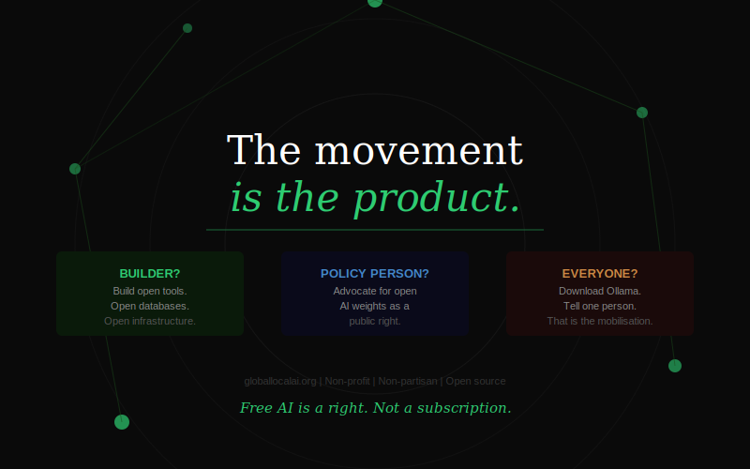
THE LAUNCH · MOBILISATION · 9:00 – 10:30
globallocalai.org
11 / 12
Notes:
SLIDE 11 — THE MOVEMENT · Target: 90 seconds. This is the mobilisation moment. SPOKEN: "GLAM — Global Local AI Mobilization — is not a startup. We are not raising a Series A. We are not building an app to sell you. We are a non-profit, non-partisan foundation. And tonight is the first chapter. The movement is the product. Every developer who builds a local tool makes the next one easier. Every community that adopts local AI makes the policy case more visible. Every person in this room who downloads Ollama tonight is one more node in a distributed network that nobody can switch off. [Point to the three boxes:] If you're a builder — we need open tools. If you're a policy person — we need your voice. If you're none of those — download Ollama. Tell one person. That's the mobilisation. Free AI is a right. Not a subscription." DEMO MOMENT — if transcription is running, point to screen NOW: "And this has been running since I walked on stage. Every word I said is on that screen. Nothing left this room. Not one word." [Let that land. Then move to handoff.]

Slide 12
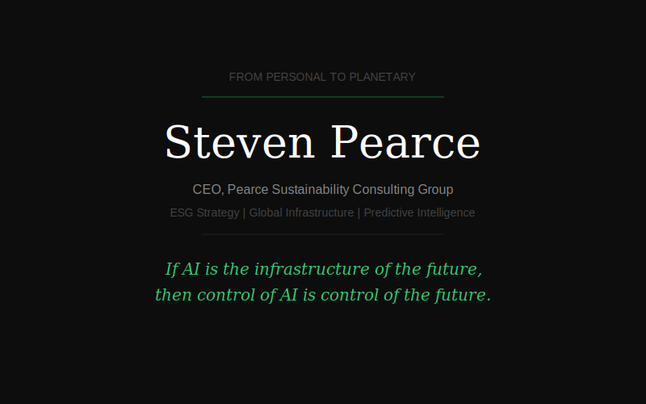
HANDOFF · 10:30 – 11:00
globallocalai.org
12 / 12
Notes:
SLIDE 12 — HANDOFF TO STEVEN · Target: 30 seconds. Warm, credible, then get off stage. SPOKEN: "I've shown you the personal case. Why this matters to you — on your device, in your hands, right now. What I want you to hear next is why it matters at planetary scale. Economically. Environmentally. Structurally. Steven Pearce has spent his career at the intersection of ESG, sustainability strategy, and global infrastructure. He sees something in local AI that I think will reframe how every person in this room thinks about the next decade. Steven —" [Step back. Clear the stage. Walk to the side. Do not linger.] TIMING REMINDER: — If you are past 10:30 at this point, cut the water slide (slide 10) and jump here. — Steven needs his full time. Your job is done. Hand the room charged up.

