Slide 1
Low Light Image Enhancement - Zero-DCE Improvements
Imrose Batterywala (314540010)
Mohammed Shahzeb (314540021)

Slide 2
Introduction - Problem & Limitations
Problem
  Low-light image enhancement is essential for visibility, perception, and downstream tasks.
Limitations
Extreme Low Light 33% of pixels remain below darkness threshold (0.2) Hard cases maintain >90% dark pixel fraction | Uneven Illumination Inconsistent enhancement across regions Harsh contrast that hides fine details
Overexposure Loss of highlight details Bright pixel fraction near zero (~2.4e-5) | Limited Aesthetic Improvement NIMA score improves only marginally (+0.06) Minimal perceptual quality gain

Slide 3
Proposed Methodology – Key Improvements
Hybrid Exposure Fusion Mix Zero-DCE output with synthetic exposure brackets Lift shadows without killing highlights | Texture-Aware Lighting Maps Gradient-respecting kernels Brighten dark regions without harsh contrast
Bright/Dark Balance Loss Dual-histogram regularization Boost highlights, reduce deep shadows | Perceptual Co-training NIMA/NIQE-based losses Enhance visibility and aesthetic realism

Slide 4
Data and Resources
Dataset
  DICM (69 images)
  LIME (10 images)
  Additional extreme low light dataset
Resources
  GPU for model training
  Python libraries and frameworks for implementation

Slide 5
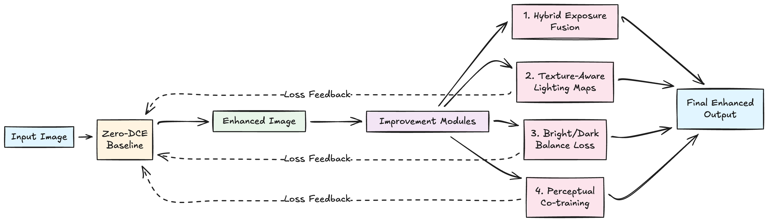
Approach - Architecture

Slide 6
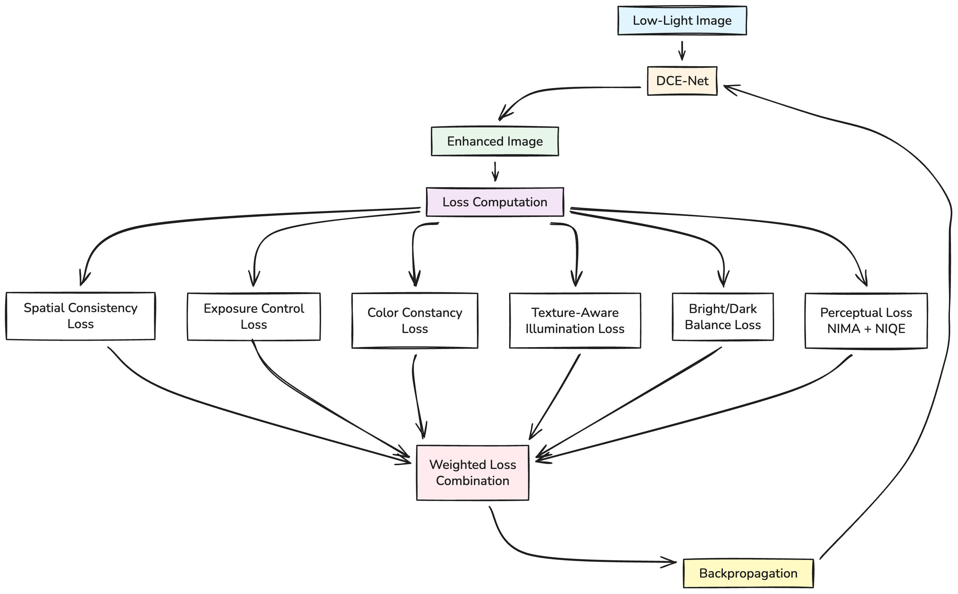
Training Architecture

Slide 7
Steps Involved (I)
Hybrid Exposure Fusion Generate synthetic exposure brackets (−2EV, −1EV, 0EV, +1EV, +2EV) Apply multi-scale exposure fusion Blend with Zero-DCE using adaptive luminance-based weights Preserve Zero-DCE detail while restoring highlight structure Benefits Bright pixel fraction improvement Better highlight preservation Reduced overexposure artifacts | Texture-Aware Lighting Maps Compute gradient-magnitude maps Use gradient-respecting smoothing kernels Modify illumination-smoothness loss accordingly Benefits Reduced harsh contrast jumps Better preservation of fine textures

Slide 8
Steps Involved (II)
Bright/Dark Balance Loss Compute dual histograms: dark <0.2, bright >0.9 Dark-pixel reduction loss Bright-pixel promotion loss Adaptive weighting based on image characteristics Benefits Dark pixel fraction reduction Bright pixel fraction gain Balanced global exposure | Perceptual Co-Training Add differentiable NIMA↑ (aesthetics) and NIQE↓ (naturalness) losses Jointly optimize with existing spatial/exposure/color losses Fine-tune pre-trained Zero-DCE Benefits NIMA score improment More natural-looking results Stronger subjective and perceptual quality

Slide 9
Expected Results
Quantitative Improvements
Reduce Dark Pixel Fraction: 0.316 (current)
Increase Bright Pixel Fraction: 2.4e-5 (current)
Improve NIMA Score: 4.06 (current)
Patch Contrast: Aim to maintain ~0.080 while reducing artifacts
Qualitative Improvements
Better visibility in extremely dark regions
More natural highlight representation
Reduced overexposure artifacts
Improved overall aesthetic quality

Slide 10
Method Exploration – Related Works
Zero-LEINR (ISCAS 2023) Intrinsic noise reduction Maintains zero-reference property | FourLLIE (ArXiv 2023) Fourier frequency domain approach Effective lightness improvement
BEENet (ICFTIC 2024) Balanced enhancement for uneven exposure Handles over/under-exposure simultaneously | ALEN (ArXiv 2024) Dual approach for uniform/non-uniform lighting Adaptive classification mechanism
Residual Quotient Learning (IEEE TIP 2025) Improved feature representation Maintains zero-reference training | Diffusion-Based (ArXiv 2023) State-of-the-art quality Computationally expensive

Slide 11
Comparative Analysis
Method | Zero-Ref | Extreme Low-Light | Uneven Illum. | Overexposure | Efficiency | Aesthetic
Zero-DCE | Low | - | - | - | High | -
Zero-LEINR | Low | - | - | - | Medium | -
BEENet | - | - | Low | Low | Medium | Low
Residual Quotient Learning (RQL) | Low | Low | Low | - | Medium | Low
FourLLIE | - | Low | - | - | Low | Low
ALEN | - | Low | Low | - | Medium | Medium
Diffusion-Based LLIE | - | High | Medium | Medium | - | High

Slide 12
Current Methodologies
Zero-LEINR (ISCAS 2023) Unified framework: intrinsic noise reduction integrated in enhancement Single-pass processing, maintains zero-reference | FourLLIE (ArXiv 2023) Fourier frequency domain processing Amplitude transform maps, frequency-spatial integration
BEENet (ICFTIC 2024) Balanced enhancement network for uneven exposure Simultaneous over/under-exposure handling | ALEN (ArXiv 2024) Classification mechanism: uniform vs. non-uniform lighting Dual approach with estimator networks
Residual Quotient Learning (IEEE TIP 2025) Novel residual quotient learning framework Improved feature extraction, zero-reference training | Diffusion-Based (ArXiv 2023) Diffusion framework with global structure-aware regularization High quality, computationally expensive

Slide 13
Existing Methods vs Our Approach
Method | Their Approach | Our Approach
Zero-LEINR | Unified noise reduction; efficient single-pass; limited handling of extreme low-light, overexposure, uneven illumination | Broader failure-mode coverage; noise handled implicitly
FourLLIE | Frequency-based enhancement; good detail preservation; complex FFT pipeline; weak overexposure handling | Simpler curve-based design; higher efficiency
BEENet | Balanced enhancement for uneven illumination; not zero-reference; weaker in extreme low-light | Zero-reference while achieving exposure balance
ALEN | Adaptive uniform/non-uniform lighting classification; requires extra classification network; not always zero-reference | Adaptability through loss design; simpler architecture
Residual Quotient Learning | Strong feature extraction; zero-reference; complex architecture; limited discussion of failure cases | Directly targets specific failure modes; complementary
Diffusion-Based | High image quality and detail retention; computationally heavy; slow inference; needs training data | Efficient structure-aware approach; real-time capable

Slide 14
References (I)
[1] C. Guo et al., “Zero-Reference Deep Curve Estimation for Low-Light Image Enhancement,” arXiv.org, Mar. 22, 2020
[2] K. Ang, W. T. Lim, Y. P. Loh and S. Ong, "Noise-aware Zero-Reference Low-light Image Enhancement for Object Detection," 2022 International Symposium on Intelligent Signal Processing and Communication Systems (ISPACS), Penang, Malaysia, 2022
[3] W. H. Tang, H. Yuan, T. -H. Chiang and C. -C. Huang, "Zero-LEINR: Zero-Reference Low-light Image Enhancement with Intrinsic Noise Reduction," 2023 IEEE International Symposium on Circuits and Systems (ISCAS), Monterey, CA, USA, 2023
[4] J. Zhang, Y. Zhou, E. Zhu and J. Sun, "BEENet: A Balanced Enhancement Network for Uneven Exposure Low-Light Image Enhancement," 2024 6th International Conference on Frontier Technologies of Information and Computer (ICFTIC), Qingdao, China, 2024
[5] C. Xie et al., "Residual Quotient Learning for Zero-Reference Low-Light Image Enhancement," in IEEE Transactions on Image Processing, vol. 34, pp. 365-378, 2025
[6] C. Wang, H. Wu, and Z. Jin, “FourLLIE: Boosting Low-Light Image Enhancement by Fourier Frequency Information,” arXiv.org, 2023.‌
[7] E. Perez-Zarate, O. Ramos-Soto, C. Liu, D. Oliva, and M. Perez-Cisneros, “ALEN: a dual-approach for uniform and non-uniform low-light image enhancement,” Multimedia Systems, vol. 31, no. 4, May 2025
[8] J. Hou, Z. Zhu, J. Hou, H. Liu, H. Zeng, and H. Yuan, “Global Structure-Aware Diffusion Process for Low-Light Image Enhancement,” arXiv.org, 2023

Slide 15
References (II)
https://github.com/Li-Chongyi/Zero-DCE
https://li-chongyi.github.io/Proj_Zero-DCE.html

