Slide 1
Handling Remote Access:
RADIUS
Remote Authentication Dial In User Service
Recommended reading:
RADIUS is standardized in RFC 2865, June 2000
Radius (poor!) security analyzed in Joshua Hill, “An analysis of the RADIUS Authentication Protocol”

Slide 2
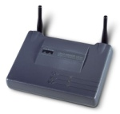


Motivation
Managing large-scale networks: a nightmare
  Multiple NAS, multiple access services
  Not only authentication, but also service-specific configuration assignment
Best achieved by managing single user "database"
User+passwd login
Internet Service Provider
NAS
PPP

Slide 3
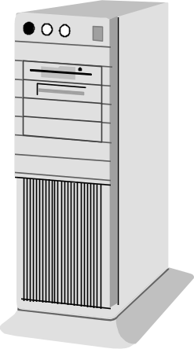
RADIUS: where?
User sends authentication attributes to NAS: no RADIUS here
NAS wraps them into Access-Request → to RADIUS Server
RADIUS Server response: OK, NO, Challenge (for some AUTH)
NAS notify user: no RADIUS here
RADIUS
server
RADIUS
Access-Request
ISP
RADIUS
Response
3
2
RADIUS
client
NAS
PPP, 802, etc
1
PPP
4

Slide 4
RADIUS: AAA protocol
Provides centralized AAA functionalities
  Authentication
    are you really the one you claim to be?
  Authorization
    Do you have permissions to access a service?
  Accounting
    what are you currently doing/using/paying?
      Transmitted bytes, billing, etc

Slide 5
RADIUS: client-server protocol
Radius client: the NAS!!
  Don’t confuse it with the end user!!
Client-Server protocol
  Based on UDP/IP
  Server port 1812 (client port ephemeral, as usual in C/S)
(Logically) centralized
  1 primary server (0+ secondary servers - replicated)
    Management of replicated servers → implementation dependent
  Server may in turns act as a proxy

Slide 6
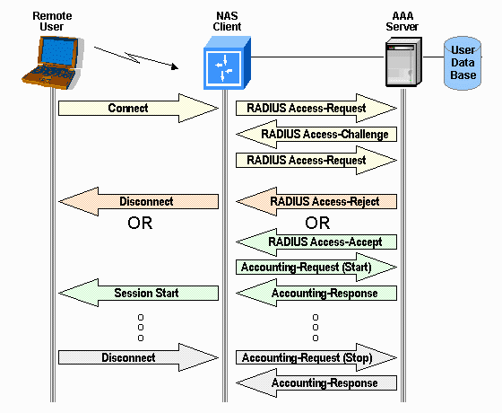
Message exchange (example)
If needed

Slide 7
Proxy Operation
RADIUS
server
May be transparent or not transparent
(e.g. change response to fit with local policies)
remote
RADIUS
server
(or other AAA e.g. Cisco TACACS+)
ISP
Frequently from
different ISP:
Typical Proxy
usage is
roaming

Slide 8
RADIUS architecture
RADIUS Server application
Registered User Database
  For each entry (user_name), contains (at least):
    Authentication information (secrets)
    Authentication Method
    Authorization attributes (access profile per each user)
Client database
  Clients which are entitled to communicate with the server
  BE CAREFUL: DO NOT confuse (radius) clients with (end) users
Accounting Database
  When radius used for accounting
    Frequently used only for authentication

Slide 9


RADIUS Security features
Per-packet authenticated reply
  Shared-secret based
  No transmission of secrets (CHAP-like, more later)
  but…
    Only reply is authenticated…
    Hash-based, not HMAC-based…
    Very specific hash function, MD5
    Often low-entropy shared key..
Encrypted user password transmission
  Custom mechanism
  Same shared key used for authentication!!

Slide 10

RADIUS authenticated reply: concept
ID, AUTH
(random)
End User credentials
End User credentials
Y/N
ID, H(ID, AUTH, replymsg, S)
Replymsg
Y/N/go-on
Shared
Secret S
=?
Shared
secret
S
ID → AUTH
H[…]
Sort of challenge-response:
challenge is the request authenticator
response also includes (hence validates) reply message

Slide 11
packet format
Code (dec) | Packet
1 | Access-Request
2 | Access-Accept
3 | Access-Reject
4 | Accounting-Request
5 | Accounting-Response
11 | Access-Challenge
Code: type of radius packet
Identifier: match requests with responses
  IP src and UDP src also help matching
Length
  minimum 20, maximum 4096
Authenticator:
  used to authenticate reply from server
  Used also as nonce for password encryption
Attributes: extensible information field
  Turned out not being extensible
  enough with “only” 256 types…
………
type
len
value
type
len
value
code
1 byte
identifier
1 byte
length
2 byte
authenticator
16 byte
attributes
***
IP header
UDP header
RADIUS PACKET

Slide 12
Authentication field
In Access-Request (C→S)
  16 randomly generated bytes
    unpredictable and unique (over the lifetime of shared C/S secret)
      To avoid replay attack
In response packets (S→C Accept/Reject/Challenge)
  One-way MD5 (!!) hash of
    the request ID
    the request authenticator,
    the shared secret,
    the packet response information
      Response packet is signed! Otherwise spoofed server’s reply possible!
  Specifically:
  MD5(Code | ID | Length | RequestAuth | Attributes | Secret)

Slide 13
Attributes (at a glance)
1 User-Name
2 User-Password
3 CHAP-Password
4 NAS-IP-Address
5 NAS-Port
6 Service-Type
7 Framed-Protocol
8 Framed-IP-Address
9 Framed-IP-Netmask
10 Framed-Routing
11 Filter-Id
12 Framed-MTU
13 Framed-Compression
14-16 (for Login service)
17 (unassigned)
18 Reply-Message
19 Callback-Number
20 Callback-Id
21 (unassigned)
22 Framed-Route
23 Framed-IPX-Network
24 State
25 Class
26 Vendor-Specific
27 Session-Timeout
28 Idle-Timeout
29 Termination-Action
30 Called-Station-Id
31 Calling-Station-Id
32 NAS-Identifier
33 Proxy-State
34-36 (for LAT)
37-39 (for AppleTalk)
40-59 (res. for accounting)
60 CHAP-Challenge
61 NAS-Port-Type
62 Port-Limit
63 Login-LAT-Port
Information and configuration details
  in request and/or reply (accept/reject/challenge) packets
Any number of attributes in a packet
  Length field → end of attributes payload
Order of attributes does NOT matter
Some attributes may appear more than once
  effect is attribute-specific (here order may matter!)
Up to 2⁸ attributes (1 byte type field):
  Type 0: reserved
  Type 1-191: IANA (public) assigned/assignable
  Type 192-240: for private use
    Type 192-223: experimental
    Type 224-240: implementation-specific
  Type 241-255: reserved
Extensible Protocol
  New attribute values can be added without disturbing existing implementations

Slide 14
Access-Request
Typically contains:
  Who is the user
    User-Name
      Mandatory: search key to access the user database
  Password
    User-Password
    CHAP-password (when CHAP employed)
  An identifier of the RADIUS client
    NAS-IP or NAS-identifier
      user might access only a subset of NAS
  An identifier of the port the user is accessing
    NAS-Port (if the NAS has ports)
      Wi-Fi: Logical association
      Dial Up: physical (modem) port# receiving the user call
    User might be restricted to access only specific ports

Slide 15
Password encryption
Native User-Password
u
g
o
Step 1: padding to 16 bytes
u
g
o
Step 2: generate a 16 bytes hash
using key and the content of the
authenticator field of the request
MD5(secret | RequestAuth)
u
g
o
Step 3: XOR padded passwd & hash
MD5(secret | RequestAuth)
If passwd longer than 16 characters:
Step 4: compute MD5(secret | result of previous XOR) and
Step 5: XOR with next segment of the passwd

Slide 16
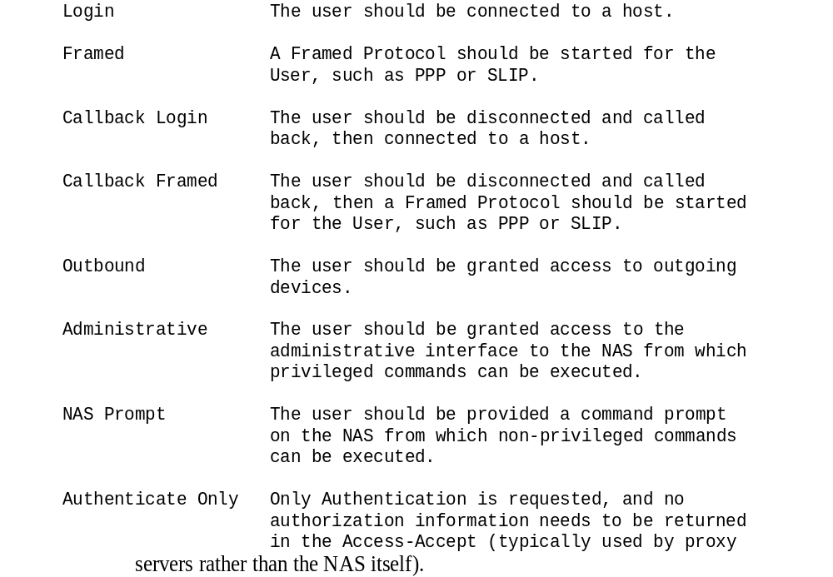
Access-Accept
Positive server response
  User authentication credentials OK
Contains all the service-specific configuration
  Including the Service-Type attribute
  Complemented with other service-related configuration parameters
    E.g. IP address, mask, etc
Possible values of the Service-Type option

Slide 17
Access-Reject
Two main reasons:
  Authentication failed
  1+ attributes in the request were not considered acceptable (authorization failed)

Slide 18
Access-Challenge
Used whenever the server wants/needs the user to send a further response
  E.g. a challenge/response authentication mechanisms
    Not necessarily CHAP (see CHAP support later on)! Could be RADIUS support for GSM/UMTS authentication!
  E.g. prompting the user to enter a password
Challenge typically contains
  One or more reply-message attributes
      Which MAY be used in a very flexible manner
    May contain text to be prompted to the user
    May contain an explicit authentication challenge
NAS collects response from the user and sends a NEW Access-Request
  New ID
  New User-Password - contains the user response (crypted)
Based on this, server accepts or rejects or send another challenge

Slide 19
PPP CHAP support with RADIUS
CHAP challenge locally generated by NAS
  No need to know user password for this!
CHAP challenge + response sent to RADIUS server
  RADIUS server retrieves user password from database, computes and compares CHAP response
Chap Challenge
Chap Response
RADIUS Access Request
(User Name, CHAP password, CHAP Challenge,
Service :Framed PPP , …)
RADIUS Access Accept
(Service : Framed PPP, …)
Verify
Chap Success
CHAP
RADIUS
PPP
UDP/IP
PPP
User
NAS
RADIUS
SERVER

Slide 20
RADIUS Security Weaknesses
Recommended reading: Joshua Hill, “An analysis of the RADIUS Authentication Protocol”

Slide 21
Vulnerable to message sniffing and modification
Clear-text protocol → privacy issues
  User-Name, Calling-Station-ID, NAS identification, location attributes sent in the clear
Access-Request not authenticated
  Access requests may be forged/modified (MITM)
  Solution:
    Message-Authenticator attribute
    Mandatorily used with EAP (only, though)

Slide 22
Extension:
Message-Authenticator
Message signature
  Primarily for Access-Request messages
    Since they are not authenticated
    Of course can be used also in Reject/Accept/Challenge packets
  MUST be used when EAP used with RADIUS (RFC 2869)
    May (of course) be used with other authentication methods
Usual attribute syntax
  Authenticator =
  HMAC-MD5(whole packet) =
  HMAC-MD5(type | ID | len | RequestAuth | attributes)
  In computation, Authenticator = 0000.0000.0000.0000
  Shared secret used as key for the HMAC-MD5 hash
Type=80
Len=18
Authenticator (16 bytes)

Slide 23

Dictionary attack to shared secret
Usually low-entropy shared secret
    Many implementations only allow ASCII shared-secrets
And often a single one is used for the entire network!!
  Fun story: Fonera hack! http://stefans.datenbruch.de/lafonera/
  Lesson: use one shared secret per each client (look up using client IP address)
Many hooks for offline dictionary attack:
  Intercept any request-response pair
    Request gives you random ReqAuth
    RespAuth = MD5(Code | ID | Length | ReqAuth | Attributes | Secret)
      Secret placed at the end: MD5 state pre-computation makes attack easier!
  Not even need to get a pair, just a request with user passwd suffices!
    Horrible idea: reuse same secret also for password encryption!!
NAS
RADIUS server
Arbitrary User-ID
Access-Request
Arbitrary Password (< 16 bytes)
User-Password attribute (16 bytes)
Request Authenticator (16 bytes)
XOR (password)
MD5(secret, RequestAuth)

Slide 24
Attacking the password of a user
FIRST STEP: as previous case, but with valid user ID:
RADIUS server
NAS
Victim User-ID
Access-Request
Arbitrary Password (< 16 bytes)
User-Password attribute (16 bytes)
XOR (password)
MD5(secret, RequestAuth)
SECOND STEP: Attacker now able to “encrypt” the user password!! May exploit:
1) lack of upper limit on authentication rate at server-side (limits imposed on clients are by-passed)
2) RADIUS servers typically do not check for authenticator reuse
Works only with 16 or less byte passwords (most cases)
Spoofed Access-Request, with:
New-passwords XOR MD5(secret, RequestAuth)

Slide 25
poor PRNG implementations
Security of radius:
  Requires uniqueness of the Request Authenticator
    Must be a nonce!
Some implementations:
  poor Pseudo-Random Number Generators (PRNGs)
    Often non-crypto generators: horrible!!
    Short cycles, predictability, …
THREE checks (when facing a weak PRNG)
  what is the «cycle»?
  What about predictability?
    E.g. LCG, if you know one value you know all!!
  unique or repeated values?
    Mersenne Twister: 2¹⁹⁹³⁷-1 cycle, but values repeat

Slide 26
Poor PRNG, a note
Assume PRNG cycle = 2^N
  At best only 2^N different values!
  Birthday attack: ½ prob with approx 2^{N/2}
  N=16 → birthday attack with o(250) packets!
  C drand48 → birthday attack with o(16M) packets
    (not really a lot!)
Terrific (?) implementation idea:
  Start from 32 bit random number
  Generate 128 bit authenticator by appending 4 subsequent 32 bit random numbers
  Cycle: reduced to 30 bits!!
    Birthday attack: o(32000) packets!

Slide 27

poor PRNG implementations
Replay Attacks
authenticate/authorize an illegal user with no valid password
NAS
Valid users
Access-Request (Request authenticator)
Access-Accept (Response authenticator)
Dictionary of ReqAuth/RespAuth
Access-Request (ReqAuth in dictionary)
Access-Accept (corresponding RespAuth)

Slide 28
poor PRNG implementations
Attack to Customer passwords /1
Passively monitor the network traffic allows to build a dictionary of Request Authenticators
and the associated (protected) User-Password attributes
NAS
Valid users
Access-Request (Request authenticator)
Dictionary of ReqAuth/User-Password
Repeated Request Authenticator observed
XOR previous user-password with new user-password
  From different users
Result: since ReqAuth is the same
  (user-password #1) XOR (user-Password #2) =
  = [pw_user1 XOR MD5(secret,ReqAuth)] XOR [ps_user2 XOR MD5(secret,ReqAuth)] =
  = pw_user1 XOR pw_user2
BUT passwords from different users differ in length:
  last characters of longer password are put in clear!!
  Password sizes are known!!
  Low-entropy passwords help disclosing them!

Slide 29
poor PRNG implementations
Attack to Customer passwords /2
ACTIVELY submit passwords chosen by attacker to add known passwords to the
dictionary of Request Authenticators and the associated (protected) User-Password attributes
NAS
Arbitrary pw
Access-Request (Request authenticator)
Dictionary of ReqAuth/User-Password
No need to guess right!!
Dictionary built using rejected attempts!

Slide 30
Lessons learned from RADIUS
Do-it-all-in-one does not pay off
AAA protocols should NOT implement their own security mechanisms
    carefully structured attacks break down RADIUS “simple” (?) approaches
    And MD5 broken in 2005 (Wang and Yu)
      MD5 hard to upgrade in radius (requires complete change)
Current trend: rely on an underlying security layer
    RADSEC = Radius over TLS; RADIUS over IPsec
    DIAMETER approach: mandatory usage of IPsec
    Easy to say, much harder to deploy (complexity, cost, extra processing)

Slide 31
AAA evolution: beyond RADIUS

Slide 32
RADIUS today
Radius initially deployed to mainly support dial-in PPP users and terminal login users
Today, RADIUS = de-facto standard for AAA
  Universal support from device vendors
But severe functional limits
  Scalability: today much larger customer base “size”
    From a few thousands of users, as in first ISPs
    To several M users as in cellular operators and national-level ISPs
  Extensibility:
    new technologies
      Wireless, DSL, 3G/4G/5G, Ethernet, …
    many more service scenarios
      Mobile-IP, roaming, carrier-grade accounting, etc
      new authentication mechanisms
  Interoperability: lot left unspecified, and dealt with in proprietarily
    E.g. failover, load balancing, server selection, etc

Slide 33
A note on scalability
48 port NAS
In average 1 request every 25 sec
Average session
time = 20 minutes
What if 10.000 of such NAS?
  400 access-requests/second
    3.2 mbps server load if request averages 1KB
  Add 400 account-requests/second
  Add delivery of accounting records
Some RADIUS implementations may be unable to manage all this load with no packet loss!
Finally, add load peaks
  when NAS reboots (e.g. after power failure)
    Many accounting records back-to-back
    Remote users log-in simultaneously
Conclusion: AAA servers (and their networks) may experience CONGESTION!!
As well as packet drop!!

Slide 34
IETF standardization
Diameter
  Started on dec 1998
  Now completed, activities moved to DiME (Diameter Maintenance and Extensions WG)
    First WG email on jan 2006
    Planned actions: support of MIPv6; QoS; AAA in IP telephony (SIP) and in Local Area Networks (VLAN)
RADext
  Started on august 2003
  RADIUS extensions with mandatory backward compatibility
    Planned actions: AAA in IP telephony (SIP) and in Local Area Networks (VLAN), pre-paid support
  No transport (still UDP) and Security enhancements
RADIUS/Diameter compatibility
  Goal of both WGs!!

Slide 35
Why “duplicating” the work?
RADIUS:
  Massive work on RADIUS deployment
    De-Facto standard, heavily integrated in business/ISP domains
  Limitations can be circumvented with “small” ad-hoc extensions
Diameter:
  Brand new protocol
    Though somehow backward compatible, neverteless it changes lots of basics
      Transport, Packet format, philosophy, …
  Much more powerful
    but also muuuuch more complex
  Perfect choice in new (emerging) scenarios
    Most notably 3G mobility world
Uncertainty on what will be THE future AAA protocol, and IF there will be ONE dominant protocol: keep both!

Slide 36
Diameter: whole picture
DIAMETER applications
(inherit base protocol and extend/customize it for specific purposes)
AAA Transport Profile (SCTP/TCP-based) – RFC 3539
DIAMETER
Base protocol
RFC 3588
Diameter
Mobile IPv4 app
RFC 4004
Diameter
NAS app
RFC 4005
Diameter
Credit ctrl app
RFC 4006
Diameter
EAP app
RFC 4072
Diameter
SIP app
in RFC queue
A very complex specification! Indeed, DIAMETER = 2 x RADIUS ☺
We will NOT enter into ANY detail…

Slide 37
Diameter improvements at a glance /1
reliable transport
      Versus RADIUS unreliable UDP and “proprietary” retransmission
  Reliability essential in accounting
    Packet loss = money loss!
  SCTP preferred (otherwise TCP)
    One persistent connection between client & server
    Packets pipelined in this single connection
Standardized error and fail-over control
      Versus RADIUS implementation dependent approaches
  Error control and retransmission functionalities at the application level
  Duplicate detection
    Especially important in accounting
  Application-layer watchdog: periodic packets devised to understand when Diameter peer fails
    Default: 1 message every 30 +/- 2 seconds (artificial random jitter added to avoid syncronized arrivals)
    May be decreased to 6 +/-2 seconds
    Timer reset when other packets arrive (i.e. watchdogs used only when no other packets arrive)

Slide 38
Diameter improvements at a glance /2
Extension of functional limits
  24 bit AVP filed (Attribute-Value-Pair) versus 8 bit attribute field (exhausted)
  No more 8 bit ID (limits to 256 packets on the fly from client to same server – not scalable), but 32 bit (Hop-by-Hop identifier)
  Duplicate detection (E2E identifier and T flag)
  Capability negotiation: mandatory/non-mandatory AVPs (flag M) allow to restrict reject only to serious lack of capabilities
      Versus radius “reject” answer if request attributes not supported
Diameter header
Version: 0x01
Message length (3B)
Flags:
R: 1=request, 0=answer
P: proxiable
E: this is an error message
T: potentially retransmitted message
R
P
E
T
res-flags
Command-Code (3B)
Application-ID (4B)
Hop-By-Hop Identifier (4B)
End-To-End Identifier (4B)
AVPs
AVP code (4B)
Flags:
V: vendor-specific bit: vendor ID follows, code
is from vendor
M: mandatory bit: reject if this AVP unsupported
P: privacy bit: need for e2e encryprion
V
M
P
res-flags
AVP length (3B)
Vendor-ID (optional, 4B)
…… DATA ……

Slide 39
Diameter improvements at a glance /3
Peer discovery, configuration, capability detection
      In RADIUS, clients are manually configured
  Diameter uses specific IETF protocols
    (Service Location Protocol version 2)
  C/S exchange capabilities when they set-up a transport connection
    Identity, diameter version, security mechanisms, supported Diameter applications
Supports unsolicited S→C messages
      Versus RADIUS pure client-server paradigm
  Allows unsolicited abort/disconnect, reauthentication/reauthorization,…
Very detailed management of intermediate entities
      Versus sloppy specification in (early) RADIUS
  Clear distinction between hop-by-hop and end-to-end
  End-To-End protection mechanisms
      RADIUS can only deal with Hop-by-Hop
  Explicit specification of Proxies, Redirects, Relay agents
    Roaming support
    Routing (!!) support

Slide 40
Diameter agents operation
request
No intermediate agent
answer
Realm routing table
request
request
Relay agent: accept request
and routes it to the proper
server based on info contained
In the message (destination realm)
Proxy agent: as relay but modifies message (hence e2e message authentication broken)
Relay
agent
answer
answer
ciro@pippo.net
pluto.net
pippo.net
Dest. realm
redirect
agent
Realm routing table
Redirect agent: provide routing
decision on incoming request
but does not actually route
request (returns redirect)
Useful when Diameter routing decisions are centralized (e.g. for a consortium of realms)
Typical usage: individual relays default-route to redirect agent
req
Redirect notif.
request
request
Relay
agent
answer
answer

