Slide 1
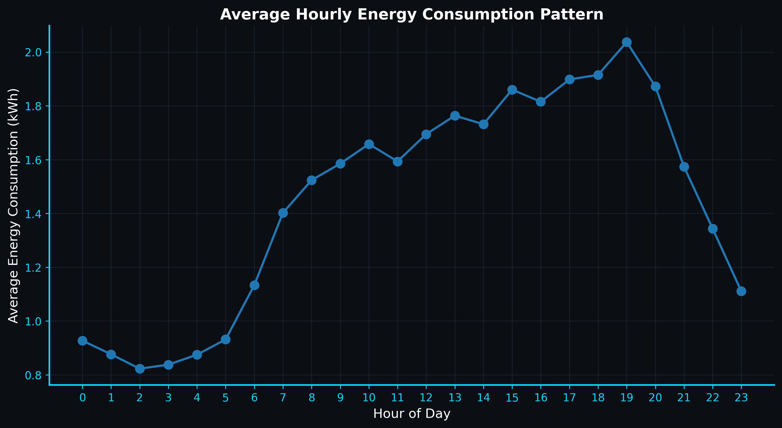
ENERGY CONSUMPTION PATTERN ANALYSIS
Grouped by when a home uses power, not how much.
A shape-first clustering pipeline for residential energy: 200 synthetic consumers, four hidden archetypes, and one real weather feed.
200 consumers • 365 days • 1,752,000 records • 51 features • K = 4
Flagship config 99c7a6631340d301
Notes:
Source: presentation/index.html; flagship results in web/public/data/*.json.

Slide 2
01 / WHY SHAPE
SUNEE / 02
Two homes can share a bill and share nothing else.
Same daily total
A bill compresses 24 hours into one number. It cannot distinguish a morning peak from an evening peak.
The model therefore groups households by the normalized shape of a day, not by raw consumption.
Source: conceptual premise in presentation/index.html; real profiles in web/public/data/profiles.json
Notes:
Source: conceptual premise in presentation/index.html; real profiles in web/public/data/profiles.json

Slide 3
01 / WHY SHAPE
SUNEE / 03
Timing tells a utility what magnitude alone cannot.
Feature | Population | Midday | Flat | Evening | Evening + weekend
Evening share | 0.29 | 0.24 | 0.26 | 0.40 | 0.36
Peak-to-average | 1.58 | 1.63 | 1.31 | 1.88 | 1.59
Weekend ratio | 1.04 | 1.06 | 0.99 | 1.03 | 1.14
The evening cluster spends 40% of its day in the 18:00–24:00 window. The flat cluster spends about 26%, even when total consumption overlaps.
Source: web/public/data/profiles.json; presentation/index.html slide 3
Notes:
Source: web/public/data/profiles.json; presentation/index.html slide 3

Slide 4
02 / DATASET
SUNEE / 04
200 consumers, four hidden rhythms, one real weather feed.
Dataset property | Flagship value
Consumers | 200
Days | 365 across four seasons
Hourly records | 1,752,000
Hidden archetypes | 4
Behavioural features | 51
Config hash | 99c7a6631340d301
Zephyr weather provenance
Hourly weather comes from the recorded Zephyr Station feed. The simulation includes seasonal amplitude and timing shifts without letting the hidden synthetic truth enter the model.
Real-world adapter
The separate Case A pathway processes 24 audited meters with the same ingestion report format and only internal metrics.
Source: RESULTS.md; docs/verification.md; models/analysis_metadata.json
Notes:
Source: RESULTS.md; docs/verification.md; models/analysis_metadata.json

Slide 5
03 / METHOD
SUNEE / 05
One deterministic path from meter to validated cluster.
01
02
03
04
05
06
07
Generate panel
→
Validate + preprocess
→
Engineer 51 features
→
Standardize + PCA
→
Select K = 4
→
Profile + explain
→
Validate + export
Leakage boundary: archetype and seasonal-phase labels are removed before preprocessing. They return only for independent validation.
Source: presentation/index.html slide 5; README.md methodology
Notes:
Source: presentation/index.html slide 5; README.md methodology

Slide 6
03 / METHOD
SUNEE / 06
The answer key never reaches the model.
Excluded before analysis
Used by the model
Hidden archetype
Seasonal phase
Synthetic generation details
Hourly energy profiles
Season label
51 behavioural features
Validation compares recovered groups with hidden archetypes only after clustering finishes.
Source: README.md section 5; presentation/index.html slide 6
Notes:
Source: README.md section 5; presentation/index.html slide 6

Slide 7
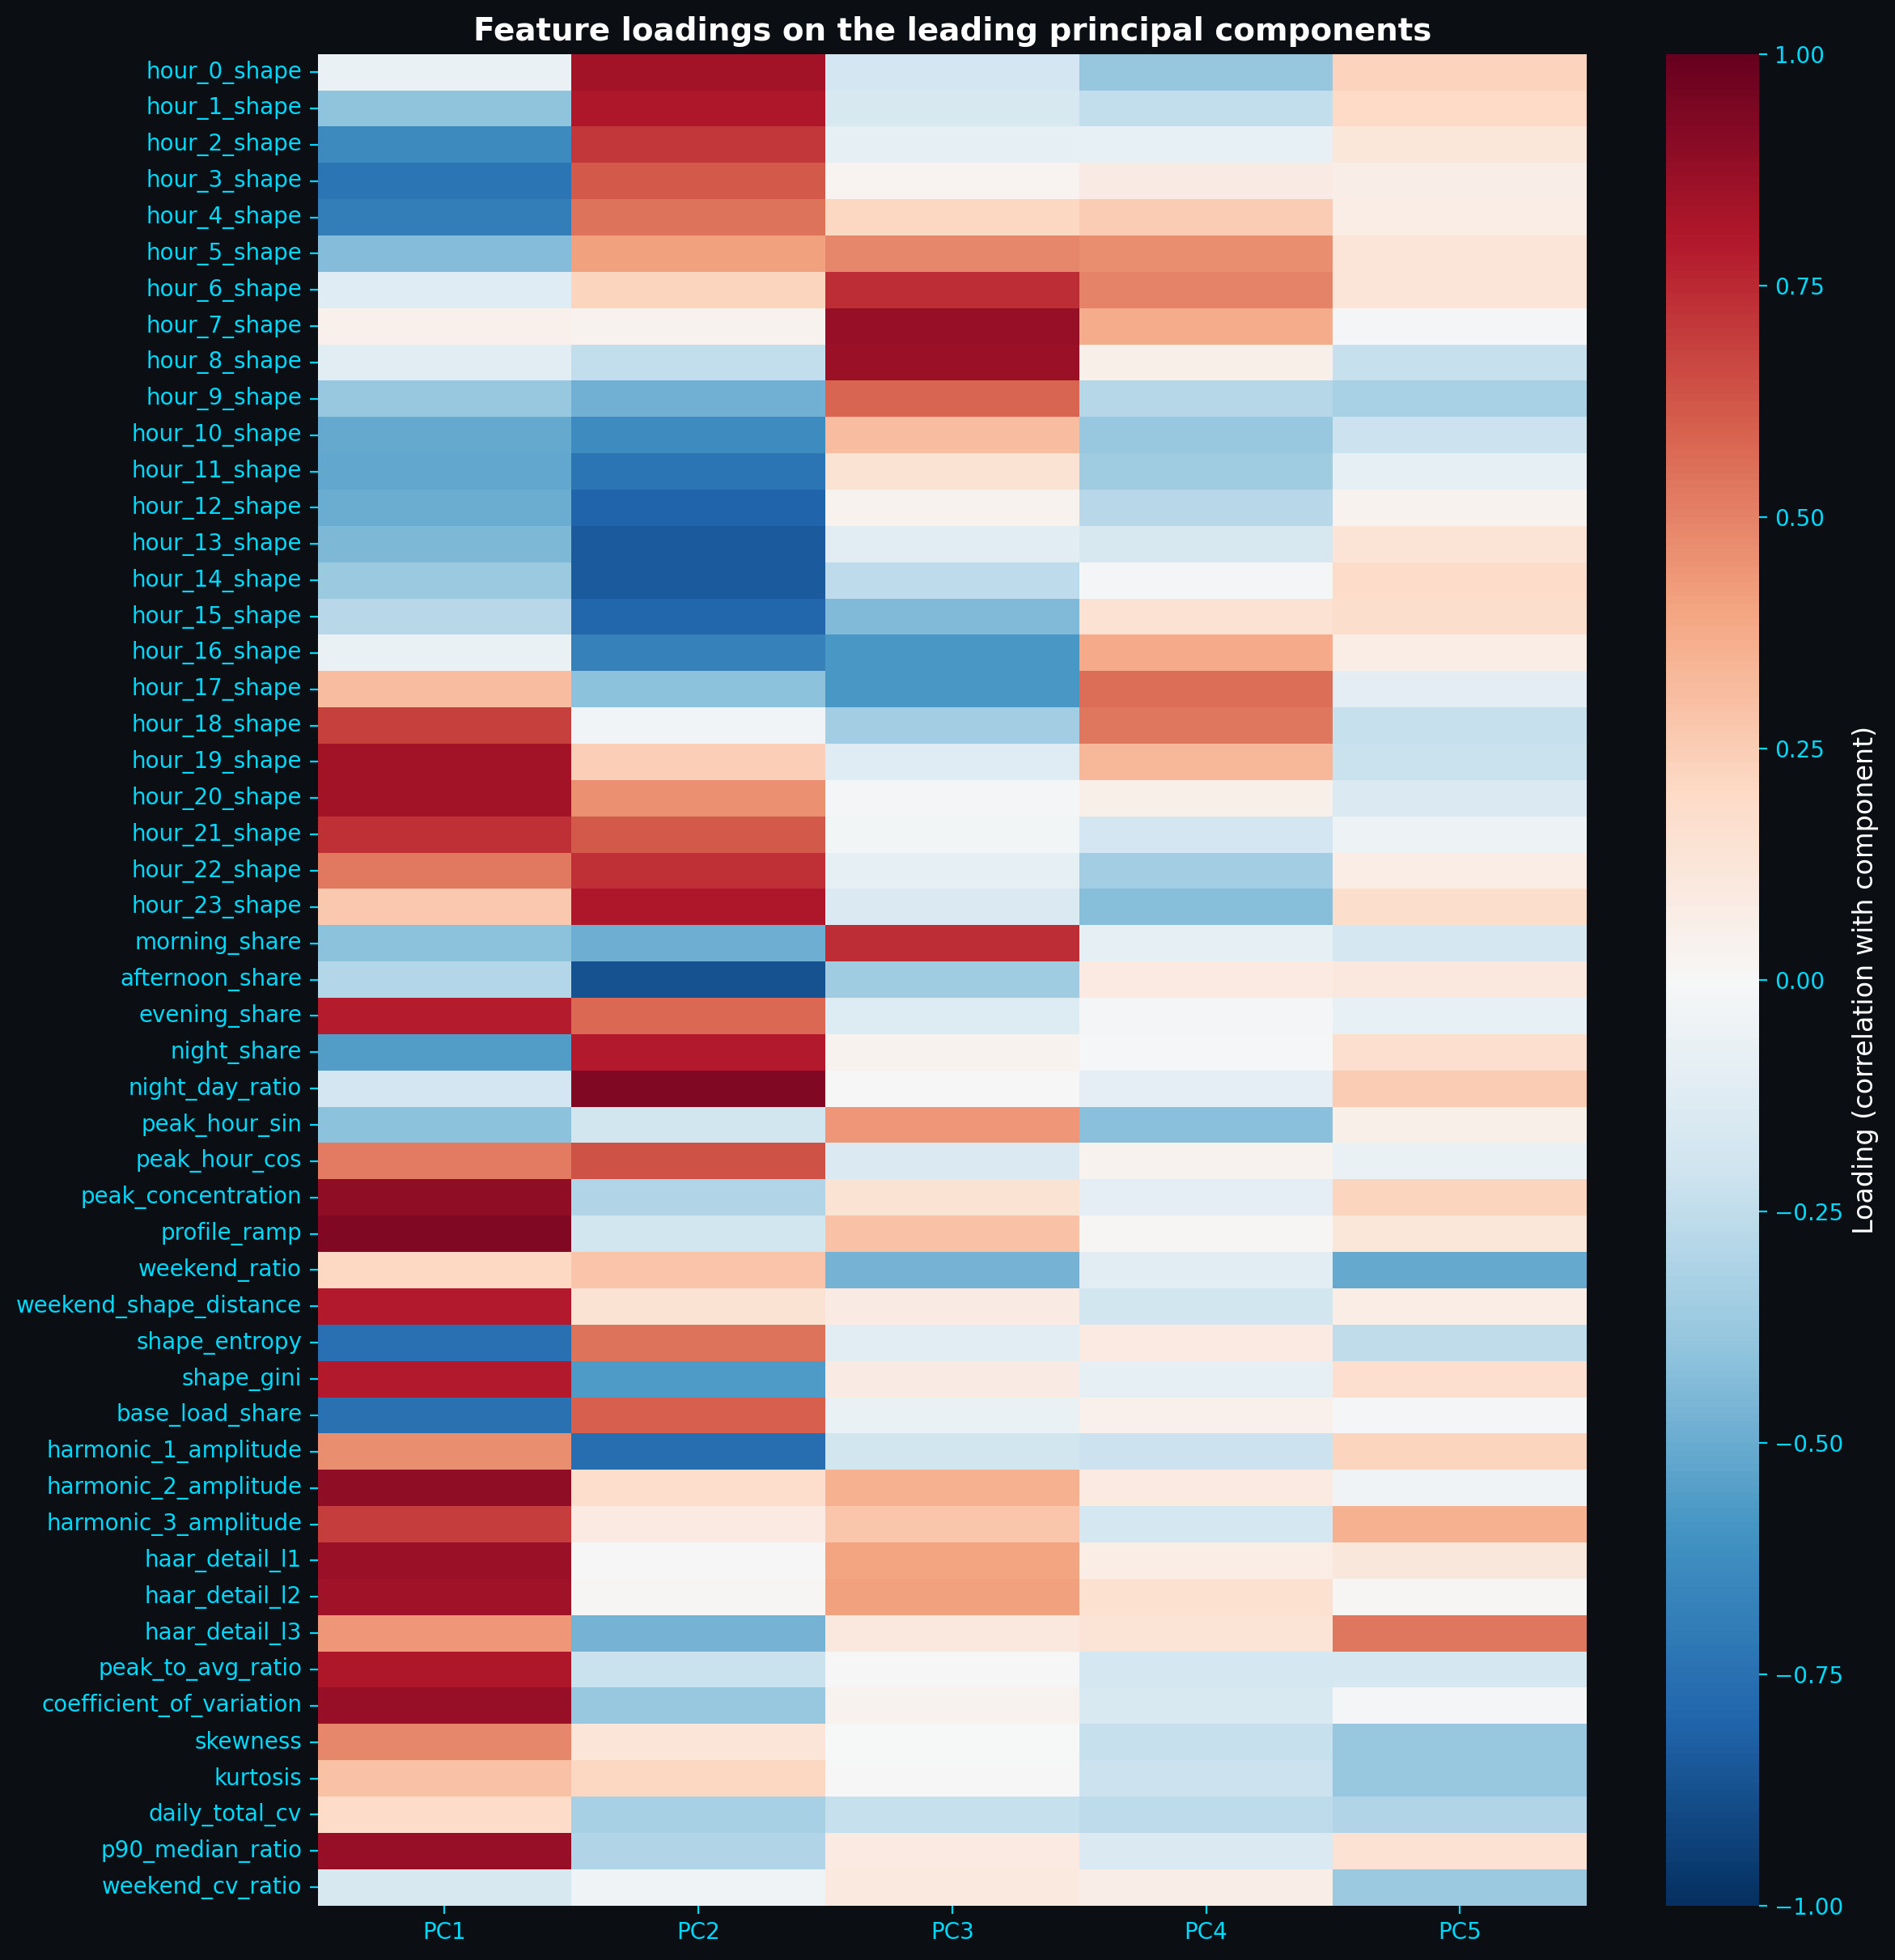
03 / METHOD
SUNEE / 07
51 features, not one of them is size.
24
27
hourly shape bins
summary descriptors
Daily load curve divided by its own mean
Timing, spikiness, weekend behaviour, dispersion
Scale diagnostics remain separate from the 51 behavioural features used for clustering.
Source: README.md section 6; outputs/metrics/pca_loadings.csv
Notes:
Source: README.md section 6; outputs/metrics/pca_loadings.csv

Slide 8
03 / METHOD
SUNEE / 08
51 correlated numbers collapse into 10 that matter.
What the first components capture
PC1 Peak concentration and ramp
PC2 Night versus afternoon use
PC3 Morning shape
PC4 Evening timing
PC5 Weekend and fine-scale variation
Source: web/public/data/pca.json; dark_mode_plots/figures/component_loadings.png
Notes:
Source: web/public/data/pca.json; dark_mode_plots/figures/component_loadings.png

Slide 9
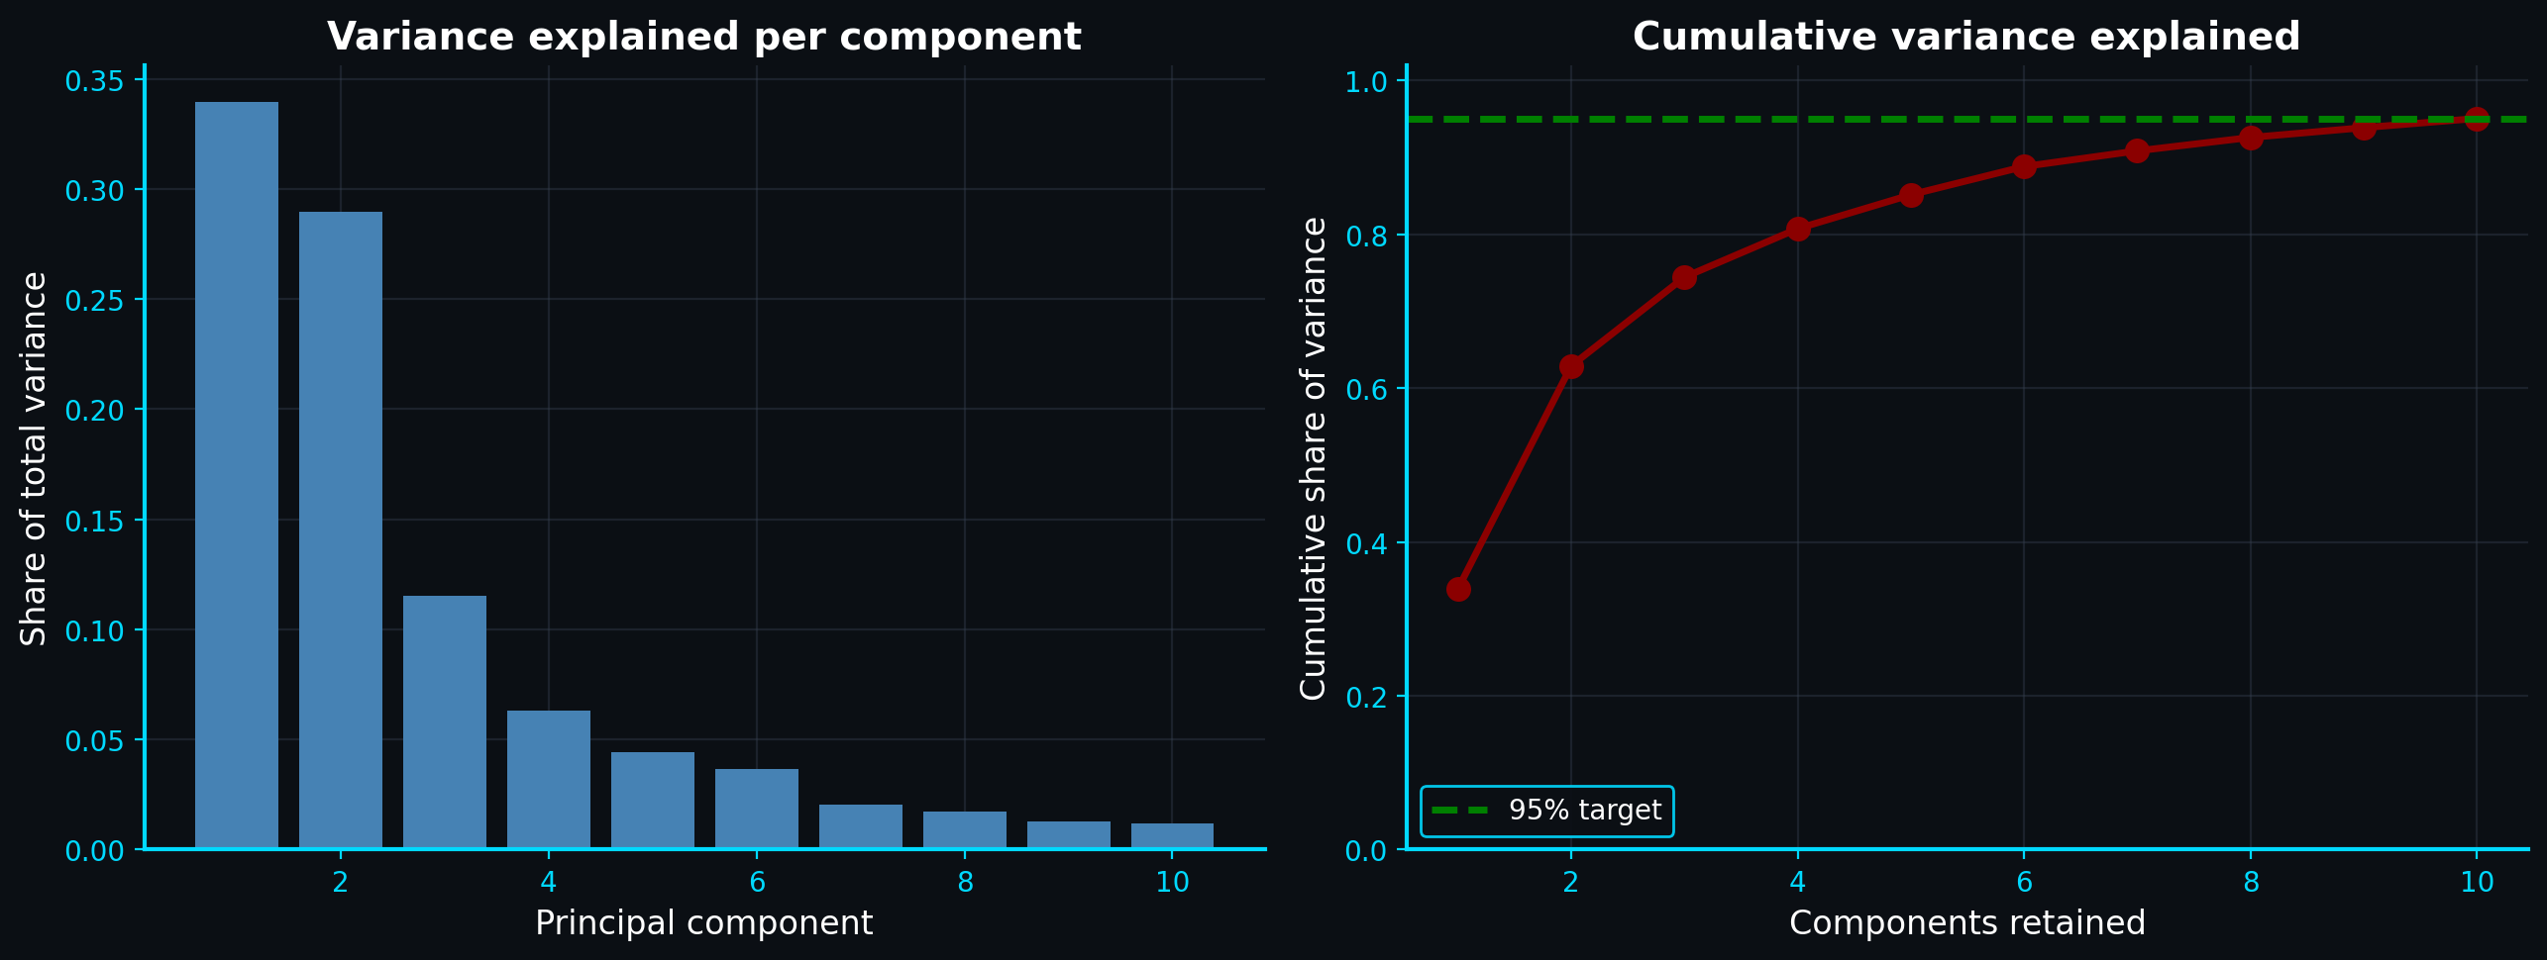
03 / METHOD
SUNEE / 09
10 components hold 95.05 percent of the variance.
95.05%
variance retained
with 10 PCA components
Kaiser and scree comparisons both indicate 7 components, but the variance threshold drives the pipeline.
Source: web/public/data/pca.json; dark_mode_plots/figures/explained_variance.png
Notes:
Source: web/public/data/pca.json; dark_mode_plots/figures/explained_variance.png

Slide 10
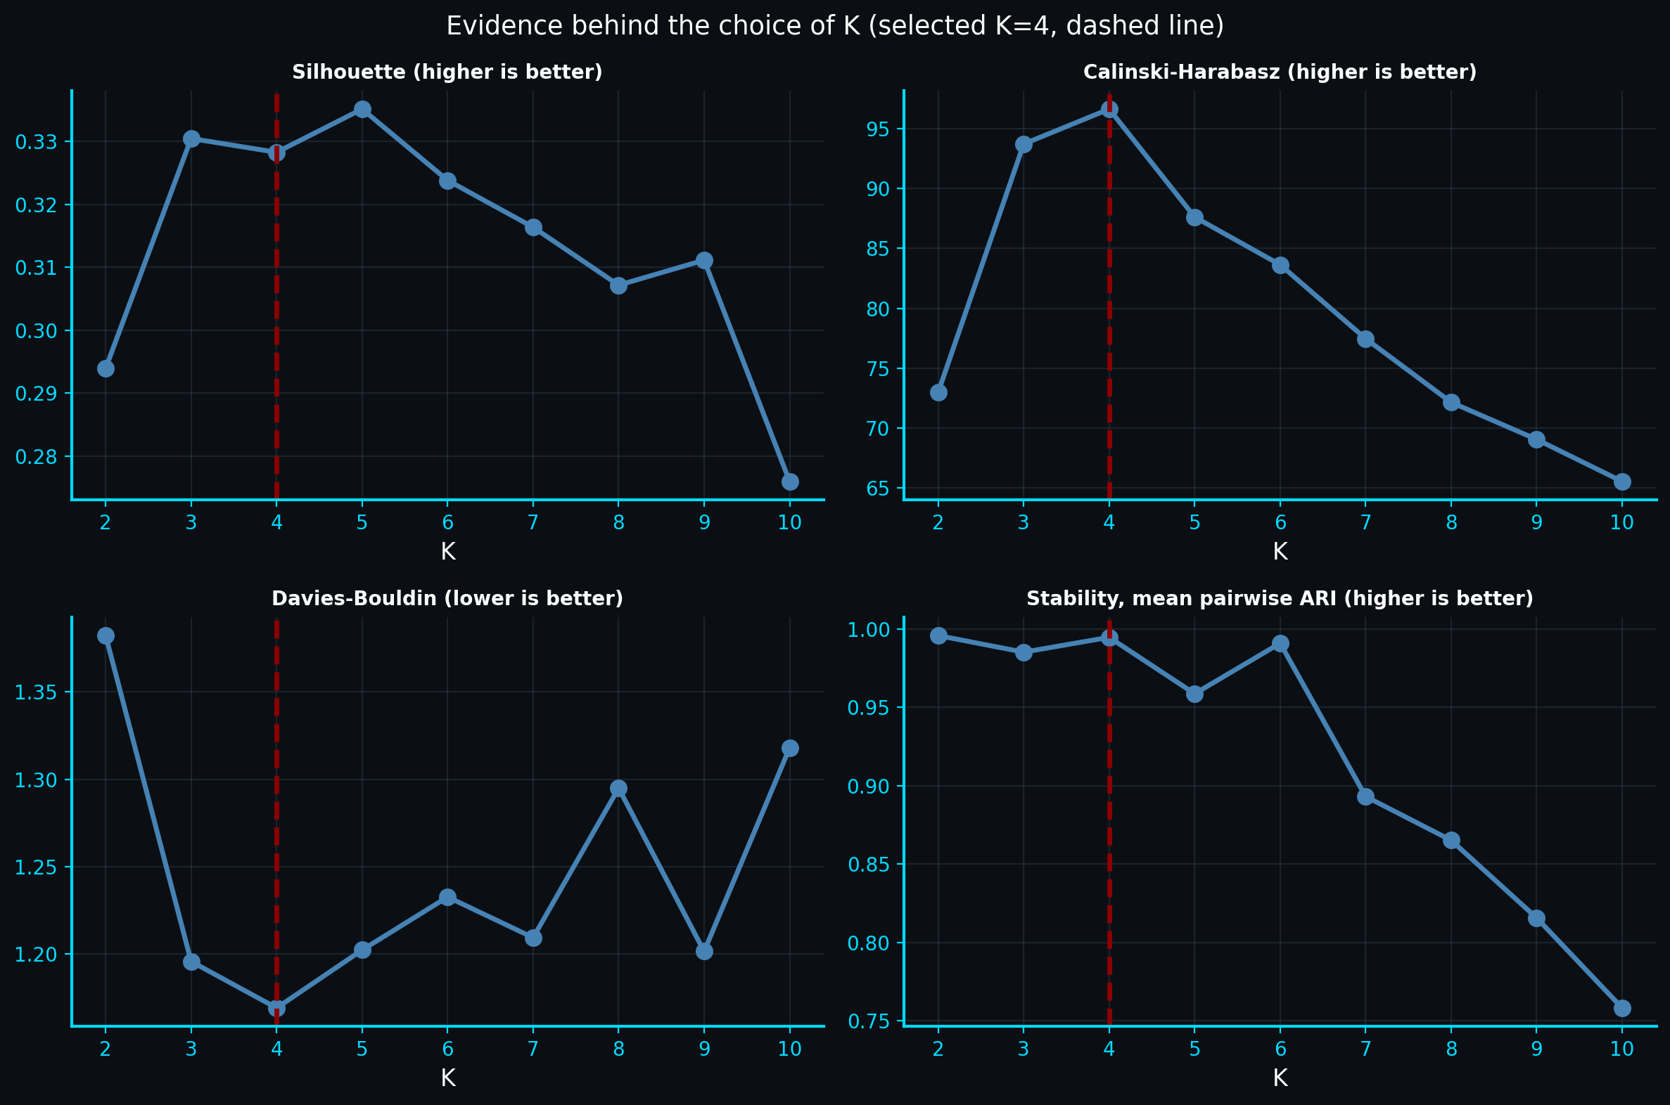
03 / METHOD
SUNEE / 10
K is picked by a rule fixed in advance, not by eye.
Composite selection rule
1. Score silhouette, Calinski–Harabasz, and inverted Davies–Bouldin
2. Average normalized scores
3. Apply a 5% parsimony tolerance band
4. Select the smallest eligible K
Source: web/public/data/clustering.json; dark_mode_plots/figures/k_selection_metrics.png
Notes:
Source: web/public/data/clustering.json; dark_mode_plots/figures/k_selection_metrics.png

Slide 11
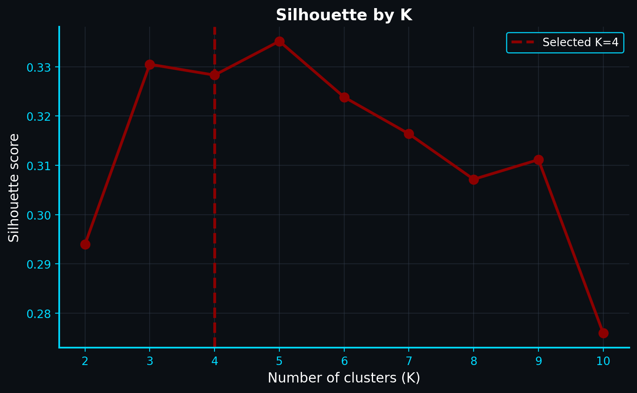
03 / METHOD
SUNEE / 11
Silhouette peaks at K = 5; the rule says K = 4.
K = 4
selected by the composite rule
Silhouette: 0.3283
Stability ARI: 0.9947
K = 5 achieves the highest standalone silhouette (0.3352) but loses the broader evidence test.
Source: web/public/data/clustering.json; dark_mode_plots/figures/silhouette_scores.png
Notes:
Source: web/public/data/clustering.json; dark_mode_plots/figures/silhouette_scores.png

Slide 12
04 / RESULTS
SUNEE / 12
Four rhythms of a day.
Recovered profiles
0 Midday
1 Flat
2 Evening
3 Evening + weekend
Cluster sizes: 39, 52, 47, and 62 consumers
Source: web/public/data/profiles.json; dark_mode_plots/figures/hourly_patterns.png
Notes:
Source: web/public/data/profiles.json; dark_mode_plots/figures/hourly_patterns.png

Slide 13
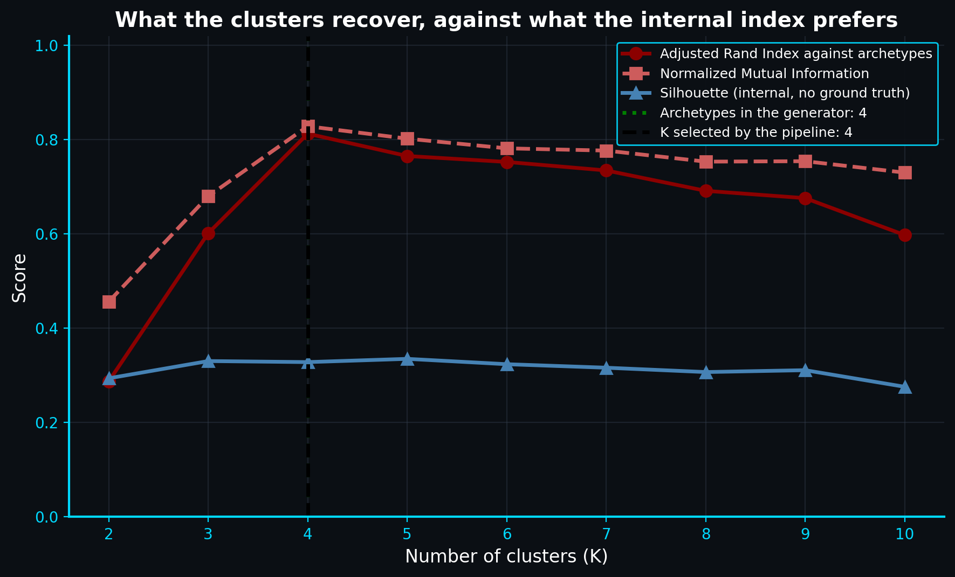
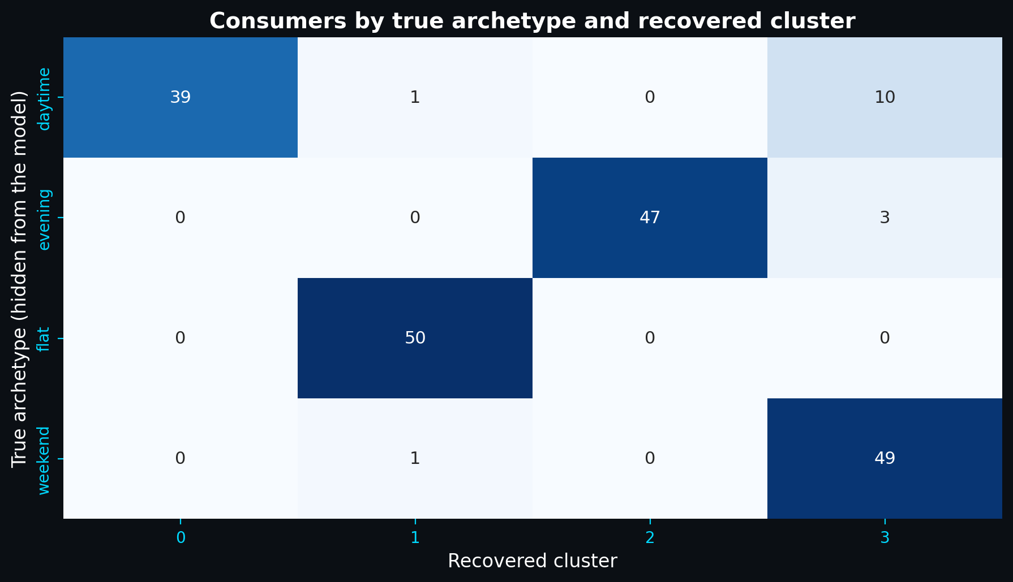
04 / RESULTS
SUNEE / 13
Recovery peaks exactly where the rule landed.
At K = 4: ARI 0.813 and NMI 0.833. The independent recovery check agrees with the fixed selection rule.
Source: web/public/data/validation.json; dark_mode_plots/figures/archetype_recovery.png and archetype_crosstab.png
Notes:
Source: web/public/data/validation.json; dark_mode_plots/figures/archetype_recovery.png and archetype_crosstab.png

Slide 14
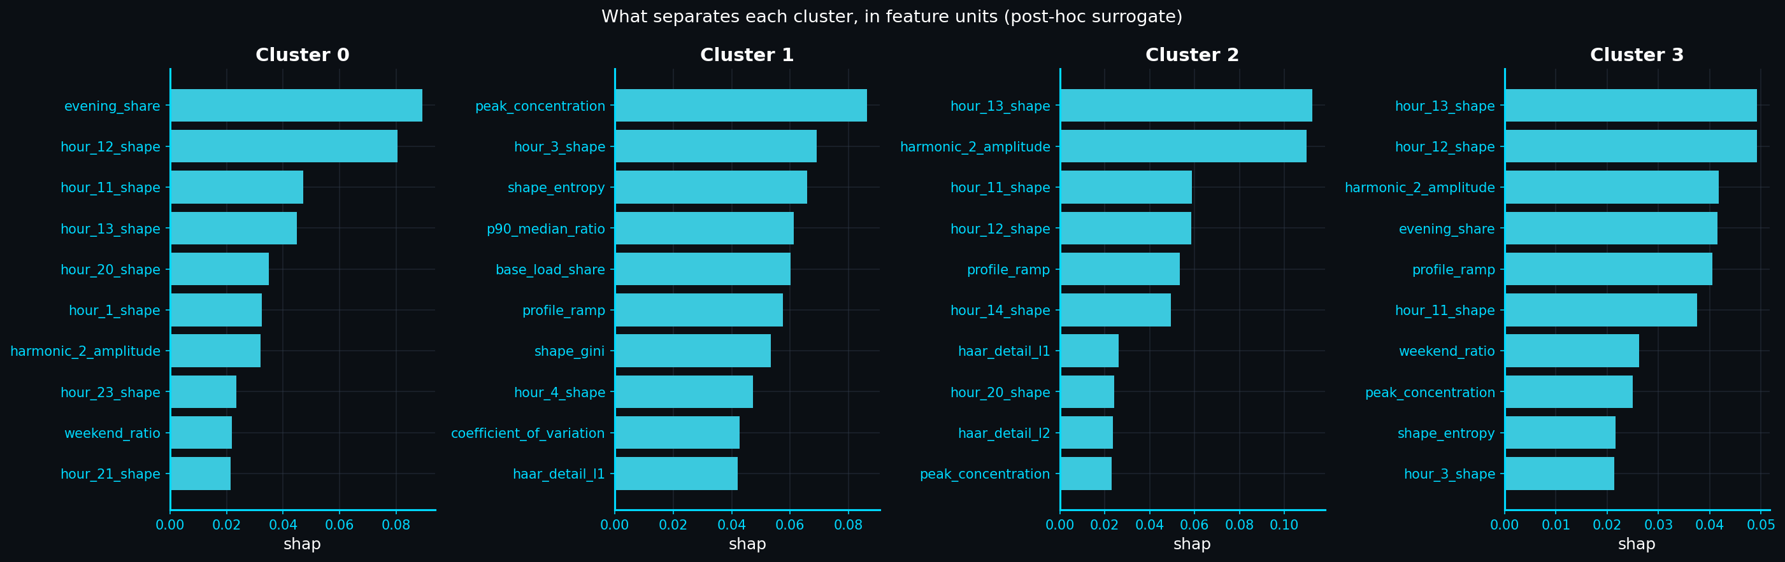
04 / RESULTS
SUNEE / 14
SHAP says which hours separate the groups.
Post-hoc explanation
A 98.5% surrogate predicts the cluster labels. SHAP ranks the features that best reproduce the partition, without claiming causality.
Source: web/public/data/explainability.json; dark_mode_plots/figures/shap_cluster_importance.png
Notes:
Source: web/public/data/explainability.json; dark_mode_plots/figures/shap_cluster_importance.png

Slide 15
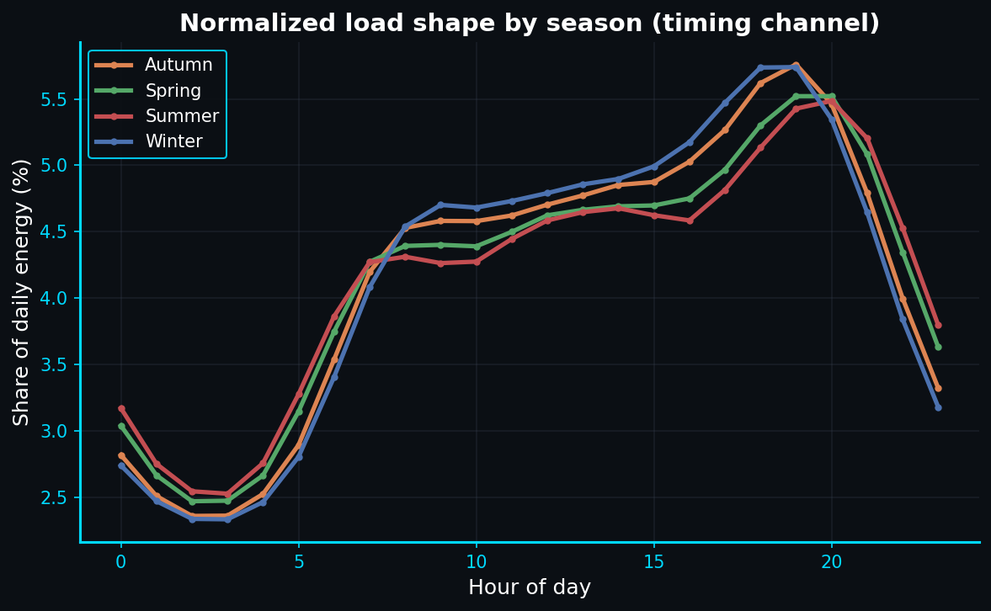
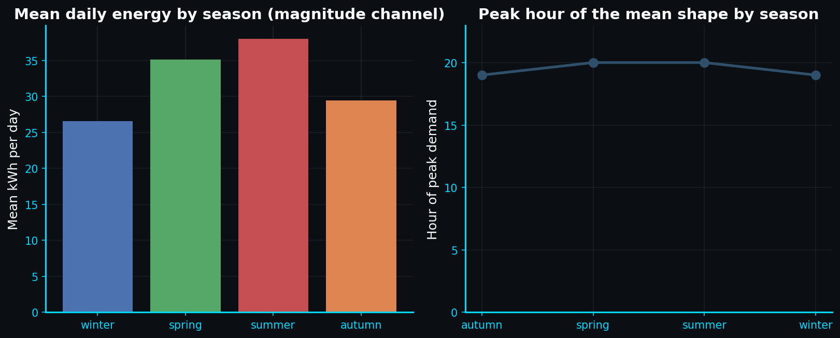
04 / RESULTS
SUNEE / 15
A 25 percent seasonal swing, the same four groups underneath.
Seasonality changes energy magnitude and timing, while the recovered shape groups remain visible across the year.
Source: web/public/data/seasonal.json; dark_mode_plots seasonal figures
Notes:
Source: web/public/data/seasonal.json; dark_mode_plots seasonal figures

Slide 16
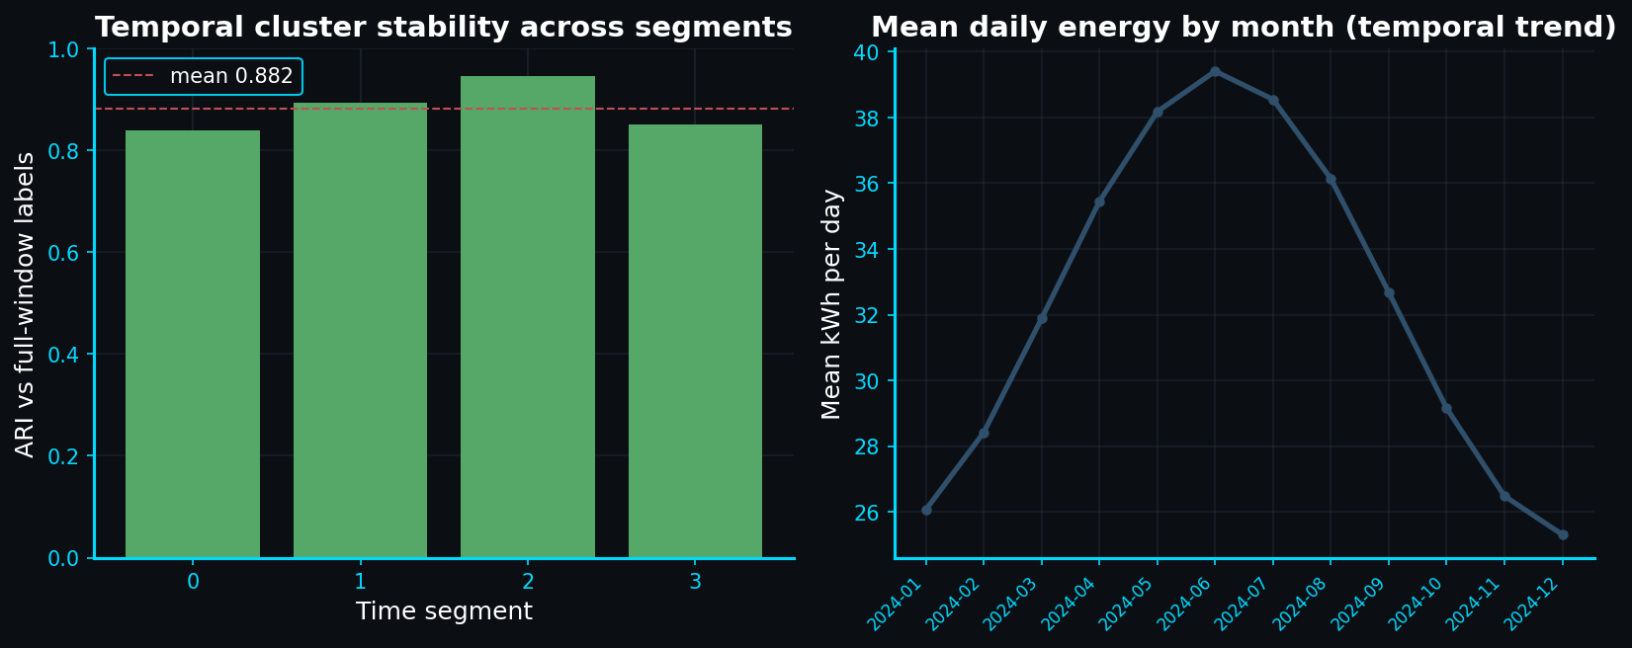
04 / RESULTS
SUNEE / 16
Mean agreement 0.88 across four quarters.
0.882
mean quarterly ARI
versus the full-year partition
Source: web/public/data/longitudinal.json; dark_mode_plots/figures/longitudinal_cluster_stability.png
Notes:
Source: web/public/data/longitudinal.json; dark_mode_plots/figures/longitudinal_cluster_stability.png

Slide 17
04 / RESULTS
SUNEE / 17
Five UN Sustainable Development Goals, ranked by directness.
SDG 7
Affordable and Clean Energy
Primary
SDG 9
Industry and Innovation
Supported
SDG 12
Responsible Consumption
Supported
SDG 11
Sustainable Cities
Indirect
SDG 13
Climate Action
Indirect
Source: README.md section 22.5; presentation/index.html slide 17
Notes:
Source: README.md section 22.5; presentation/index.html slide 17

Slide 18
05 / DELIVERY
SUNEE / 18
Same method, two apps, one optional native kernel.
Stage | Flagship | Medium | Wide
K-Means | 5.60× | 6.45× | —
PCA | 0.66× | 0.77× | 0.29×
End to end | 1.32× | — | —
Delivery
Streamlit dashboard
Midnight canvas
Vercel explorer
Contract-driven UI
Optional C++ kernel
Same analysis contracts
C++ accelerates K-Means on these shapes. Python and scikit-learn remain the scientific reference; the deck reports slower PCA results too.
Source: web/public/data/benchmark.json; README.md C++ engine section
Notes:
Source: web/public/data/benchmark.json; README.md C++ engine section

Slide 19
05 / LIMITATIONS
SUNEE / 19
A 30-day window already broke this rule once.
Step | 30 days | 365 days
Selected K | 3 | 4
ARI vs archetypes | 0.585 | 0.813
Seasonal analysis | Unavailable | Amplitude 0.202
Longitudinal analysis | Not run | Mean ARI 0.882
Honesty notes
Synthetic truth validates the method, not real meters.
SHAP explains the surrogate, not causality.
The real-data pathway reports only internal metrics.
Source: RESULTS.md runs 1 and 2; docs/verification.md
Notes:
Source: RESULTS.md runs 1 and 2; docs/verification.md

Slide 20
05 / TAKEAWAY
SUNEE / 20
The shape of a day is real, recoverable, and modestly separated.
What was shown
What was not claimed
K = 4 by a fixed rule. ARI 0.813 at the selected K. Four rhythms remain visible through seasonal variation and quarterly re-runs.
Causality, universality, or a production estimate. The separation is modest, the data is synthetic, and short windows change the result.
Reproduce: py run_module.py energy_analysis -- --n_days 365 --n_consumers 200
Source: RESULTS.md sections 4 and 6; presentation/index.html slide 20
Notes:
Source: RESULTS.md sections 4 and 6; presentation/index.html slide 20

