Slide 1
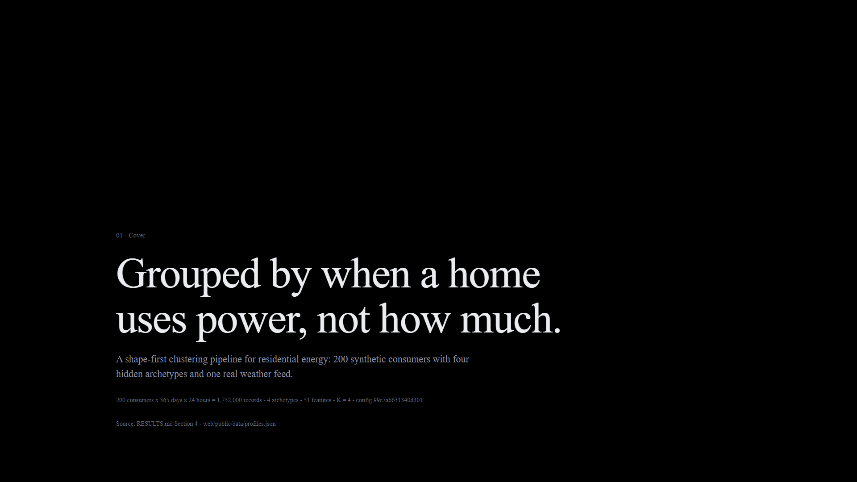
Notes:
Exact visual export of presentation/index.html, slide 1.

Slide 2
Notes:
Exact visual export of presentation/index.html, slide 2.

Slide 3
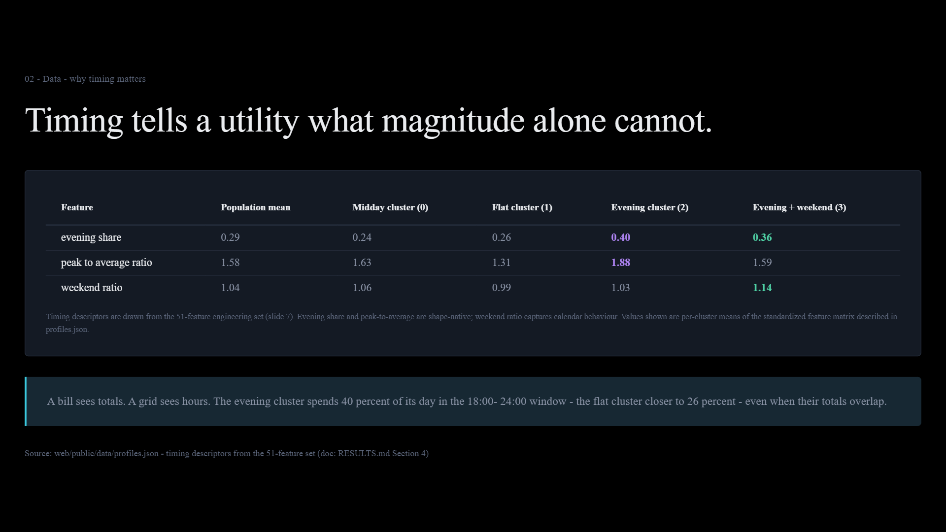
Notes:
Exact visual export of presentation/index.html, slide 3.

Slide 4
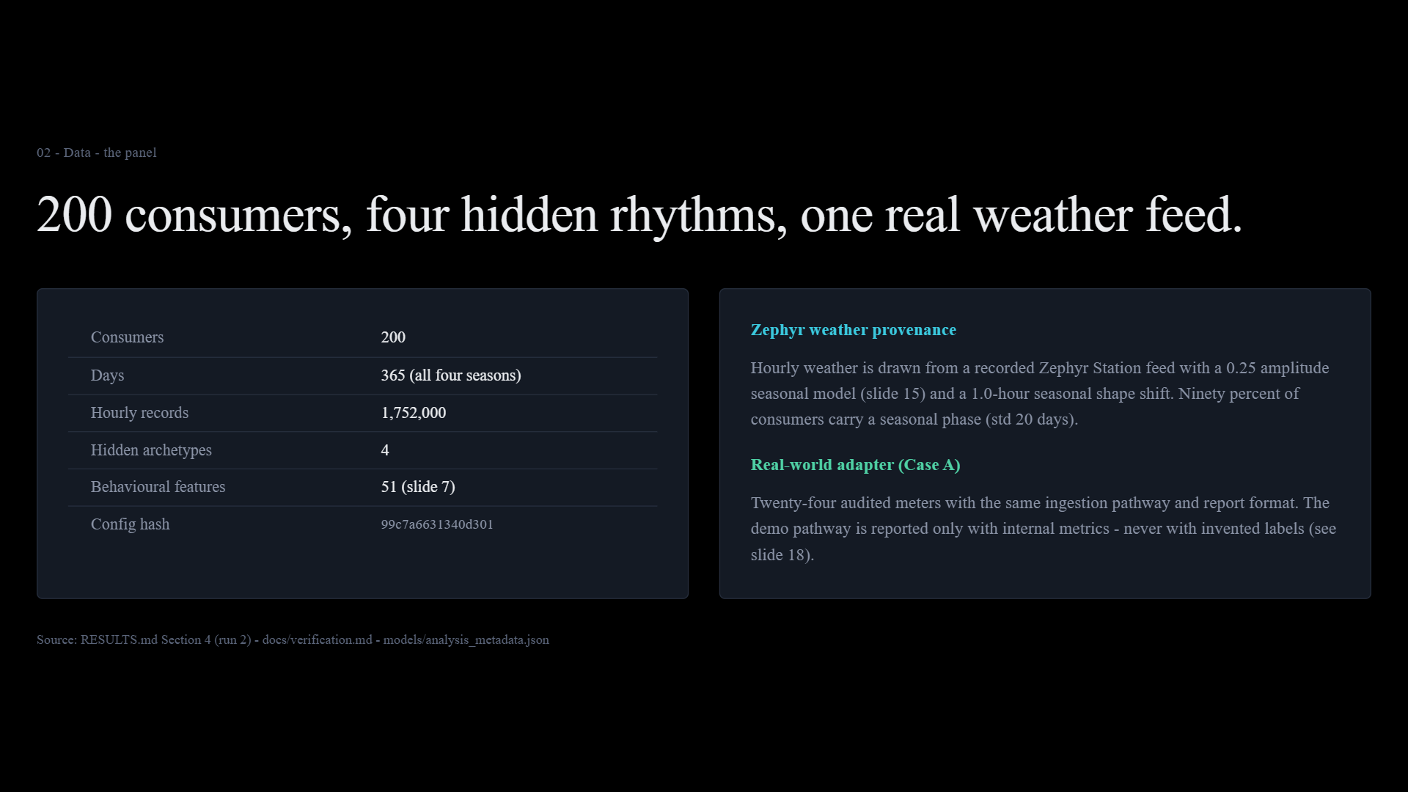
Notes:
Exact visual export of presentation/index.html, slide 4.

Slide 5
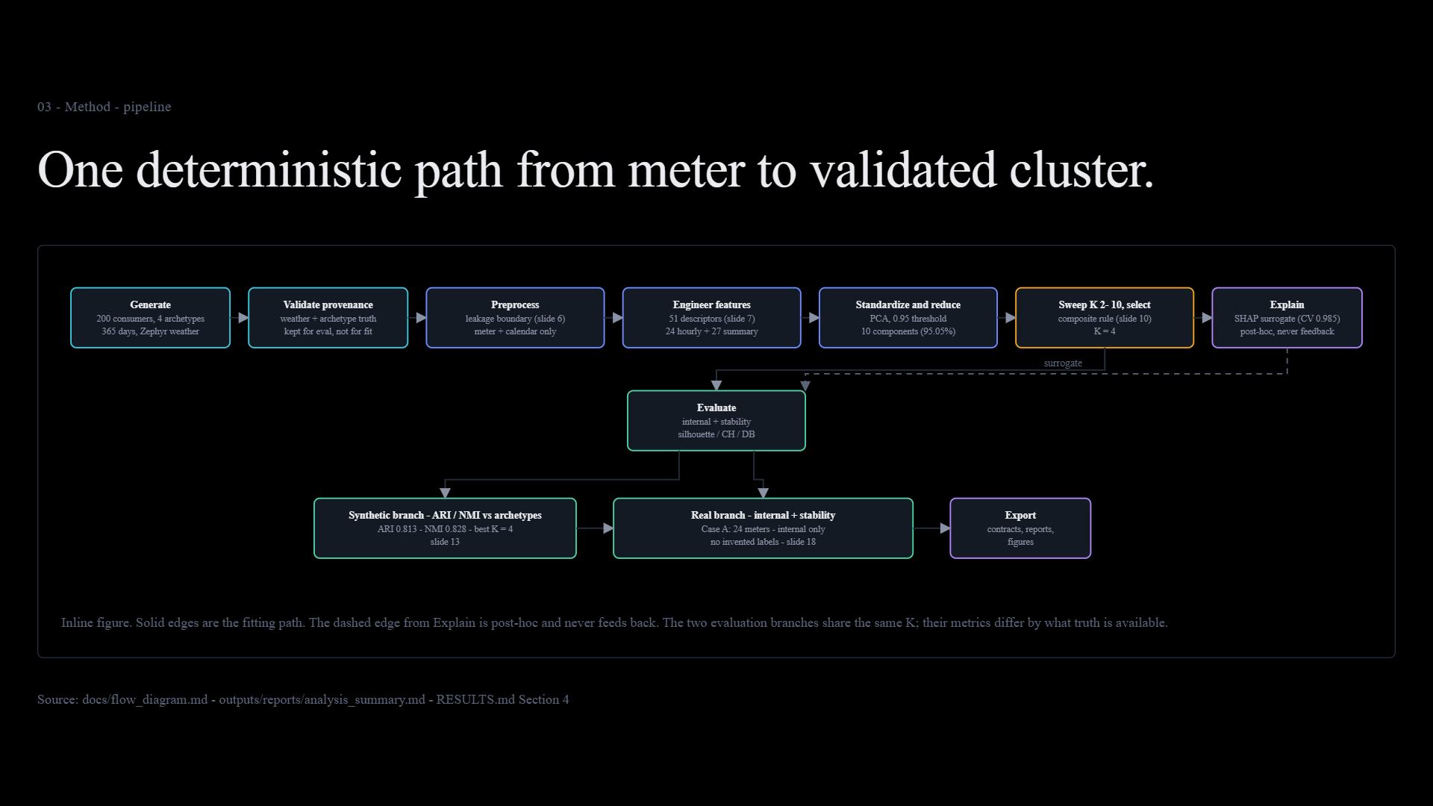
Notes:
Exact visual export of presentation/index.html, slide 5.

Slide 6
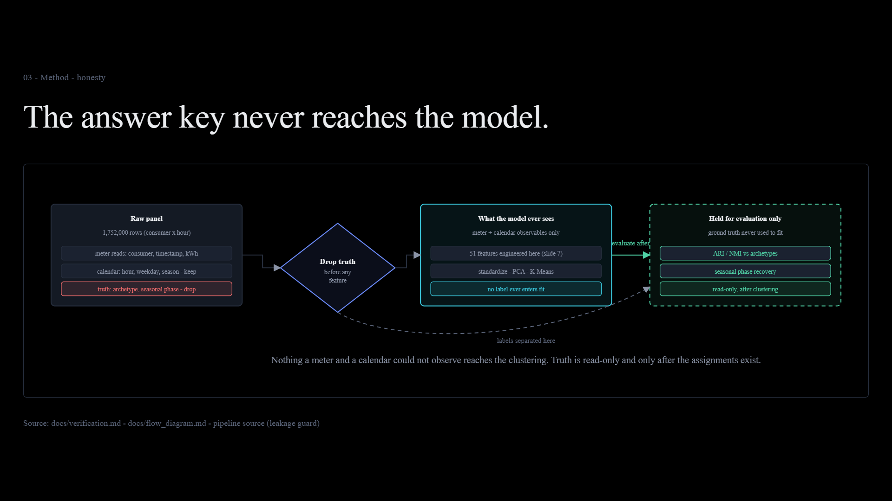
Notes:
Exact visual export of presentation/index.html, slide 6.

Slide 7
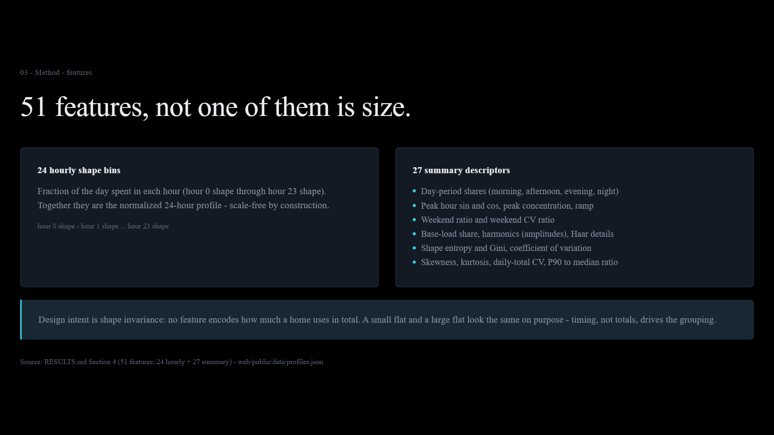
Notes:
Exact visual export of presentation/index.html, slide 7.

Slide 8
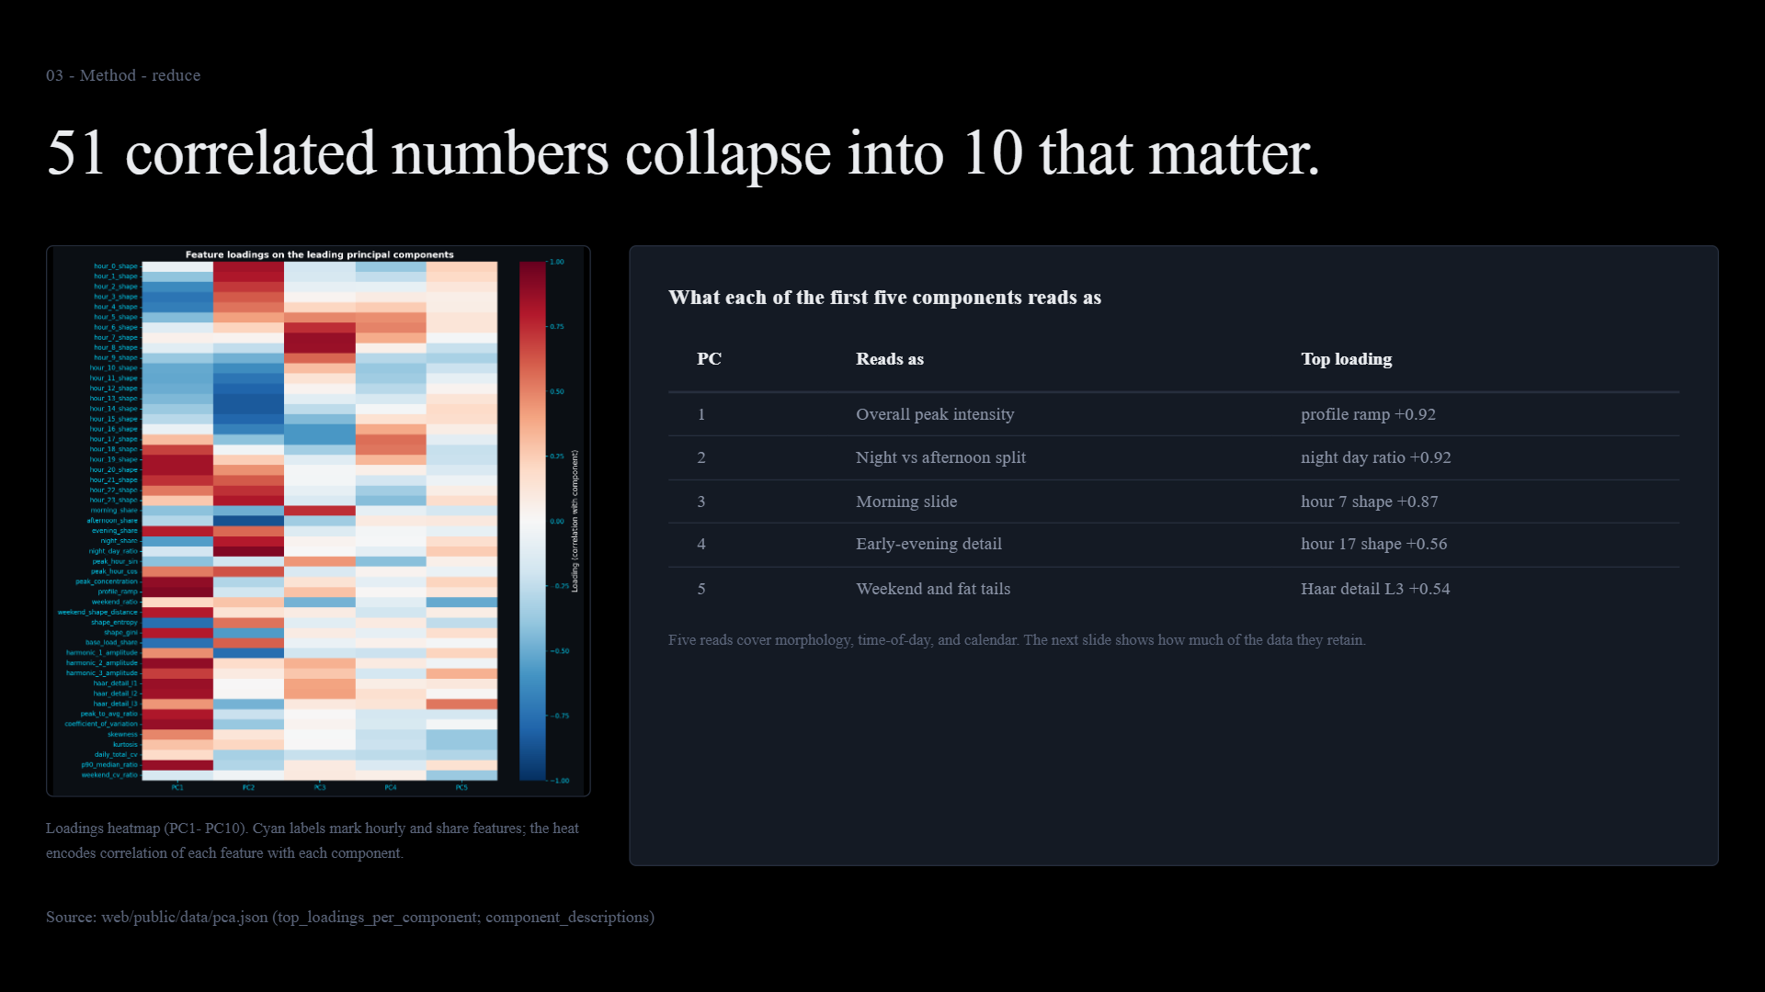
Notes:
Exact visual export of presentation/index.html, slide 8.

Slide 9
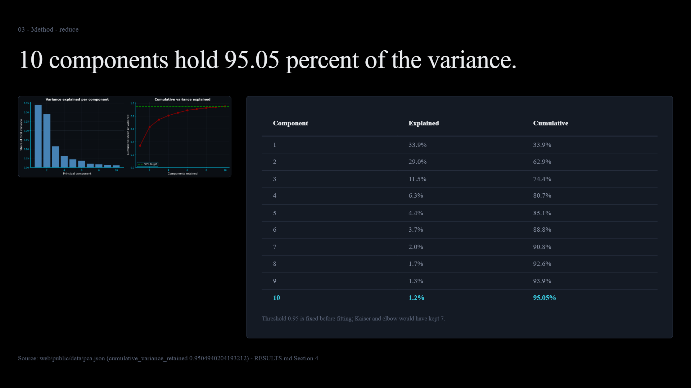
Notes:
Exact visual export of presentation/index.html, slide 9.

Slide 10
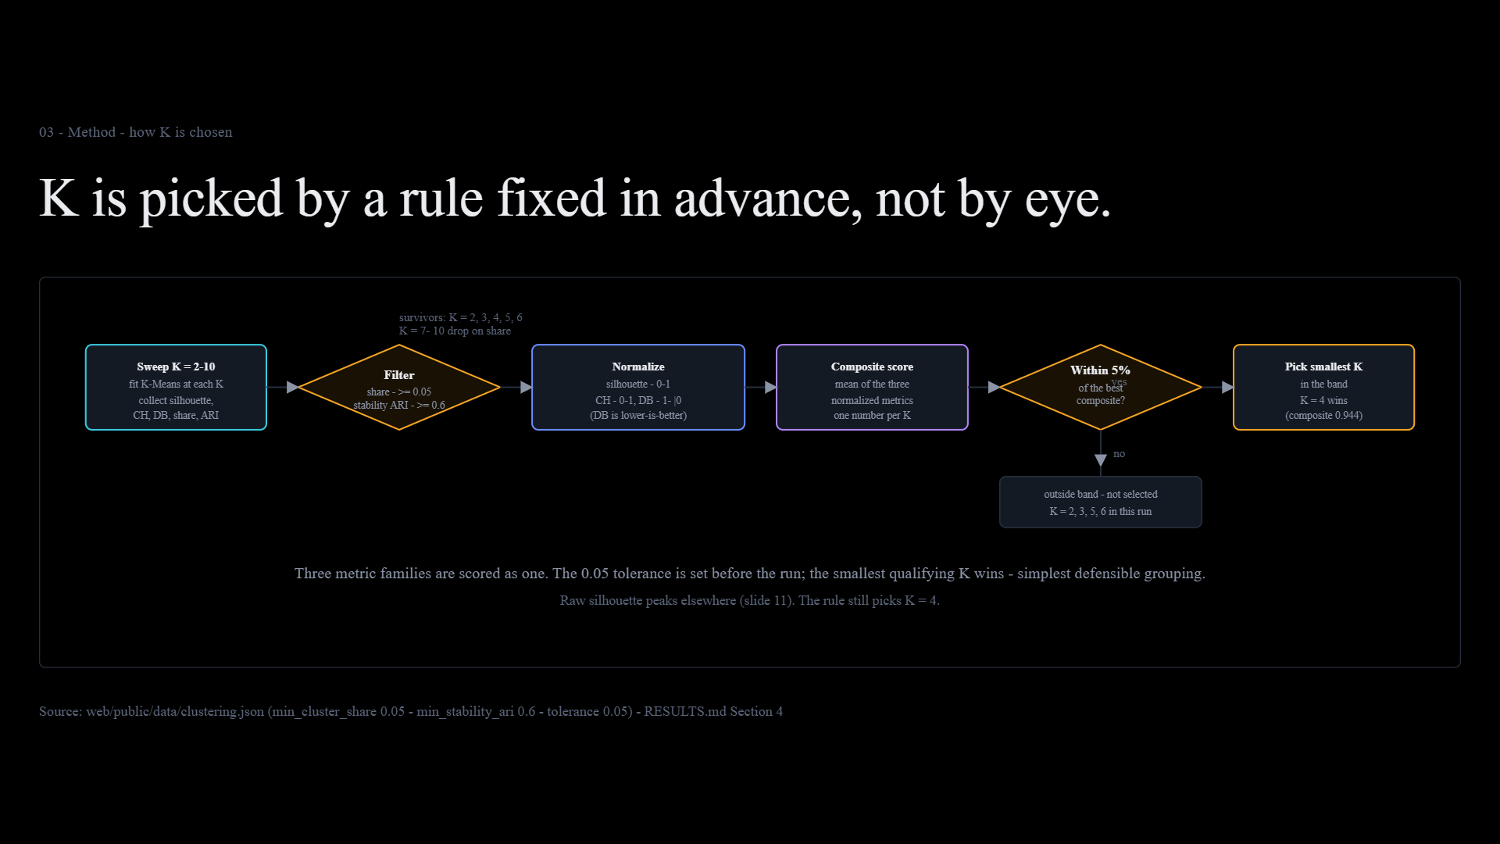
Notes:
Exact visual export of presentation/index.html, slide 10.

Slide 11
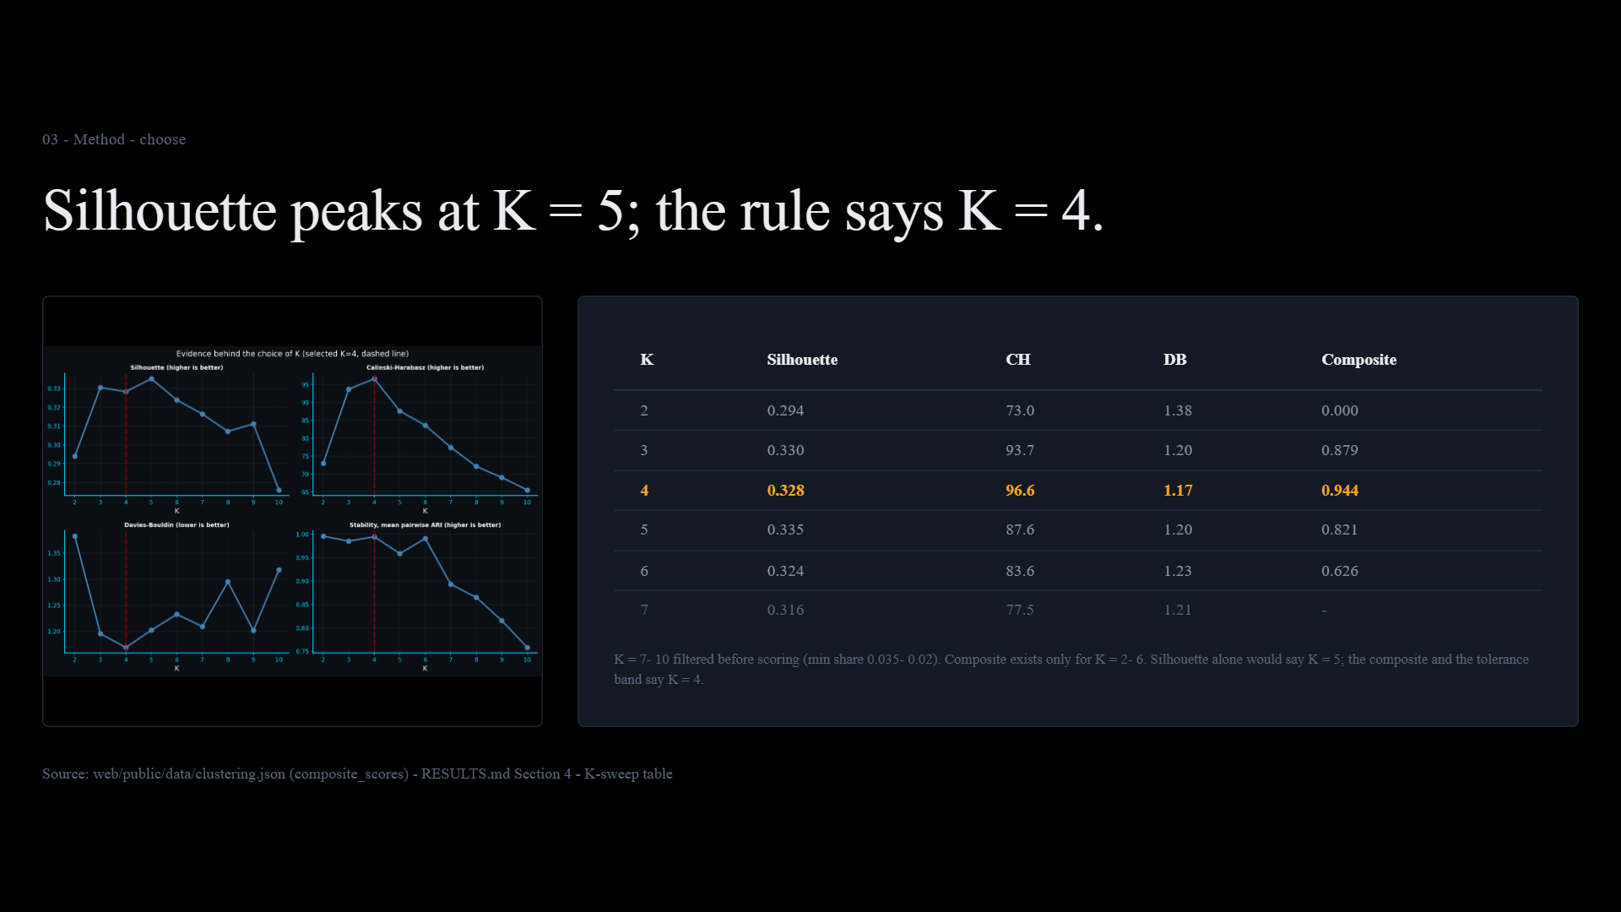
Notes:
Exact visual export of presentation/index.html, slide 11.

Slide 12
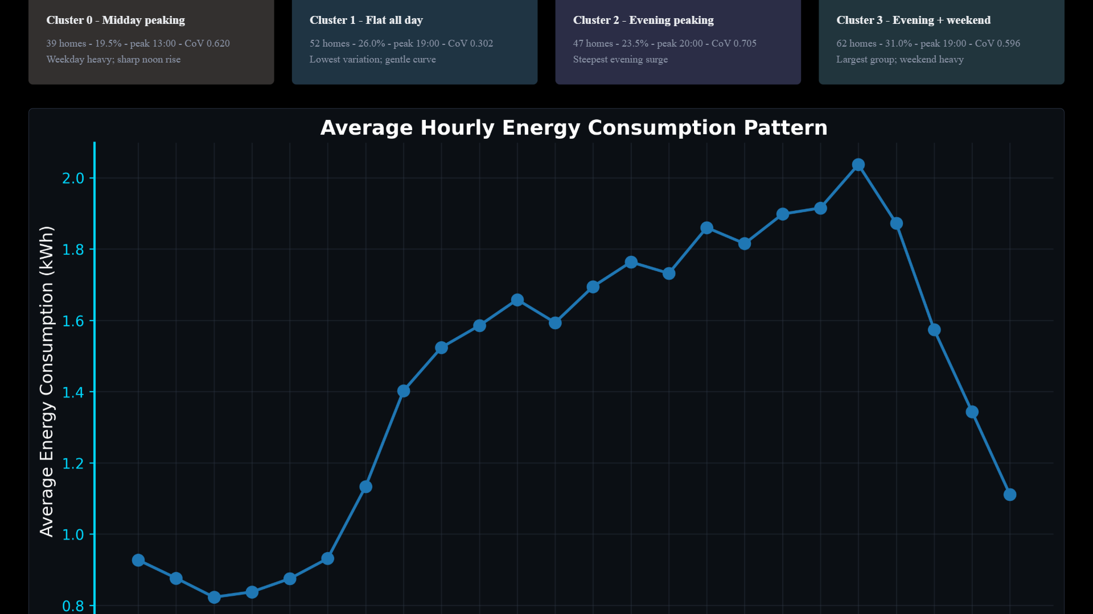
Notes:
Exact visual export of presentation/index.html, slide 12.

Slide 13
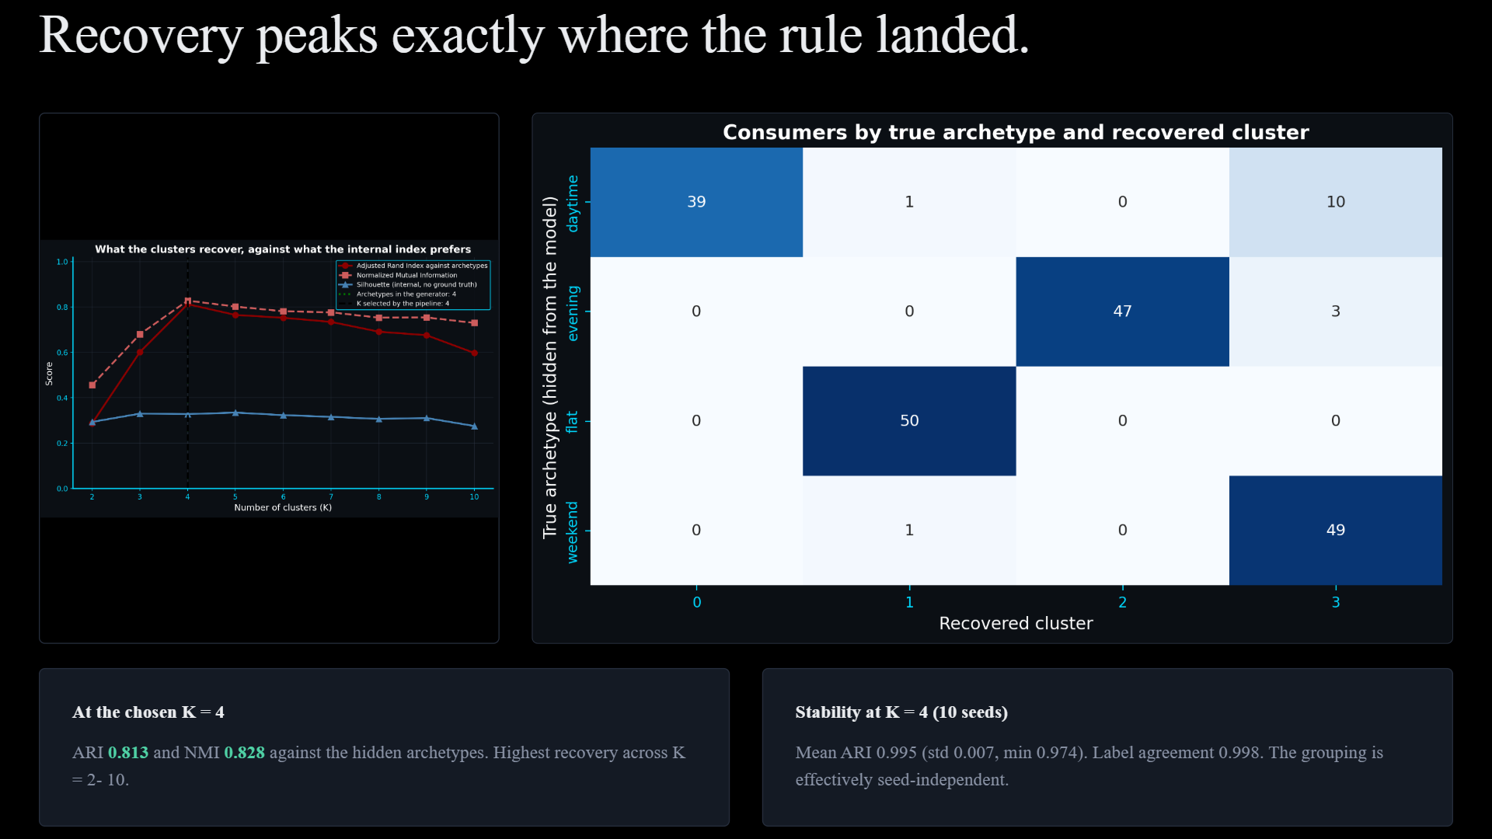
Notes:
Exact visual export of presentation/index.html, slide 13.

Slide 14
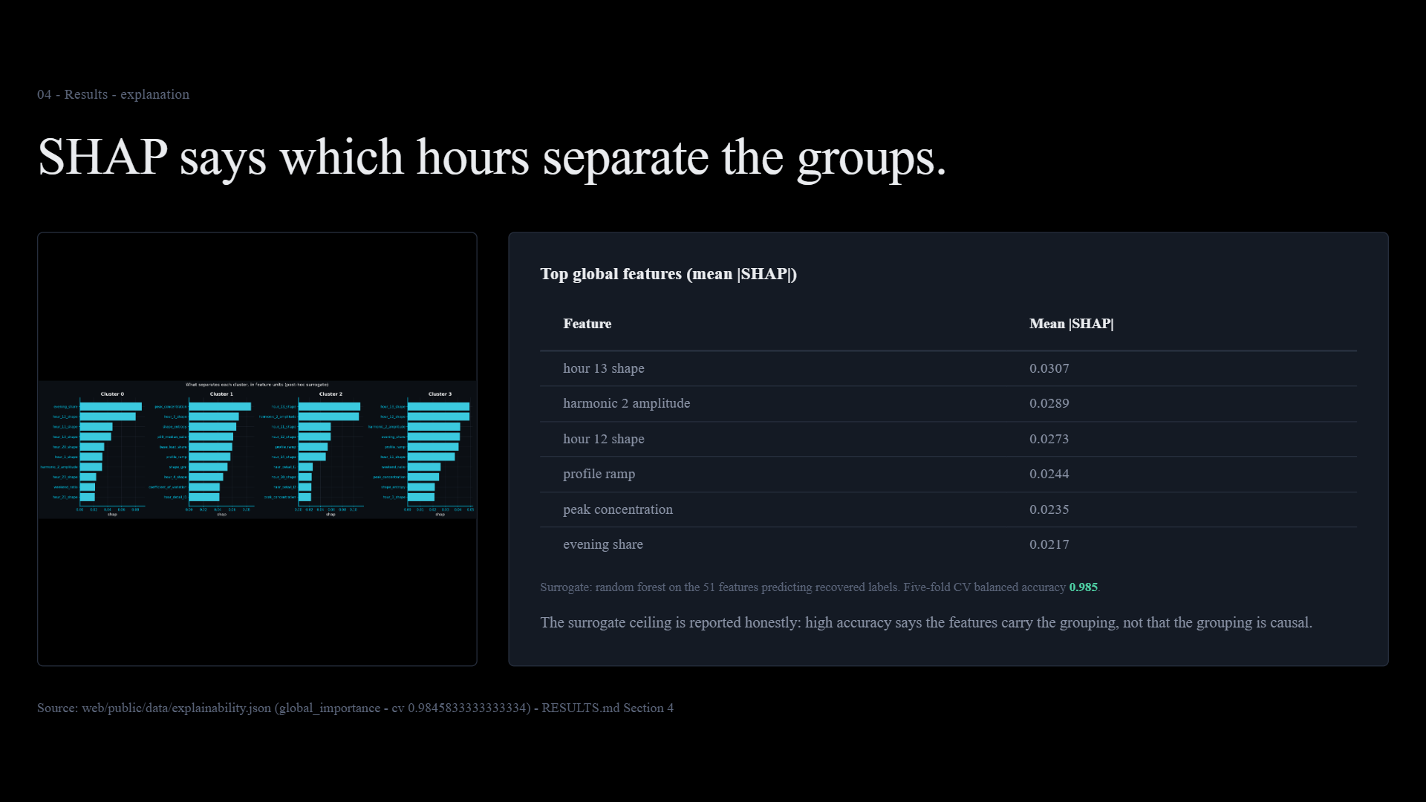
Notes:
Exact visual export of presentation/index.html, slide 14.

Slide 15
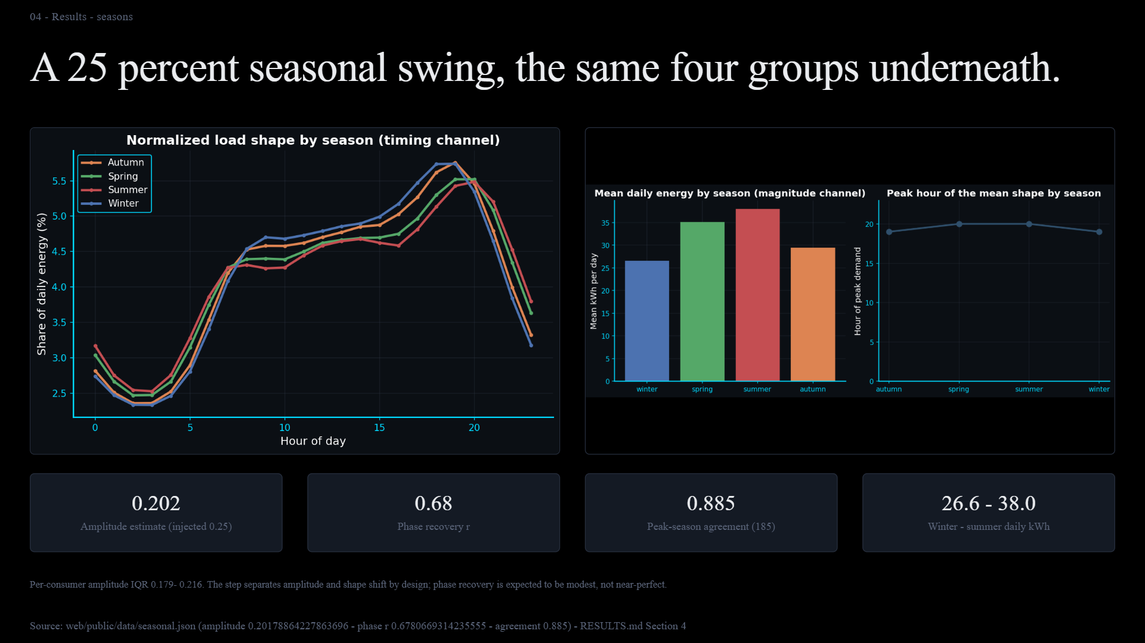
Notes:
Exact visual export of presentation/index.html, slide 15.

Slide 16
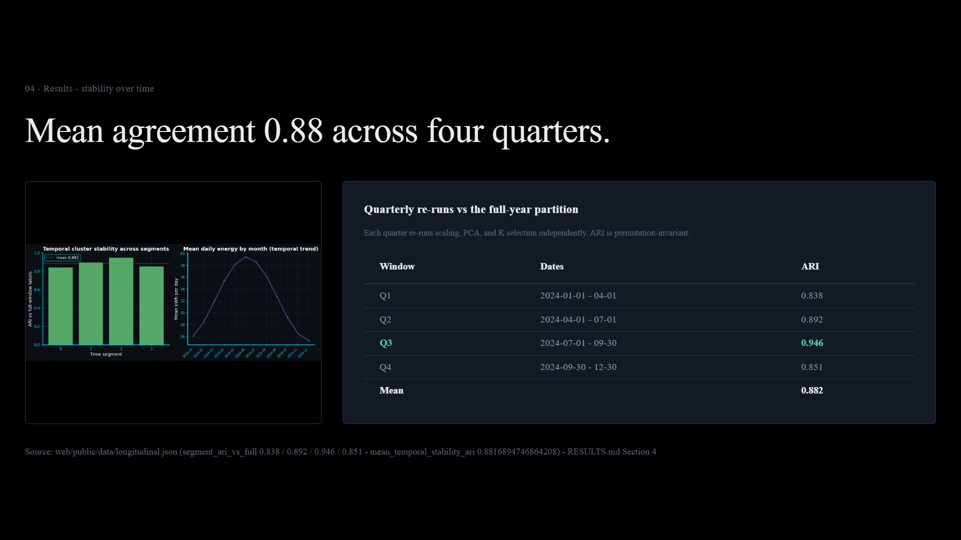
Notes:
Exact visual export of presentation/index.html, slide 16.

Slide 17
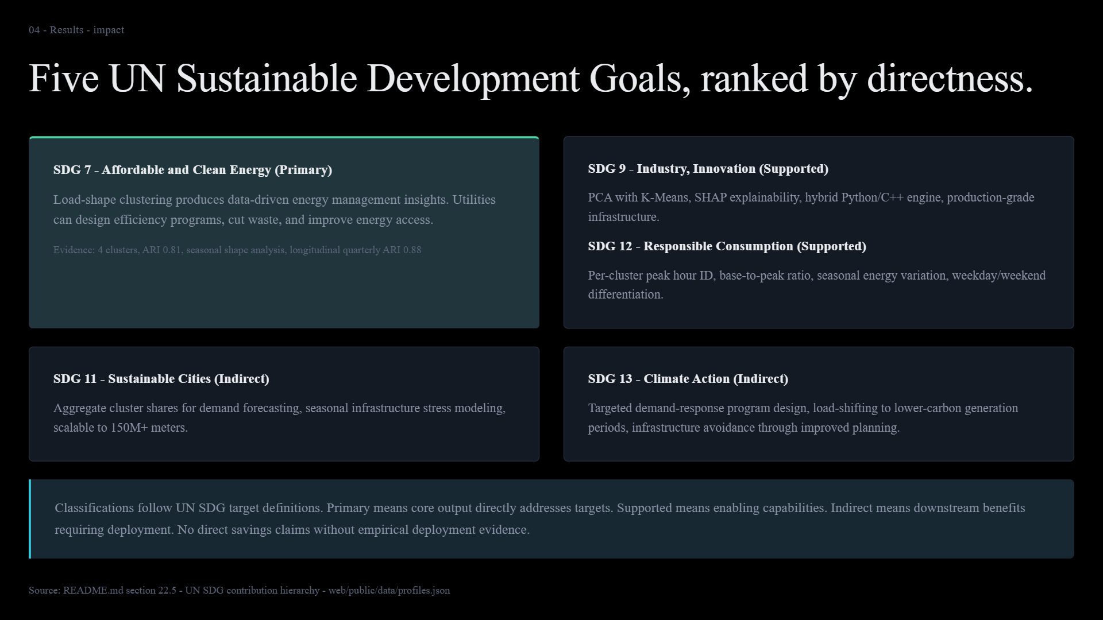
Notes:
Exact visual export of presentation/index.html, slide 17.

Slide 18
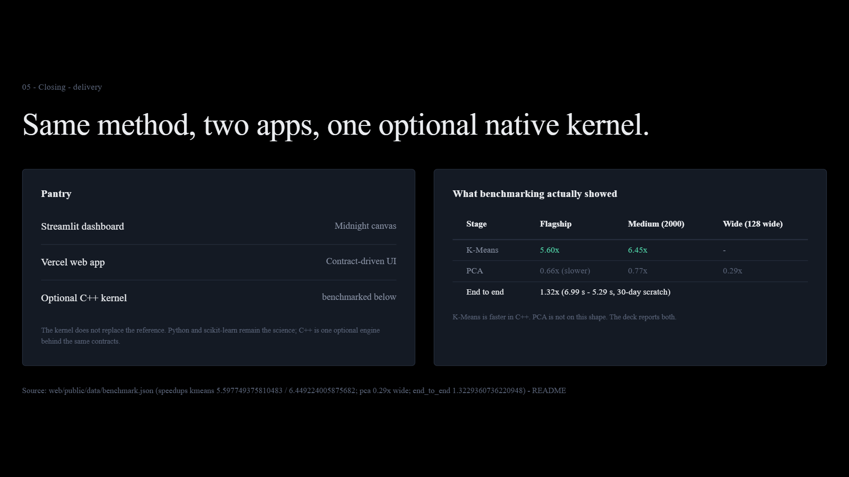
Notes:
Exact visual export of presentation/index.html, slide 18.

Slide 19
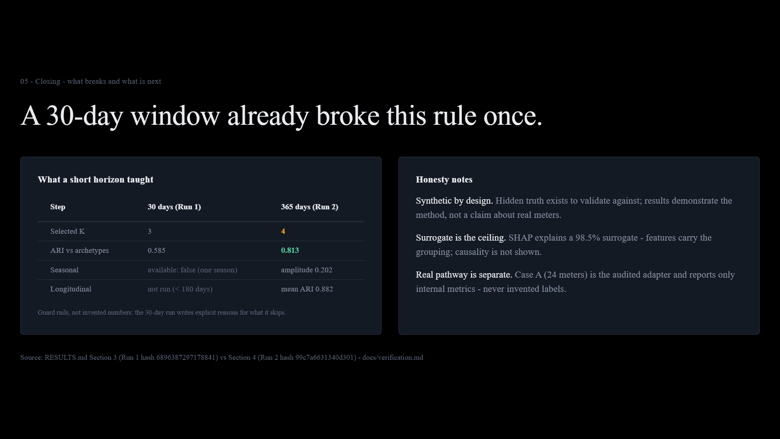
Notes:
Exact visual export of presentation/index.html, slide 19.

Slide 20
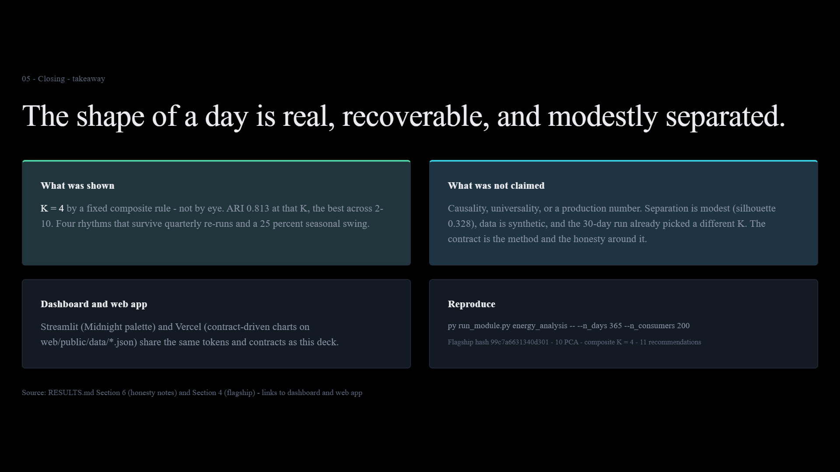
Notes:
Exact visual export of presentation/index.html, slide 20.

