Slide 1
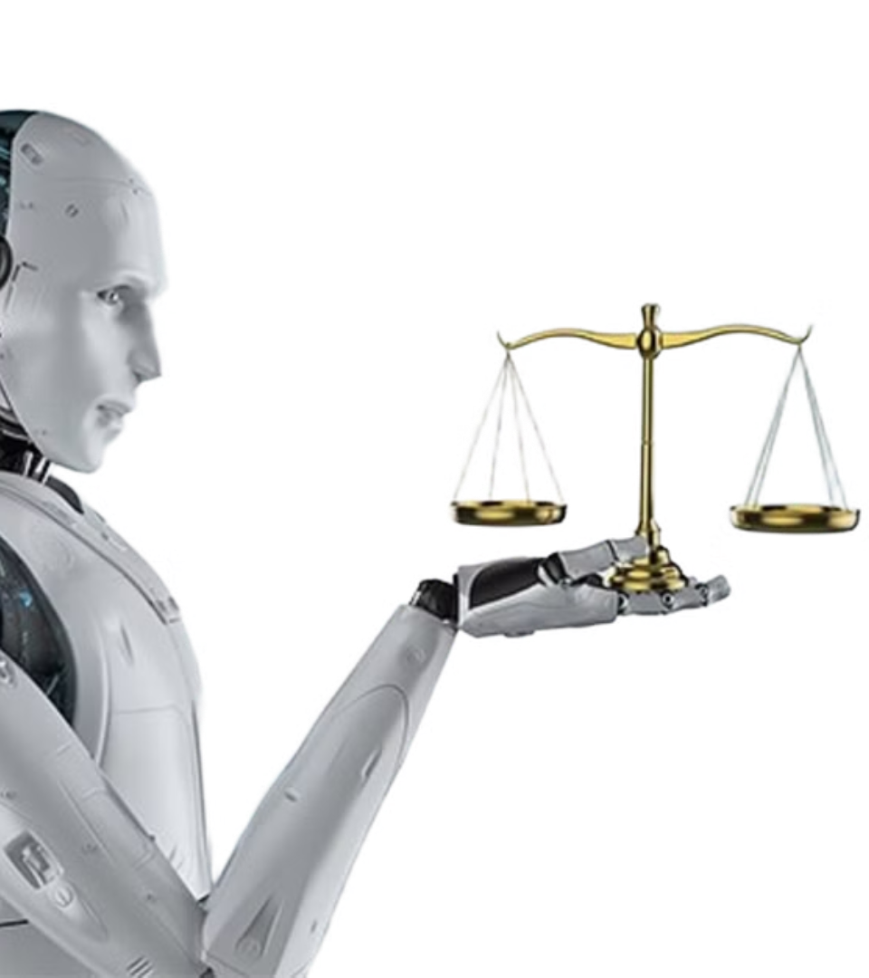
Inference Without Assumptions:
Detecting and Rewriting Social Bias
In Natural Language Inference.
​
Names:
Ariel Soffer​
Katherine Zablianov​​
Shay Yeffet​
Neta Robinzon Butbul​
Notes:
1

Slide 2
Problem Description and Objectives
Problem:
Natural Language Inference (NLI) systems often make gender-based assumptions when the context is insufficient. These assumptions can reflect harmful stereotypes and introduce social bias into applications like chatbots, search engines, or summarization tools.
Why it's important:
Biased language models can reinforce social inequalitie.
Misgendering and unwarranted gender inference harm user trust and fairness.
Ensuring balanced gender representation in AI outputs is essential for ethical deployment
Why it’s hard:
Gender bias in natural language is often subtle, contextual, and embedded in seemingly neutral language .
Many professional or social roles do not imply gender, but models often infer one anyway.
Addressing this requires context-aware detection and careful controlled rewriting of outputs.
Project Objectives:
Detect biased NLI sentence pairs where the second sentence introduces a gender reference not justified by the first.
Fine-tune baseline models by using pre-trained SBERT model, to classify sentence pairs as biased or not.
Use GPT-4o and GPT-3.5 models to rewrite biased outputs with balanced gender ratio of male and female sentences .
Evaluate the effectiveness of rewriting using embedding-based bias scoring.
Compare freezing strategies, model types, and prompting styles in both detection and mitigation stages.
Notes:
2

Slide 3
Formal Task Specification
Task 1: Bias Detection
Input:
Synthetic data we created of sentence pairs (Premise - first sentence, and Hypothesis - second sentence)
where the first sentence (the premise) describes a role, profession, a relative, of other person, and the second sentence (the hypothesis) include a gender term (like he, she,her, him,...) that refers to that entity .
Output:
Classification labels - "1" or "0".
If gender in the second sentence is assumed without justification from the first sentence (“My friend is a lawyer. She works...") , then it is biased, and label=1
In any other case - if the gender term in the second sentence is inferable and clear (“My mother is a lawyer. She works...), the pair is not biased and label=0
Metrics:
Classification Accuracy, F1, Recall, Precision
Task 2: Bias Mitigation (Rewriting)
Input: Sentence pairs labeled as biased
Output: Rewritten versions of the hypothesis (second sentence): rewritten gender-balanced sentences – expecting half of them to have a male term (like "he") and the other half to have a female term (like "she")
Metrics: Cosine similarity to “man”/“woman” embeddings , mean of distances ≈ 0
Notes:
3

Slide 4
High Level Plan
Data generation/labeling: generate a synthetic dataset by using prompt engineering and other specific labeling strategies (using names dictionary, gender terms dictionary and more)
Detection: Compare generative models like GPT-3.5, GPT-4o vs pretrained SBERT with different fine-tuning approaches and validation on labeled test partition
Rewriting: using generative LLMs like GPT4o to rewrite the biased sentences to be male/female sentences with a probability of 0.5
Evaluation Metric: "Embed 'man' and 'woman' reference phrases, measure cosine distances to compute gender bias scores. Based on the distance creating gendered sentence embeddings, and then calculating average biased score
Validation: Expect biased sets |score| >> 0, expect rewritten sets |score| ≈ 0 for successful debiasing
Notes:
4

Slide 5
Prior Art
Source/Title | Task Solved | Approach/Model | Data | Metrics | Results
“Counterfactually Augmented Data Improves Robustness in NLI” (Kaushik et al., 2020) | Robust NLI classification and fairness through counterfactual examples | BERT fine-tuned on original + human-edited counterfactuals | SNLI + counterfactual edits | Accuracy, Robustness Gap | Improved generalization and reduced reliance on biased heuristics
“BERT for Natural Language Inference” (Devlin et al., 2019, original BERT paper) | Sentence-pair classification including NLI | Fine-tuning pre-trained BERT on NLI datasets | MNLI, SNLI, SciTail | Accuracy | Achieved state-of-the-art performance on MNLI and GLUE benchmark
“StereoSet: Measuring stereotypical bias in pretrained language models” (Nadeem et al., 2021) | Evaluating social and gender bias in pretrained language models | StereoSet benchmark applied to BERT, RoBERTa, GPT-2 | StereoSet (stereotype vs. anti-stereotype triplets) | Bias score, LM score | Most LMs showed bias toward stereotypical completions

Slide 6
Data Preparation/Description
Name: labeled_dataset1
Link: dataset_link
Fields:
Sentence1: a general sentence that describes a situation with a person/role/profession without refering to its gender.
Sentence 2: a sentence that continues the privious one and mentions the gender of the person that was mentioned in it.
Label: 1 if there is contextual bias (gender term in sentence 2 can not be concluded from sentence 1), and 0 if there is not.
Data generation:
Using GPT4o model to create prompt instructions for a generative model
Improving the instruction and giving it to GPT 4o in a new session
Generating 30 samples each time, to acheive stability and diversity of samples
Based on generated samples, improving instructions and getting more accurate and relevant results
Notes:
6

Slide 7
Data Preparation/Description
Labeling process:
Collecting all terms from sentence 1 that indicate the gender of a person, like: aunt, father, Sean, Sister, Lily (names and family-gendered-terms) and creating 2 dictionaries from them: one for family terms and the other for names.
Writing code that searches for one of the words from these dictionaries in the first sentences, and if it finds one, it labels them as not biased=0. Otherwise, they are labeled as biased=0
To solve the problem of unisex names, we went through every name in the names dictionary we created, and constructed all Unisex names*
We wrote another code that find these Unisex names, and replaces them with explicit gender names*
Date properties:
Total Samples: 3,400 sentence pairs
Label Distribution:
Label 0: 1760 samples (about 50%)
Label 1: 1659 samples (about 50%)

Slide 8
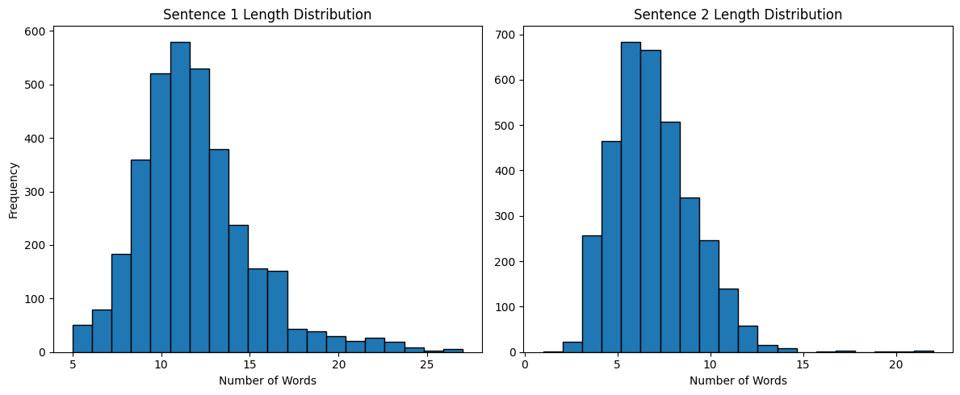
Data Preparation/Description
Input Features:
Vocabulary diversity: High — includes hundreds of professions, hobbies, family terms, and name variants
Lenth of input diversity: the length of sentence 1 and sentence 2 are different and diverse:
Example:
Sentence 1: “The firefighter, soaked in sweat, emerged with a rescued puppy.”
Sentence 2: “His bravery stunned the crowd.”
Label: 1 (Biased)
Explanation:
The pronoun "his" refers to the firefighter without knowing the gender. Since "firefighter" is a neutral form and in the second sentence the presumption is that it is a male, the gendered reference is not supported and thus, biased.
Notes:
8

Slide 9
Models
Chat GPT 4o/3.5 as a classifier model –
these models label 30 samples each time as biased/not biased in a loop we created, using API, and this way give their predictions.
Does not train on any data, but uses zero-shot inference based on instructions.
Code is written on colab.
Pre-Trained SBERT (sentence BERET) models with a classification head:
There are 3 versions of sbert models- pretrained:
One with 25% frozen layers (3)
One with 50% frozen layers (6)
One with 100% frozen layers (all 12 layers exept the classification head)
each model is pretrained on (NLI) datasets such as SNLI and MultiNLI, where the task involves determining the relationship (entailment, contradiction, neutral) between pairs of sentences
all 3 models are attached to a linear lwyer that represents the classification head
Embedding Layer: Unfrozen for better adaptability
Train-test-validation split:
Train: 64% | Validation: 16% | Test: 20% — achieved via an 80/20 split for train+val vs. test, then a 80/20
Notes:
9

Slide 10
Models
Configuration (SBert fine tuned models):
Epochs: 8
Batch Size: 16
Learning Rate: 2e-5
Weight Decay: 0.01
Early Stopping: Enabled (patience = 2 epochs)
Evaluation Metrics: F1 score (main), Accuracy, Precision, Recall
Logging: Every 10 steps
Best Model Loading: Based on highest validation F1
Platform: Google Colab
GPU: NVIDIA L4 (via Colab runtime)

Slide 11
Metrics of Classifier models:
Accuracy: Overall correct predictions.
Precision: Correctly predicted biased cases out of all predicted biased.
Recall: Correctly predicted biased cases out of all actual biased.
F1 Score: Harmonic mean of precision and recall — primary metric
.
IN the SBert fine-tuned models:
During training:
Metrics are computed on the validation set at the end of each epoch to monitor generalization and avoid overfitting.
eval_f1 is used to select the best model (load_best_model_at_end=True in TrainingArguments).
During final evaluation:
The model is tested on a held-out test set, and all four metrics are computed and reported for comparison across different fine-tuning strategies (25%, 50%, full 100%).
Metrics
Notes:
11

Slide 12
Metrics
In the gpt3.5 and gpt4o label classification:
zero-shot inference based on instructions, evaluation using accuracy, precision, recall and f1_score metrics.
Rewriting Evaluation metric defenition:
preparing two “gender key phrases”: “man “ and “woman”
Creating embedding each of the phrases and producing reference embeddings “wembedding” and “membedding”
Measurring distance (cosine similarity) between each of these gender embeddings and the second sentence in each dataset pair.
Adding a negative sign to the men's distance and a positive sign to the women's distance.
Computing the average score, which is the average distance of sentences from zero.
Evaluation
Expecting biased sentences to be far from zero (abs(score)>>0)
Expecting them to be much more close to 0 after rewriting: abs(score))~0

Slide 13
Code Organization
Link to Github: https://github.com/Neta-Robinzon-Butbul/Modular_Pipeline_for_Gender_Bias_Mitigation_in_NLI
Data:
Dataset.csv - dataset_of_pairs_link
Gpt3.5_predictions.csv - gpt_3.5_predictions_link
Gpt4o_predictions.csv -gpt_4o_predictions
Notebooks:
data_labeling.ipynb - Labeling_and_cleaning_pairs_dataset_link
train_sbert_classifier.ipynb - training_sbert
gpt_prediction_loop.py - prediction_loop_ggot_gpt_baselines
Evaluation_metrics_function_gpt.py - evaluation_metrics_for_gpt_baselines|
Link to colab notebook: colab_notebook_link
Notes:
13

Slide 14
Intermediate Results and Baseline
Goal: Evaluate baseline models and intermediate results before selecting the best-performing SBERT classifier
Intermediate SBERT Classifiers (Fine-Tuned)
All models trained on pseudo-labels generated by GPT:
Model | Accuracy | F1 Score | Precision | Recall | Notes
GPT-3.5 | 60.7% | 56.2% | 61.3% | 51.8% | Zero-shot prompt
GPT-4o | 68.5% | 53.7% | 94.2% | 37.5% | More robust output
Model | Accuracy | F1 Score | Precision | Recall
SBERT (25% frozen layers) | 90.6% | 90.7% | 90.6% | 90.6%
SBERT (50% frozen layers) | 90.2% | 90.3% | 90.2% | 90.2%
SBERT (all layers are frozen exept classification head) | 42.3% | 78.9% | 78.9% | 78.9%
Notes:
14

Slide 15
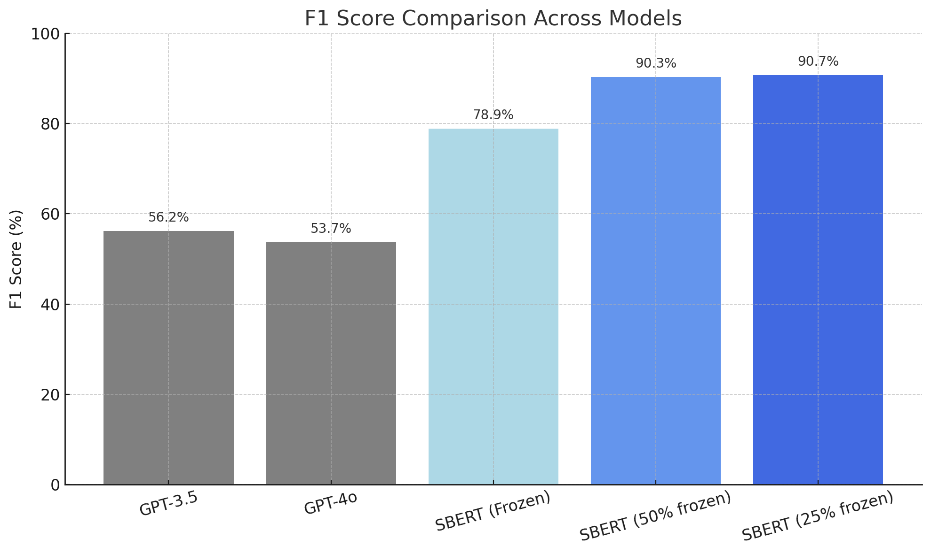
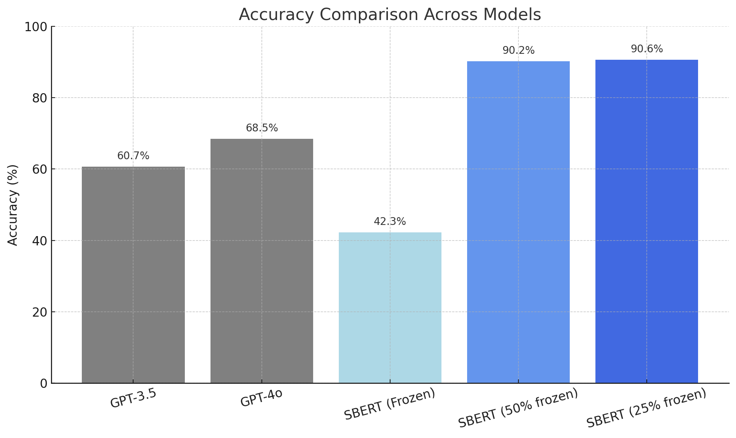
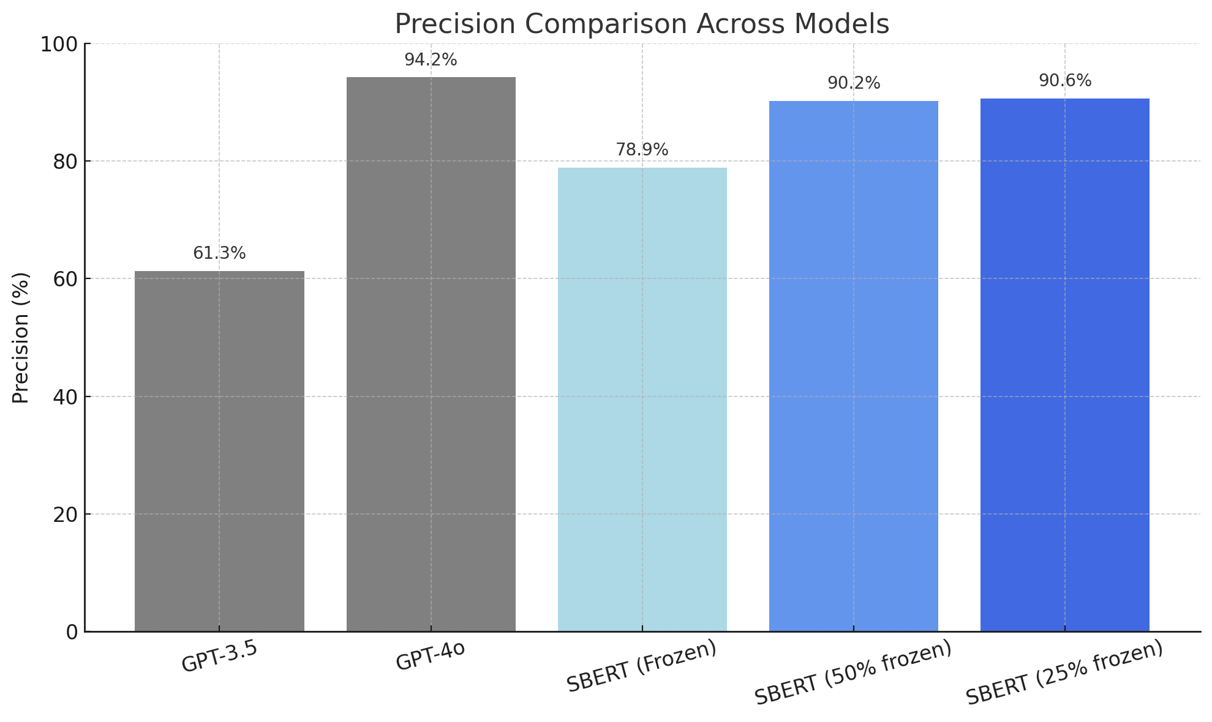
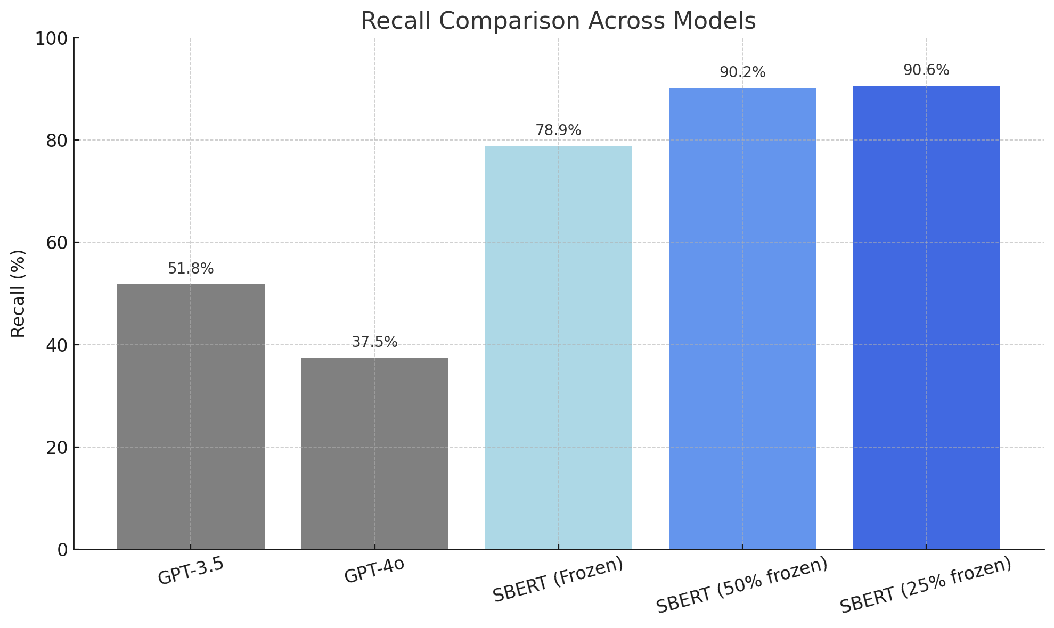
Results visualization and Conclusions
Insights:
First, we can see that our pre-trained SBERT models echived the highest results and outperformed the GPT models, despite their size (as expected, because the GPT models did not train).
Best Overall Model: SBERT with 25% Frozen Layers
This model acheived F1 = 90.7% on the test set — the highest among all models, and also reached balanced high precision and recall (90.6%), indicating strong, stable classification across all sentence types.
Although the 25% frozen layered fine-tuned SBERT model acheived the best results on the test set, it was not very far from the 50% frozen one, that got to very close results. That indicates that if we want to train less and save some time and resources, we can also use this model.
As expected, the 100% frozen layered fine-tuned SBERT acheived poor and unstable results, since it was fine tuned and trained only on the classification head (all the rest of the layers were frozen).
GPT models performed very badly, and got unstable results between different metrics. GPT 3.5 was worse than GPT4o (as expected)
Notes:
15

Slide 16
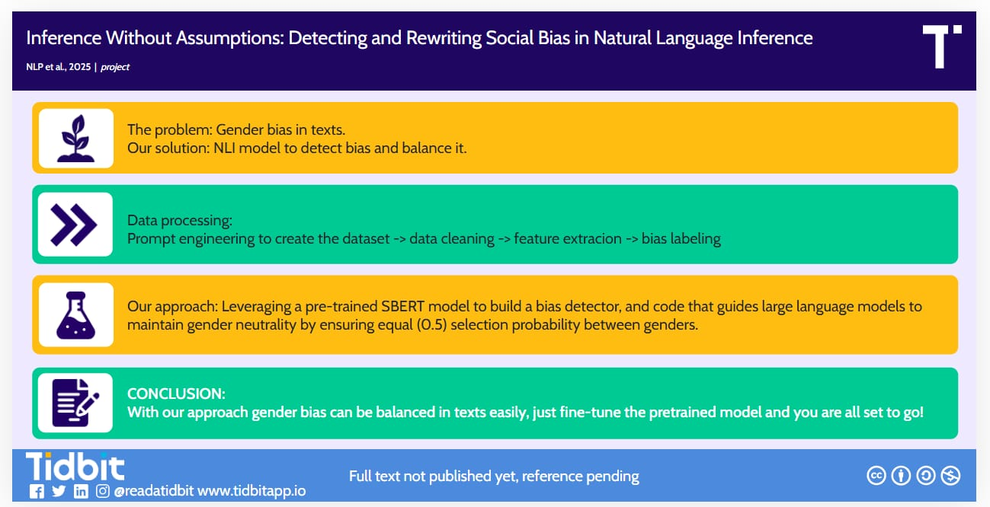
Visual Abstract

