Slide 1
WILDCAST
Forecasting where animals move next
One animal’s history.
Many plausible futures.
Probabilistic movement forecasts from 1 hour to 90 days
108 training taxon labels
Four predictors, one ensemble
Measured local gains
Research objective: frontier migration forecasting
Evidence: immutable corrected cache; current packaged ensemble; matched local development panel.
WILDCAST / DEVELOPMENT EVIDENCE / 8 NOV 2026
1
Notes:
WildCast predicts an individual animal's possible future locations, from one hour to ninety days. The goal is a frontier migration model. What we have today is a probabilistic movement model with an encouraging local benchmark result, broad training coverage, and a clear path to stronger evidence.
Evidence
evidence.json
reports/migration-public-panel-v1/metrics.json

Slide 2
DATA AND SCOPE
The dataset and the inputs
34.8M
799,681
108
reviewed position observations
training forecast origins
training taxon labels
Public animal tracking studies
Current leading inputs
131 study labels in TRAIN
Terrestrial animals, birds and marine examples
Observed GPS + timestamps + species
Derived season, velocity and daylight
108 labels = 107 species names + Testudinidae (family). Observed future positions are never interpolated.
Sources: corrected manifest and source preflight; migration_repaired_features.py. Forecast origins are not independent animals.
WILDCAST / DEVELOPMENT EVIDENCE / 8 NOV 2026
2
Notes:
We reviewed 34.8 million position observations from public tracking studies. The corrected training set contains about 800,000 forecast origins across 108 taxon labels: 107 species names and one tortoise family label. Training data represents 131 study labels, including terrestrial animals, birds and some marine species. Our current leader takes observed GPS history, species and time. Season, recent velocity and daylight are derived from that history. Weather, currents, habitat, age and sex are not yet inputs to the leading model. Missing observations remain explicitly missing, and future positions are never interpolated into training labels.
Technical detail
144 study labels have cases across all splits; 131 have TRAIN cases. There are 4,300 conservative training exclusion groups, not a certified count of biological animals. The leader excludes weather, currents, habitat, infrastructure, age and sex. Missing history is masked.
Evidence
evidence.json
study-inventory.csv
taxon-inventory.csv
artifacts/migration-current-ensemble-v1/data/reference/manifest.json

Slide 3
ARCHITECTURE
From observed history to plausible futures
Observed history
Four joint predictors
Joint future distribution
29 lag slots + masks
Species + 22 derived features
Minutes through one year
Causal Transformer encoders
Direct location × 2
Goal route × 2
8 components per predictor
Weighted ensemble
64 sampled paths × 9 horizons
≈35M total parameters
A predictor is selected once per complete sampled route
Sources: migration_model.py; migration_ensemble.py; packaged member configurations and weights in evidence.json.
WILDCAST / DEVELOPMENT EVIDENCE / 8 NOV 2026
3
Notes:
We encode the animal's observed history at 29 lag slots, covering minutes through a year, together with masks, species and 22 derived features. Four predictors use causal Transformer history encoders: two forecast locations directly, and two parameterize a route through a possible destination. Each predicts an eight-component joint distribution across nine horizons. A learned ensemble selects a predictor for each complete sampled route. This lets us retain different plausible destinations and dependence between future times, rather than forcing one average path. The complete ensemble contains about 35 million parameters.
Technical detail
Compact experts have width128/layers2; scaled experts width512/layers6, with4 attention heads in each encoder. Each component has9×2 mean coordinates and an18×18 structured covariance. The goal-route parameterization is a destination/timing/curve bias, not an externally supplied destination. Weights are global, not an animal-specific gating network.
Evidence
wildcast/migration_model.py
wildcast/migration_ensemble.py
evidence.json

Slide 4
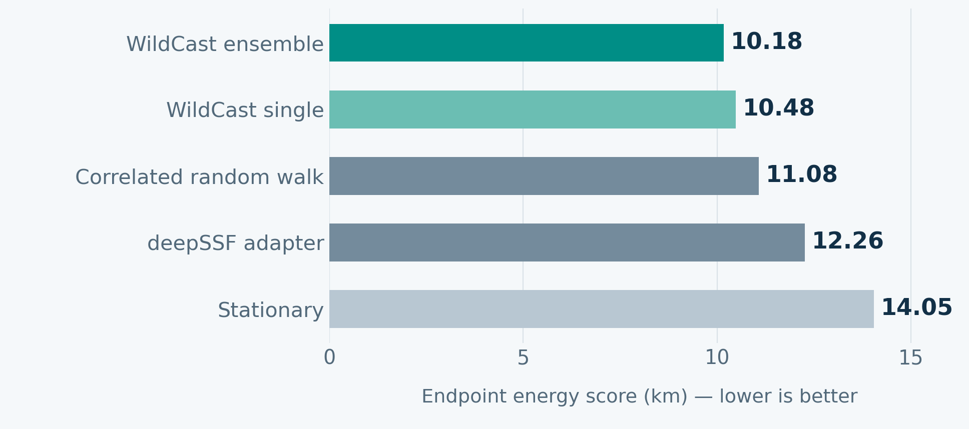
MEASURED COMPARISON
Better scores on the matched local panel
4,096 identical origins • 1h / 12h / 1d • 64 samples
8.1%
lower than CRW
17.0%
lower than deepSSF
Energy evaluates the full predicted distribution. Development results are averaged across two validation splits.
Source: migration-public-panel-v1/metrics.json. Local adaptations; ensemble probabilities fitted on development; no official MoveBench rank.
WILDCAST / DEVELOPMENT EVIDENCE / 8 NOV 2026
4
Notes:
For a controlled local comparison, every method forecast the same 4,096 origins at one hour, twelve hours and one day, with 64 samples. The ensemble's endpoint energy score is 10.18 kilometres, versus 11.08 for a correlated random walk and 12.26 for the deepSSF adaptation. Lower scores mean better predicted distributions. That is about eight percent and seventeen percent lower, respectively. These are development results from local method adaptations. Ensemble weights used development data, and this is not an official MoveBench ranking or an independent final test.
Technical detail
8,831 observed targets. Equal conservative identity weight within species, then horizons and validation splits. deepSSF uses its selected trained epoch3 checkpoint. More recent MoveFormer and iSSF runs are excluded from this fixed table until a common64-draw comparison is complete. Energy is not metabolic energy or a percentage accuracy score.
Evidence
reports/migration-public-panel-v1/metrics.json
reports/migration-public-panel-v1/comparison-summary.json

Slide 5
EVIDENCE AND DESIGN RATIONALE
Why combining predictors can help
History and season
Several possible futures
Complementary predictors
Connect recent movement
with annual context
Represent different destinations
and uncertainty over time
Combine direct forecasts
with a destination-based bias
2.9%
lower energy than our strongest single predictor
The gain is concentrated in unseen animals. The held-out-year difference is small and uncertain.
Sources: matched public-panel scores and paired cluster bootstrap; model source. Mechanisms below are hypotheses, not isolated causal findings.
WILDCAST / DEVELOPMENT EVIDENCE / 8 NOV 2026
5
Notes:
The design combines recent movement and seasonal context, represents several possible futures, and mixes direct and destination-based predictors. The evidence for combining predictors is specific: on this same panel, the ensemble improves the score by 2.9 percent over our strongest single model. Most of that improvement is in the unseen-animal split; the held-out-year gain is small and uncertain. The architectural mechanisms are plausible explanations, but we still need controlled ablations to establish which features cause the gain. We cannot claim that every component independently outperforms every alternative.
Technical detail
Ensemble vs single: val_individual7.866 vs8.454km; val_year12.488 vs12.515km. The year-split paired95% Bayesian bootstrap interval includes zero. These intervals are conditional on observed exclusion blocks and do not adjust for model selection. Controlled feature/architecture ablations and independent test evidence are still needed.
Evidence
reports/migration-public-panel-v1/metrics.json
reports/migration-public-panel-v1/comparison-summary.json

Slide 6
WHAT COMES NEXT
Constraints and the next improvements
Current constraints
Priorities
Environment and demographics missing
Uneven species and regional coverage
Movement labels mix migration and residence
Independent final test still pending
1 Freeze independent public comparisons
2 Add dated environmental and trait data
3 Expand independent marine populations
4 Validate calibration and transfer
Today: promising local gains. Next: demonstrate reliable superiority on independent data.
Sources: current input code, metadata proposal, context trials and evaluation scope. Frontier superiority remains unestablished.
WILDCAST / DEVELOPMENT EVIDENCE / 8 NOV 2026
6
Notes:
The main constraints are incomplete environmental and demographic inputs, uneven species and regional coverage, and limited independent evaluation. Movement observations also do not always identify active migration. Human built-up maps are being tested with controls; completed adaptation attempts have not improved the leader. Next, we need a frozen independent test and stronger public comparisons, then issue-available weather, ocean conditions, habitat and infrastructure, with reliable age and sex metadata. We should expand independent marine populations and check uncertainty under geographic and temporal shift. The claim today is a useful, fast model with promising local gains, while frontier superiority remains to be demonstrated.
Technical detail
Human-pressure trials use GHSL built-up surface with prior nominal epochs and retrospective-vintage flags. Completed fine-tuning/frozen-projection attempts did not beat the GPS parent; training from original initialization remains under evaluation. GHSL is not a complete road/fence/habitat layer. Weather/ocean additions must respect forecast issue availability. Current architecture forecasts individuals, not social interactions or whole populations.
Evidence
wildcast/migration_context_joint.py
reports/migration-causal-deployment-feature-proposal-v1.json
reports/migration-delivery-v1-status.json

