Slide 1
HW2 · BISTABLE NMDA / KIR DENDRITE
Can a sleep-tuned dendrite handle
wake-like bursts?
A single dendrite detects ordered spike sequences by propagating a plateau from distal to proximal segments. We ask whether that mechanism survives when wake-like bursts introduce temporal overlap, and which fixes restore it.
Shay · Li
Notes:
Welcome. Our project asks a single, concrete question: the HW2 dendrite was tuned in a sleep-like regime where each neuron fires clean, well-separated bursts. Real wake activity is messier, with bursts that overlap in time. Does the sequence-detection mechanism still work under that overlap, and if it breaks, what fixes it? The core mechanism: this is one dendritic cable of 12 segments. The four most distal segments (0-4) are pre-set into a plateau (the 'up' state). Detection happens at segments 5 through 8. When the target sequence arrives in the right order, each segment's synaptic input arrives just as the plateau front diffuses into it, so the up-state propagates proximally, one segment at a time, like a row of dominoes. Wrong order, and the front stalls. Roadmap: Shay covers Overview, Swap Tolerance, NMDA Scaling, and the Recommendation; Li covers Input Regimes, Conductance Dynamics, and the First-Spike Rule. We tested three candidate fixes for overlap: swap tolerance, the first-spike rule, and synaptic NMDA scaling.

Slide 2
OVERVIEW · SHAY
The mechanism, and the question
How detection works
12 segments form one dendrite. Segments 0-4 are held in a plateau. As the target sequence [5, 6, 7, 8] arrives in order, each segment fires just as the up-state front reaches it, so the plateau walks proximally, segment by segment.
Why bursts threaten it
Sleep-like input gives each neuron a clean, separated burst. Wake-like input lets bursts overlap, blurring the timing boundary between adjacent positions and risking ambiguous or false detection.
seg 0
plateau pre-set
seg 1
seg 2
seg 3
seg 4
seg 5
detection zone
seg 6
seg 7
seg 8
seg 9
distal buffer
seg 10
seg 11
Fix 1: Swap tolerance
score by order, allow one violation
Fix 2: First-spike rule
one timing marker per neuron
Fix 3: NMDA scaling
scale synaptic NMDA gain
1
Notes:
Let me ground the whole talk in one picture. This is a single dendritic cable, discretized into 12 segments. The four distal segments, 0 through 4, start already in the plateau, or up-state. Detection happens at segments 5, 6, 7, 8 (the teal band). The target we want the dendrite to recognize is the sequence 5, 6, 7, 8 arriving in that order. The propagation logic: a segment flips to the up-state only when two things coincide, its own synaptic input AND the plateau front having diffused in from the neighbor just distal to it. So when inputs arrive in the correct distal-to-proximal order, each new segment is 'primed' by the front exactly as its own input lands, and the plateau walks down the cable. If inputs arrive out of order, a segment gets its input before the front arrives, the coincidence fails, and propagation stalls. That order-sensitivity IS the sequence detector. Why we worried: the original tuning assumed sleep-like input, clean bursts well separated in time. Under wake-like conditions bursts overlap, and overlap smears the arrival times of adjacent positions together. Our hypothesis was that non-overlapping bursts preserve order but overlapping bursts collapse the timing and produce ambiguous or false detections. The three fixes at the bottom (swap tolerance, the first-spike rule, and NMDA scaling) are what we evaluated, and they structure the rest of the talk.

Slide 3
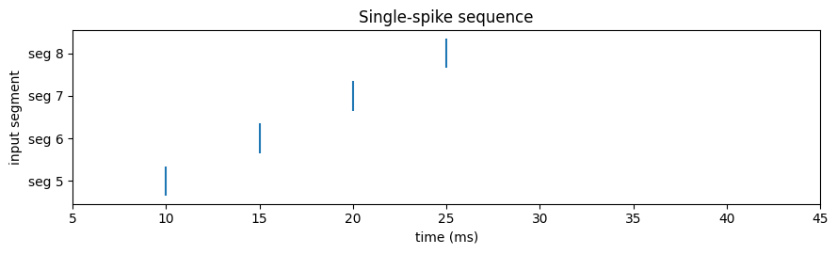
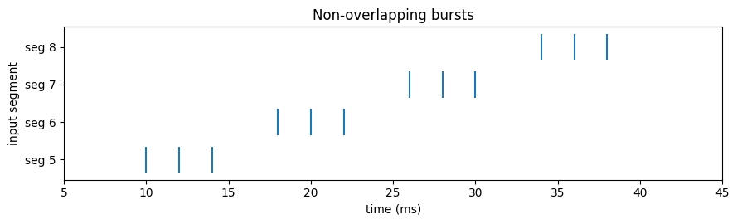
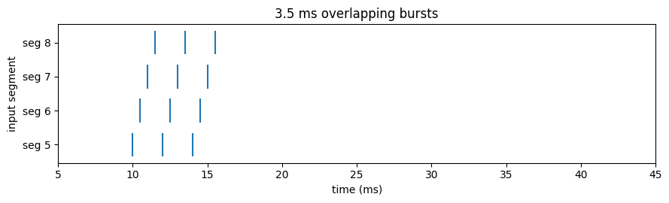
INPUT REGIMES · LI
Baseline: From single spikes to overlapping bursts
Single spike per neuron: the minimal, idealized input
Non-overlapping bursts: sleep-like, clean separation
Overlapping bursts (3.5 ms): wake-like, timing begins to blur
2
Notes:
These three rasters define the input ladder we sweep across. Each row of dots is one presynaptic neuron mapped to a detection segment; the x-axis is time in milliseconds. Top: the minimal case, one spike per neuron, staggered in time to encode the order 5, 6, 7, 8. This is the cleanest possible drive and it's where the mechanism is easiest to satisfy. Middle: non-overlapping bursts. Each neuron now fires a 3-spike burst (ISI 2 ms, so the burst spans 4 ms), but the bursts are spaced far enough apart that they don't run into each other. This is the sleep-like regime the dendrite was tuned for. The order information is still cleanly readable. Bottom: overlapping bursts at 3.5 ms onset spacing, our wake-like stress case. Now the burst from segment 5 is still firing when segment 6's burst begins, and so on, so the four bursts interleave in time. Visually you can already see the timing boundary between adjacent positions blurring. The question for the next several slides is what that overlap does to the conductances and the plateau, and that's the bridge into Conductance Dynamics.

Slide 4
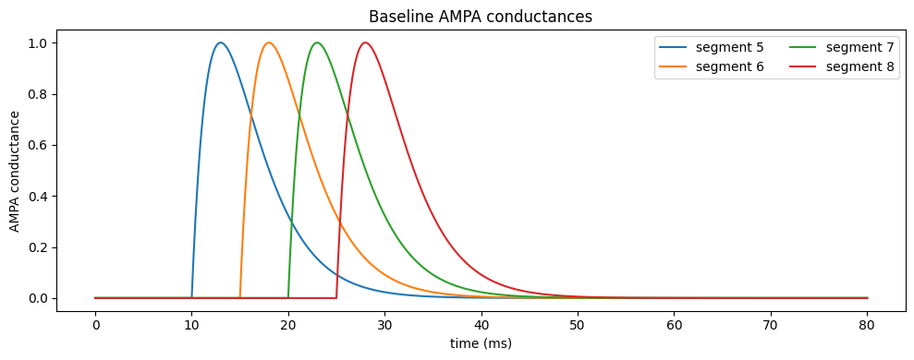
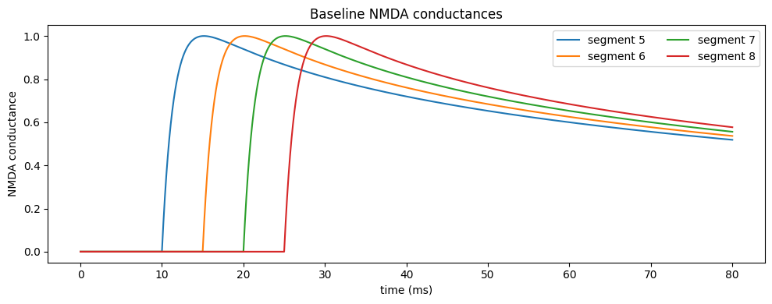
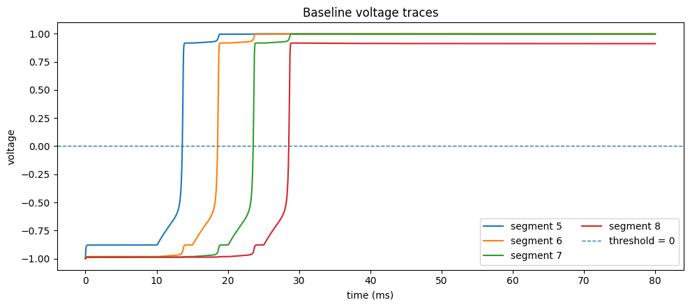
CONDUCTANCE DYNAMICS · LI
Baseline: what one clean input does
AMPA conductance: fast, transient
NMDA conductance: slow, lingering
Voltage traces: the plateau walks 5 → 6 → 7 → 8 in order
3
Notes:
This is the baseline, the reference everything else is compared against: the forward sequence with clean, non-overlapping input. Top-left is the AMPA conductance, top-right the NMDA conductance, both for the detection segments; the bottom panel is the membrane voltage of each segment. Two timescales to notice up top. AMPA (left) rises and falls fast, its time constant is 3 ms, so each input produces a sharp, transient bump that's essentially gone within about 10 ms. NMDA (right) is slow: its kernel is a sum of exponentials with decay constants of 12.6, 57.3, and 372 ms, so each input opens a conductance that lingers for tens of milliseconds. That slow NMDA tail is what holds a segment in the up-state long enough for the next segment to catch up. Hold onto this contrast, the next slide shows how it behaves under bursts. The bottom voltage panel is the payoff: the segments cross into the up-state in strict order, 5 then 6 then 7 then 8, each lagging the previous by a few milliseconds. That staircase IS a successful detection. The whole rest of the section asks how this picture deforms as we move from single spikes to bursts to overlapping bursts.

Slide 5
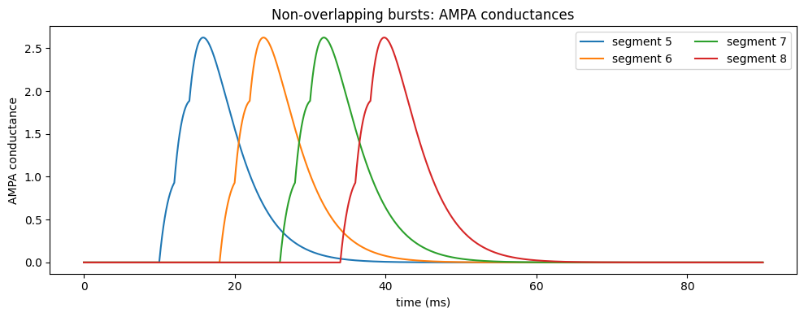
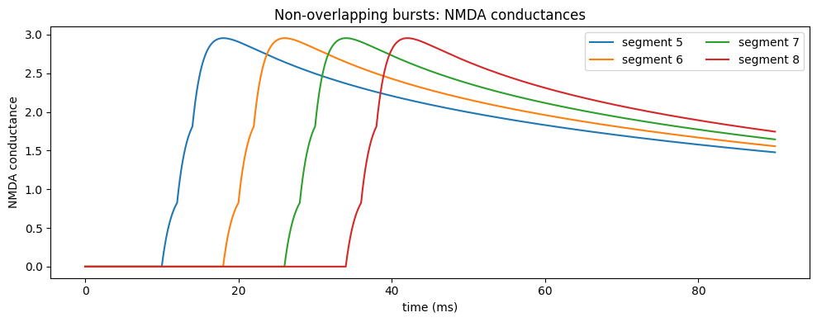
CONDUCTANCE DYNAMICS · LI
Bursts: NMDA accumulates, AMPA does not
Non-overlapping bursts, detection segments
AMPA under a burst: three separate transients
NMDA under a burst: the three contributions sum
4
Notes:
Now each neuron fires a 3-spike burst, ISI 2 ms, but bursts are still non-overlapping. Compare the two channels under that burst. AMPA, on the left: because its 3 ms time constant is comparable to the 2 ms spacing, you see three distinct, mostly separate transients; the channel keeps collapsing back toward zero between spikes. Very little carries over. NMDA, on the right: because its decay constants (12.6, 57.3, 372 ms) are far longer than the 2 ms ISI, the conductance from the first spike has barely faded when the second and third arrive. The three contributions stack on top of each other, so the summed NMDA conductance climbs to a noticeably higher peak than any single spike would give, and stays elevated. This temporal summation is exactly the residual effect we isolate two slides from now. It's also the reason a burst latches a segment more firmly than a lone spike: the slow channel integrates the burst into one sustained drive while the fast channel just sees three blips.

Slide 6
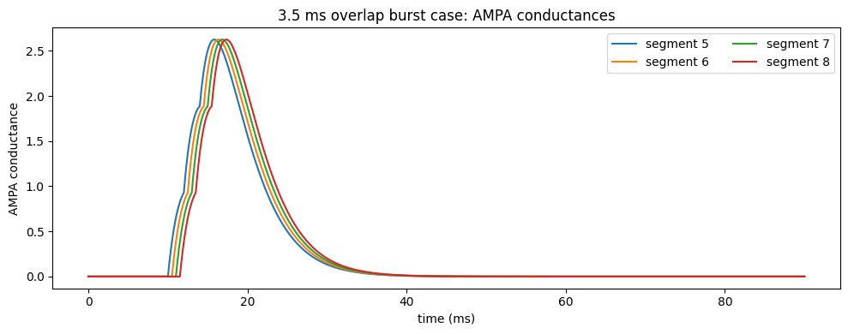
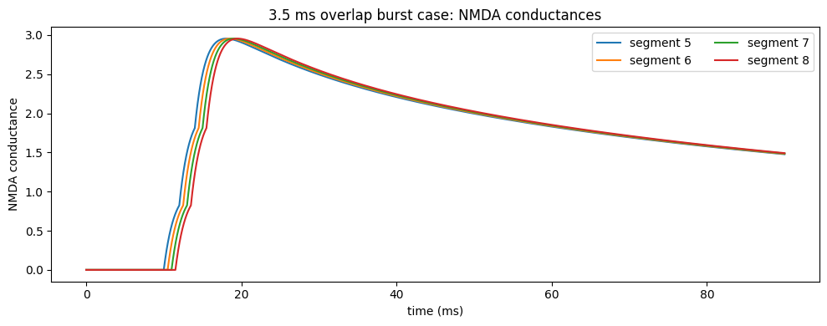
CONDUCTANCE DYNAMICS · LI
Overlap: the channels blur together
Overlapping bursts (3.5 ms onset spacing), detection segments
AMPA, overlapping bursts (3.5 ms)
NMDA, overlapping bursts: segments' tails merge
5
Notes:
Same two channels, now under the wake-like overlapping bursts at 3.5 ms spacing. The point of this slide is what overlap does ACROSS segments. Because the bursts now interleave in time, the slow NMDA tails of adjacent segments (right panel) merge into one another: segment 6 is still riding segment 5's residual when its own burst lands, segment 7 on top of that, and so on. The clean per-segment staggering you saw at baseline is washed out, the conductance landscape no longer carries a sharp distal-to-proximal ordering. AMPA (left) blurs less because it decays fast, but it also carries less of the integrating drive. This is the mechanistic root of the failure mode: the dendrite reads order from the relative timing of when segments reach threshold, and overlap erodes exactly that timing separation. So the very property that makes NMDA good at latching a burst, its long memory, is also what lets adjacent bursts bleed together under overlap. That tension is the through-line for the fixes in the second half of the talk.

Slide 7
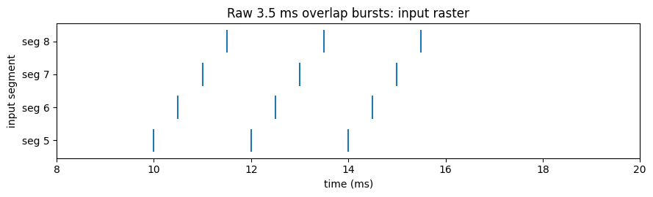
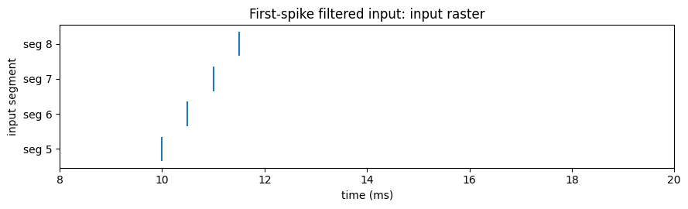
FIRST SPIKE RULE · LI
One timing marker per neuron
Inspired by the Spiking Manifesto: represent each burst by its first spike only, so the dendrite receives a single clean timing marker per neuron instead of several overlapping spikes.
Outcome by spacing
Spacing
Raw bursts
First-spike
0.5 ms
Plateau, no sequence
Fails to propagate
≥ 1.0 ms
Sequence success
Sequence success
Raw overlapping bursts (3.5 ms)
Filtering removes the overlap but also removes the summed drive: at 0.5 ms there is no longer enough conductance to propagate, so segment 8 never fires.
First-spike filtered: one marker each
9
Notes:
Second fix, the first-spike rule, and this one comes with a caveat. The motivation, borrowed from the Spiking Manifesto, is upstream filtering: since overlapping bursts blur the timing boundary between adjacent positions, why not collapse each burst to just its first spike? Then every neuron contributes exactly one clean timing marker, and there's nothing left to overlap. The two rasters show the transform: raw overlapping bursts on top, the filtered one-marker-per-neuron version below. It looks like it should help, and the order information does survive the filter. But look at the table. At spacing 1.0 ms and above, both the raw bursts and the first-spike version succeed, fine. At very tight 0.5 ms spacing, things diverge in an instructive way: the raw bursts at least form a plateau (though not a clean sequence), but the first-spike-filtered version fails to propagate at all, segment 8 never reaches threshold, the final voltage actually goes negative. The reason ties straight back to the residual slide: by throwing away spikes 2 and 3, we also throw away the NMDA summation that gives each segment enough sustained drive to latch. So first-spike filtering trades the overlap problem for an under-drive problem. It helps at moderate spacing but it is not a free lunch at tight spacing, you can see the failure directly in the voltage traces on the next slide.

Slide 8
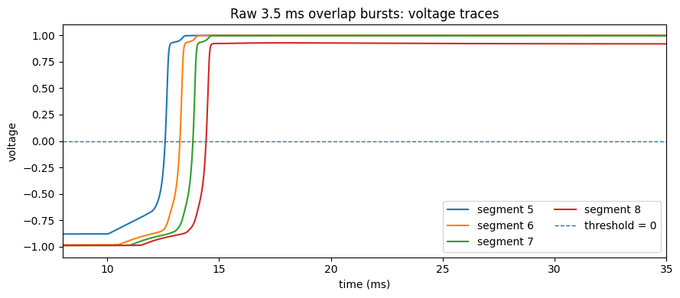
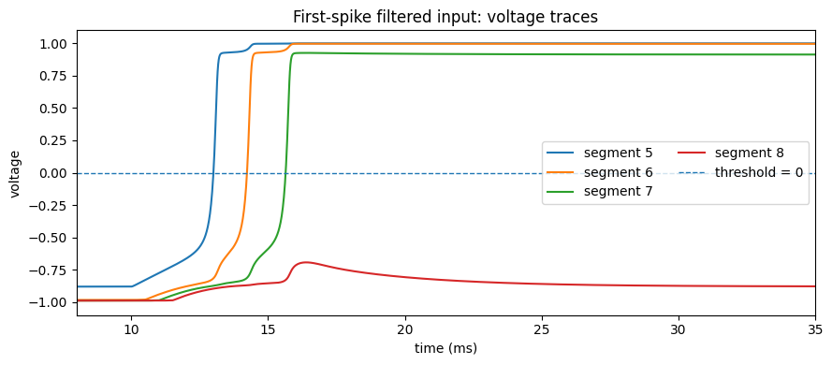
FIRST SPIKE RULE · LI
It propagates: until the spacing is too tight
Raw bursts: voltage propagates
First-spike filtered, 0.5 ms: segment 8 fails
10
Notes:
Here are the voltage traces that make the trade-off concrete. Left: the raw overlapping bursts, voltage propagates across the segments, the up-state does move down the cable. Right: the first-spike-filtered case at the tight 0.5 ms spacing, and you can see segment 8 simply never crosses into the up-state, its activation time is undefined and the final membrane voltage settles negative, around minus 0.88. The plateau front dies before it reaches the last detection segment. So the verdict on the first-spike rule is nuanced. It's a legitimate idea and it does clean up the overlap, at moderate spacing (1 ms and up) it works just as well as the raw input. But because it discards the second and third spikes of every burst, it also discards the NMDA temporal summation those spikes provide, and at tight spacing that lost drive is fatal, the cell can no longer sustain propagation to segment 8. It's a filter that helps with one failure mode while introducing another. That sets up the contrast with the next fix, NMDA scaling, where Shay asks whether we can instead turn the synaptic gain up directly. As we'll see, that particular knob is a dead end, which is what makes the comparison interesting.

Slide 9
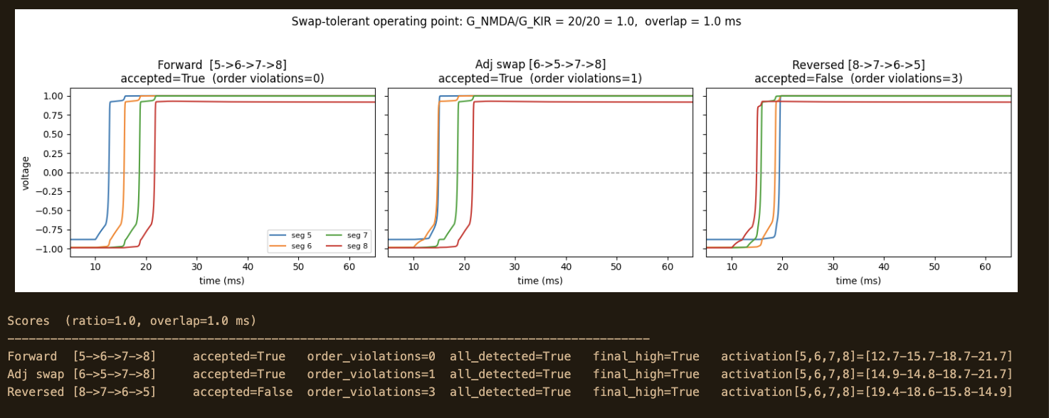
SWAP TOLERANCE · SHAY
Scoring by order, not exact timing
ratio 1.0, overlap 1.0 ms
Forward
accepted: 0 violations
Adjacent swap
accepted: 1 violation, within budget
Reversed
rejected: 3 violations
Forward, adjacent-swap, and reversed inputs with detection scores
7
Notes:
Now the first fix, swap tolerance, and this is the one I (Shay) think is the cleanest win. The idea: instead of demanding the segments fire at exact target times, we score by ORDER and allow a small budget of order violations. Forward gets a budget of 0; swap and reversed cases get a budget of 1. Three columns, all at intrinsic ratio 1.0 and a mild 1.0 ms overlap. Left, the forward sequence: segments activate at roughly 12.7, 15.7, 18.7, 21.7 ms, strictly increasing, zero violations, accepted. Middle, an adjacent swap, where two neighboring positions trade order: activation times come out around 14.9, 14.8, 18.7, 21.7, that's a single inversion, one violation, which is within budget, so it's accepted. That's the whole point of swap tolerance, a biologically reasonable amount of timing jitter shouldn't break detection. Right, the fully reversed input: activations run backwards, around 19.4, 18.6, 15.8, 14.9, three violations, well over budget, correctly rejected. So the mechanism does the right thing at this operating point: it's robust to a small swap but still says no to a genuinely scrambled, reversed sequence. The natural next question is how wide that tolerant zone is across overlap and intrinsic balance, which is the phase diagram on the next slide.

Slide 10
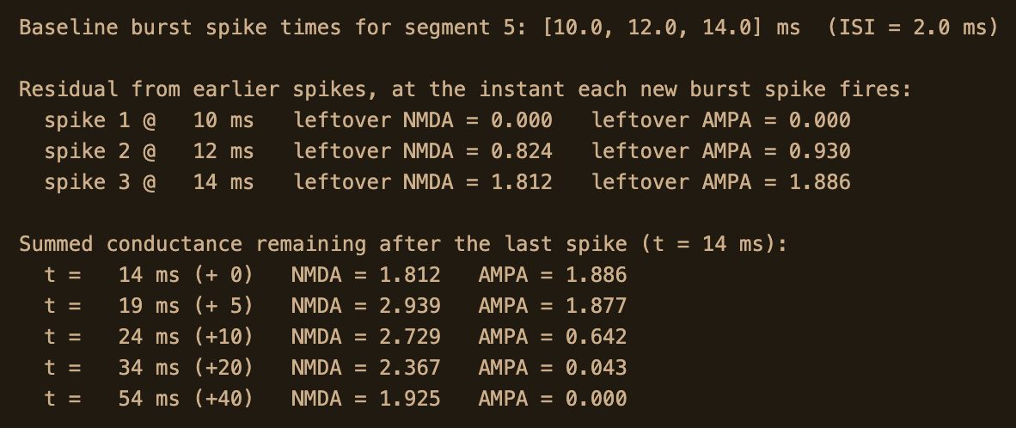
CONDUCTANCE DYNAMICS · LI
The residual that adds up
Anchored to the Section-2 baseline
No re-simulation. We take the exact spikes the baseline injected into segment 5 (10, 12, 14 ms) and evaluate the conductance kernels directly.
What persists after the burst
At 2 ms spacing both channels sum a little during the burst, so summation alone isn't the story. The distinction is persistence: 20 ms after the last spike, NMDA still holds 2.37 while AMPA has fallen to 0.04.
This residual is what every simulate_dendrite call relies on, realized by g_NMDA_vector summing all spike kernels.
Same baseline burst, segment 5: single spike vs. all three summed
6
Notes:
This slide isolates the single mechanism behind everything: the NMDA residual. Important methodological note, this is NOT one of the 504 sweep simulations, and it doesn't re-simulate anything. We anchor it to the baseline from Section 2: we take the exact spike times the baseline injected into the first detection segment, segment 5, which fired at 10, 12, and 14 ms, and we just evaluate the synaptic conductance kernels those spikes produce. Read the figure as single-spike (dashed) versus all-three-summed (solid), for each channel. Now the honest refinement, and please say this carefully because it's a subtlety we corrected: at a 2 ms ISI, BOTH channels actually sum a bit while the burst is still firing. So 'NMDA sums and AMPA doesn't' is too glib. The real distinction is what survives AFTER the burst ends. NMDA holds its accumulated conductance for tens of milliseconds, across the plateau window that latches the segment; AMPA collapses within about 10 ms. The hard numbers: 20 ms after the last spike, summed NMDA is still about 2.37 while AMPA has fallen to about 0.04, nearly two orders of magnitude apart. Why it matters for the project: in code, this is g_NMDA_vector summing the kernels of all spike events inside simulate_dendrite. That persistence is what lets a segment stay up long enough to prime its neighbor, and it's also, as we just saw, what lets adjacent bursts merge under overlap. One mechanism, both the feature and the failure.

Slide 11
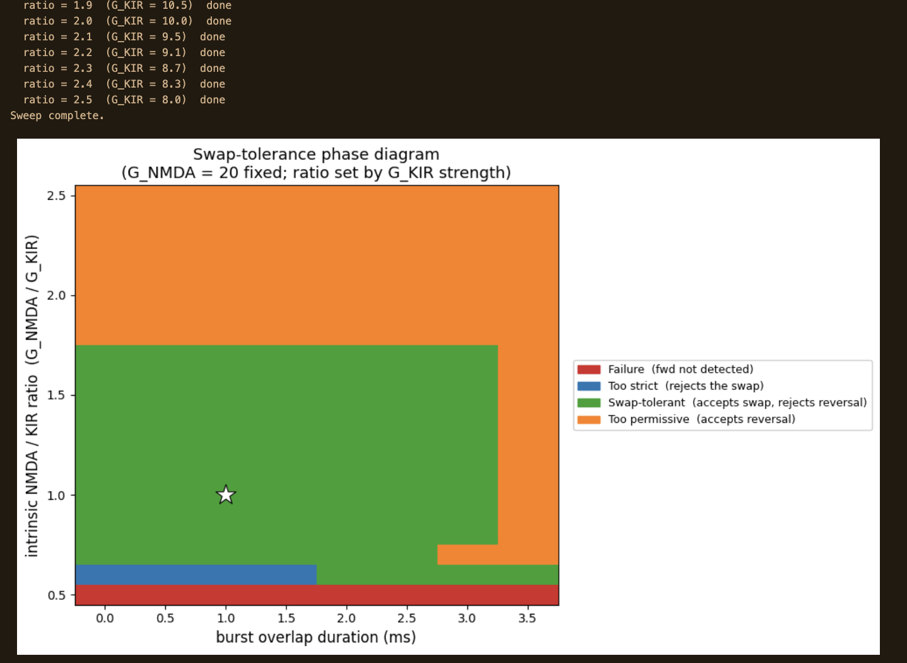
SWAP TOLERANCE · SHAY
How wide is the tolerant zone?
Failure front never propagates (KIR too strong)
Too strict rejects valid swaps
Swap-tolerant the target operating zone
Too permissive accepts reversed input
The green swap-tolerant band is broad: it holds for overlap up to roughly 3 ms and is robust around ratio ≈ 1. The white star marks our (1.0, 1.0) operating point.
Failure appears at low ratio (KIR dominates and nothing propagates); too-permissive appears only at high ratio combined with severe overlap.
Regime vs. intrinsic ratio (x) and burst overlap (y)
8
Notes:
This phase diagram is the evidence that swap tolerance isn't just a lucky single operating point. The x-axis is the intrinsic ratio, the balance between the NMDA conductance and the KIR conductance that sets how easily a segment latches; the y-axis is burst overlap in milliseconds. Each cell is colored by which of the four regimes the dendrite lands in. The colors: red is outright failure, the plateau front never propagates, which happens when the ratio is low and KIR dominates, clamping segments down. Blue is too strict, the detector is so conservative it rejects even valid single swaps. Green is the swap-tolerant regime we want: accepts small swaps, rejects reversals. Orange is too permissive, it'll even accept a reversed input. The headline is that the green band is broad and forgiving. It holds up to roughly 3 ms of overlap and is robust around ratio near 1. The white star is our chosen operating point at ratio 1.0, overlap 1.0, sitting comfortably inside green. Notice the failure modes are confined to the extremes: too much KIR on the left, or the combination of high ratio and severe overlap pushing you into the permissive orange corner. The practical message: swap tolerance gives a wide, stable target to tune into, which is exactly what you want from a robustness fix. Li will now take the first-spike rule as a complementary approach.

Slide 12
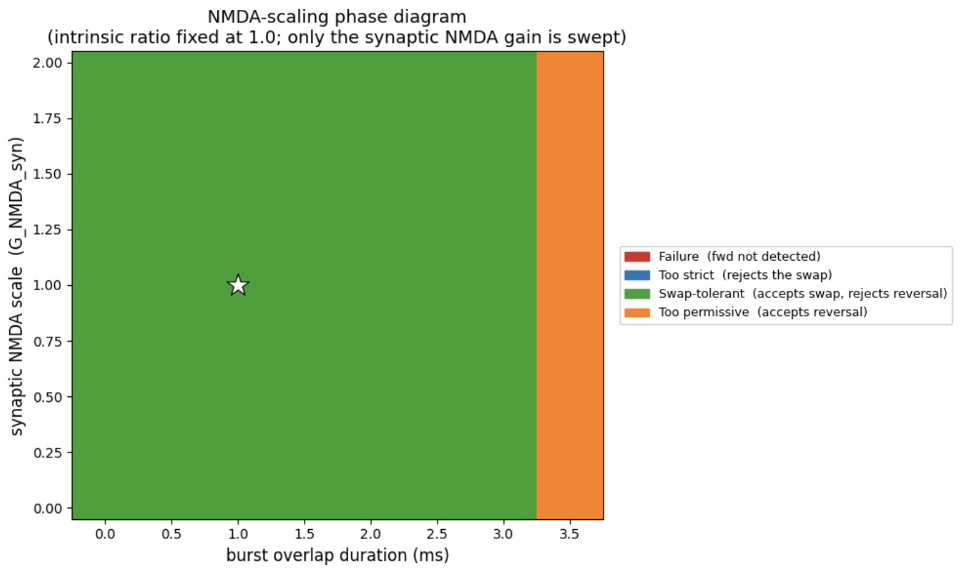
NMDA SCALING · SHAY
Scaling synaptic NMDA: a flat knob
The decision never flips
Sweeping the synaptic NMDA gain leaves the phase diagram essentially flat. The too-permissive stripe at 3.5 ms overlap stays put for every value of the gain, all the way down to zero.
Why it fails
Scaling synaptic NMDA multiplies every segment's residual by the same factor. It raises all magnitudes together without changing which segment crosses threshold first, so it shifts the traces but never flips the order decision.
Regime vs. synaptic NMDA gain (x) and overlap (y)
11
Notes:
Third fix, and this is the negative result, which I think is actually one of our more useful findings. The intuition was tempting: NMDA carries the propagating drive, so if overlap is washing out detection, just scale the synaptic NMDA gain up (or down) and you should be able to tune your way out. This phase diagram says no. X-axis is the synaptic NMDA gain, y-axis is overlap. The striking thing is how FLAT it is, the regime boundaries are essentially vertical. That too-permissive orange stripe at 3.5 ms overlap sits in exactly the same place no matter what we set the gain to, and we swept it all the way down to zero. The knob moves the traces up and down but it never flips a single decision. The reason is a uniformity argument. Scaling synaptic NMDA multiplies every segment's residual conductance by the same common factor. The order decision depends on WHICH segment crosses threshold first, that is, on the relative timing, and multiplying everyone by the same number doesn't change any ordering. You raise or lower all the magnitudes together but the comparison that determines the regime is invariant to that scaling. So it's not that we picked a bad range, it's that this particular knob is structurally incapable of flipping the decision. That naturally raises the question, is there a synaptic knob that DOES work? And the answer, on the next slide, is AMPA.

Slide 13
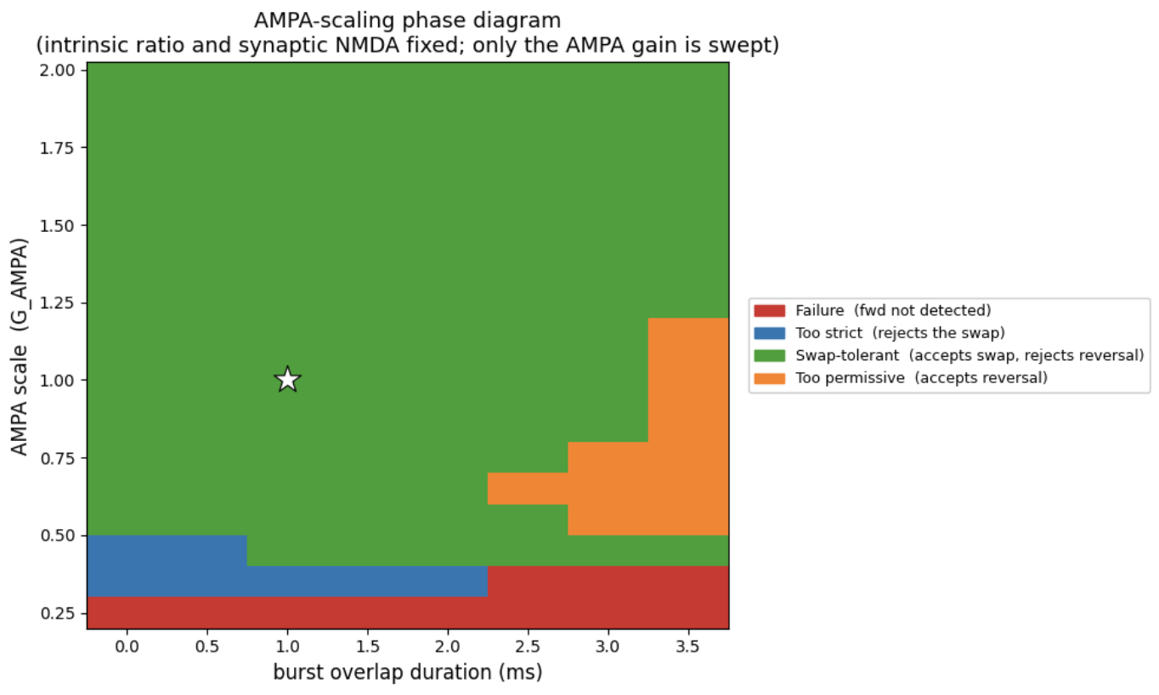
NMDA SCALING · SHAY
AMPA scaling is the knob that works
Here the boundaries bend
Unlike NMDA, scaling AMPA reshapes the diagram. Raising the AMPA gain to ≥ 1.25 restores rejection of reversed input even at 3.5 ms overlap. Below ~0.5 the cell collapses to too-strict / failure.
Why it works
AMPA's fast current peaks several times larger than synaptic NMDA at the failure point. Stronger per-segment AMPA makes each segment fire on its own input rather than the diffusing plateau front, restoring order sensitivity.
Regime vs. synaptic AMPA gain (x) and overlap (y): real structure
12
Notes:
Contrast this directly with the previous slide, same kind of phase diagram, but now we sweep the synaptic AMPA gain on the x-axis. And unlike the flat NMDA picture, here the boundaries genuinely bend, there's real structure. Raising the AMPA gain to about 1.25 and above restores rejection of the reversed input even at the nasty 3.5 ms overlap, that is, it pulls you out of the too-permissive regime. Push it the other way, below about 0.5, and the cell collapses into too-strict and then outright failure. Why does AMPA work where NMDA didn't? It comes down to what each channel does to the timing. At the failure point, the fast AMPA current actually peaks several times larger than the synaptic NMDA. When you strengthen the per-segment AMPA, you make each segment fire predominantly on its OWN, sharply-timed input rather than on the slow plateau front diffusing in from its neighbor. That restores the crisp, segment-specific timing that the order decision reads, the thing overlap had smeared away. NMDA scaling couldn't do this because it acts on the slow, shared, diffusing component, the very thing that's uniform across segments. One important caveat I'll flag for the recommendation: AMPA is the lever that works, but in this model it's not a free design parameter we can dial down, reducing it just breaks the cell. So the finding is really 'AMPA gain matters and must be high enough,' more than 'turn this dial.' That's the segue to wrapping up.

Slide 14
RECOMMENDATION · SHAY
What stabilizes swap recognition
Swap tolerance
Order-based scoring with a small violation budget. Broad, stable green zone up to ~3 ms overlap. Our primary recommendation.
✓
First-spike rule
Helps at ≥ 1 ms spacing, but discards the NMDA summation and fails at tight 0.5 ms spacing. Use with care.
✓
NMDA scaling
Structurally flat: uniform residual scaling never flips the order decision. Drop it.
✗
Bottom line: tune for swap tolerance; the AMPA gain must stay strong; NMDA scaling is a dead end.
13
Notes:
To wrap up, here's what the three fixes tell us to actually do. The question we set out with was whether a sleep-tuned dendrite can handle wake-like bursts, and how to stabilize recognition of swapped patterns. Swap tolerance, green check, is our primary recommendation. It's order-based scoring with a small violation budget, and the phase diagram showed a broad, stable tolerant zone, robust around ratio 1 and holding up to roughly 3 ms of overlap. It directly buys you robustness to the kind of timing jitter that overlap introduces. First-spike rule, qualified check. It genuinely helps at 1 ms spacing and above by giving one clean marker per neuron, but because it throws away the second and third burst spikes it also throws away the NMDA summation, and at tight 0.5 ms spacing that under-drive makes segment 8 fail. So: useful, but not at tight spacing, use with care. NMDA scaling, red cross, drop it. It's structurally flat, scaling the synaptic NMDA gain multiplies every segment's residual uniformly and never changes which segment crosses first, so it can't flip the order decision. The knob that actually reshaped the regime was AMPA, but AMPA can't be turned DOWN without breaking propagation, so the practical statement is that AMPA gain must stay strong rather than 'tune AMPA.' So the bottom line for stabilizing swap recognition: tune for swap tolerance as the main lever, keep the AMPA gain strong, and don't bother with NMDA scaling. Thanks, happy to take questions.

