Slide 1
1. Introduction
Background : Safety should be a top priority of anyone who is going on a trip anywhere. If you don’t feel safe on your trip , you're not going to do the very thing that you went to do and that is to enjoy and have a good time .
Problem : This project aims to select to safest neighbourhoods in Toronto based on the total crimes, explore that neighbourhood to find to 10 most common venues to visit in each neighbourhood and finally cluster the neighbourhoods using k-means clustering algorithm.
Interest : This project is meant for cautious travellers who are looking to have a good time on a trip and also at the same time be as safe as they can while exploring the common venues around each neighbourhood.

Slide 2
Data Acquisition and Cleaning
Data Acquisition : The data for this project has been acquired from two sources :
The first source of data for this project shows the crime per neighbourhood in Toronto
The second source of data is scraped from a Wikipedia page that contains the list of Toronto neighbourhoods.

Slide 3
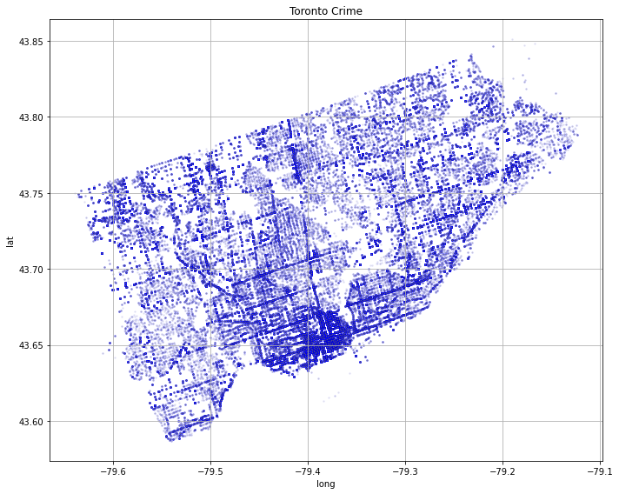
Mapping crime in Toronto

Slide 4
We can see from the previous slide that most crimes in Toronto happen in south side of Toronto (Downtown Toronto).
I thought it would be effective to find places with high criminal density, the neighbourhoods around also exhibit high criminal activity and there are also other spots suggesting criminal neighbourhoods can be clustered.

Slide 5
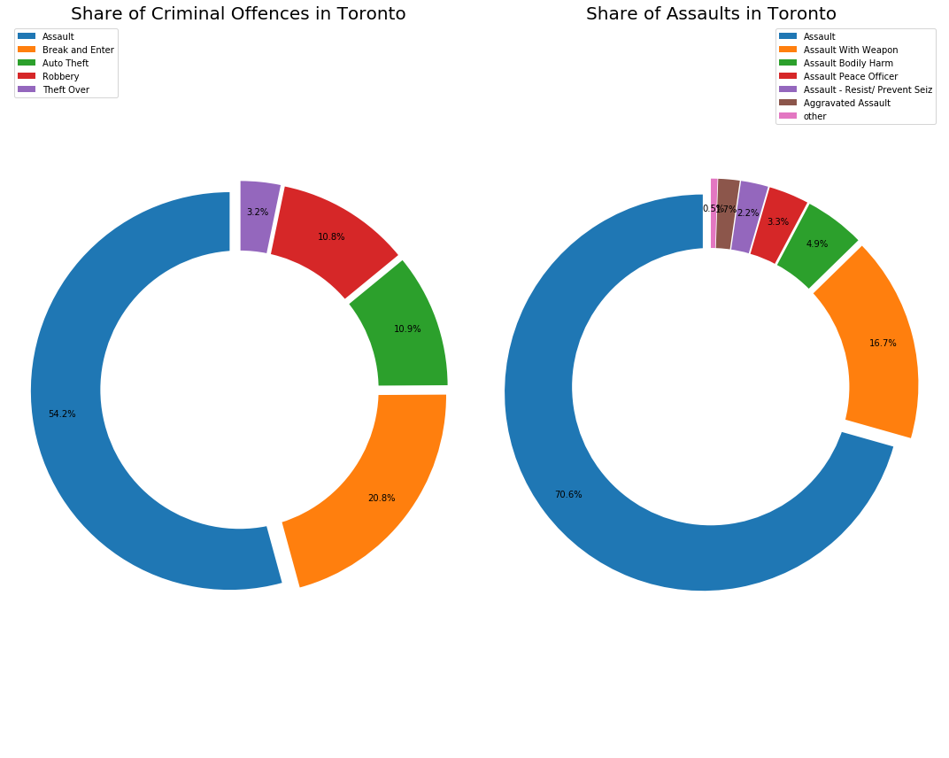
Crime visualisation of Toronto

Slide 6
As we can see from the previous slide that out of all the crimes which take place in Toronto more than half of those crimes are Assaults.
And out of the all the assaults which take place in Toronto 16 % of Assaults happen with a weapon and 4.9 % of assaults result in bodily harm of individuals .

Slide 7
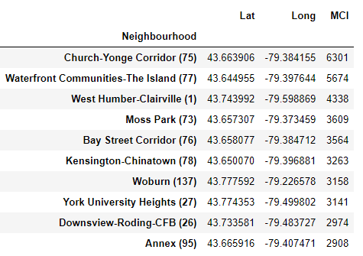
Neighborhoods to avoid

Slide 8
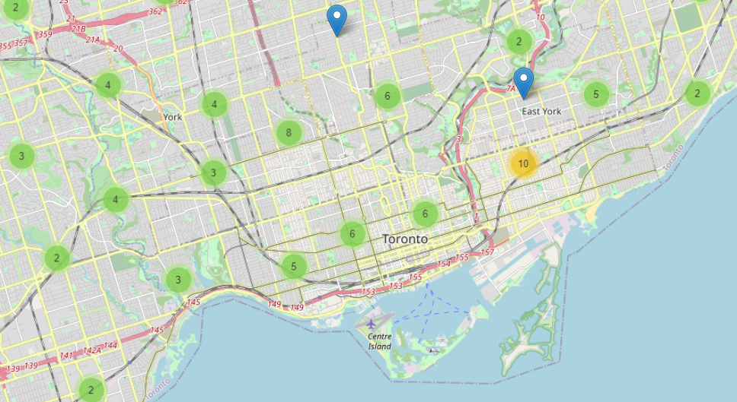
Crime map of Toronto

Slide 9
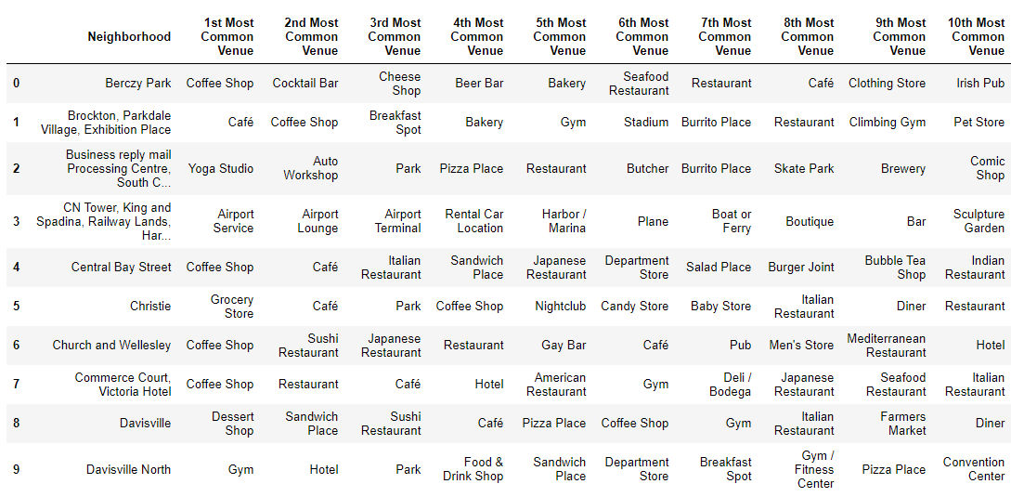
Results
After running the K-means clustering we can access each cluster created to see which neighbourhoods were assigned the 1’st to 10th most common venues.

Slide 10
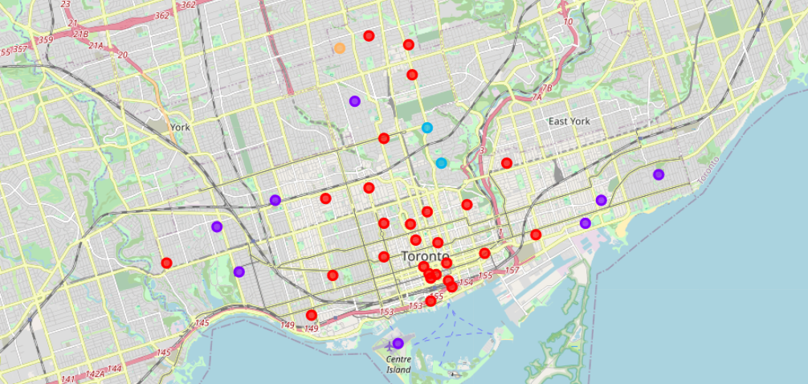
Venue map of Toronto
Now that we have successfully clustered venues together lets plot them on a map for the user to see and get a better idea of the most common venues in the city of Toronto.

Slide 11
5. Discussion
The aim of this project is to help people who are looking to have a safe trip to Toronto, an expat can choose a neighbourhood to visit by referring to the common venues in that neighbourhood. For example if a person is looking to play around with their kids and just want to have sort of a picnic he can look up the common venues in cluster 3 which shows that the most common venue in that cluster is actually the park. If a person is looking for a neighbourhood with stores and restaurants in a close proximity then the neighbourhoods in the first cluster is suitable. For a family I feel that the neighbourhoods in Cluster 4 are more suitable dues to the common venues in that cluster, these neighbourhoods have common venues such as Parks, Gym/Fitness centres, Bus Stops, Restaurants, Electronics Stores and Soccer fields which is ideal for a family. The choices of neighbourhoods may vary from person to person.

Slide 12
6.Conclusion
This project helps a person get a better understanding of the neighbourhoods with respect to the most common venues in that neighbourhood. I’ve just taken safety as a primary concern to shortlist the safest borough of Toronto with the lowest crimes.(Neighbourhoods with lowest MCI )

