Slide 1

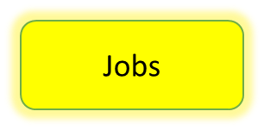
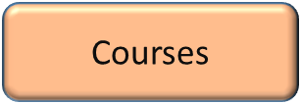
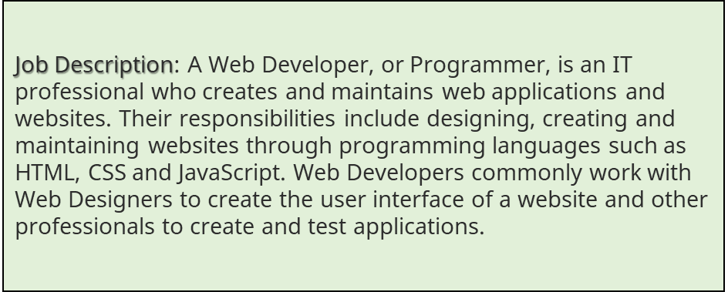
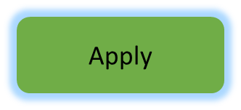
MENU
About Us
Contact Us
Locations
image
Our certified team breaks the mold blending persuasive messaging, mesmerizing design, and seamless user experience into your website. Following industry leaders' frameworks and backed by a proven track record we can place you in a category of one.

Slide 2
MENU
About Us
Contact Us
Locations
image
Our certified team breaks the mold blending persuasive messaging, mesmerizing design, and seamless user experience into your website. Following industry leaders' frameworks and backed by a proven track record we can place you in a category of one.

Slide 3
About our web developers
MENU
About Us
Contact Us
Locations
Profiles
Web developer 1
Personal details and work experience
Current job in company
Opinion about working in the company
Web developer 2
Personal details and work experience
Current job in company
Opinion about working in the company
Get Help

Slide 4
About our web developers
MENU
About Us
Contact Us
Locations
Web developer 1
Personal details and work experience
Current job in company
Opinion about working in the company
Profiles
Web developer 2
Personal details and work experience
Current job in company
Opinion about working in the company

Slide 5
Job specifications and requirements
MENU
About Us
Contact Us
Locations
Specification | Requirements | Other options
Your primary task as a web developer will be to use programming languages to create reliable and high-performing websites and web-based applications and services. It's likely that you'll work in one of two areas: back end: which focuses solely on the underlying software and databases, where you'll deal with functional aspects front end: working on the interface and visual design, focusing on aspects that users interact with. It's also possible to combine the two which is known as full-stack development. | Bachelor's degree in Web development or related field, or relevant experience. Solid knowledge and experience in programming applications. Proficient in JavaScript, HTML, CSS. Proficient in My SQL. Dedicated team player. Ability to thrive in a fast-paced environment. Solid ability in both written and verbal communication. Knowledge of programming language and technical terminology. Able to develop ideas and processes and clearly express them. High degree of independent judgment. Able to solve complex problems. | If you have other interests or your qualifications have slight differences from what we need for this role, you can explore other options that our company has to offer.
Search for other options here

Slide 6
Job specifications and requirements
Specification | Requirements | Other options
Your primary task as a web developer will be to use programming languages to create reliable and high-performing websites and web-based applications and services. It's likely that you'll work in one of two areas: back end: which focuses solely on the underlying software and databases, where you'll deal with functional aspects front end: working on the interface and visual design, focusing on aspects that users interact with. It's also possible to combine the two which is known as full-stack development. | Bachelor's degree in Web development or related field, or relevant experience. Solid knowledge and experience in programming applications. Proficient in JavaScript, HTML, CSS. Proficient in My SQL. Dedicated team player. Ability to thrive in a fast-paced environment. Solid ability in both written and verbal communication. Knowledge of programming language and technical terminology. Able to develop ideas and processes and clearly express them. High degree of independent judgment. Able to solve complex problems. | If you have other interests or your qualifications have slight differences from what we need for this role, you can explore other options that our company has to offer.
MENU
About Us
Search for other options here
Contact Us
Locations

Slide 7
Online application form
MENU
About Us
Contact Us
Locations
Name
Surname
Email address
Contact number
Address
CV
Applicant qualifications
Submit

Slide 8
Online application form
MENU
About Us
Contact Us
Locations
Name
Surname
Email address
Contact number
Address
CV
Applicant qualifications
Submit

Slide 9
Links to our courses
MENU
About Us
Contact Us
Locations
Python web development course (link 1)
Online web design course (link 2)
Web programming course (link 3)
Web development training (link 4)
Users feedbacks:

Slide 10
Links to our courses
MENU
About Us
Contact Us
Locations
Python web development course (link 1)
Online web design course (link 2)
Web programming course (link 3)
Web development training (link 4)
Users feedbacks:

Slide 11
Site Map
Job listing
Menu
Jobs
Job listing
Employees
Info about employees
About us
Contact us
Locations
Courses

