Slide 1
DATA ANALYST MID-TERM PROJECT
District Project Performance
& Budget Analysis
A data pipeline combining Excel, SQL, and Python to analyze district-wise
project targets, achievements, and budget utilization.
• PRESENT BY (SHAYAN)

Slide 2
Project Objective
1
Analyze district-wise project performance
Compare Target vs Achievement across all districts to see where projects are succeeding or falling behind.
2
Evaluate budget efficiency
Understand how much of the allocated budget each district actually utilized.
3
Identify trends over time
Track how achievement changed across quarters to spot seasonal or ongoing patterns.
4
Recommend where to focus
Turn the analysis into a clear, actionable recommendation for decision-makers.
District Project Performance & Budget Analysis
2

Slide 3
Methodology: Tools & Pipeline
E
S
P
→
→
EXCEL
SQL
PYTHON
Raw data organized
into a structured table
Queries to filter,
group & extract insights
Cleaning, analysis
& visualization
Excel → SQLite Database → Pandas Analysis → Matplotlib / Seaborn Visualization
District Project Performance & Budget Analysis
3

Slide 4
Data Overview & Cleaning
Dataset Columns
Data Cleaning Steps
District
Category
Quarter
Target
Achievement
Status
Budget_Allocated_PKR
Budget_Utilized_PKR
Checked shape, data types & summary statistics
Identified missing values per column
Filled numeric gaps with 0, text gaps with "Unknown"
Detected and removed duplicate rows
Verified totals after cleaning to confirm accuracy
District Project Performance & Budget Analysis
4

Slide 5
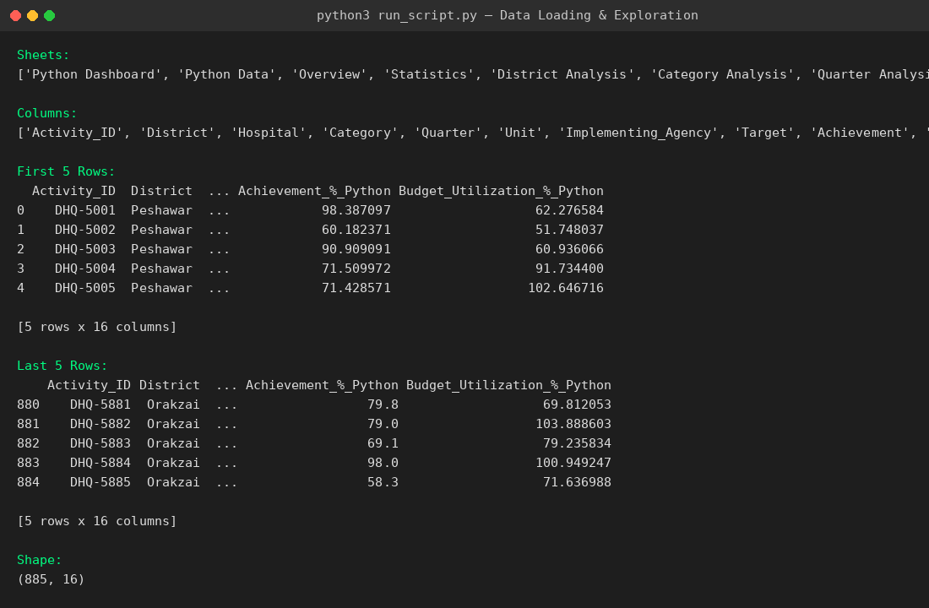
Python: Data Loading & Exploration
Loading the Excel file with Pandas and inspecting its structure — sheets, columns, first/last rows, and shape
District Project Performance & Budget Analysis
5

Slide 6
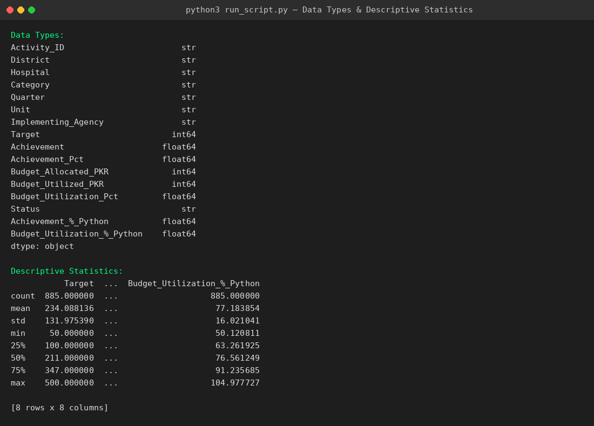
Python: Data Types & Descriptive Statistics
Checking each column's data type and generating summary statistics (mean, min, max, etc.)
District Project Performance & Budget Analysis
6

Slide 7
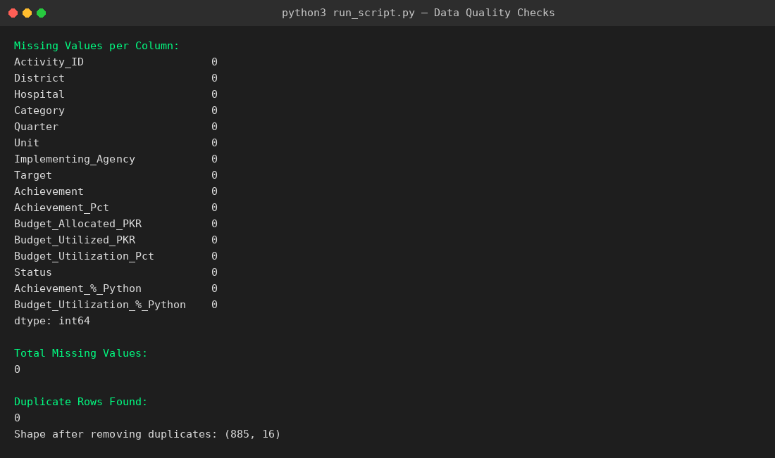
Python: Data Quality Checks
Verifying data quality before analysis — missing values per column and duplicate rows
District Project Performance & Budget Analysis
7

Slide 8
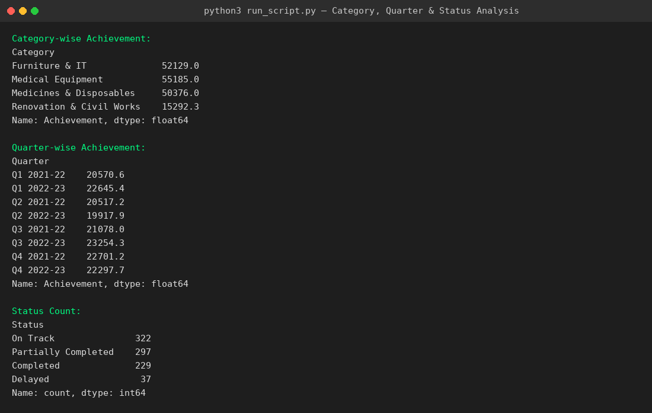
Python: Category, Quarter & Status Analysis
Grouping achievement totals by category and quarter, and counting activities by status
District Project Performance & Budget Analysis
8

Slide 9
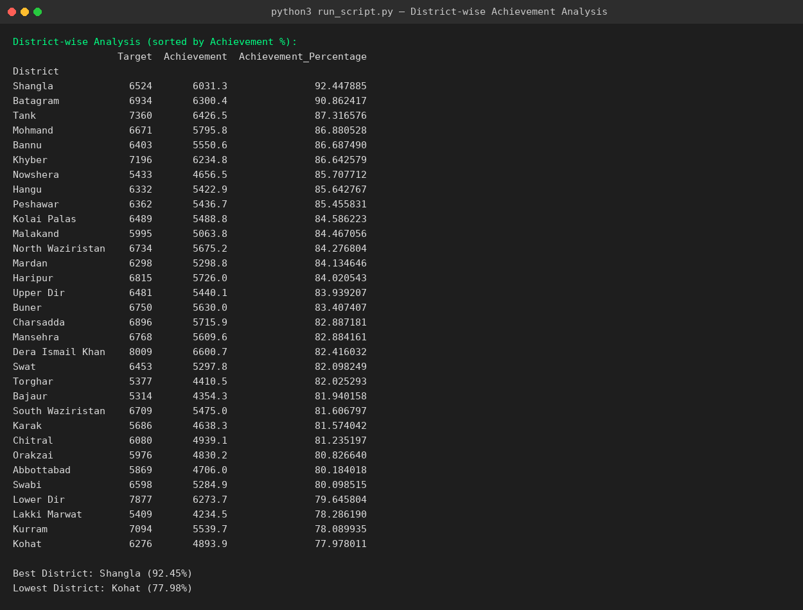
Python: District-wise Achievement Analysis
Target vs. Achievement by district, sorted by Achievement Percentage, with best and lowest performers identified
District Project Performance & Budget Analysis
9

Slide 10
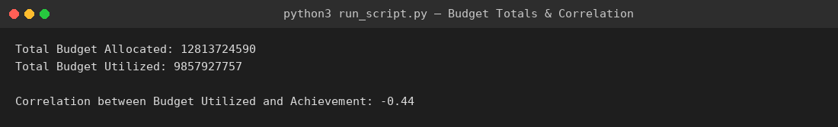
Python: Budget Totals & Correlation
Total budget allocated vs. utilized, and the correlation between budget usage and achievement
TOTAL ALLOCATED
TOTAL UTILIZED
CORRELATION
PKR 12.81 B
PKR 9.86 B
-0.44
District Project Performance & Budget Analysis
10

Slide 11
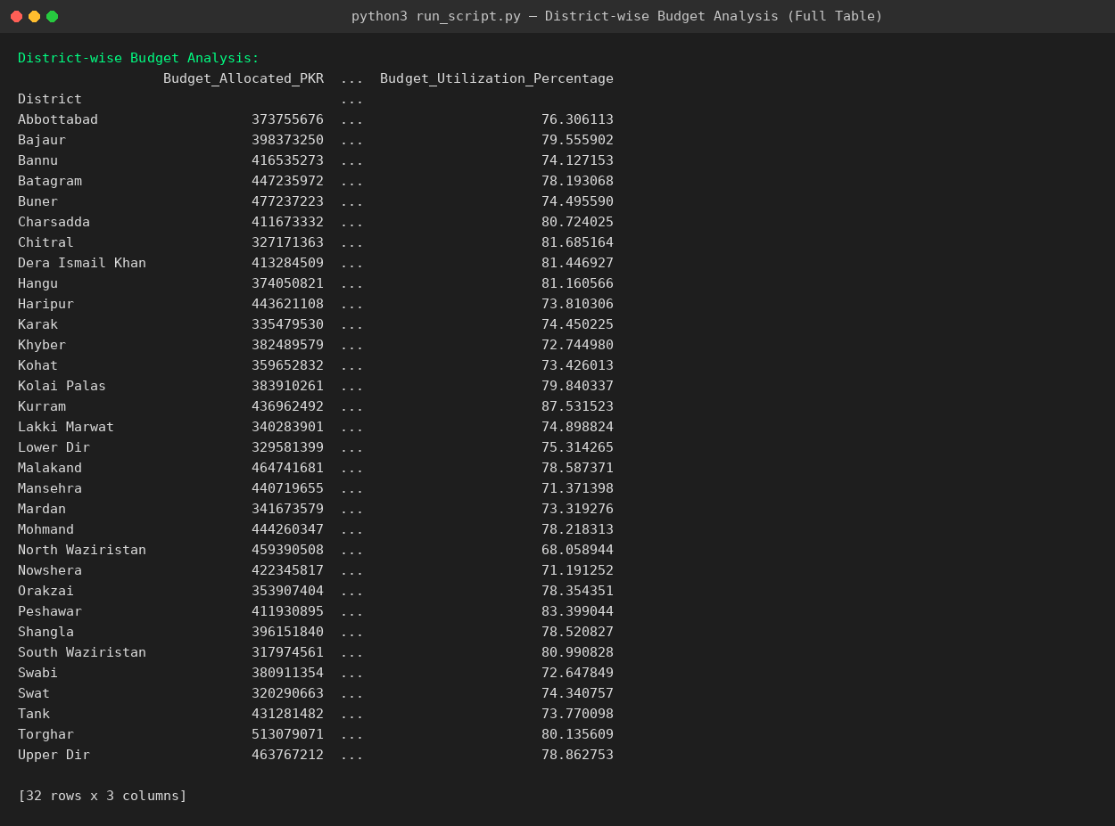
Python: District-wise Budget Analysis
Full breakdown of allocated budget, utilized budget, and utilization percentage for all 32 districts
District Project Performance & Budget Analysis
11

Slide 12
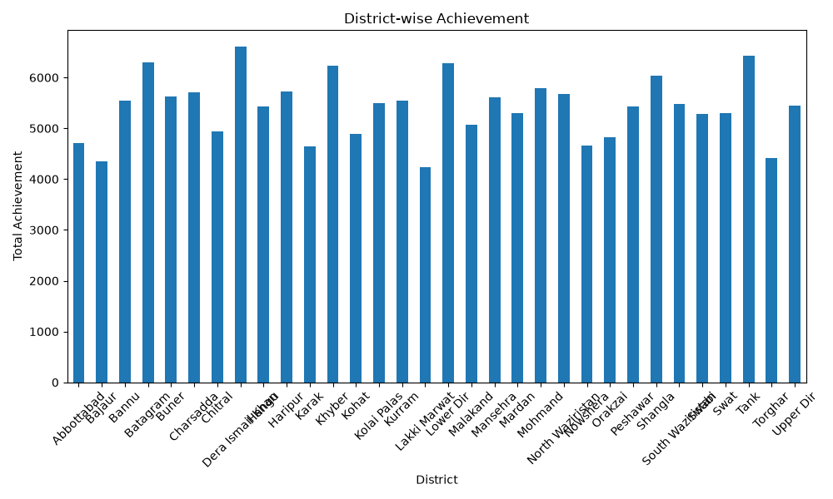
District-wise Achievement
Total achievement summed across all quarters, grouped by district
Key Takeaway
Achievement is fairly spread across districts, generally in the 4,200–6,600 range. Districts like Dera Ismail Khan, Kurram, and Tank sit at the higher end, while Lakki Marwat and Torghar are on the lower side.
District Project Performance & Budget Analysis
12

Slide 13
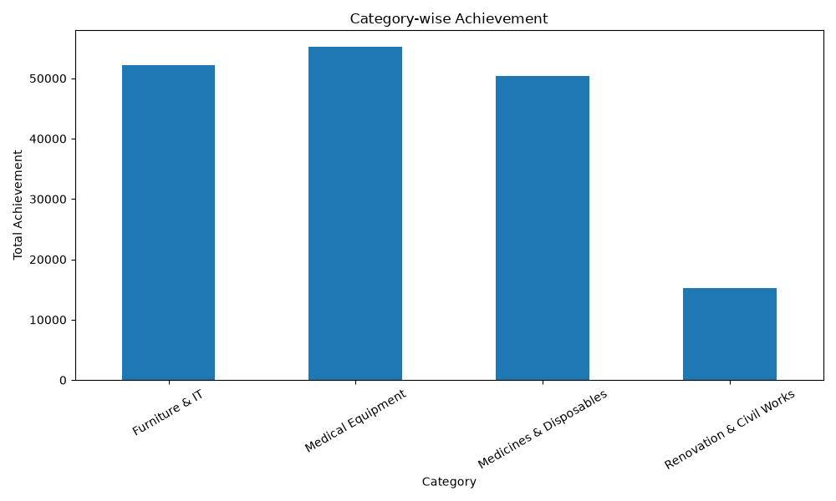
Category-wise Achievement
Total achievement grouped by equipment/activity category
Key Takeaway
Medical Equipment and Furniture & IT lead in total achievement, followed closely by Medicines & Disposables. Renovation & Civil Works trails well behind the other three categories.
District Project Performance & Budget Analysis
13

Slide 14
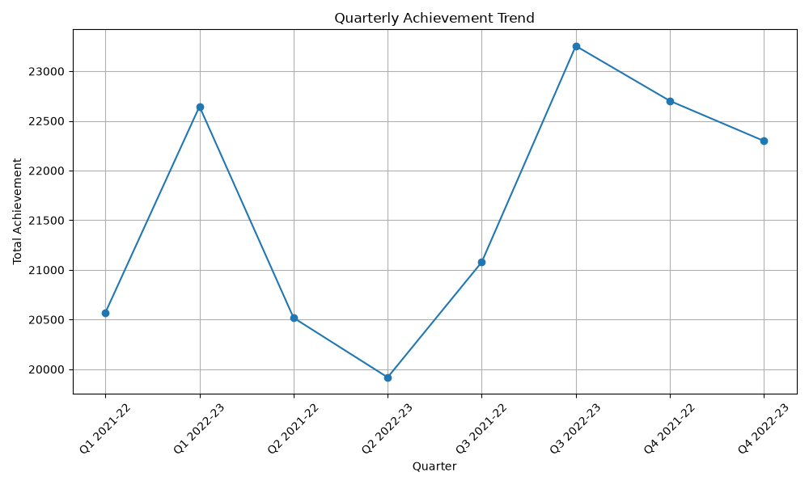
Quarterly Achievement Trend
Total achievement tracked across each quarter
Key Takeaway
Achievement fluctuates quarter to quarter rather than trending steadily up or down. Q3 2022-23 shows the strongest quarter, while Q2 2022-23 dips to the lowest point in the trend.
District Project Performance & Budget Analysis
14

Slide 15
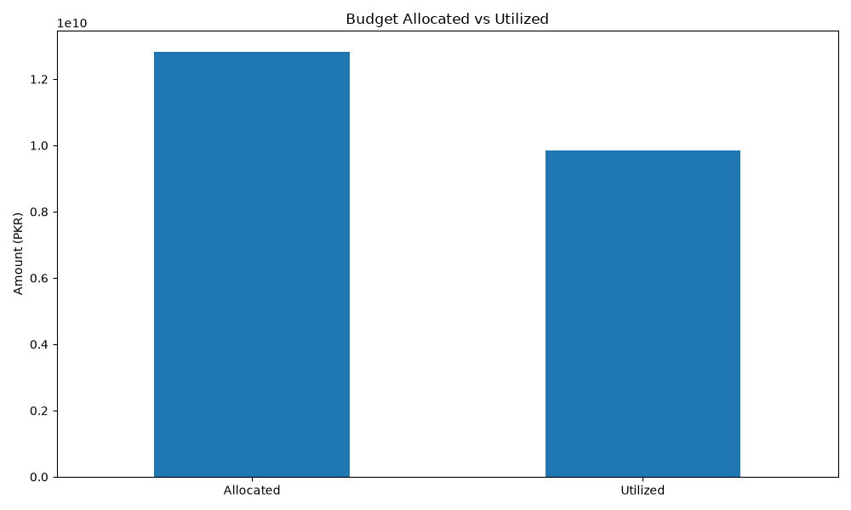
Budget: Allocated vs Utilized
Total budget allocated compared to total budget actually spent
Key Takeaway
A meaningful gap exists between allocated and utilized budget — roughly a quarter of the total allocated budget across all districts was not used, pointing to a utilization gap worth investigating.
District Project Performance & Budget Analysis
15

Slide 16
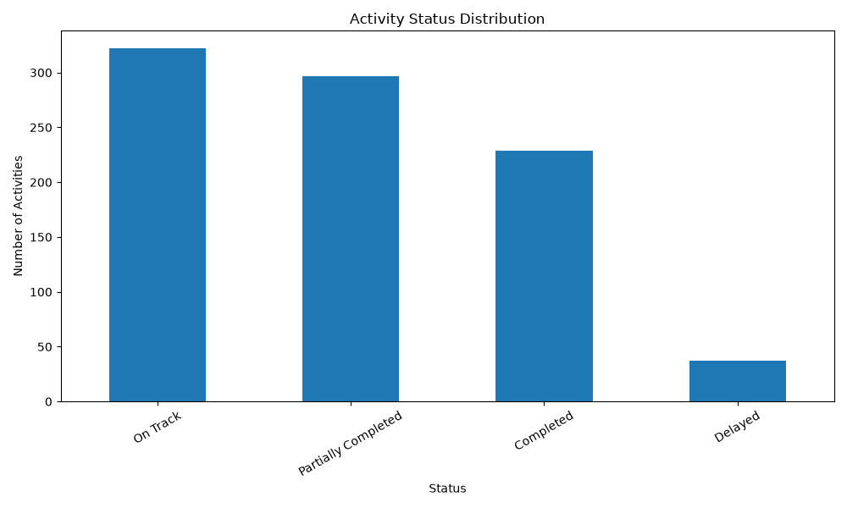
Activity Status Distribution
Count of activities by their current status
Key Takeaway
Most activities are either "On Track" or "Partially Completed." Only a smaller share are fully "Completed," and a minority are "Delayed" — a manageable but non-zero risk group.
District Project Performance & Budget Analysis
16

Slide 17
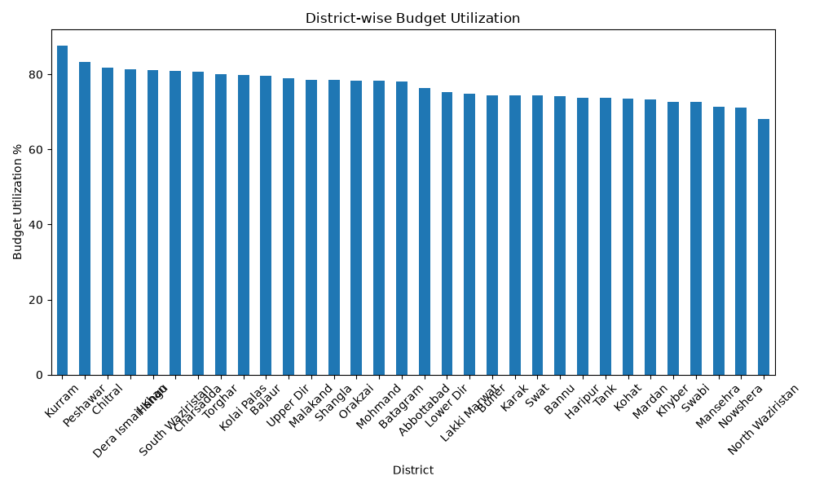
District-wise Budget Utilization
Budget utilized as a percentage of budget allocated, sorted highest to lowest
Key Takeaway
Kurram leads budget utilization at the top of the ranking, while North Waziristan sits at the bottom. Most districts cluster between roughly 70–80% utilization.
District Project Performance & Budget Analysis
17

Slide 18
Key Insights
TOP ACHIEVEMENT %
NEEDS ATTENTION
BEST BUDGET USE
LOWEST BUDGET USE
Shangla
Kohat
Kurram
North Waziristan
92.45% of target achieved
77.98% of target achieved
87.53% utilization
68.06% utilization
Correlation check: budget utilized vs. achievement = -0.44 (moderate negative). Districts that used more of their budget tended to achieve slightly less — spending more does not, by itself, guarantee higher achievement.
District Project Performance & Budget Analysis
18

Slide 19
Recommendations
1
Review low-utilization districts
Districts like North Waziristan are leaving allocated budget unused — investigate procurement or capacity bottlenecks.
2
Support lagging districts
Kohat and similar low-achievement districts may need additional resources or a revised timeline.
3
Investigate the Q2 2022-23 dip
The lowest quarterly point deserves a closer look to understand what caused the slowdown.
4
Prioritize Renovation & Civil Works
This category trails all others in achievement and may need focused attention next cycle.
District Project Performance & Budget Analysis
19

Slide 20
Thank You
Questions & Discussion
• PRESENT BY (SHAYAN)

