Slide 1
DATA ANALYST PROJECT
Global E-Commerce Sales Intelligence
An end-to-end business analysis using Excel, SQL & Python
EXCEL
MYSQL
PYTHON
2,000 orders • 1,534 customers • 7,115 units
Prepared by Muhammad Shayan
01

Slide 2
01 / EXECUTIVE VIEW
The business in five numbers
A compact read of the full 2,000-order dataset
TOTAL SALES
TOTAL PROFIT
ORDERS
CUSTOMERS
UNITS SOLD
$484,559
$158,872
2,000
1,534
7,115
Revenue generated
32.79% margin
Transactions
Unique names
Quantity
WHAT STANDS OUT
Furniture is the dominant commercial engine.
It leads both sales and profit, while Europe is the strongest region and Consumer is the largest customer segment.
02

Slide 3
02 / BUSINESS QUESTIONS
From raw transactions to decisions
The analysis was designed around four questions
01
PERFORMANCE
How much are we selling, earning and processing?
02
DRIVERS
Which regions, categories and segments create value?
03
RANKINGS
Which products and countries are the strongest performers?
04
PRICING
Does discounting appear to improve or damage profit?
03

Slide 4
03 / DATA FOUNDATION
One dataset, three analytical lenses
Excel explains the dashboard; SQL validates and queries; Python deepens the analysis.
01
02
03
EXCEL
→
MYSQL
→
PYTHON
Pivot tables Dashboard
Queries Aggregation
Pandas Statistics + plots
15 analytical columns
0 duplicate rows • 0 missing values
Discount range: 0%–30%
04

Slide 5
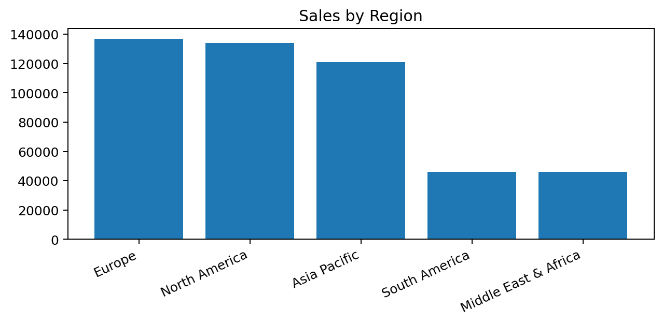
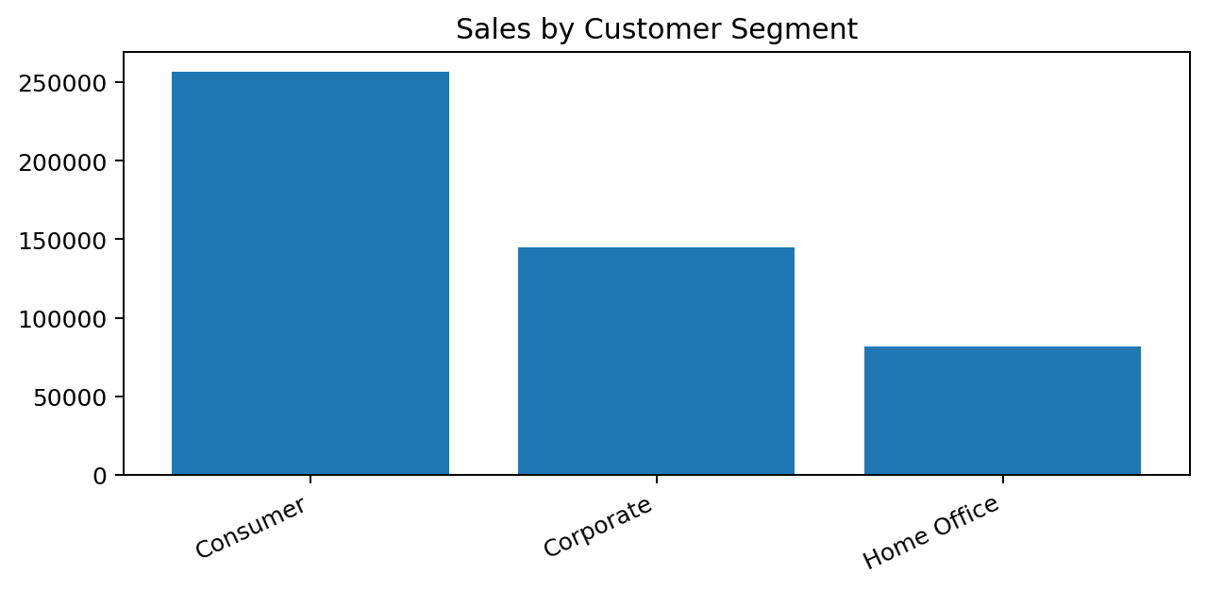
04 / EXCEL
The dashboard turns transactions into a management view
Eight complementary views were built from PivotTables and PivotCharts
CORE VIEWS
Sales by region • Profit by category • Customer segment • Monthly sales • Top products • Payment method
05

Slide 6
05 / SQL
The database layer answers the “how much?” questions
Core KPIs and grouped summaries were queried directly from the ecommerce_sales table
SELECT SUM(Total_Sales) AS Total_Sales, SUM(Profit) AS Total_Profit, COUNT(DISTINCT Order_ID) AS Orders, SUM(Quantity) AS Units FROM ecommerce_sales;
SALES
PROFIT
$484.6K
$158.9K
ORDERS
UNITS
2,000
7,115
SQL techniques: SUM • COUNT DISTINCT • GROUP BY • ORDER BY • LIMIT
06

Slide 7
06 / SQL RANKING
Ranking reveals where value is concentrated
ORDER BY + LIMIT was used to surface the highest-value products and countries.
01
Stand Desk Converter
Top product by sales
02
Ergonomic Office Chair
High-value office category
03
Corner L-Shaped Desk
Strong furniture performer
04
Mesh Back Task Chair
Consistent demand
05
Wireless Bluetooth…
Technology leader
07

Slide 8
07 / PYTHON
Pandas turns the same data into reproducible analysis
The Python layer was used for cleaning, summaries, correlation and visualization.
import pandas as pd df = pd.read_excel("Global_Ecommerce_Sales.xlsx") df = df[[ "Order_ID","Order_Date","Customer_Name", "Region","Product_Category","Product_Name", "Quantity","Discount_Percent", "Total_Sales","Shipping_Cost","Profit", "Payment_Method" ]]
region_sales = ( df.groupby("Region")["Total_Sales"] .sum() .sort_values(ascending=False) ) discount_profit_corr = ( df["Discount_Percent"] .corr(df["Profit"]) )
PANDAS
NUMPY / STATS
MATPLOTLIB
Result: analysis is repeatable — change the source data and rerun the workflow.
08

Slide 9
08 / PYTHON VISUALS
Regional performance is uneven
Europe leads, while South America and Middle East & Africa are the clear opportunity zones.
REGIONAL READ
Europe
~$137K sales
North America is close behind, while the
two lowest regions remain below $50K.
Insight
Prioritize targeted regional growth
instead of uniform spending.
09

Slide 10
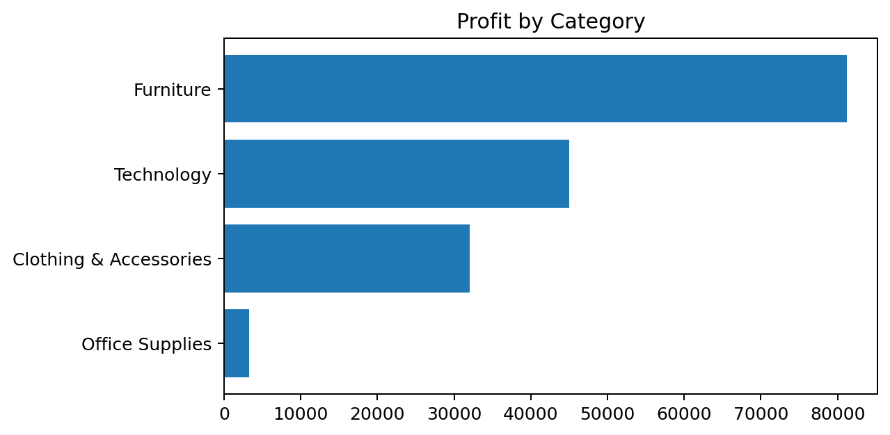
09 / CATEGORY ECONOMICS
Furniture is the commercial engine
The category dominates both revenue and profit — making it the strongest place to scale.
FURNITURE PROFIT
FURNITURE SALES
$81.2K
$256.3K
≈51% of total
≈53% of total
WHY IT MATTERS
Furniture is not simply the largest category;
it is the clearest combined sales + profit winner.
SCALE THE WINNER
10

Slide 11
10 / CUSTOMER BEHAVIOR
Consumer customers carry the largest sales base
Segment and payment views help translate revenue into customer strategy.
Credit Card
40%
PayPal
30%
Cash on Delivery
15%
Bank Transfer
15%
Consumer sales: ~$256K
11

Slide 12
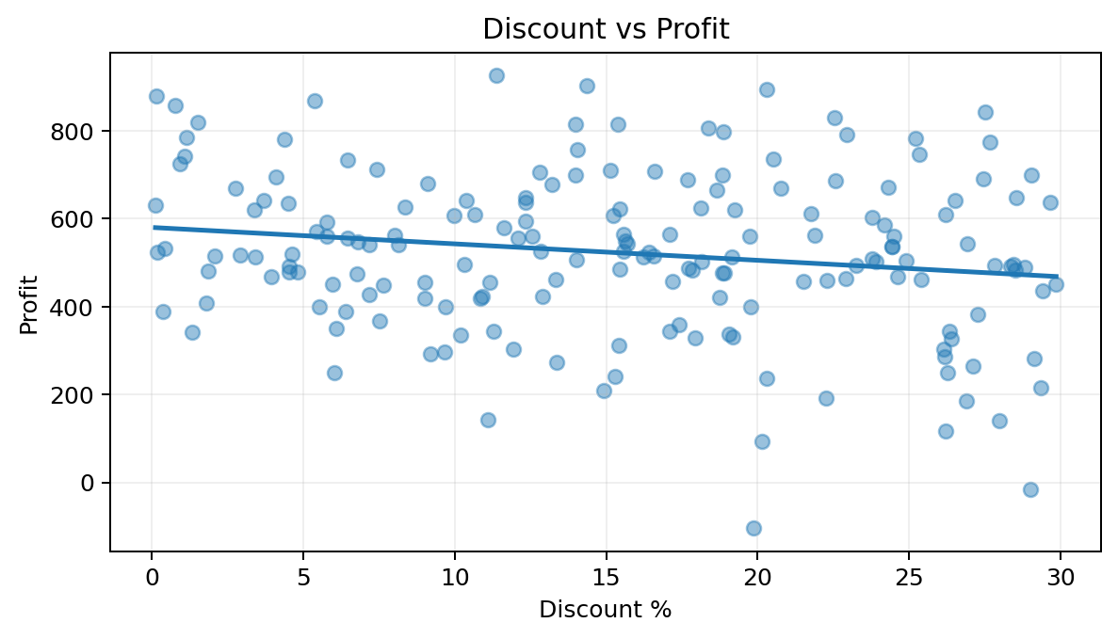
11 / PRICING ANALYSIS
Discounting is not a strong profit lever
Python correlation analysis found a very weak relationship between discount percentage and profit.
CORRELATION
−0.14
Very weak negative relationship
Interpretation
Discounts alone do not explain meaningful
changes in profit. Use targeted promotions
rather than blanket discounting.
12

Slide 13
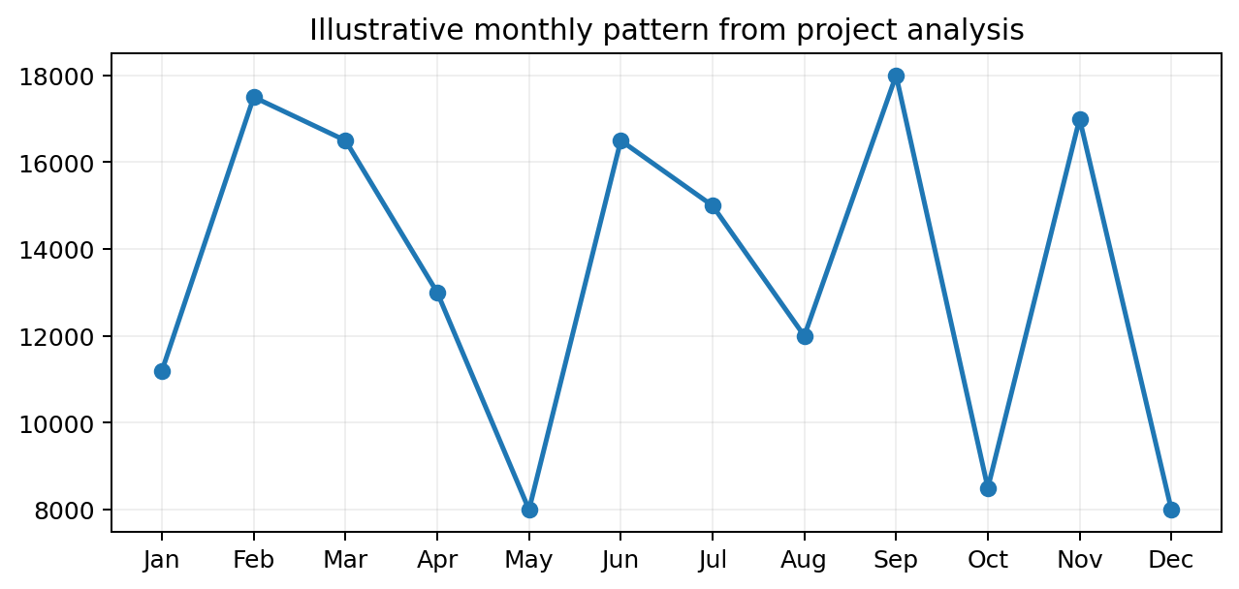
12 / TIME SERIES
Sales move in waves, not a straight line
The monthly view is useful for spotting peaks, weak periods and campaign opportunities.
2023
2024
2025
Baseline period
Volatile movement
Recovery + peaks
Use monthly peaks to time promotions,
inventory and campaign budgets.
13

Slide 14
13 / VALIDATION
Three tools, one story
The strongest conclusions repeat across dashboarding, database queries and Python analysis.
EXCEL
SQL
PYTHON
Visual management
Data validation
Deep analysis
PivotTables • KPI cards • Dashboard
Aggregations • Ranking • Filtering
Cleaning • Correlation • Visualization
→
Dashboard
→
Queries
→
Evidence
Conclusion: the tools are complementary, not competing.
14

Slide 15
14 / KEY INSIGHTS
What the data is really saying
Five findings that matter more than any single chart.
01
Furniture
~53% of sales and ~51% of profit
02
Europe
Highest regional sales at ~$137K
03
Consumer
Largest customer segment at ~$256K
04
Office Supplies
Smallest category; pricing/mix deserves review
05
Discounts
Correlation with profit is only −0.14
15

Slide 16
15 / ACTION PLAN
Turn the analysis into decisions
Recommendations are prioritized by commercial impact and evidence strength.
01
Scale Furniture
Expand high-performing furniture products and prioritize marketing/inventory.
02
Target weak regions
Build focused campaigns for South America and Middle East & Africa.
03
Review Office Supplies
Investigate product mix, pricing and margin structure.
04
Use targeted discounts
Avoid blanket promotions; test discounts where conversion needs help.
Decision principle: invest where sales + profit + evidence point in the same direction.
16

Slide 17
GLOBAL E-COMMERCE
From transactions to business insight.
Excel • MySQL • Python • Pandas • Matplotlib
Q&A
Muhammad Shayan
Thank you
17

