Slide 1

کارگاه مبانی برنامه‌نویسی
جلسه اول: آشنایی با کامپیوتر
#1

Slide 2

Basic Concepts

Slide 3
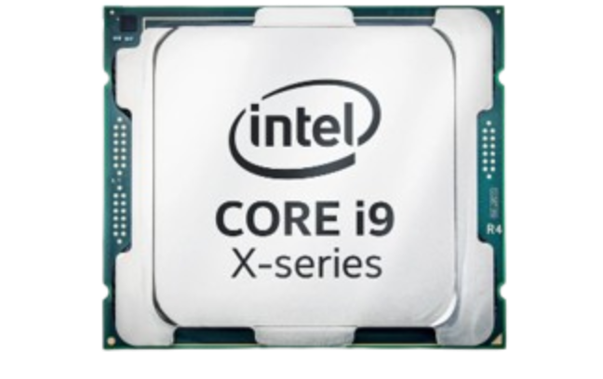
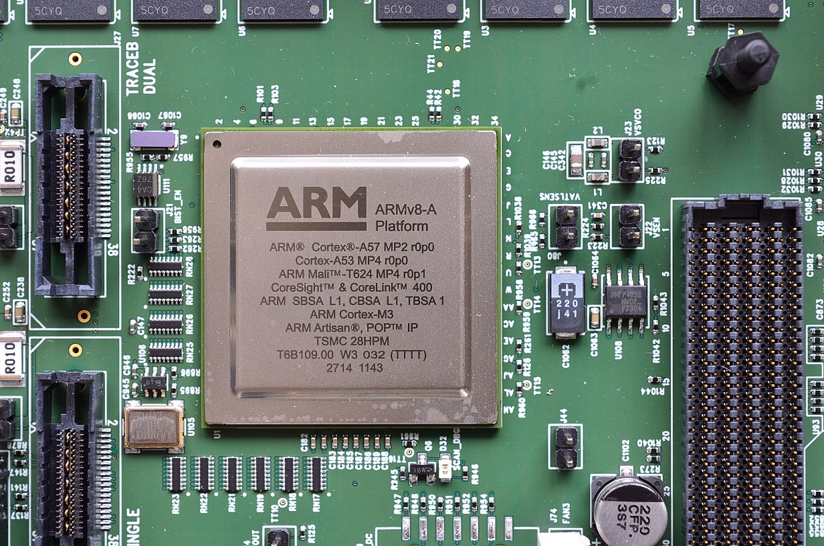
Different kinds of Processors’;
Processors.c
CPU
GPU
FPGA
CPU, speed matters!
Programming Language

Slide 4
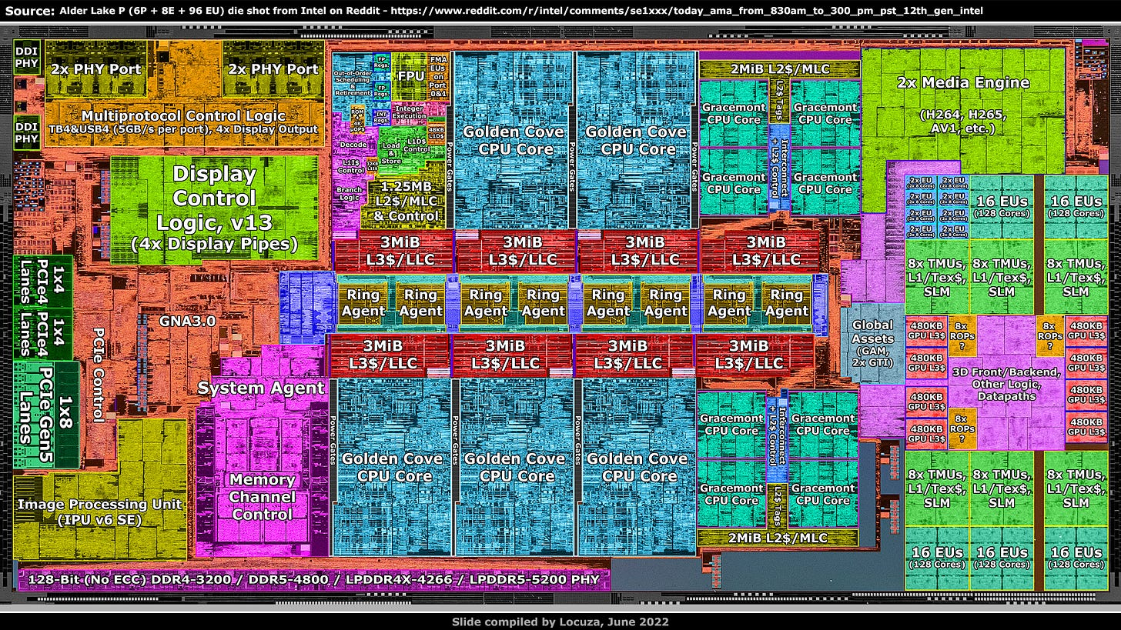

Slide 5
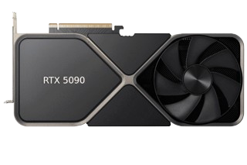
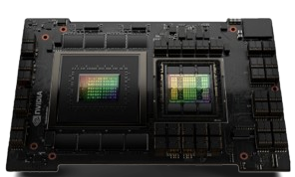
Different kinds of Processors’;
Processors.c
CPU
GPU
FPGA
GPU, throughput matters!
Programming Language

Slide 6
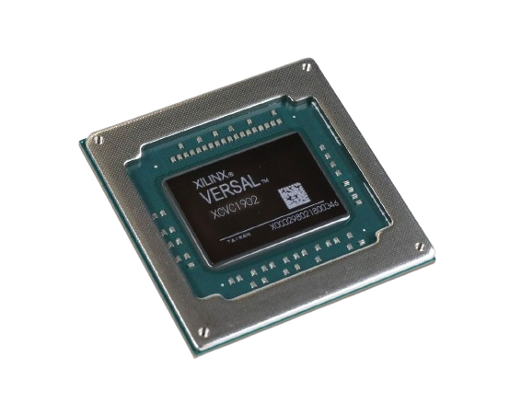
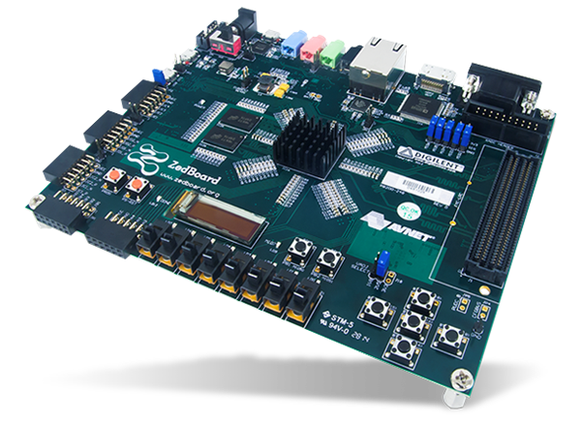
Different kinds of Processors’;
Processors.c
CPU
GPU
FPGA
FPGA, is used for prototyping!
Programming Language

Slide 7
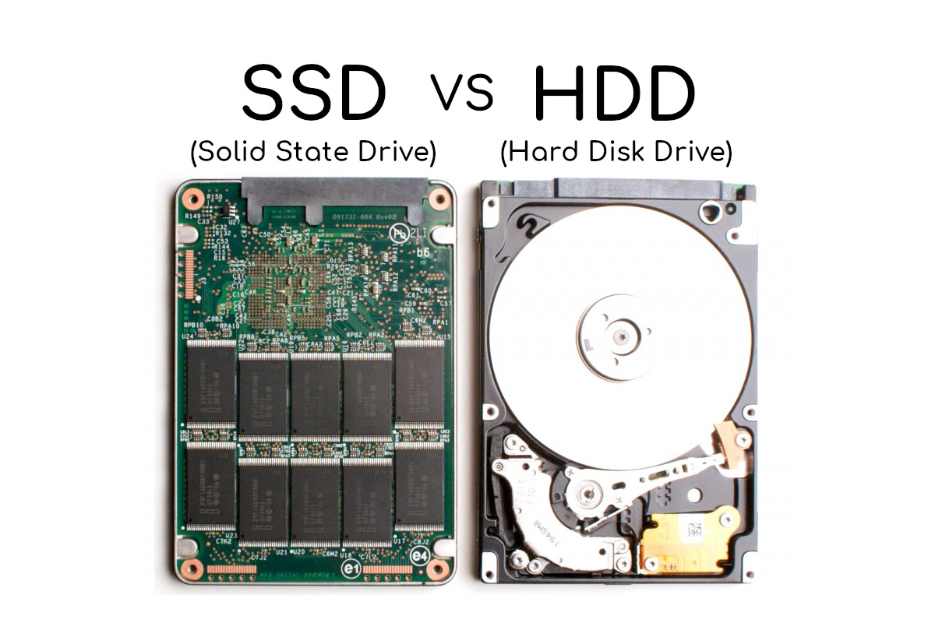
Different kinds of Memories’;
Memory.c
Secondary Storage (SSD Or HDD)
Random Access Memory (RAM)
Programming Language

Slide 8
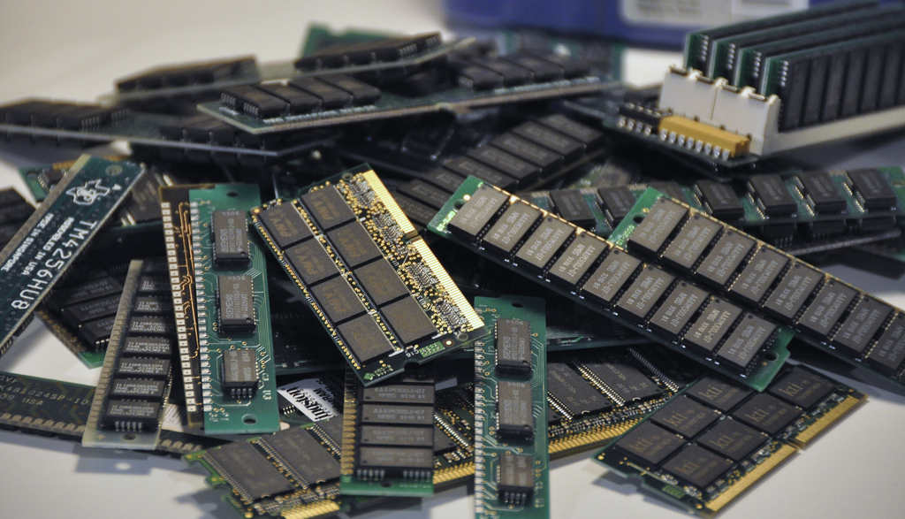
Different kinds of Memories’;
Memory.c
Secondary Storage (SSD Or HDD)
Random Access Memory (RAM)
Programming Language

Slide 9
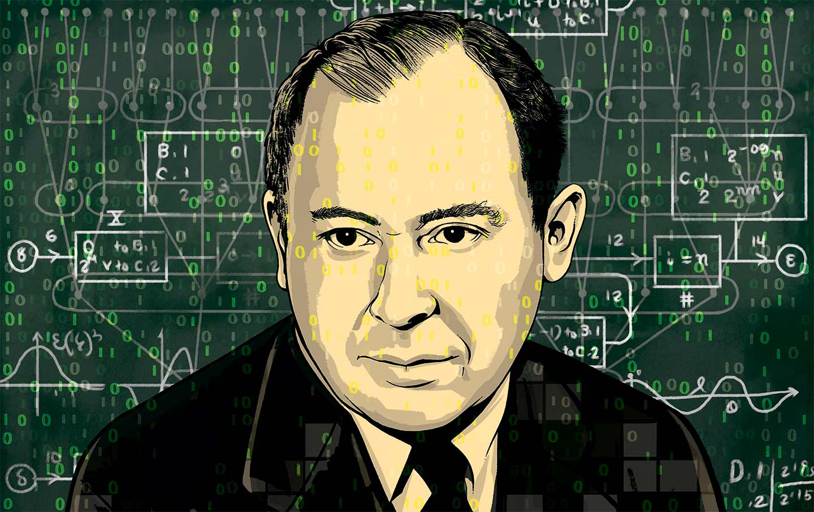
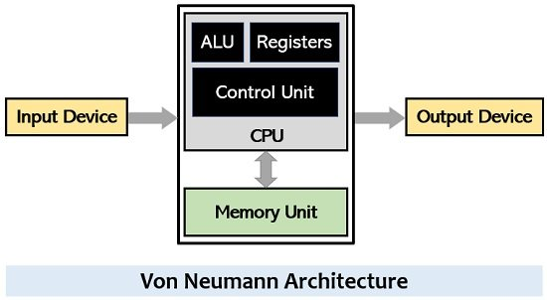
Computer Architecture;
Architecture.c
John Von Neumann Architecture
John Von Neumann
(1903 – 1957)
Programming Language

Slide 10
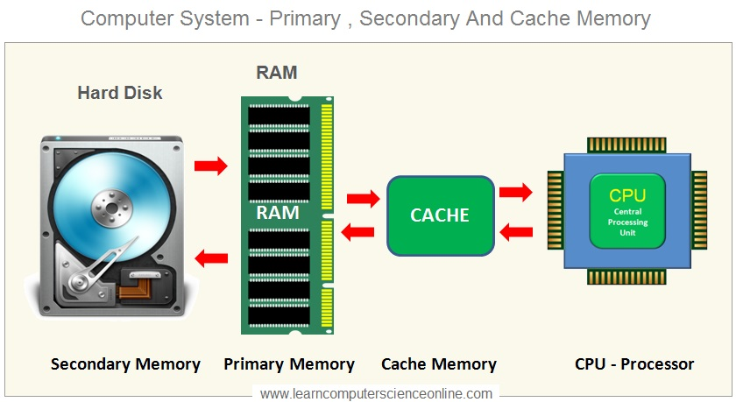
Computer Architecture;
Architecture.c
John Von Neumann Architecture
John Von Neumann
(1903 – 1957)
Programming Language

Slide 11
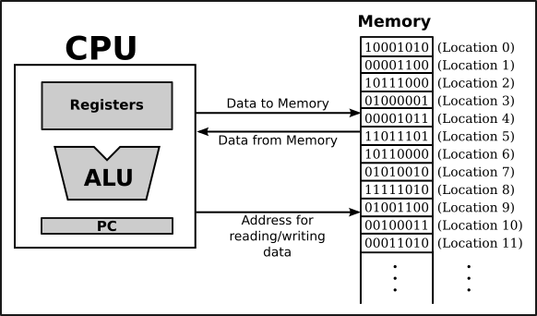
Execution Model of CPU;
Architecture.c
CPU executes data in binary format.
CPU just understands 0 and 1.
CPU understands 0 and 1 as the low and high voltage!
Programming Language

Slide 12
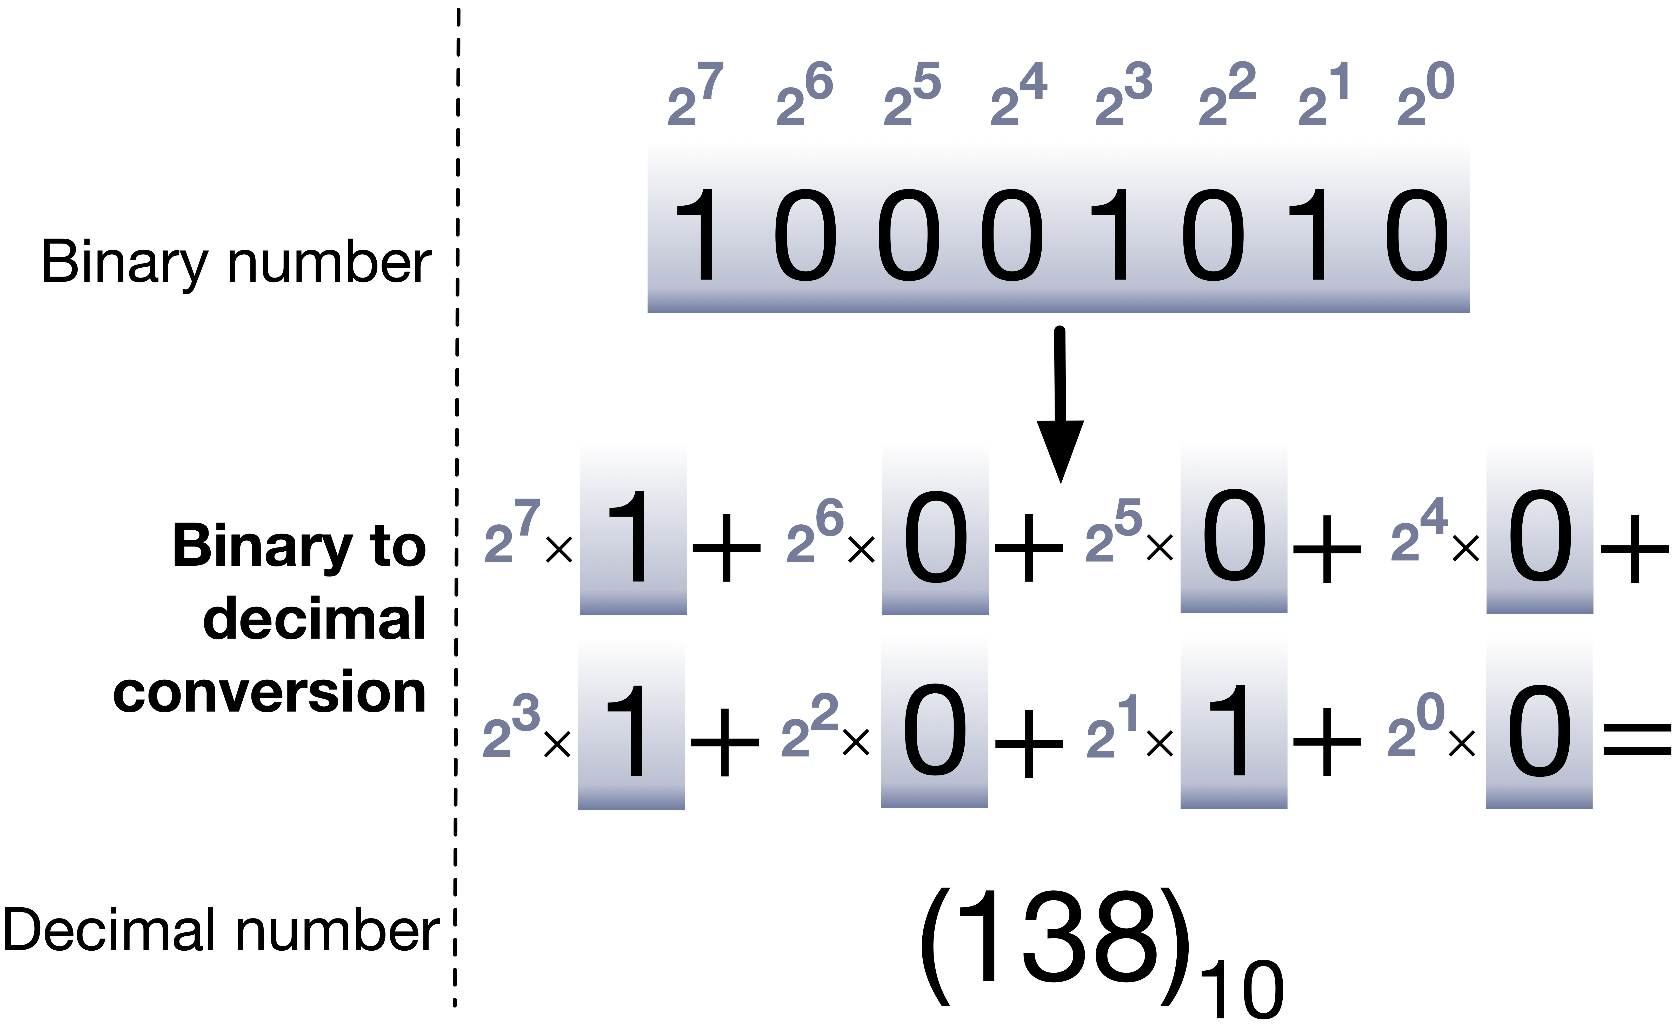
Binary Representation of Data;
binary.c
Data is stored and processed in binary format.
Programming Language

Slide 13
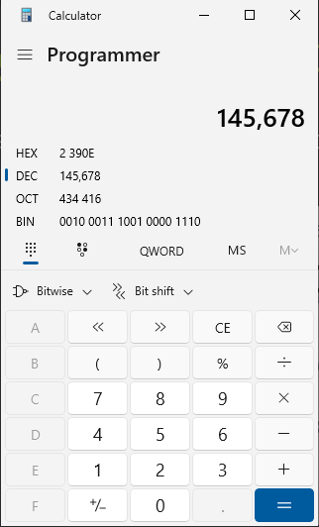
Binary Representation of Data;
binary.c
As a practice, try to work with Programmer mode of the calculator of your PC.
See different formats of numbers.
Programming Language

Slide 14
Binary Representation of Data;
binary.c
As a practice, try to get to know the ASCII table. (Search for it!)
The ASCII table maps characters (letters, digits, symbols, etc.) to numerical values (codes) that computers use to represent and process text data.
Programming Language

Slide 15
Operating System and Softwares

Slide 16
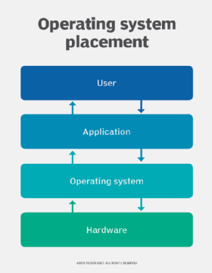
Operating System(OS);
Memory.c
OS is a software that manages computer hardware and software resources.
OS as an interface between applications and hardware.
Programming Language

Slide 17
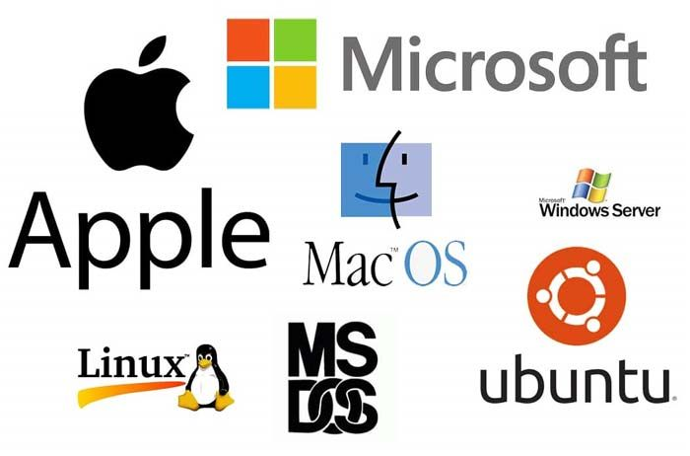
Different types of OS;
OS.c
Open Source (Linux)
Free to use.
You can participate in developing it!
Commercial (Windows, Mac)
Programming Language

Slide 18
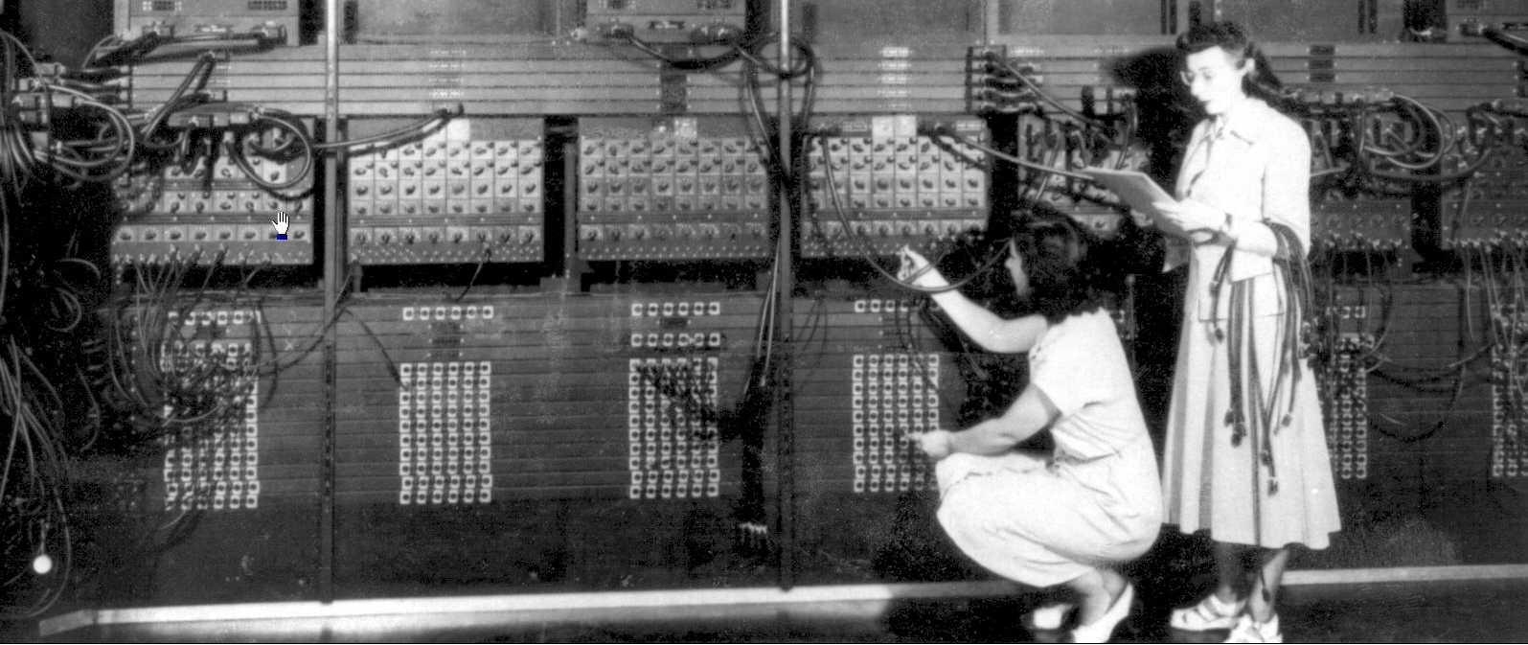
How to communicate with Computers;
Programming.c
We need to know their language(?):
Language of 0’s and 1’s.
Early programmers had to know how to code in 0’s and 1’s.(such a difficult job!)
Programming the ENIAC
Programming Language

Slide 19
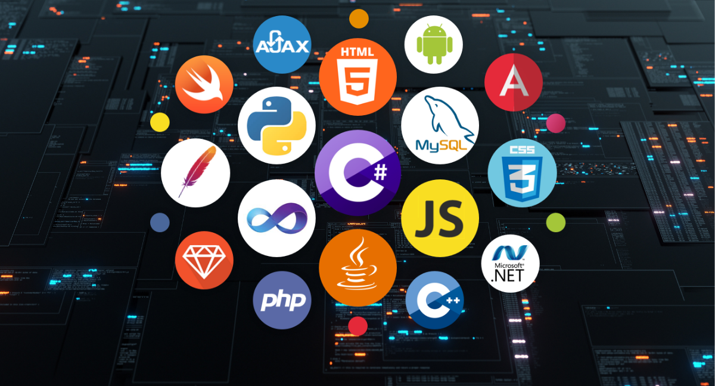
Programming Languages;
Programming.c
Set of instructions and rules used to communicate with computers.
No need to code in 0’s and 1’s. (How?)
Programming Language

Slide 20
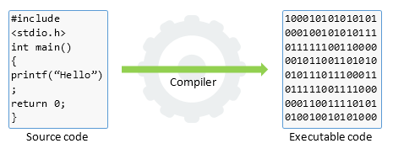
What is Compiler?
compiler.c
A compiler is a program that translates code written by humans in a programming language into machine code.
Programming Language

Slide 21
What we need to Code?
coding.c
An editor to as a tool for writing instructions.
A programming language for talking to computers.
A compiler for translation.
Programming Language

Slide 22
What we need to Code?
coding.c
An editor to code in it.
A programming language for talking to computers.
A compiler for translation.
Programming Language

Slide 23
C programming Language

Slide 24
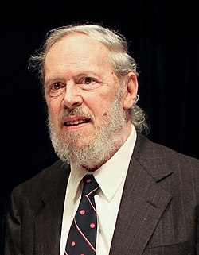
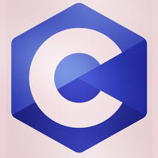
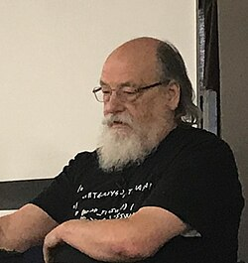
C programming Language;
C.c
Dennis Ritchie
(1941 – 2011)
C is a general-purpose programming language.
It was created in the 1970s by Dennis Ritchie
and Ken Thompson.(winners of Turing Award!)
Most of other languages are inspired by C such as Java and C++.
Ken Thompson
(1943)
Programming Language

Slide 25
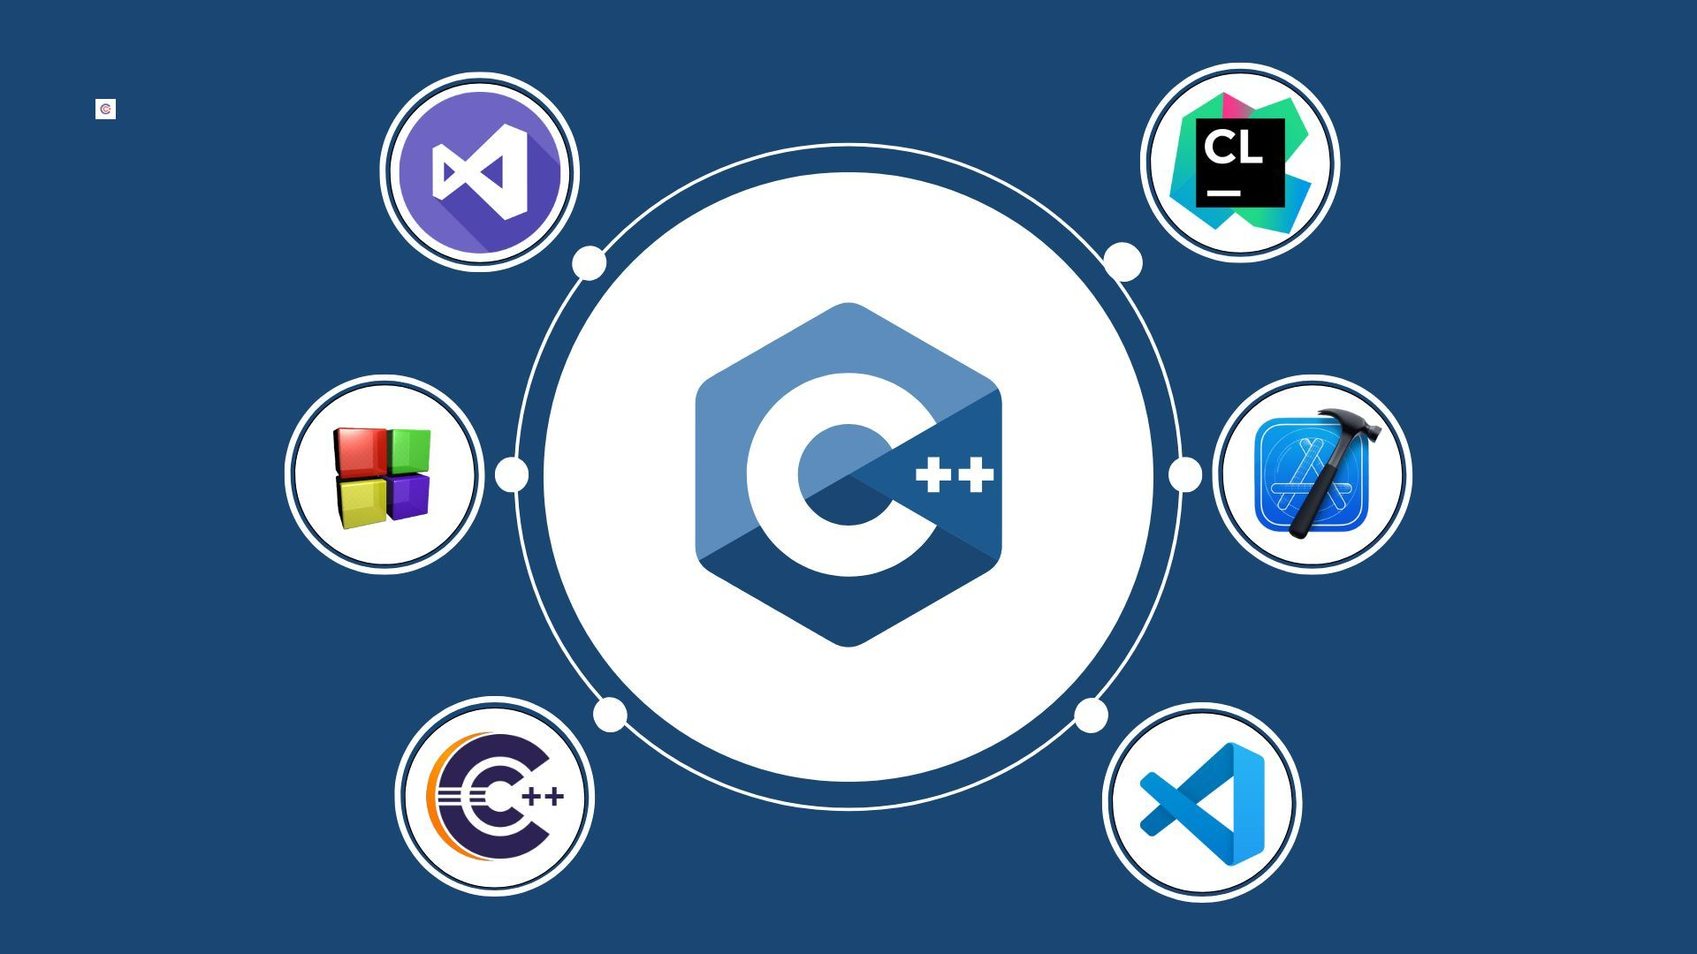
What is IDE?
IDE.c
An IDE (Integrated Development Environment) is a software application that provides all the tools you need to write, test, and debug code in one place — like a text editor, compiler.
Programming Language

Slide 26
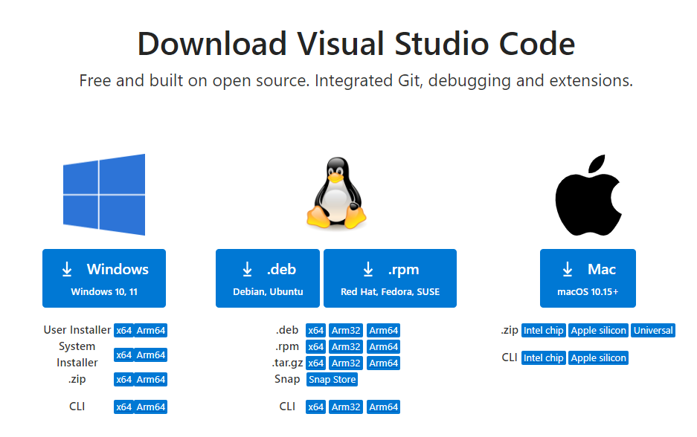
Get started with Vscode
Vscode.c
AS a practice try to install Visual Studio Code IDE.
Programming Language

Slide 27
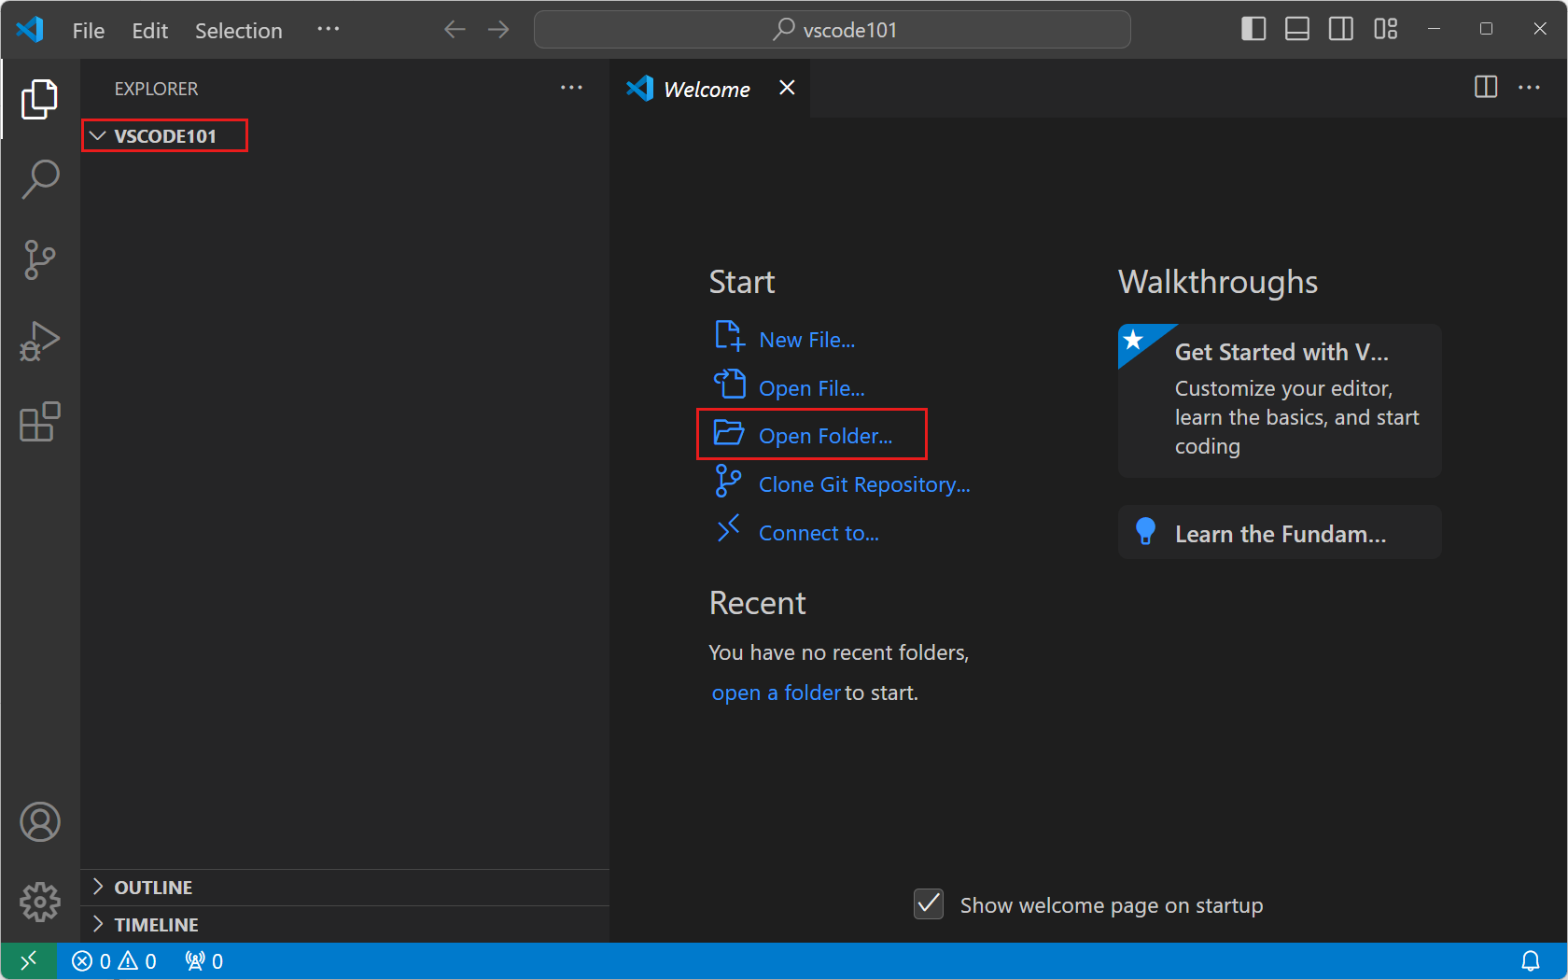
Visual Studio Code
Vscode.c
Programming Language

Slide 28
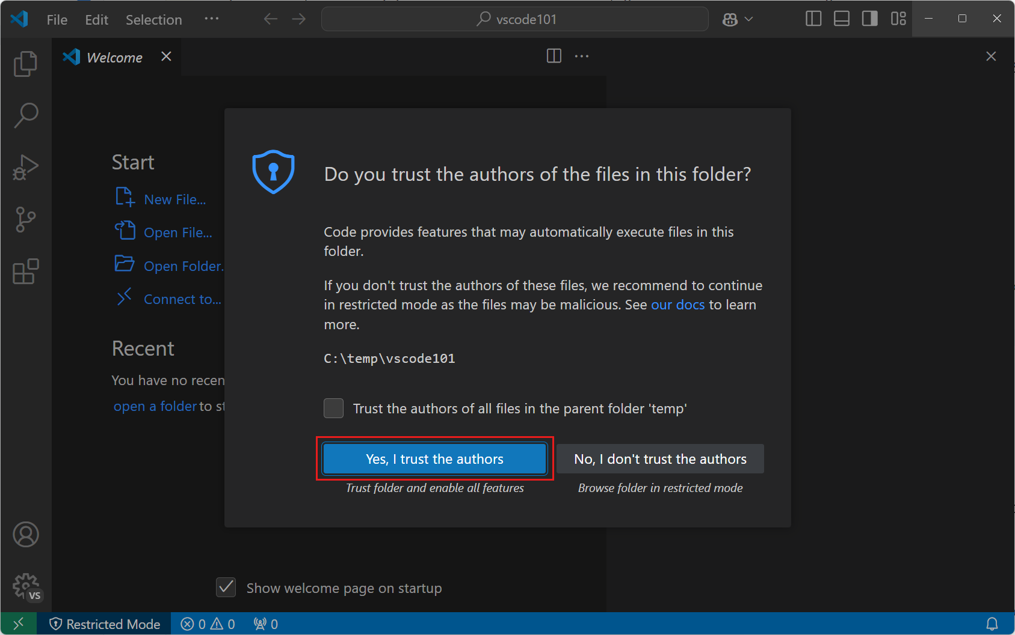
Visual Studio Code
Vscode.c
Programming Language

Slide 29
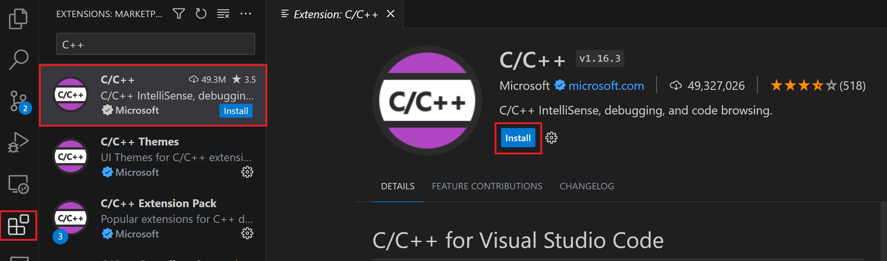
Visual Studio Code
Vscode.c
Programming Language

Slide 30
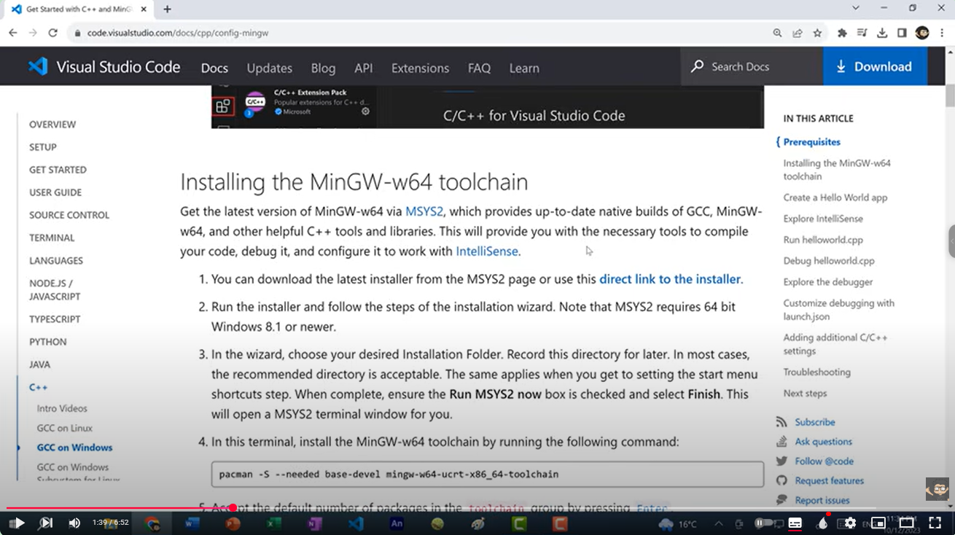
Installing the MinGW-w64 toolchain
Vscode.c
1. Get the latest version of MinGW-w64
2. Please follow the steps below as demonstrated in this video
Programming Language

Slide 31
Homework
Vscode.c
Now, perform the steps on your own system: install the compiler and Visual Studio Code, and execute the Hello World program.
"Of course, you can also use other environments."
Programming Language

Slide 32

What is GitHub, and why is it necessary?
GitHub.c
GitHub is a web-based platform for version control and collaboration that allows developers to store, manage, and track changes to their code.
Programming Language

Slide 33
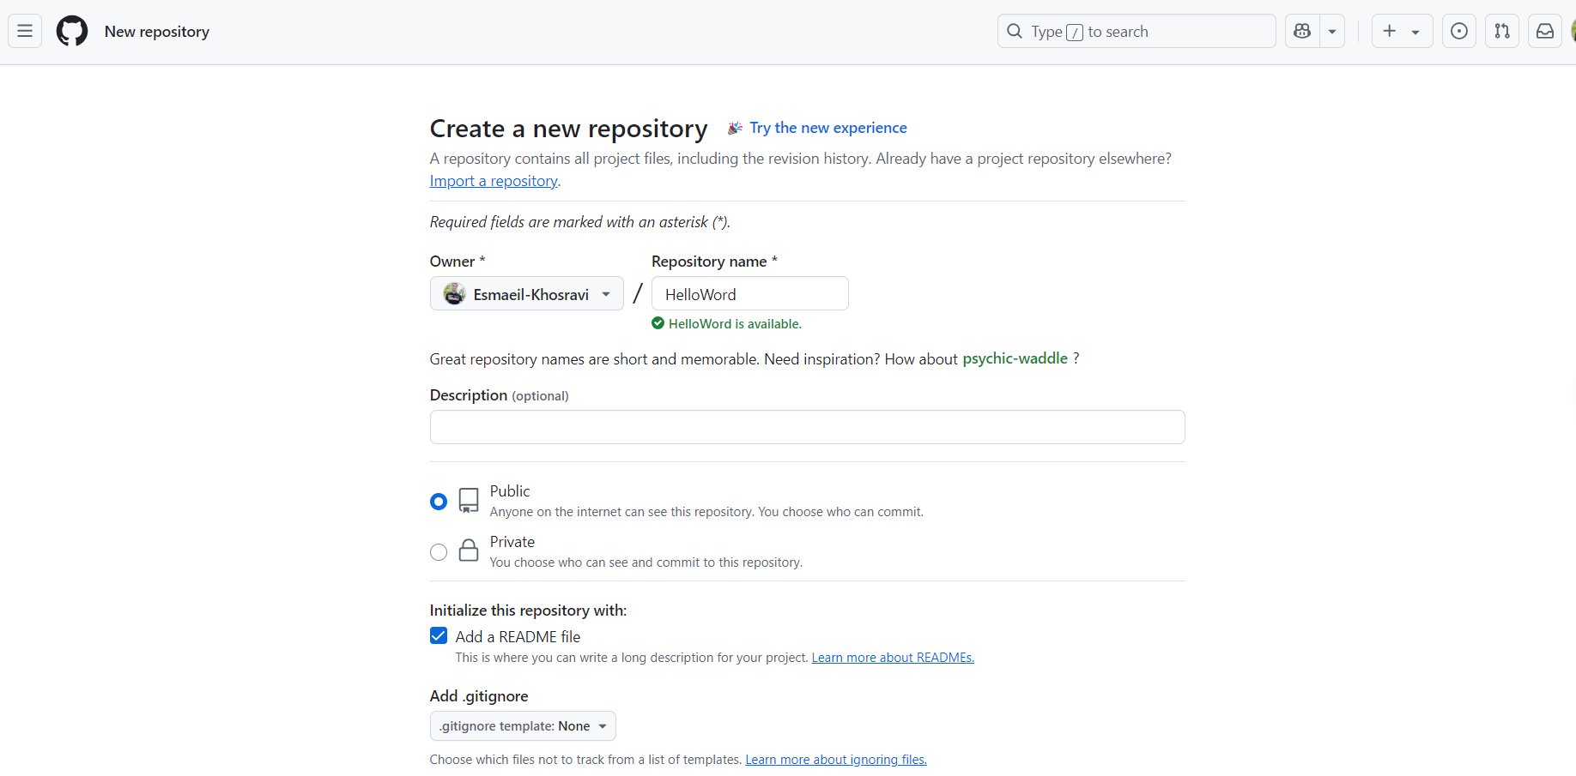
How To Use GitHub
GitHub.c
1. Sign up to GitHub and create account
2. Create first Repo
Programming Language

Slide 34

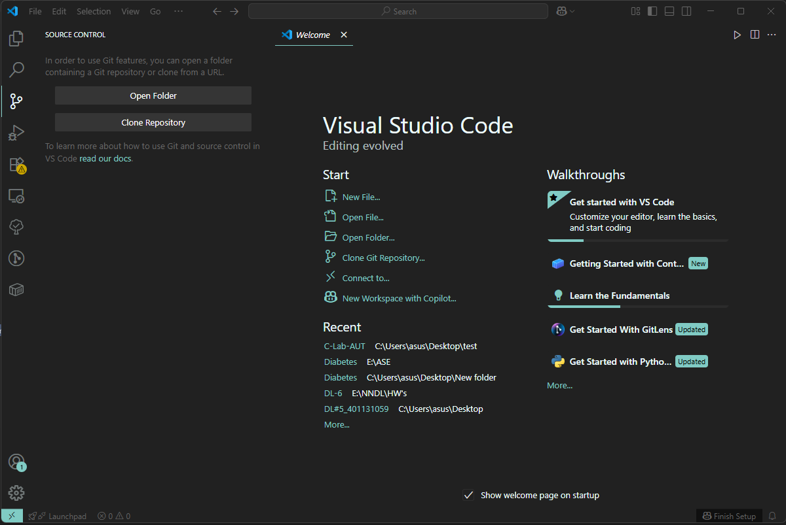
How To Use GitHub with Vscode
GitHub.c
3. Install GitHub Desktop from this link
4. Now you need to use an IDE to make changes or work with other repositories and we use Vscode
5. create a folder for your project and initialize Git in it or Clone your empty repository
Programming Language

Slide 35
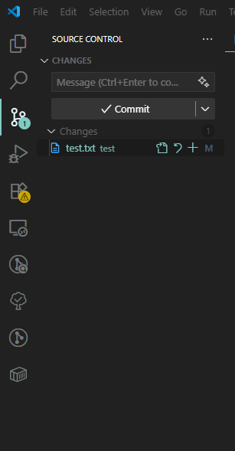
How To Use GitHub with vscode
GitHub.c
6. Now you can make changes to your code or anything in the project folder, commit them, and save every change without worrying about losing your work.
Programming Language

Slide 36
How To Use GitHub with vscode
GitHub.c
Before you start using Git, you should at least be familiar with the following basic commands
commit – to save your changes locally
push – to upload your committed changes to a remote repository
pull – to download and merge changes from the remote repository
And ..
Programming Language

Slide 37
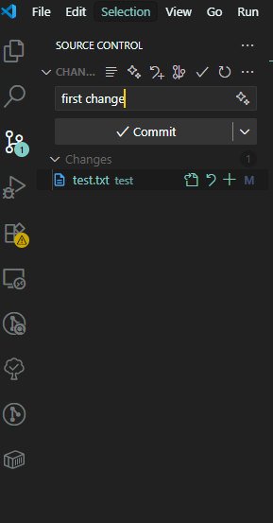
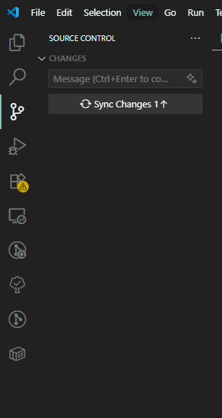
How To Use GitHub with vscode
GitHub.c
Now you can commit and push to your repository.
Programming Language

Slide 38
Homework
GitHub.c
Now push your Hello World program to your first repository and commit your changes
Note : you can also use other environments for this task
Programming Language

