Slide 1

Amirkabir University of Technology
(Tehran Polytechnic)
Department of Computer Engineering
Function
#1
Programming Language Lab

Slide 2

Function Implementation

Slide 3

What is function?;
function.c
You probably know the concept of function in math.
Function in Math
y $=f(x)$
Output
Input
How could we implement functions in programming?
Programming Language Lab
1

Slide 4
What is function?;
function.c
Recap the general syntax of defining a function in C as depicted in the given picture.
Function
Name
Parameter
Name
int sum ( int a, int b );
What are the built-in functions(methods!) in C?
Ending
Statement
Return
Type
Parameter
Type
Programming Language Lab
2

Slide 5
Binary and Decimal formats;
function.c
Task 1
Write a C program that takes a binary number (up to 32 bits) as input from the user and converts it to its decimal (base-10) equivalent.
You should develop a function for the conversion!
Programming Language Lab
3

Slide 6
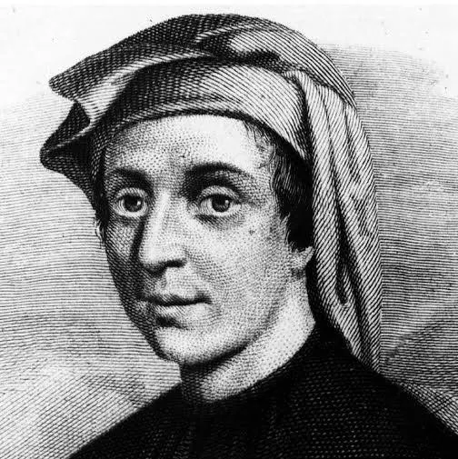
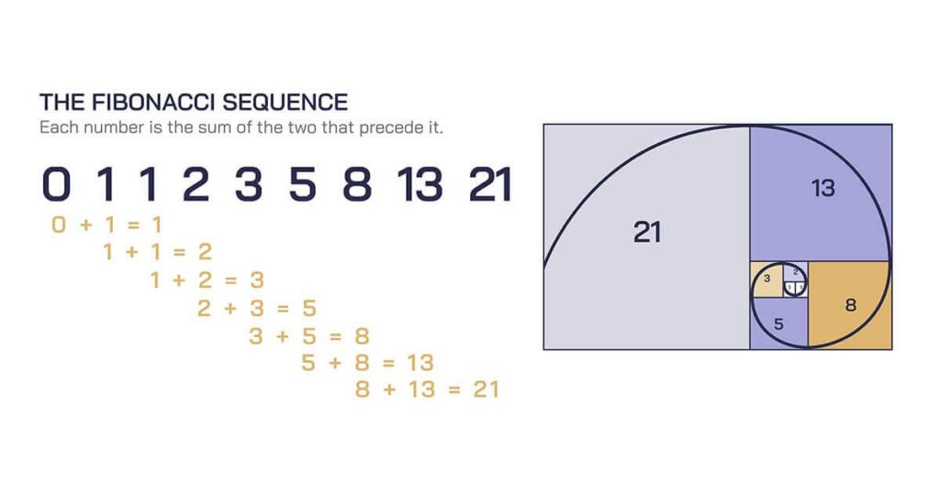
The Fibonacci Series;
function.c
Are you familiar with this sequence?
Fibonacci
(1170-1250)
It has got many application (search for it!)
Programming Language Lab
4

Slide 7
decision.c
Task 2
The Fibonacci Series;
Write a program implementing the Fibonacci sequence, so that calculates the nth Fibonacci number.
Fibonacci Series
Follow the rule which is shown in the picture!
Default
Implement both iterative and recursive versions!
0 1 1 2 3 5
0 + 1 = 1
1 + 1 = 2
1 + 2 = 3
2 + 3 = 5
Programming Language Lab
5

Slide 8
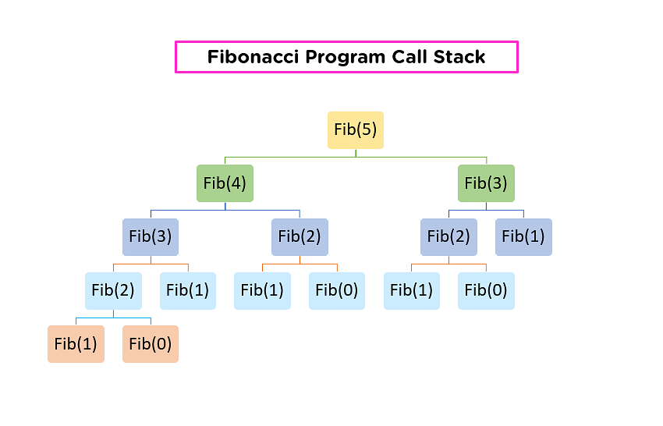
function.c
Task 2
The Fibonacci Series;
Which version is faster as the size of the input grows? Why?
Try out different size of values for the input of both versions.
Programming Language Lab
6

Slide 9


Combination and Permutation;
function.c
Task 3
You might be familiar with factorial concept in math!
Which is the foundation of combination and permutation. (As shown in the picture!)
$$P(n,r)=\frac{n!}{(n−r)!}$$
$$P(n,r)=\frac{n!}{(n−r)!}$$
Programming Language Lab
7

Slide 10

Combination and Permutation;
function.c
Task 3
$$C(n,r)=\frac{n!}{r!(n−r)!}$$
Develop a program implementing combination and permutation.
You should have functions for calculating factorial and permutation and combination.
$$P(n,r)=\frac{n!}{(n−r)!}$$
According to the relation, notice that there are two inputs!
Programming Language Lab
8

Slide 11
Homework
HW1
Write a C program that takes a positive integer number from the user and recursively analyzes its digits to determine:
The sum of its digits.
The product of its digits.
Whether all digits are even or not.
You must implement at least three separate functions:
int digitSum(int n); – returns the sum of the digits.
int digitProduct(int n); – returns the product of the digits.
int allEvenDigits(int n); – returns 1 if all digits are even, otherwise 0.
Programming Language Lab
9

Slide 12
Homework
HW2
Assignment: do the following:
5.36 (Towers of Hanoi)
from C How to Program, 9th Edition (Deitel)
Programming Language Lab
10

