Slide 1

Amirkabir University of Technology
(Tehran Polytechnic)
Department of Computer Engineering
Pointers
Programming Language Lab

Slide 2

Pinters and Memory address (part 2)

Slide 3
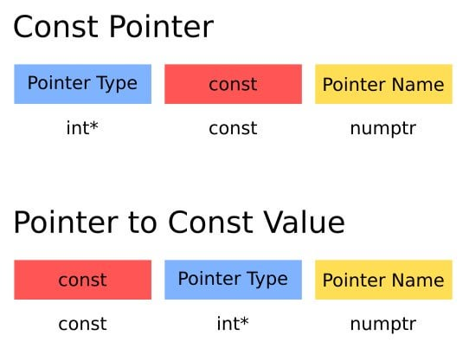
Pointer.c
Const Pointer vs Pointer to Const
We need const in C to:
Protect data from being changed accidentally
Allow compiler optimizations
Prevent bugs with pointers
Work with string literals safely
…
Programming Language Lab
1

Slide 4
Pointer.c
Task 1
Const Pointer vs Pointer to Const
Run the program in different states. (by uncommenting or commenting A-D)
#include <stdio.h>
int main() {
int x = 10, y = 20;
const int *p = &x; // pointer to const int
int *const q = &y; // const pointer to int
// *p = 15; // (A)
p = &y; // (B)
*q = 25; // (C)
// q = &x; // (D)
printf("x = %d, y = %d\n", x, y);
return 0;
}
Which lines (A–D) cause compile errors, and why?
Explain the difference between:
const int *p
int *const q
Programming Language Lab
2

Slide 5
Pointer.c
Memory Allocation
Dynamic memory allocation lets us request memory at runtime
Sometimes we don’t know size at compile time.
#include <stdio.h>
#include <stdlib.h>
int main() {
int *ptr = (int *)malloc(20);
// Populate the array
for (int i = 0; i < 5; i++) {
ptr[i] = i + 1;
}
// Print the array
for (int i = 0; i < 5; i++) {
printf("%d ", ptr[i]);
}
return 0;
}
Look at the given code and see how it is done with pointers.
Try out calloc() and figure out the difference with malloc().
Programming Language Lab
3

Slide 6
Pointer.c
Task 2
Memory Allocation for Matrix
Complete the given code to define and fill a matrix
#include <stdio.h>
#include <stdlib.h>
int main() {
int rows = 3, cols = 4;
int **matrix;
// allocate row pointers
matrix = (int **) malloc(...);
}
You should fill the matrix, print its values and finally free the memory.
Programming Language Lab
4

Slide 7
Pointer.c
Task 3
3D array
Complete the given code to define and fill a 3D array.
#include <stdio.h>
int main() {
int arr[2][3][4]; // 2 layers, 3 rows, 4 cols
int *p = (int *)arr; // flatten 3D array into pointer
int layers = 2, rows = 3, cols = 4;
// Fill using pointer arithmetic: arr[i][j][k] = i + j + k
}
You should use pointer arithmetic for filling and printing the 3D array.
Programming Language Lab
5

Slide 8
Pointer.c
Function Pointer
A function pointer contains the address of a function in memory. A function name is really the starting address in memory of the code that performs the function’s task.
#include <stdio.h>
int square(int n) {
return n * n;
}
int main() {
// declare a function pointer
int (*fp)(int);
// assign function address
fp = square;
// call function using pointer
printf("%d\n", fp(5));
return 0;
}
This example shows how function pointer works in practice
Programming Language Lab
6

Slide 9
Pointer.c
Task 4
Function Pointer
design a small calculator that can add, subtract, multiply, or divide two integers using function pointers.
#include <stdio.h>
int add(int a, int b) { return a + b; }
int sub(int a, int b) { return a - b; }
int mul(int a, int b) { return a * b; }
int divide(int a, int b) { return b != 0 ? a / b : 0; }
int main() {
// : declare a function pointer
// : store address of different functions
// : call functions using the pointer
return 0;
}
Complete the given code by doing what is asked.
Programming Language Lab
7

Slide 10
Pointer.c
HW
Homework
Assignment: do the following:
7.20 — (Maze Traversal)
7.21 (Generating Mazes Randomly)
from C How to Program, 9th Edition (Deitel)
Programming Language Lab
8

