Slide 1

Amirkabir University of Technology
(Tehran Polytechnic)
Department of Computer Engineering
Pointers
Programming Language Lab

Slide 2

Pinters and Memory address

Slide 3
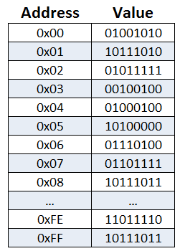
Pointer.c
Pointers and Memory addresses
The picture shows the model of memory.
Every content (value) which is stored in RAM is indexed by an address.
Those values are accessible by their address.
Programming Language Lab
1

Slide 4
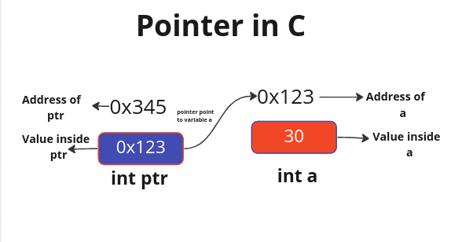
Pointer.c
Pointers Operators
A pointer is a variable that stores the address of another variable.
Pointers have type and value.
Programming Language Lab
1

Slide 5
Pointer.c
Pointers Operators
Let’s recap operators for pointer.
Adress operator: &
Dereference Operator: *
Review what you have learnt for declaring pointers.
Programming Language Lab
1

Slide 6
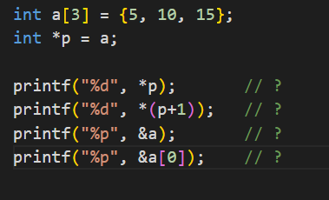
Pointer.c
Task 1
Pointer Arithmetic
What are the output of the following?
(first guess the output without coding it)
Programming Language Lab
1

Slide 7
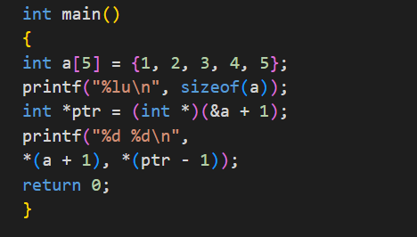
Pointer.c
Task 2
Pointer Arithmetic
Run the given program and justify the result.
Do the results make sense?
Programming Language Lab
1

Slide 8
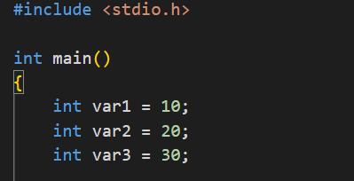
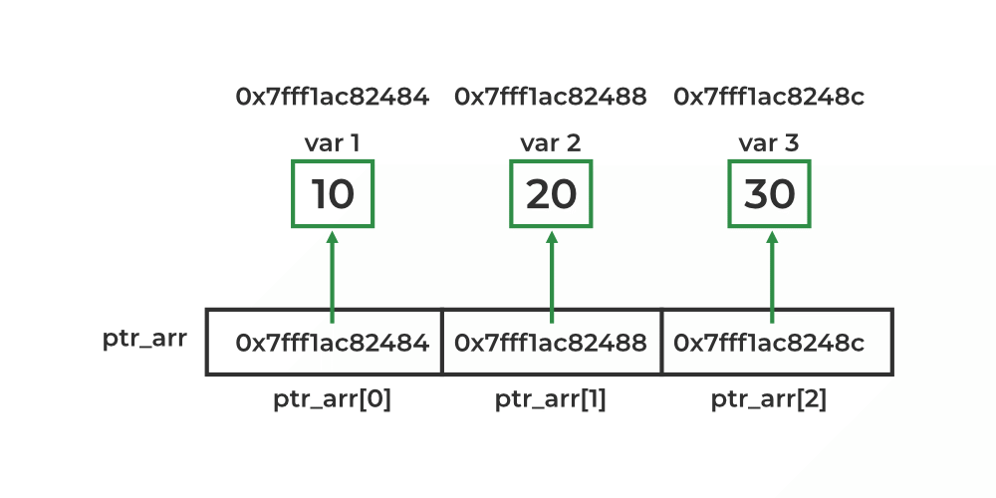
Encoding.c
Task 3
Array of Pointers
Complete the program to have array of pointers.
Each of pointers should point to each of defined variables.
Traverse the array and print the value of variables and their address.
What is the difference between pointer to array and array of pointers?
Programming Language Lab
2

Slide 9
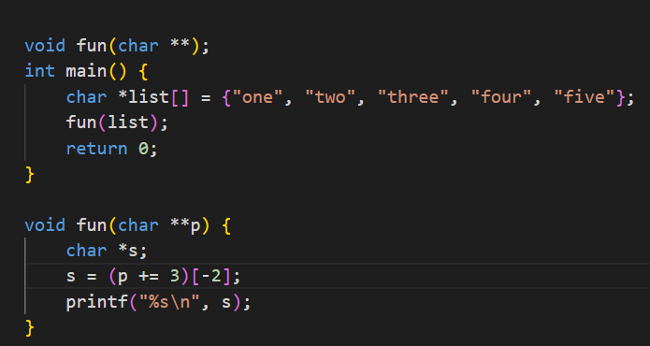
Pointer.c
Task 4
Pointer to Pointer
Predict the output of the code
without compiling it.
Why dose it output such a result?
Programming Language Lab
1

Slide 10
Homework
HW
Assignment: 7.12 — Card Shuffling and Dealing: Dealing Poker Hands
Source: C How to Program, 9th Edition (Deitel)
You should write functions for a-f parts.
Programming Language Lab
13

