Slide 1

Amirkabir University of Technology
(Tehran Polytechnic)
Department of Computer Engineering
Array
#1
Programming Language Lab

Slide 2
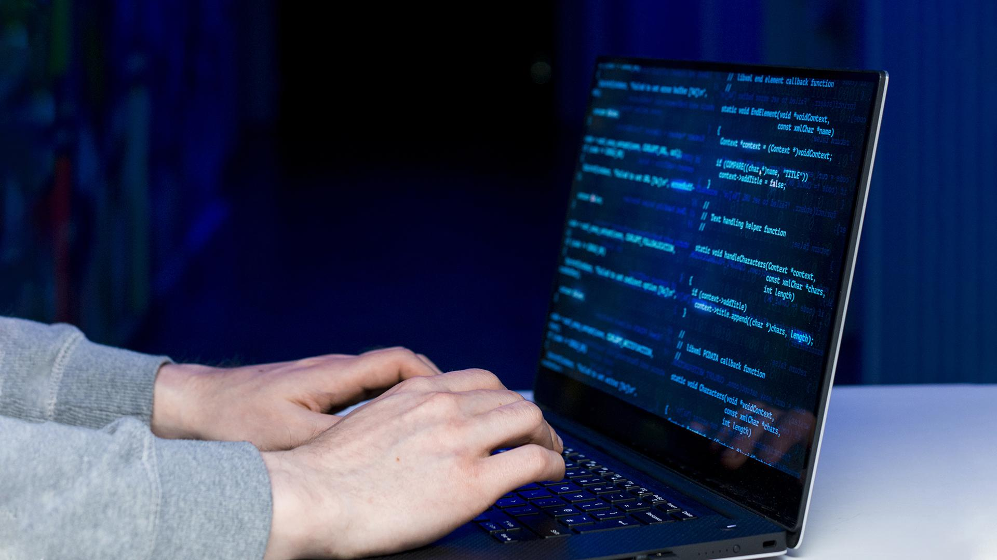
Arrays

Slide 3
Why do we need arrays?
Array.c
One way to improve the execution time of recursive functions is to use Memorization
Avoids redundant computations
Significantly reduces execution time
Enhances the performance of algorithms such as Fibonacci, dynamic programming, and partitioning problems
Programming Language Lab
1

Slide 4
function.c
Task 1
Complete the following code (Top-Down).
#include <stdio.h> int memory[1000];
int fibonacci(int n) {
if (n == 1 || n == 2) {
return 1;
}
if (memory[n] == 0) {
memory[.........] = fibonacci(......) + fibonacci(........);
}
return memory[n];
}
Programming Language Lab
2

Slide 5
Array.c
Task 2
Now try to compute the Fibonacci sequence using an array, without using a recursive function (Bottom-Up).
Which method do you think is better, and why?
Programming Language Lab
3

Slide 6
Array.c
Strings
We can store a string as a character array in the C language. Each element of the array holds one character
#include <stdio.h>
int main() {
char name[20];
printf("Enter your name: ");
scanf("%19s", name);
printf("Hello, %s!\n", name);
return 0;
}
Programming Language Lab
4

Slide 7
Strings
Write a program that takes a string as input and prints the frequency of each character in the string.
Input:”Programming Language”
Output:
Character frequencies:
Array.c
Task 3
L : 1
P : 1
a : 3
e : 1
g : 4
i : 1
m : 2
n : 2
o : 1
r : 2
u : 1
Programming Language Lab
5

Slide 8
Remove Duplicates From Sorted Array
Array.c
Task 4
You are given an integer array sorted in non-decreasing order. Your task is to remove duplicates
Input: [2,10,10,30,30,30]
Output: [2,10,30]
Programming Language Lab
6

Slide 9
Homework
HW1
You are given an integer array and an integer value. Your task is to remove all occurrences of value from array.
Input:[0,1,2,2,3,0,4,2], value = 2
Output: [0,1,3,0,4]
Programming Language Lab
7

