Slide 1

Amirkabir University of Technology
(Tehran Polytechnic)
Department of Computer Engineering
Pointers
Programming Language Lab

Slide 2

Pinters and Memory address (part 2)

Slide 3
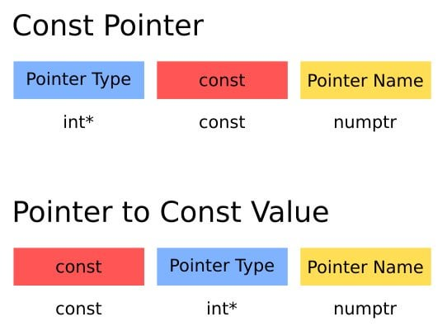
Pointer.c
Const Pointer vs Pointer to Const
We need const in C to:
Protect data from being changed accidentally
Allow compiler optimizations
Prevent bugs with pointers
Work with string literals safely
…
Programming Language Lab
1

Slide 4
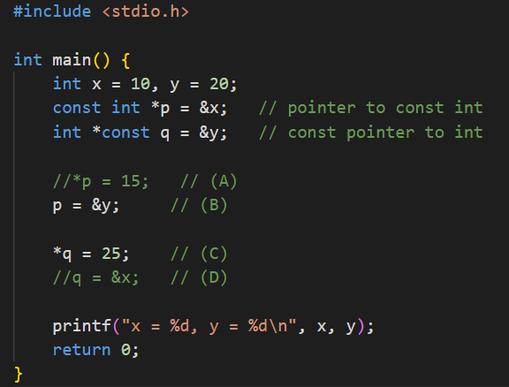
Pointer.c
Task 1
Const Pointer vs Pointer to Const
Run the program in different states. (by uncommenting or commenting A-D)
Which lines (A–D) cause compile errors, and why?
Explain the difference between:
const int *p
int *const q
Programming Language Lab
1

Slide 5
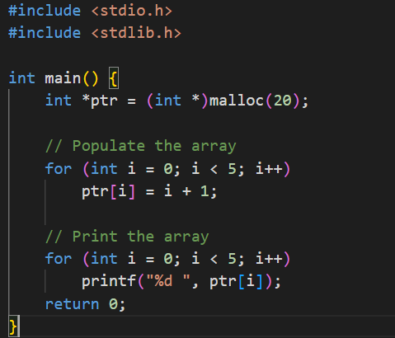
Pointer.c
Memory Allocation
Dynamic memory allocation lets us request memory at runtime
Sometimes we don’t know size at compile time.
Look at the given code and see how it is done with pointers.
Try out calloc() and figure out the difference with malloc().
Programming Language Lab
1

Slide 6
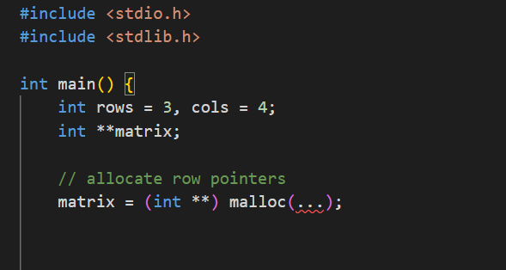
Pointer.c
Task 2
Memory Allocation for Matrix
Complete the given code to define and fill a matrix
You should fill the matrix, print its values and finally free the memory.
Programming Language Lab
1

Slide 7
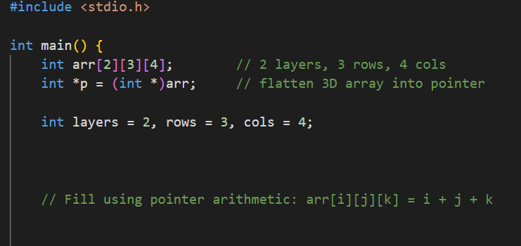
Pointer.c
Task 3
3D array
Complete the given code to define and fill a 3D array.
You should use pointer arithmetic for filling and printing the 3D array.
Programming Language Lab
1

Slide 8
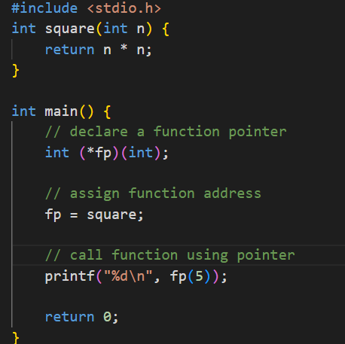
Pointer.c
Function Pointer
A function pointer contains the address of a function in memory. A function name is really the starting address in memory of the code that performs the function’s task.
This example shows how function pointer works in practice
Programming Language Lab
1

Slide 9
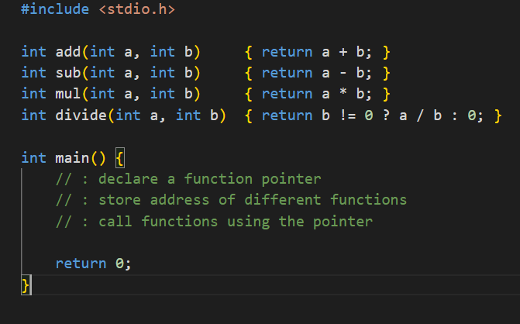
Pointer.c
Task 4
Function Pointer
design a small calculator that can add, subtract, multiply, or divide two integers using function pointers.
Complete the given code by doing what is asked.
Programming Language Lab
1

Slide 10
Pointer.c
Task 3
Function Pointer
design a small calculator that can add, subtract, multiply, or divide two integers using function pointers.
Complete the given code by doing what is asked.
Programming Language Lab
1

Slide 11
Pointer.c
Task 3
Function Pointer
design a small calculator that can add, subtract, multiply, or divide two integers using function pointers.
Complete the given code by doing what is asked.
Programming Language Lab
1

Slide 12
Pointer.c
HW
Homework
Assignment: do the following:
7.20 — (Maze Traversal)
7.21 (Generating Mazes Randomly)
from C How to Program, 9th Edition (Deitel)
Programming Language Lab
1

