Slide 1

Intro.c
کارگاه مبانی برنامه‌نویسی
#1

Slide 2
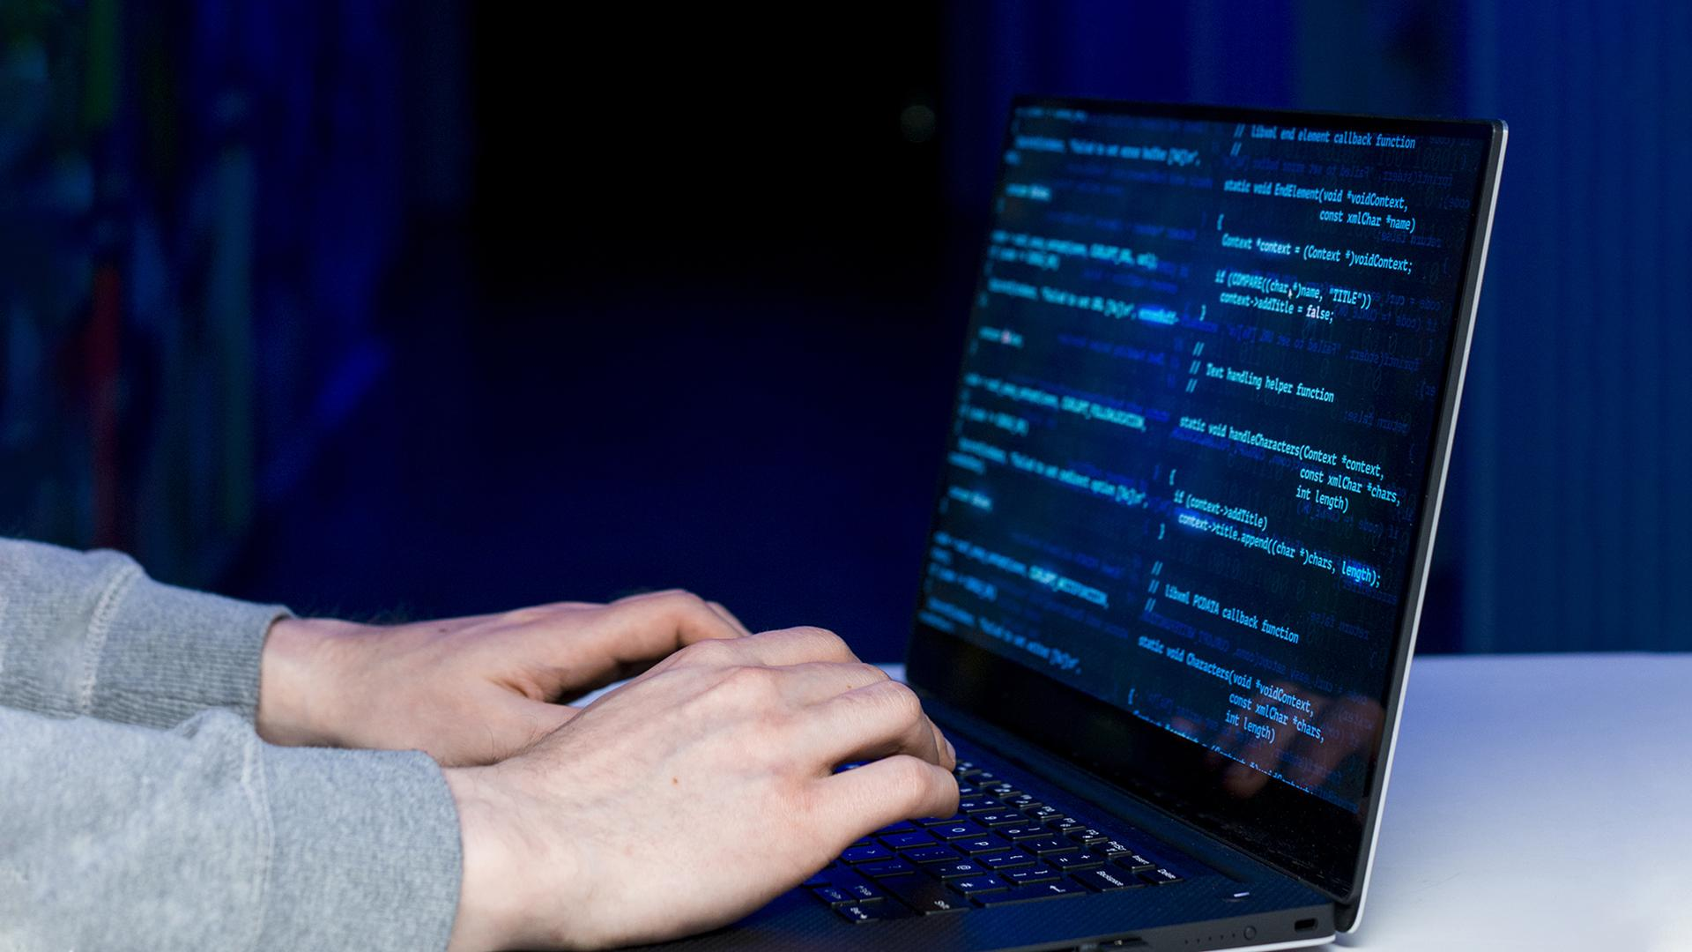
Decision Making In Programming
}

Slide 3
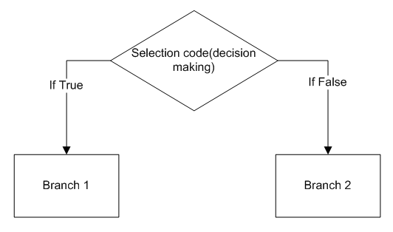
Decision making;
decision.c
Programming Language Lab

Slide 4
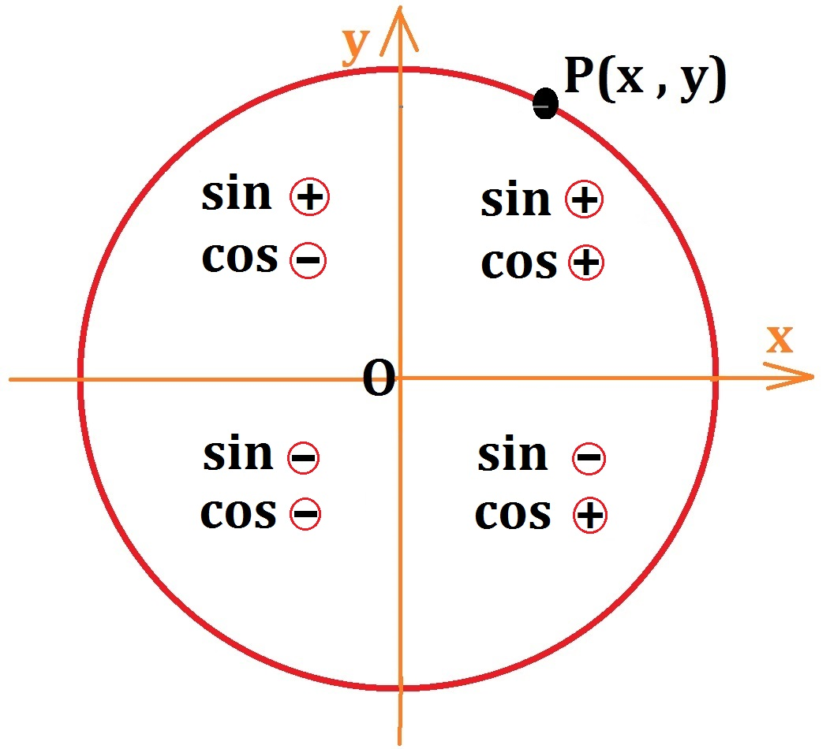
Angles and Positions;
decision.c
Write a program that takes an angle value as input (in degrees) and determines the position of that angle on the unit circle.
You need to use if and else if syntax.
Programming Language Lab

Slide 5
Banking Operations;
decision.c
Do you know how banking operations are done in practice?
Programming Language Lab

Slide 6
Banking Operations;
decision.c
Banking operations are full of conditions!
Where banking systems (programs) need to decide what to do in case of every possible condition.
That’s where ‘if’ and ‘else if’ come in handy.
Programming Language Lab

Slide 7
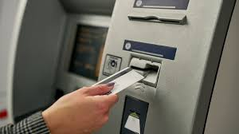
Banking Operations;
decision.c
Write a C program to simulate a simple ATM machine interface
Programming Language Lab

Slide 8
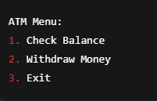
Banking Operations;
decision.c
Write a C program to simulate a simple ATM machine interface
First develop a menu for choice of the user!
Just like the given picture
Programming Language Lab

Slide 9
Banking Operations;
decision.c
Write a C program to simulate a simple ATM machine interface with the following features:
For each choice of user, you should make a decision!
You can use ‘switch-case’ syntax as well.
Programming Language Lab

Slide 10
Banking Operations;
decision.c
In the menu:
Option 1: Should display the current balance
Programming Language Lab

Slide 11
Banking Operations;
decision.c
Options 2: should ask the user to enter a withdrawal amount.
Only allow the withdrawal of 100, 200, or 500 units.
Check if the balance is sufficient.
If valid, deduct the amount and display the new balance.
If not, show an "Insufficient funds" message.
If an invalid amount is entered, show an "Invalid amount" message.
Programming Language Lab

Slide 12
Banking Operations;
decision.c
In the menu:
Option 3: Exit the program with a goodbye message.
Programming Language Lab

Slide 13
Banking Operations;
decision.c
Write a C program to simulate a simple ATM machine interface with the following features:
Programming Language Lab

Slide 14
Homework;
howework.c
Programming Language Lab

Slide 15
A simple problem! {
01
forbeginners.html
workshop.css
wirte
}
Programming Language

Slide 16
01 {
[Theory Lesson]
forbeginners.html
workshop.css
< You can enter a subtitle here if you need it >
}
Programming Language

Slide 17
Concepts < /1 > {
forbeginners.html
workshop.css
< Mercury is the closest planet to the Sun and the smallest one in the Solar System—it’s only a bit larger than the Moon >
}
Concepts < /2 > {
< Venus has a beautiful name and is the second planet from the Sun. It’s hot and has a poisonous atmosphere >
}
Programming Language

Slide 18
Introduction; {
forbeginners.html
workshop.css
‘Here you can give a brief description of the topic you want to talk about’
<p For example, if you want to talk about Mercury, you can say that it’s the smallest planet in the entire Solar System >
</p>
}
Programming Language

Slide 19
What Is this ‘Topic About ?’ {
forbeginners.html
workshop.css
Languages
Html
60%
Css
40%
< Mercury is the smallest planet in the entire Solar System >
< The Earth is the only one that harbors life in the Solar System >
Create a web page
Venus has a nice name
Mars is a cold place
Jupiter is a gas giant
}
Programming Language

Slide 20
Features of ‘the Topic’ {
forbeginners.html
workshop.css
Step 01
Mercury is the closest planet to the Sun and the smallest one
Step 02
Saturn is a gas giant and has several rings
Step 03
The Earth is the only planet that harbors life
Step 04
Venus has a beautiful name and is the second planet from the Sun
}
Programming Language

Slide 21
Recommendations; {
forbeginners.html
workshop.css
Mercury
< Mercury is the closest planet to the Sun and the smallest one in the Solar System >
Saturn
< It was named after the Roman god of wealth and agriculture >
Jupiter
< Jupiter is a gas giant and the biggest planet in the Solar System >
}
Programming Language

Slide 22
Examples About ‘The Topic’{
forbeginners.html
workshop.css
Mercury
Jupiter
< Mercury is the closest planet to the Sun >
< Jupiter is a gas giant and the biggest planet >
Saturn
Venus
< Saturn is a gas giant and has several rings >
< Venus has a nice name and high temperatures >
}
Programming Language

Slide 23
Practical Exercise {
< /1 >
< /2 >
forbeginners.html
workshop.css
< Saturn is the fourth-largest object by diameter in the Solar System >
Mercury is the smallest planet
The Earth is the planet we live on
Saturn is made of oxygen and helium
Jupiter is a gas giant
Venus has high temperatures
Neptune is very far away from the Sun
}
Programming Language

Slide 24
9h 55m 23s {
333,000.000
386,000 km
forbeginners.html
workshop.css
< Is Jupiter's rotation period >
< Earths fit in the Sun’s mass >
< Distance between the Moon and the Earth >
}
Programming Language

Slide 25
Awesome { Words;
forbeginners.html
workshop.css
}
Programming Language

Slide 26
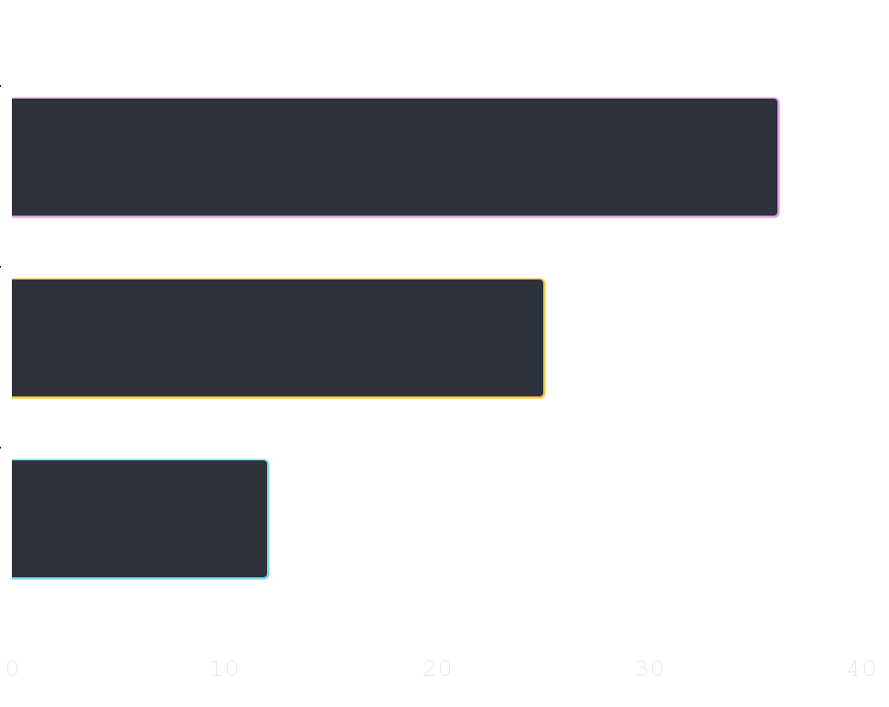
Did You Know ‘This ?’ {
forbeginners.html
workshop.css
36.00
Mercury is the smallest planet of the Solar System
25.00
Venus has a beautiful name and high temperatures
12.00
Despite being red, Mars is actually a cold place
}
Follow the link in the graph to modify its data and then paste the new one here. For more info, click here
Programming Language

Slide 27
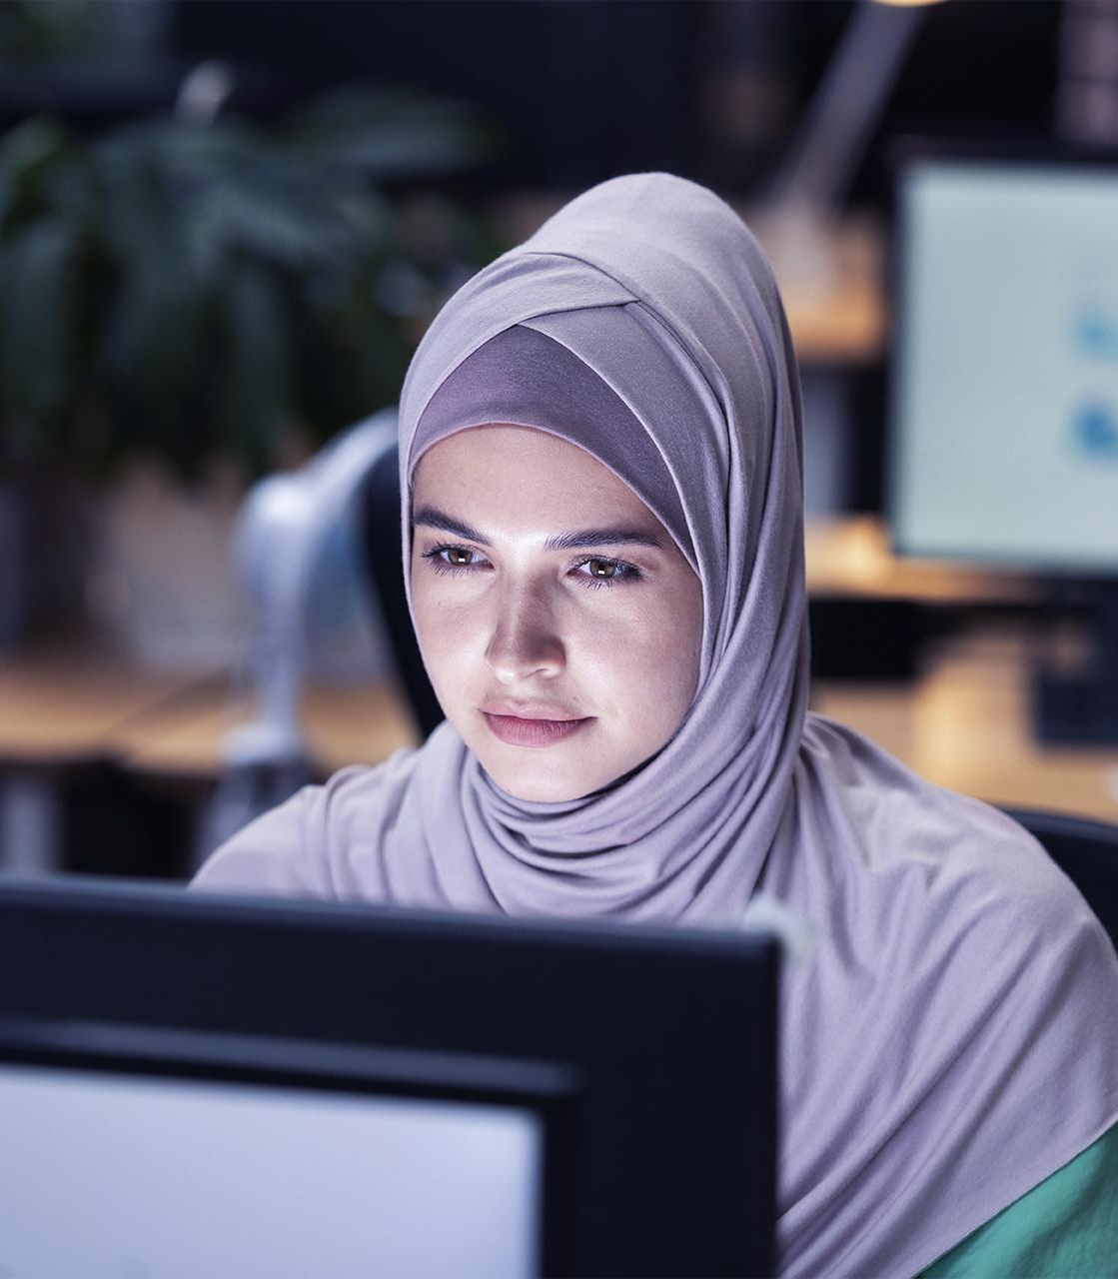
A ‘Picture’ Always Reinforces The Concept {
forbeginners.html
workshop.css
< Images reveal large amounts of data, so remember: use an image instead of a long text. Your audience will appreciate it >
}
Programming Language

Slide 28
150,005,630 {
forbeginners.html
workshop.css
< Big numbers catch your audience’s attention >
}
Programming Language

Slide 29
— Someone ‘Famous’
forbeginners.html
workshop.css
< “This is a quote, words full of wisdom that someone important said and can make the reader get inspired.” >
Programming Language

Slide 30
Review ‘Concepts’ {
forbeginners.html
workshop.css
< Mercury is the closest planet to the Sun and the smallest one in the Solar System >
Venus
Ceres
Saturn
}
Programming Language

Slide 31
Planning of ‘September’{
forbeginners.html
workshop.css
M | T | W | T | F | S | S
 |  | 01 | 02 | 03 | 04 | 05
06 | 07 | 08 | 09 | 10 | 11 | 12
13 | 14 | 15 | 16 | 17 | 18 | 19
20 | 21 | 22 | 23 | 24 | 25 | 26
27 | 28 | 29 | 30
Mercury is the smallest planet
Venus has a beautiful name
The Earth is the third planet
Mars is actually a cold place
Jupiter is a gas giant
}
Programming Language

Slide 32
JavaScript For ‘Beginners’ {
forbeginners.html
workshop.css
Mercury
Mars
It is the closest planet to the Sun
Despite being red, Mars is a cold place
Jupiter
Venus
Jupiter is the biggest planet
Venus is the second planet from the Sun
Saturn
Neptune
Saturn is a gas giant and has several rings
Neptune is very far from the Earth
}
Programming Language

Slide 33
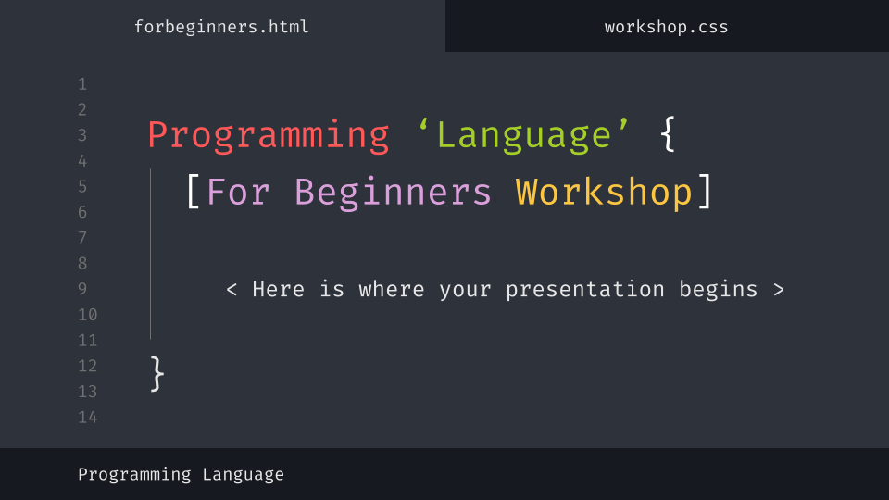
Desktop Software {
forbeginners.html
workshop.css
You can replace the image on the screen with your own work. Just delete this one, add yours and center it properly
}
Programming Language

Slide 34
Thanks; {
forbeginners.html
workshop.css
‘Do you have any questions?’
youremail@freepik.com
+91 620 421 838
yourcompany.com
< Please keep this slide for attribution >
}
Programming Language

Slide 35
Web ‘Design’
forbeginners.html
workshop.css
Programming Language

Slide 36
Alternative ‘Resources’ {
forbeginners.html
workshop.css
Here’s an assortment of alternative resources whose style fits the one of this template
Photos:
Portrait hacker I
Portrait hacker II
}
Programming Language

Slide 37
Resources {
forbeginners.html
workshop.css
Did you like the resources on this template? Get them for free at our other websites:
Photos:
Close up hacker
Medium shot woman working computer
Icons:
Web design
}
Programming Language

Slide 38
Instructions for use
In order to use this template, you must credit Slidesgo by keeping the Thanks slide.
You are allowed to:
- Modify this template.
- Use it for both personal and commercial projects.
You are not allowed to:
- Sublicense, sell or rent any of Slidesgo Content (or a modified version of Slidesgo Content).
- Distribute Slidesgo Content unless it has been expressly authorized by Slidesgo.
- Include Slidesgo Content in an online or offline database or file.
- Offer Slidesgo templates (or modified versions of Slidesgo templates) for download.
- Acquire the copyright of Slidesgo Content.
For more information about editing slides, please read our FAQs or visit Slidesgo School:
https://slidesgo.com/faqs and https://slidesgo.com/slidesgo-school

Slide 39
Instructions for use (premium users)
As a Premium user, you can use this template without attributing Slidesgo or keeping the "Thanks" slide.
You are allowed to:
Modify this template.
Use it for both personal and commercial purposes.
Hide or delete the “Thanks” slide and the mention to Slidesgo in the credits.
Share this template in an editable format with people who are not part of your team.
You are not allowed to:
Sublicense, sell or rent this Slidesgo Template (or a modified version of this Slidesgo Template).
Distribute this Slidesgo Template (or a modified version of this Slidesgo Template) or include it in a database or in any other product or service that offers downloadable images, icons or presentations that may be subject to distribution or resale.
Use any of the elements that are part of this Slidesgo Template in an isolated and separated way from this Template.
Register any of the elements that are part of this template as a trademark or logo, or register it as a work in an intellectual property registry or similar.
For more information about editing slides, please read our FAQs or visit Slidesgo School:
https://slidesgo.com/faqs and https://slidesgo.com/slidesgo-school

Slide 40
Fonts & colors used
This presentation has been made using the following fonts:
Fira Code
(https://fonts.google.com/specimen/Fira+Code)
#16191f
#2e323b
#707070
#e7e7e7
#ffffff
#ff5858
#fcc642
#dba0db
#72d9f0
#a5cf27

Slide 41
Storyset
Create your Story with our illustrated concepts. Choose the style you like the most, edit its colors, pick the background and layers you want to show and bring them to life with the animator panel! It will boost your presentation. Check out How it Works.
Pana
Amico
Bro
Rafiki
Cuate

Slide 42
Use our editable graphic resources...
You can easily resize these resources without losing quality. To change the color, just ungroup the resource and click on the object you want to change. Then, click on the paint bucket and select the color you want. Group the resource again when you’re done. You can also look for more infographics on Slidesgo.

Slide 45
JANUARY
FEBRUARY
MARCH
APRIL
MAY
JUNE
PHASE 1
Task 1
Task 2
PHASE 2
Task 1
Task 2
JANUARY
FEBRUARY
MARCH
APRIL
PHASE 1
Task 1
Task 2

Slide 48
...and our sets of editable icons
You can resize these icons without losing quality.
You can change the stroke and fill color; just select the icon and click on the paint bucket/pen.
In Google Slides, you can also use Flaticon’s extension, allowing you to customize and add even more icons.

Slide 49
Educational Icons
Medical Icons

Slide 50
Business Icons
Teamwork Icons

Slide 51
Help & Support Icons
Avatar Icons

Slide 52
Creative Process Icons
Performing Arts Icons

Slide 53
Nature Icons

Slide 54
SEO & Marketing Icons

Slide 55


