Slide 1

Function.c
کارگاه مبانی برنامه‌نویسی
#1

Slide 2

Function Implementation
}

Slide 3
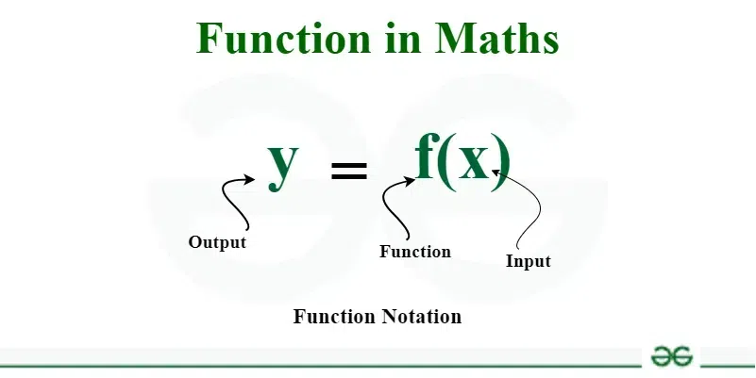
What is function?;
function.c
You probably know the concept of function in math.
How could we implement functions in programming?
Programming Language Lab

Slide 4
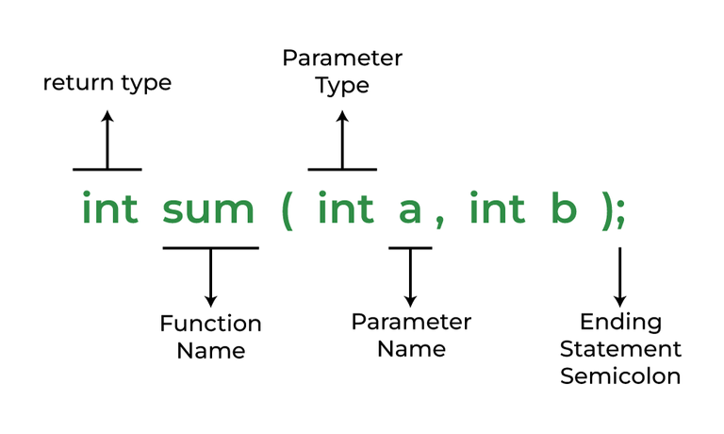
What is function?;
function.c
Recap the general syntax of defining a function in C as depicted in the given picture.
What are the built-in functions(methods!) in C?
Programming Language Lab

Slide 5
Binary and Decimal formats;
function.c
Write a C program that takes a binary number (up to 32 bits) as input from the user and converts it to its decimal (base-10) equivalent.
You should develop a function for the conversion!
Programming Language Lab

Slide 6
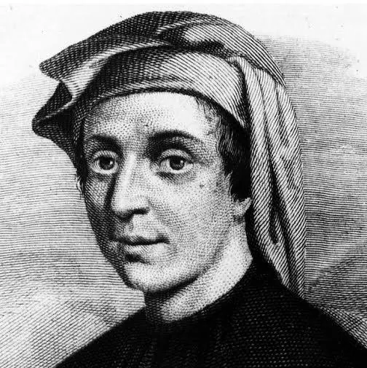
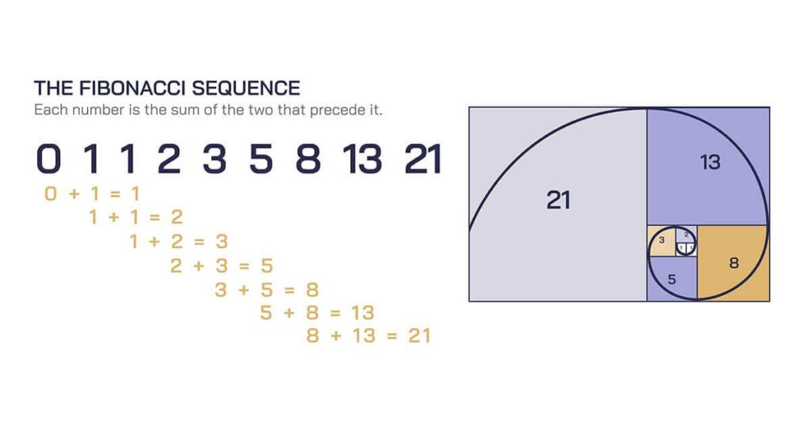
The Fibonacci Series;
function.c
Are you familiar with this sequence?
Fibonacci
(1170-1250)
It has got many application (search for it!)
Programming Language Lab

Slide 7
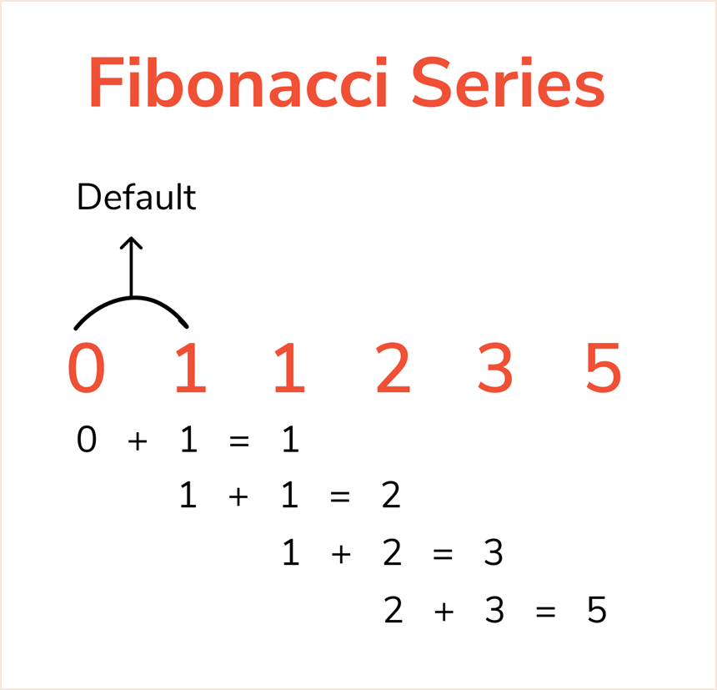
decision.c
The Fibonacci Series;
Write a program implementing the Fibonacci sequence, so that calculates the nth Fibonacci number.
Follow the rule which is shown in the picture!
Implement both iterative and recursive versions!
Programming Language Lab

Slide 8
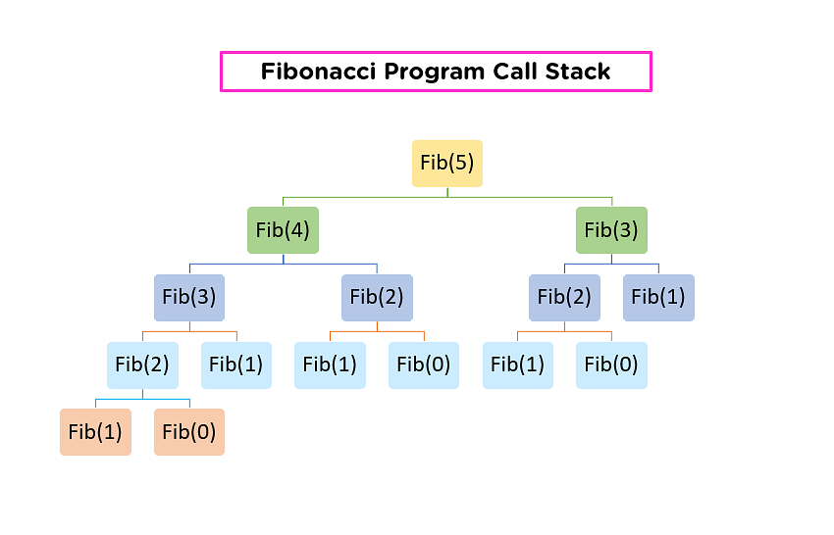
function.c
The Fibonacci Series;
Which version is faster as the size of the input grows? Why?
Try out different size of values for the input of both versions.
Programming Language Lab

Slide 9
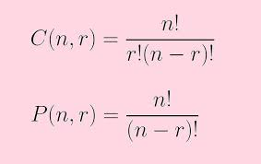
Combination and Permutation;
function.c
You might be familiar with factorial concept in math!
Which is the foundation of combination and permutation.
(As shown in the picture!)
Programming Language Lab

Slide 10
Combination and Permutation;
function.c
Develop a program implementing combination and permutation.
You should have functions for calculating factorial and permutation and combination.
According to the relation, notice that there are two inputs!
Programming Language Lab

Slide 11
Combination and Permutation;
function.c
Develop a program implementing combination and permutation.
You should have functions for calculating factorial and permutation and combination.
According to the relation, notice that there are two inputs!
Programming Language Lab

Slide 12
Homework;
function.c
Programming Language Lab

