Slide 1

Function.c
کارگاه مبانی برنامه‌نویسی
#1

Slide 2

Loops and Repetions
}

Slide 3

Loops in Mathematics
loop.c
Task 2
Binomial Expansion series is very popular in mathematics, which is shown in the below. (search for its application!)
$${\left(x+a\right)}^{n}=\sum_{k=0}^{n}{\left({n \atop k}\right)x^{k}a^{n−k}}$$
Try to implement the above formula using loops!
Where we see a sum notation, we need a loop!
X, a, and n should be set as input parameters.
Programming Language Lab

Slide 4
Where we need loops?;
loop.c
Where we need repetition or automation .
In computer science, most of algorithms are full of repetitions.
What are the needed syntaxes for performing repetitions in C? Recap what you need!
Programming Language Lab

Slide 5
Checking a condition
loop.c
Task 1
Write a program to determine whether a given number has specific characteristics.
The number is named ugly if its only prime factors are 2, 3, or 5.
You need to check specific factors of a number!
Programming Language Lab

Slide 6

Loops in Mathematics
loop.c
Task 2
Binomial Expansion series is very popular in mathematics, which is shown in the below. (search for its application!)
$${\left(x+a\right)}^{n}=\sum_{k=0}^{n}{\left({n \atop k}\right)x^{k}a^{n−k}}$$
Where we see a sum notation, we need a loop!
Programming Language Lab

Slide 7
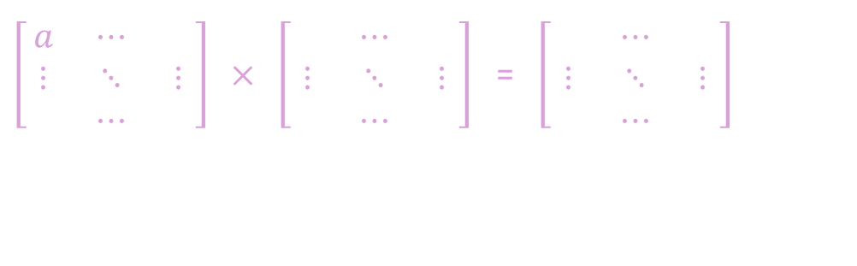
Matrix multiplication;
loop.c
Matrix operations like multiplication are so common in the world of AI.
Do you know how multiplication of matrixes are done? Recap from high school.
$\left[\begin{matrix}a & ⋯ & \\ ⋮ & ⋱ & ⋮ \\ & ⋯ & \end{matrix}\right]$ $×$ $\left[\begin{matrix} & ⋯ & \\ ⋮ & ⋱ & ⋮ \\ & ⋯ & \end{matrix}\right]$ = $\left[\begin{matrix} & ⋯ & \\ ⋮ & ⋱ & ⋮ \\ & ⋯ & \end{matrix}\right]$
Programming Language Lab

Slide 8
Binary and Decimal formats;
function.c
Task 3
Write a C program that takes a binary number (up to 32 bits) as input from the user and converts it to its decimal (base-10) equivalent.
You should develop a function for the conversion!
Programming Language Lab

Slide 9
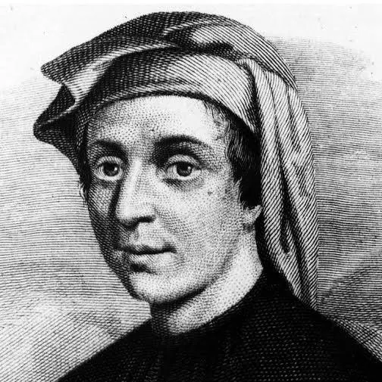
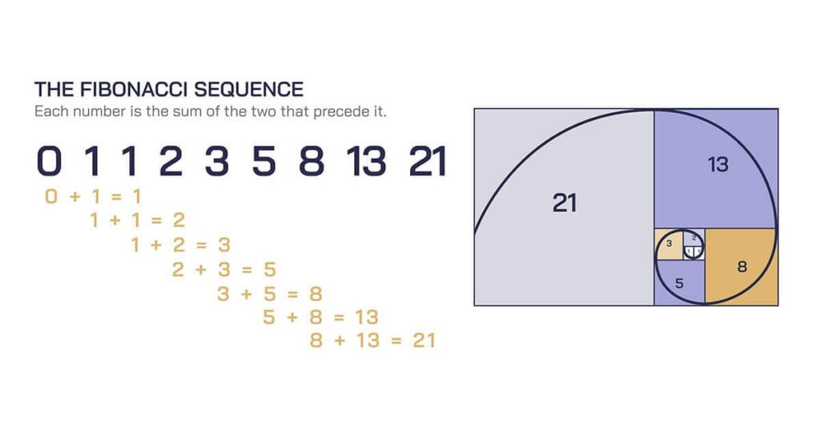
The Fibonacci Series;
function.c
Are you familiar with this sequence?
Fibonacci
(1170-1250)
It has got many application (search for it!)
Programming Language Lab

Slide 10
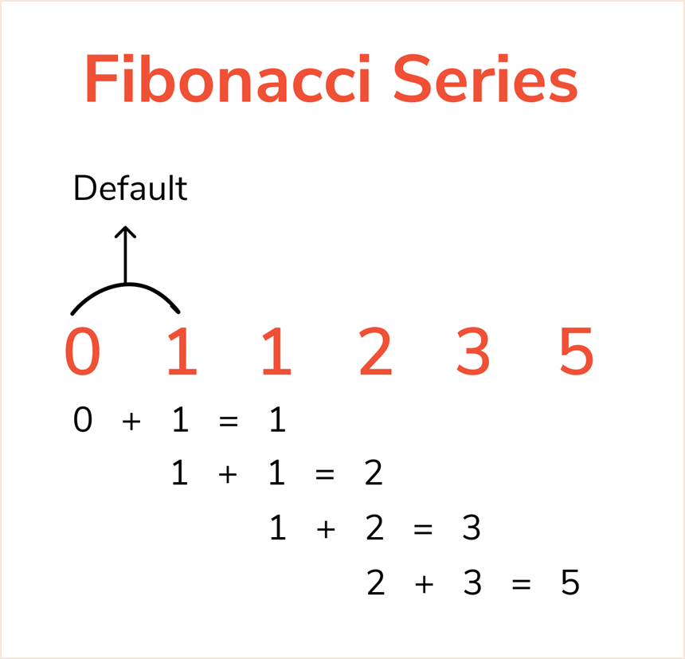
decision.c
The Fibonacci Series;
Write a program implementing the Fibonacci sequence, so that calculates the nth Fibonacci number.
Follow the rule which is shown in the picture!
Implement both iterative and recursive versions!
Programming Language Lab

Slide 11
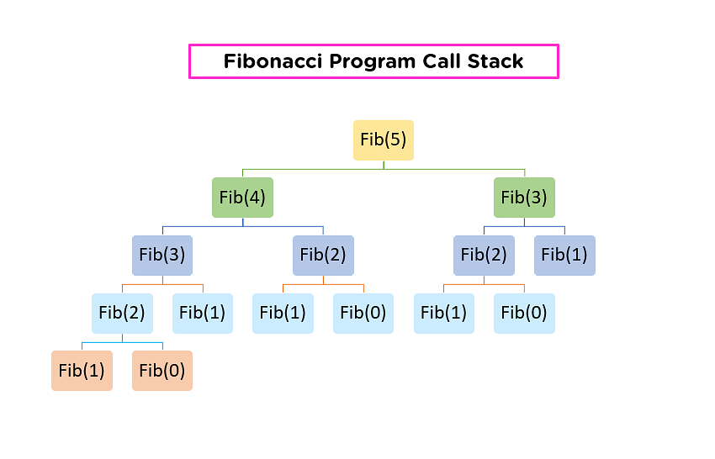
function.c
The Fibonacci Series;
Which version is faster as the size of the input grows? Why?
Try out different size of values for the input of both versions.
Programming Language Lab

Slide 12
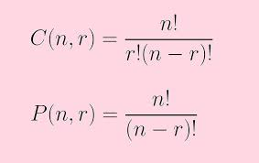
Combination and Permutation;
function.c
You might be familiar with factorial concept in math!
Which is the foundation of combination and permutation.
(As shown in the picture!)
Programming Language Lab

Slide 13
Combination and Permutation;
function.c
Develop a program implementing combination and permutation.
You should have functions for calculating factorial and permutation and combination.
According to the relation, notice that there are two inputs!
Programming Language Lab

Slide 14
Combination and Permutation;
function.c
Develop a program implementing combination and permutation.
You should have functions for calculating factorial and permutation and combination.
According to the relation, notice that there are two inputs!
Programming Language Lab

Slide 15
Homework;
function.c
Programming Language Lab

