Slide 1
Predicting US Housing Costs
Machine Learning Final Project
Reese Daniel & Shayan Saif
November 2020
Ontario Tech University
Notes:
Reese - 1.aifc
Hi everyone, I’m Reese and, along with Shayan, this is our final project presentation on predicting US housing costs with machine learning

Slide 2
Introduction
Notes:
Reese - 2.aifc
Let’s start by framing the topic

Slide 3

Introduction
USA is large country with diverse range of places to live
Urban and rural environments
Big mansions and shoebox apartments
Prices range dramatically
In this project, we:
Use recent, existing data to train machine learning models
Attempt to accurately predict how much a given housing unit costs per month, depending on a variety of factors
Notes:
Reese - 3.aifc
The United States is a large country with a diverse range of places to live. Renters can choose from urban and rural environments, big mansions and tiny apartments, and prices which range from relatively low to astronomical.
In this project, we use recent, existing data to train machine learning models in an attempt to accurately predict how much a given housing unit, that is an apartment, costs per month, depending on a variety of features.

Slide 4
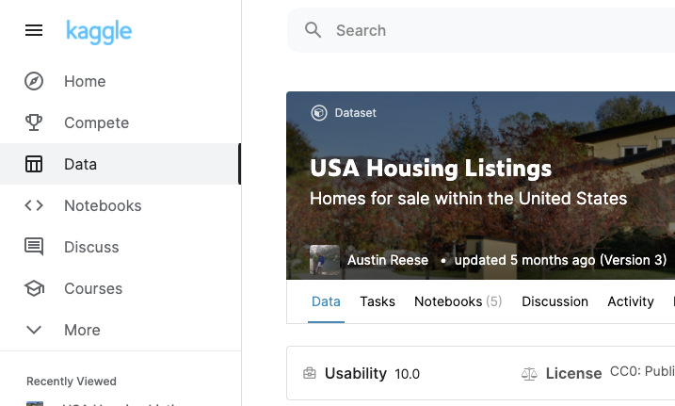
Dataset
USA Housing Listings
Scrapes Craigslist for US apartments, condos, etc. rentals
~385,000 observations
22 column
Price per month
Type of property (apartment, house, townhouse, condo, etc.)
Square footage
Number of beds
Number of bathrooms
Latitude
Longitude
US state
Cats/dogs allowed?
Smoking allowed?
Wheelchair accessible?
Electric vehicle charging?
Property comes furnished?
Notes:
Reese - 4.aifc
The dataset used is called USA Housing Listings. It was created by scraping Craigslist for listings for apartment, condo, townhouse, and other types of rentals.
The dataset contains about 385,000 observations, or rows, and 22 columns, or features.
These features are: *read features*

Slide 5
Graphs & Insights
Notes:
Reese - 5.aifc
Now let’s analyze and visualize these data

Slide 6
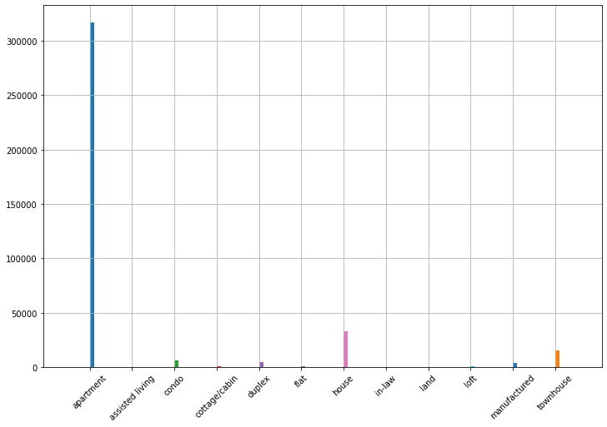
Graphs & Insights
Frequencies of housing types
Apartments are hefty majority of dataset
All housing types besides apartments removed
Thus, ‘type’ column removed as well
Notes:
Reese - 6.aifc
This graph shows the distribution of housing types. As you can see, apartments make up the hefty majority of the dataset. For this reason, we decided to focus solely on apartments and removed all other housing types. Thus, the type column was removed entirely as well.

Slide 7
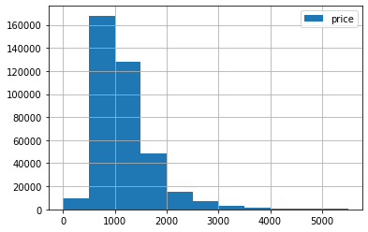
Graphs & Insights
Histogram of housing prices
Most housing listings between $500 and $4,000
Model likely better at predicting prices for apartments that cost only a few thousand dollars per month
To prevent outliers, removed all apartments with prices > $10,000
Also 1070 rows with price $0
Assumed these are outliers
Listers probably didn’t want to share rent price online
These rows were removed
Notes:
Reese - 7.aifc
This is a histogram of housing prices. Most apartments were listed for between $500 to $4000. This means that our models will likely be better at predicting prices for apartments that cost only a few thousand dollars per month.
To prevent outliers, we removed all apartments with prices higher than $10,000. In addition, 1070 rows had a price of $0. We assumed that the listers probably didn’t want to share the rent price online, so these rows were removed to prevent outliers.

Slide 8
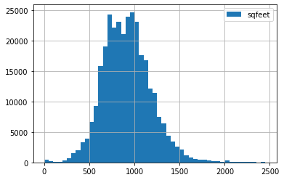
Graphs & Insights
Histogram of housing square feet
Most house listings are less than 1500 square feet
665 rows indicated a square footage of less than 100 sq. ft.
These rows were removed
They were likely errors
Notes:
Reese - 8.aifc
This is a histogram of housing size in square feet. As you can see, most apartments are less than 1500 square feet. 665 rows indicated a square footage of less than 100 square feet. As these were likely errors, these rows were removed from the dataset.

Slide 9
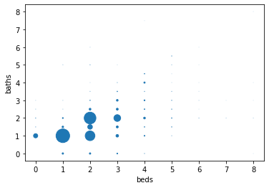
Graphs & Insights
Scatter showing # of beds vs. # of bathrooms
Larger markers = higher occurrence of bed/bathroom combination
Most common units have 1 bed/1 bathroom, 2 beds/2 bathrooms, or 2 beds/1 bathroom
Range of beds is [0,8]
Range of bathrooms is also [0,8]
Notes:
Reese - 9.aifc
This is a scatter plot showing number of beds vs. numbers of bathrooms. Larger markers indicate a higher occurrence of that specific bed/bathroom combination.
The most common units have 1 bed and 1 bathroom. This is followed by 2 beds and 2 bathrooms, followed by 2 beds and 1 bathroom. The range of beds and bathrooms were both 0 to 8 inclusive.

Slide 10
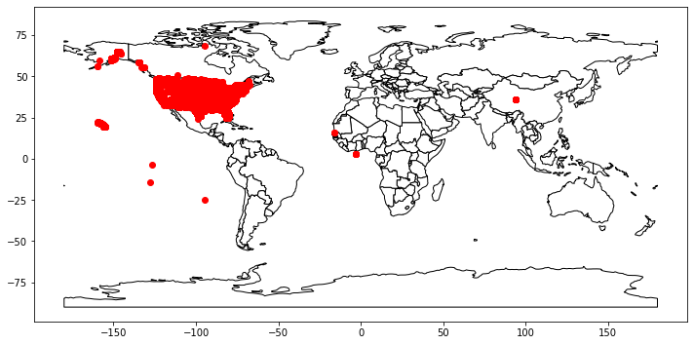
Graphs & Insights
When data plotted on world map, we can see that a number of points have incorrect latitudes and longitudes
Dataset is supposed to only reflect the United States
All points outside of the continental United States were removed
Notes:
Reese - 10.aifc
When the data are plotted on a world map, we can see that a number of points have incorrect latitudes and longitudes. The dataset is supposed to only reflect the United States, so all points in other countries or in water are errors. As such, all of these points outside of the continental US were removed.

Slide 11
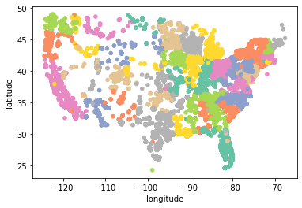
Graphs & Insights
If we zoom in on the continental US and color each point by state, we see that the dataset covers close to the entire country, with only a little bit of sparseness in the west
Our models should be able to predict pricing for all continental US states
Notes:
Reese - 11.aifc
If we zoom in on the continental US and color each point by state, we see that the dataset covers close to the entire country, with only a little but of sparseness in the west. Our models thus should be able to predict pricing for all continental US states.

Slide 12
Data Preparation
Notes:
Reese - 12.aifc
Now let’s get the dataset ready for machine learning

Slide 13
Data Preparation
These columns were removed, as they were not needed for the machine learning algorithms:
ID (a unique ID for each row)
URL (the URL for the Craigslist listing)
Region (the name of the region the listing was in)
Region_URL (the URL for the region’s website)
Image_URL (the URL for the listing’s image)
Description (some text describing the property)
Laundry_Options (an enum of 5 different types of laundry)
Parking_Options (an enum of 7 different types of parking)
Notes:
Reese - 13.aifc
The following columns were removed entirely because they were not needed for the machine learning algorithms

Slide 14
Data Preparation
1,920 rows were dropped because they contained missing values
2 housing units were listed as having 1000 beds and 2 other units were listed as having 1100 beds, so these 4 outliers were removed
The state column was removed as this information can be deduced from the longitude and latitude
This left us with the following columns:
price; sqfeet; beds; baths; cats_allowed; dogs_allowed; smoking_allowed; wheelchair_access; electric_vehicle_charge; comes_furnished; latitude; longitude
The data were finally split into 80% training, 20% testing sets
From each target set, the price column was removed
Notes:
Reese - 14.aifc
After this, 1920 rows were dropped because they contained one or more missing values. 2 apartments were listed as having 1000 beds and 2 more were listed as having 1100 beds, so these 4 outliers were removed.
The state column was removed as well, as this information can be deduced from the longitude and latitude.
This left us with the following columns: *read*
The data were finally split into 80% training and 20% testing sets
From each target set, the price column was removed

Slide 15
Machine Learning Algorithms
Notes:
Shayan

Slide 16
Algorithm 1
Notes:
Shayan

Slide 17
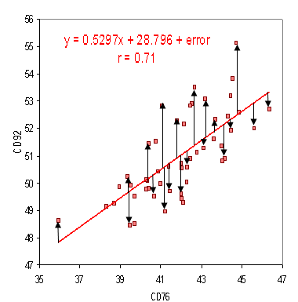
Linear Regression
Line of best fit
Root Mean Squared Error
Fitting the model
Sq footage
Number of beds and baths
If pets were allowed
If smoking was allowed
If it had wheelchair access
If it had an electric vehicle charging station
If it was furnished
Location (latitude and longitude)
Accuracy of 55.57%
Notes:
Linear Regression is what is commonly known as ‘line of best fit’. Root mean squared error is used as a metric for calculating the accuracy of the model. The root mean squared error is the distance between the line and each individual scatter point and this algorithm tries to minimize this error and create a line with the best slope and intercept. Afterwards, any predictions that are made go through the simple slope function of y = m sub n * x + b with m representing the coefficient, n representing the number of features the model has and b as the intercept.
We fitted the model with eleven features from the training dataset (sqfeet, beds, baths, cats_allowed, dogs_allowed, smoking_allowed, wheelchair access, electric_vehicle_charge, comes_furnished and its latitude and longitude. The model was then able to determine the coefficients for each feature and find a suitable intercept. Afterwards, we used the testing dataset to determine the accuracy for this model and found that it had a root mean squared error of 511.68, translating to an accuracy of 55.57%.

Slide 18
Algorithm 2
Notes:
Shayan

Slide 19
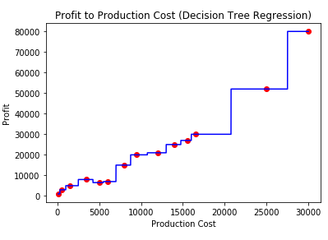
Decision Tree Regressor
Decision Tree Regressor is used for classification problems
Each leaf represents a numeric value
Resembles a staircase pattern as the algorithm tries to create classifications
If production cost is >= 16000 and < 21000, then profit is 30000
Maximum depth of 4, minimum leaf sample of 10% and random state set to 3
Root Mean Squared Error to test for accuracy
Beat the linear Regression model, RMSE was 464.74, accuracy was 59.65%
Notes:
This algorithm uses a decision tree to create a classification model with each leaf representing a numeric value. We see a sort of staircase pattern because unlike linear regression, the decision tree regressor creates classifications. For example, in the graph, if the production cost is between $16,000 and $21,000, the profit will be $30,000.
We initialized the decision tree regressor with a maximum depth of four and a minimum leaf sample of 0.1 and its random state to 3. We fitted the model using the training dataset and had it predict the test data, using RMSE to test for accuracy. We found that it had a lower RMSE than the linear regression model of 464.74 and an accuracy of 59.65%.

Slide 20
Algorithm 3
Notes:
Shayan

Slide 21
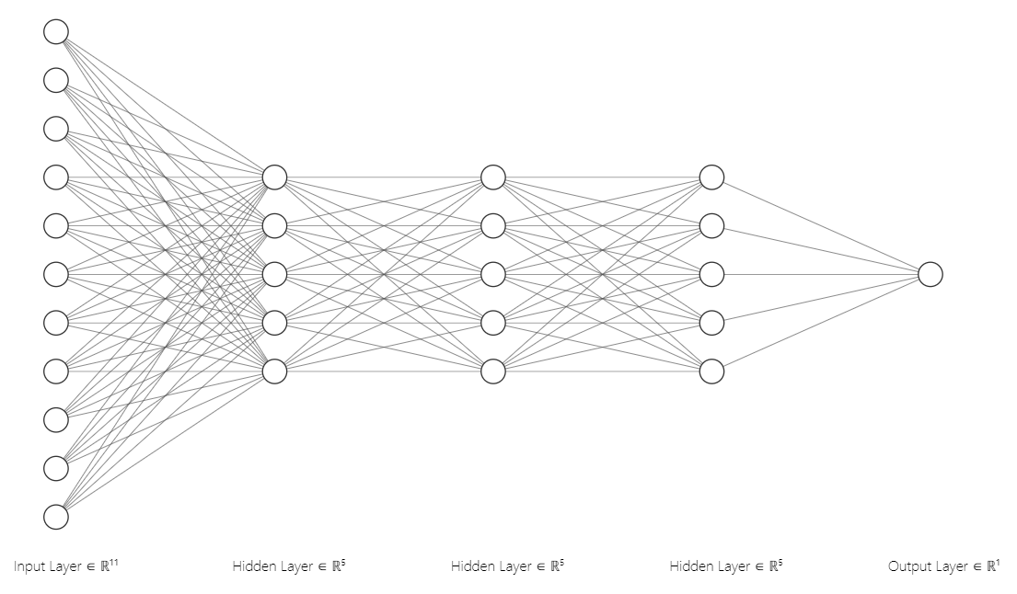
Deep Neural Network
Notes:
With large datasets, it may be better to approach the problem using deep learning. Unlike the artificial neural network, deep learning uses more than one hidden layer. A standard DNN will require an input of size n, which will be the starting nodes. It processes this data through the hidden layers using activation functions (i.e. relu, sigmoid, softmax) and then outputs the result(s). Depending on how many epochs you configure, the model will improve slightly with each step.
Our model, like the other algorithms we looked at, had an input of those same eleven features. It processes this data through the three sets of relu layers that have five neurons each and spits out one value as its prediction. The model was compiled using the adam optimizer and mean squared error as the metric for both loss and accuracy. After ten epochs, the model showed little improvement and had an overall RMSE if 516.16 and an accuracy of 44.82% was achieved. In contrast, this performed worse than expected and we believe this maybe due to the number of features it has to make a prediction from.

Slide 22
Performance & Graphs
Notes:
Shayan

Slide 23
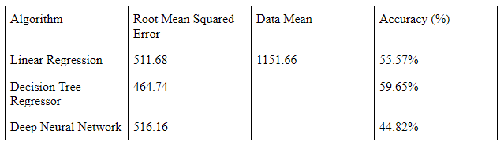
Performance
Notes:
We tested three algorithms, one of which was deep neural network. After fitting the model with the training data and making predictions for the test data, we compared the accuracy for each algorithm using the root mean squared error approach. Linear regression did not do too well as it had a near 50-50 accuracy. The Decision Tree Regressor improved the accuracy by a small margin. The deep learning algorithm did the poorest with a 44.82% accuracy.

Slide 24
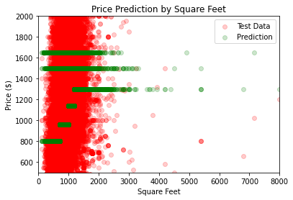
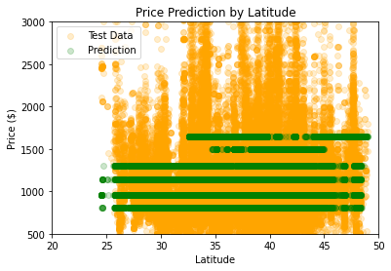
Graphs
Notes:
Here, we see the price prediction based on the square footage and latitude. The color green represents the prediction our decision tree model made. We see this sort of staircase pattern that we saw earlier in the production cost to profit example. To our surprise, there appears to be very little correlation, especially for the square footage, hence why there is so much uncertainty, even with our best model.

Slide 25
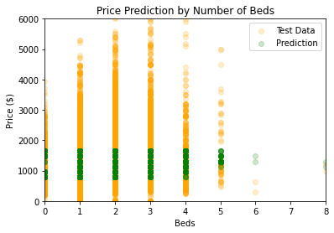
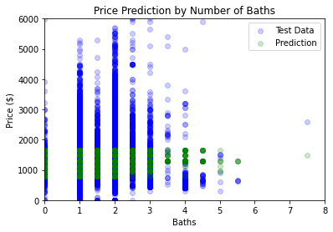
Graphs
Notes:
And here are our graphs showing the price prediction based on the number of beds and baths a house had.

Slide 26
Conclusion
Notes:
We used the USA housing dataset and performed three different regression algorithms to predict the price based on a variety of factors and it turns out that for this particular dataset, decision tree was the most accurate of the three.
In the future, if we were facing this same problem, we would try to limit the amount of inputs so the model can make an accurate prediction without having to factor in too many details. As for the latitude and longitude, we could have made clusters that highlight wealthy neighborhoods vs impoverished neighborhoods, that way the model can make effective predictions instead of trying to interpret coordinates. Unfortunately, with the size of this dataset, the hardware google offered was not as powerful to cycle through each epoch as we saw in our previous assignment so we were limited to ten epochs.
Thank you all for watching.

Slide 27
Bonus content added for time

Slide 28
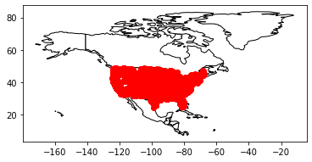
Graphs & Insights
Dataset after removing rows with incorrect longitudes and latitudes
Notes:
Reese -
This is what the dataset looks like visually after removing all of those rows with incorrect longitudes and latitudes. This was done by only retaining rows with a longitude between -144 and -64, and a latitude between 24 and 49. These coordinates represent the extremes of the continental US.

Slide 29
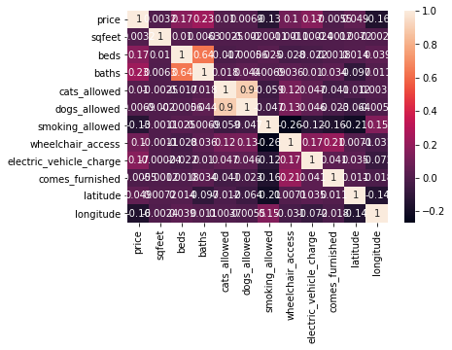
Graphs & Insights
longitude -0.158831
smoking_allowed -0.133275
comes_furnished -0.005537
sqfeet 0.003155
dogs_allowed 0.006927
cats_allowed 0.010311
latitude 0.049311
wheelchair_access 0.102725
beds 0.165958
electric_vehicle_charge 0.166638
baths 0.229534
price 1.000000
Correlation Matrix and Heatmap
Notes:
Reese -
Here is the correlation matrix for the dataset. A correlation matrix shows how correlated each pair of columns is or, in other words, shows which independent variables are most related to which dependant variables. A value of 1 indicates that two variables are perfectly correlated. This is always the case when the two variables are the same, such as with price and price. That is, price is always a perfect predictor of price. A value of 0 indicates that two variables are not correlated at all. And a value of -1 indicates two variables are perfectly negatively correlated, which means that as one increases, the other decreases by the same amount. For the case of this dataset, the variables that were most highly correlated to price were baths, electric_vehicle_charge, beds, longitude, and smoking_allowed. It is interesting to note that longitude is more than 3 times more correlated to price than latitude, perhaps suggesting that being on a coast weighs more heavily in price than being north or south.
It is also interesting that the correlation coefficient between cats_allowed and dogs_allowed is 0.9. This indicates that, most of the time, an apartment that allows cats will also allows dogs, and vice versa. The correlation between beds and baths is also quite high, at 0.64. This means that, usually, as the number of beds increases, so too does the number of baths.

