Slide 1
Lecture Notes Chapter 1: Running Linux in a Virtual Environment
CYENG 312: Trusted Operating System
Instructor: Dr. Shayan (Sean) Taheri
Gannon University (GU)

Slide 2
Personal Information
Name: Shayan (Sean) Taheri.
Date of Birth: July/28/1991.
Past Position: Postdoctoral Fellow at University of Florida.
Ph.D. Degree: Electrical Engineering from the University of Central Florida.
M.S. Degree: Computer Engineering from the Utah State University.
University Profile: “https://www.gannon.edu/FacultyProfiles.aspx?profile=taheri001”.
Notes:
Adelson-Velskii and Landis

Slide 3
Chapter 1 Overview
Initial Questions:
Why do we care about the security of operating systems?
Why do I need to study security of Linux operating system? Isn’t Linux already secure (in compare to Windows)?
Linux has certain advantages over Windows when it comes to security, including:
Unlike Windows, Linux was designed from the ground up as a multiuser operating system. So, user security tends to be a bit better on a Linux system.
Linux offers a better separation between administrative users and unprivileged users. This makes it a bit harder for intruders, and it also makes it a bit harder for a user to accidentally infect a Linux machine with something nasty.
Linux is much more resistant to viruses and malware infections than Windows is. Certain Linux distributions come with built-in mechanisms, such as SELinux in Red Hat and its free-of-charge clones, and AppArmor in Ubuntu and SUSE, that help prevent intruders from taking control of a system.
Linux is free and open source software. This allows anyone who has the skill to audit Linux code to hunt for bugs or backdoors.
But even with those advantages, Linux is just like everything else that’s been created by mankind and is not perfect.

Slide 4
Chapter 1 Overview (Cont.)
Chapter Overview:
Looking at the threat landscape.
Why every Linux administrator needs to learn about Linux security.
A bit about the threat landscape, with some examples of how attackers have, at times, been able to breach Linux systems.
Resources for keeping up with IT security news.
Differences between physical, virtual, and cloud setups.
Setting up Ubuntu Server and Red Hat-type virtual machines with VirtualBox, and installing the Extra Packages for Enterprise Linux (EPEL) repository in the Red Hat-type virtual machines
Creating virtual machine snapshots.
Installing Cygwin on a Windows host so that Windows users can connect to a virtual machine from their Windows hosts.
Using the Windows 10/11 Bash shell to access Linux systems.
How to keep your Linux systems updated.

Slide 5
Chapter 1 Overview (Cont.)
Chapter Overview:
Looking at the threat landscape.
Why every Linux administrator needs to learn about Linux security.
A bit about the threat landscape, with some examples of how attackers have, at times, been able to breach Linux systems.
Resources for keeping up with IT security news.
Differences between physical, virtual, and cloud setups.
Setting up Ubuntu Server and Red Hat-type virtual machines with VirtualBox, and installing the Extra Packages for Enterprise Linux (EPEL) repository in the Red Hat-type virtual machines
Creating virtual machine snapshots.
Installing Cygwin on a Windows host so that Windows users can connect to a virtual machine from their Windows hosts.
Using the Windows 10/11 Bash shell to access Linux systems.
How to keep your Linux systems updated.

Slide 6
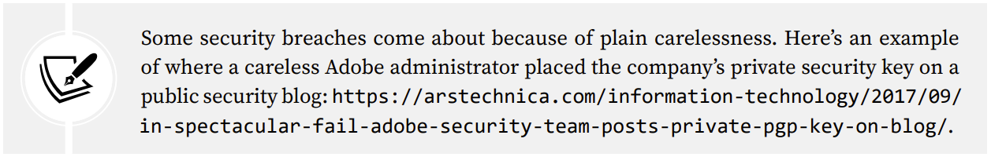
Looking at the threat landscape
Here are some examples of Linux vulnerabilities:
Botnet Malware: This causes a server to join a botnet that is controlled by a remote attacker. One of the more famous cases involved joining Linux servers to a botnet that launched denial-of-service (DoS) attacks against other networks.
Ransomware: This is designed to encrypt user data until the server owner pays a ransom fee. But even after paying the fee, there’s no guarantee that the data can be recovered.
Cryptocoin Mining Software: This causes the CPUs of the server on which it’s planted to work extra hard and consume more energy. Cryptocoins that get mined go to the accounts of the attackers who planted the software.
There have been plenty of breaches that don’t involve malware, such as where attackers have found a way to steal user credentials, credit card data, or other sensitive information.

Slide 7
Why do security breaches happen?
Regardless of whether you’re running Linux, Windows, or whatever else, the reasons for security breaches are usually the same.
They could be security bugs in the operating system or security bugs in an application that’s running on that operating system.
Often, a bug-related security breach could have been prevented had the administrators applied security updates in a timely manner.
Another big issue is poorly configured servers.
A standard, out-of-the-box configuration of a Linux server is actually quite insecure and can cause a whole ton of problems.
One cause of poorly configured servers is simply the lack of properly trained personnel to securely administer Linux servers.
In addition to Linux on servers and desktops, we have Linux on devices that are part of the Internet of Things (IoT).
There have been many security problems with these devices, in large part because people just don’t know how to configure them securely.
One thing we can do is to keep up with security-related news.

Slide 8
Keeping up with security news
If you’re in the IT business, even if you’re not a security administrator, you’ll want to keep up with the latest security news.
Examples of network security news: Packet Storm Security and The Hacker News.
Related regular tech news sites and Linux news websites, such as Ars Technica, Fudzilla, The Register, ZDNet, and LXer.
Related YouTube channels, such as BeginLinux Guru.
Finally, regardless of which Linux distro you’re using, be sure to keep up with the news and current documentation for your Linux distro.
Distro maintainers should have a way of letting you know if a security problem crops up in their products.
Here are links to some good security-related websites:
Packet Storm Security: https://packetstormsecurity.com
The Hacker News: https://thehackernews.com
Here are links to more generalized tech websites:
Ars Technica: https://arstechnica.com
Fudzilla: https://www.fudzilla.com
The Register: https://www.theregister.co.uk
ZDNet: https://www.zdnet.com
You can check out some general Linux learning resources as well as Linux news sites:
LXer: http://lxer.com
BeginLinux Guru on YouTube: https://www.youtube.com/channel/UC88eard_2sz89an6unmlbeA

Slide 9
Differences between physical, virtual, and cloud setups
The concept of virtual machines: This is just a way of running one operating system within another operating system.
It doesn’t matter whether you’re running Windows, macOS, or Linux on your host machine.
You can run a Linux virtual machine that you can use for practice, and that you won’t have to worry about if it gets trashed.
Platform to Use: Oracle’s VirtualBox.
In an enterprise setting, you’ll find other forms of virtualization software that are better suited for use in data centers.
In the past, server hardware could only handle doing one thing at a time, which meant that you had to have one server running DNS, another running DHCP, and so on.
Nowadays, we have servers with gobs of memory, gobs of drive space, and CPUs with as many as 96 cores each.

Slide 10
Differences between physical, virtual, and cloud setups (Cont.)
So, it’s now cheaper and more convenient to install multiple virtual machines on each server, with each virtual machine doing its own specific job.
You not only have to worry about security on the physical server that hosts these virtual machines but you also need to worry about the security of each virtual machine.
An added problem is that you need to ensure that the virtual machines remain properly isolated from each other, especially ones that contain sensitive data.
Many different outfits provide cloud services, where a person or a company can spin up an instance of either Windows or their choice of a Linux distro.
When setting up a Linux distro on a cloud service, there are things that you’ll have to do right away to enhance security.
When you set up a server on a cloud service, you’ll always have more concerns about proper security, because it will have an interface that connects to the wild and woolly Internet.
Your on-premises servers, except for ones that are meant to serve the public, are usually isolated from the Internet.

Slide 11
Introducing VirtualBox and Cygwin
Linux Distro to Use: (1) Red Hat Enterprise Linux (RHEL); (2) Ubuntu Linux; and (3) SUSE Linux.
RHEL is the most popular for enterprise use, while Ubuntu is the most popular for cloud deployments, and SUSE is the third big enterprise Linux distro.
Since Red Hat is a fee-based product, we’ll substitute CentOS 7, AlmaLinux8, and AlmaLinux9, which are built from Red Hat source code and are free of charge.
CentOS and AlmaLinux offer various download images.
You’ll want to download the DVD images, because they contain necessary things that are missing from the minimal images.
Specifically, download these image files:
CentOS 7: CentOS-7-x86_64-DVD-2009.iso
AlmaLinux 8: AlmaLinux-8-latest-x86_64-dvd.iso
AlmaLinux 9: AlmaLinux-9-latest-x86_64-dvd.iso

Slide 12
Introducing VirtualBox and Cygwin (Cont.)
For Ubuntu, we’ll concentrate on version 22.04, since it’s the newest Long-Term Support (LTS) version.
We’ll also take an occasional look at Ubuntu 20.04, since it’s still supported and there are a few differences between it and 22.04.
A new LTS version of Ubuntu comes out in April of every even-numbered year, and non-LTS versions come out in April of every odd-numbered year and every October.
For production use, you’ll mainly want to stick with the LTS versions, because the non-LTS versions can
sometimes be a bit problematic.
VirtualBox is available for Windows, Linux, and Mac hosts, and is free of charge for all of them.
Simulation of creating a connection from your host machine to a remote Linux server:
If your host machine is either a Linux or a Mac machine, you’ll just be able to open the terminal and use the built-in Secure Shell (SSH) tools.
If your host machine is running Windows, you’ll need to install some sort of Bash shell, such as Cygwin, or just use the Bash shell that’s built into Windows 10/11 Pro.

Slide 13
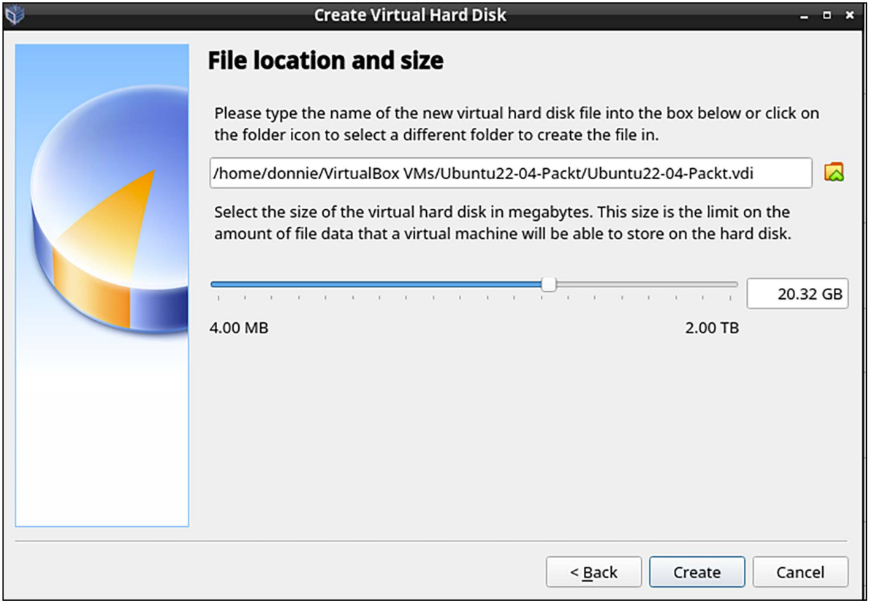
Installing a virtual machine in VirtualBox
For those of you who’ve never used VirtualBox, here’s a quick guide to get you going:
Download and install VirtualBox and the VirtualBox Extension Pack. You can get them from https://www.virtualbox.org/.
Download the installation .iso files for Ubuntu Server 22.04, CentOS 7, AlmaLinux8, and AlmaLinux9. You can get them from https://ubuntu.com/, https://almalinux.org/, and https://www.centos.org/.
Start VirtualBox and click the New icon at the top of the screen. Fill out the information where requested. Increase the virtual drive size to 20 GB, but leave everything else as the default settings, as shown here:
Create the virtual drive.

Slide 14
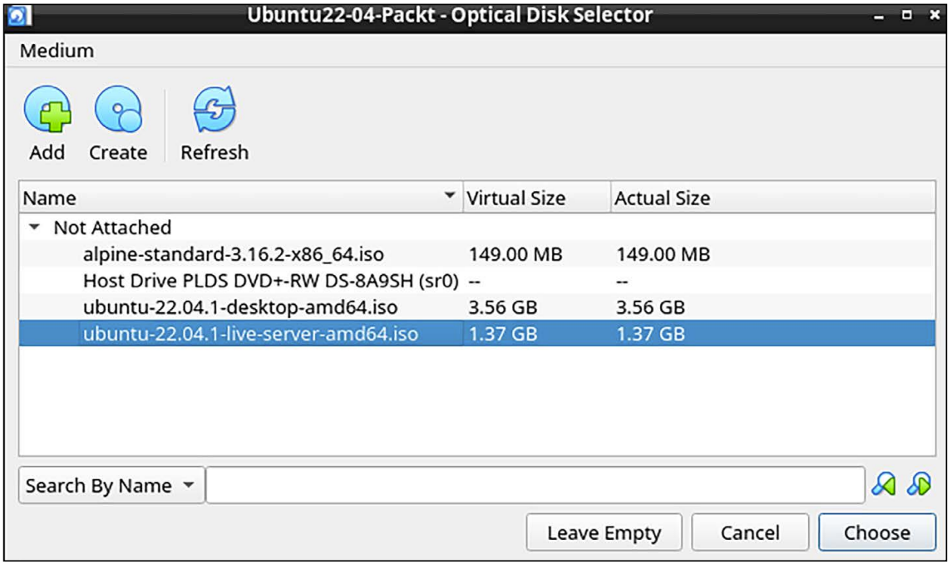
Installing a virtual machine in VirtualBox (Cont.)
For those of you who’ve never used VirtualBox, here’s a quick guide to get you going:
Start the new virtual machine. Click on the folder icon that’s beside the Location dialog box and navigate to the directory where you stored the .iso files that you downloaded. Choose either the Ubuntu ISO file, the CentOS ISO file, or one of the AlmaLinux ISO files, as shown in the following screenshot. (If the ISO file doesn’t show up in the list, click the Add button in the top-left corner to add it.)
Click the Start button on the dialog box to start installing the operating system. Note that for Ubuntu Server, you won’t be installing a desktop interface. For the CentOS 7 and AlmaLinux virtual machines, choose to install a Server without a graphical interface. (Later on, we’ll go through at least one exercise that will require a desktop interface for an AlmaLinux machine. You can create a virtual machine with a graphical interface at that time.)
Choose the .iso file.

Slide 15
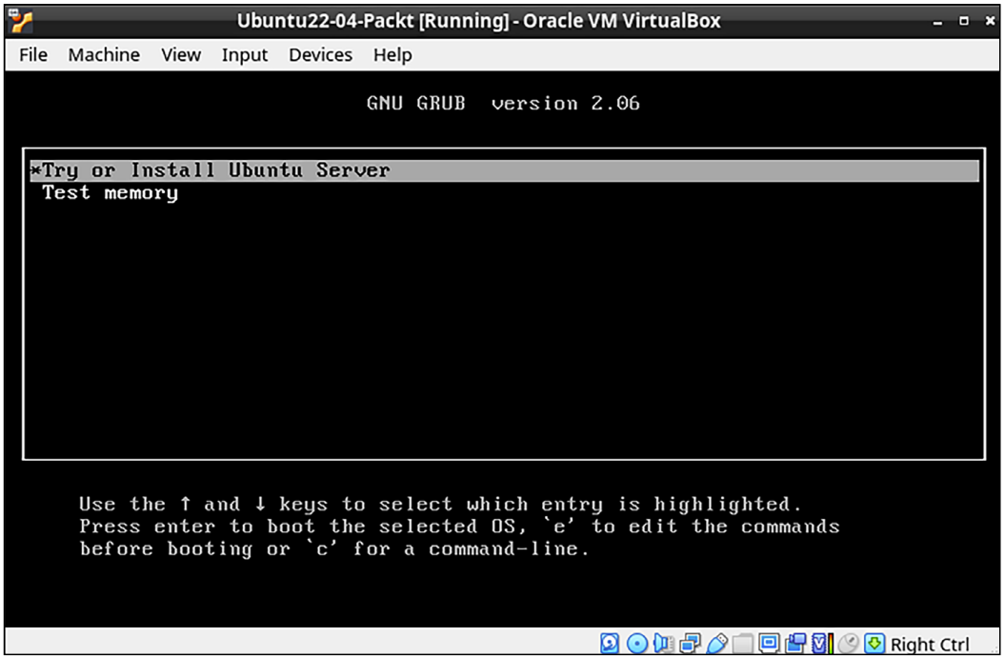
Installing a virtual machine in VirtualBox (Cont.)
For those of you who’ve never used VirtualBox, here’s a quick guide to get you going:
When installing Ubuntu, choose Try or Install Ubuntu Server when you get to this screen:
Repeat the procedure for the other Linux distros.
Update the Ubuntu virtual machine with these two commands:
Installing Ubuntu.

Slide 16
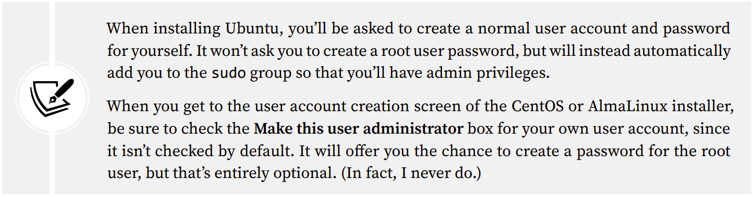
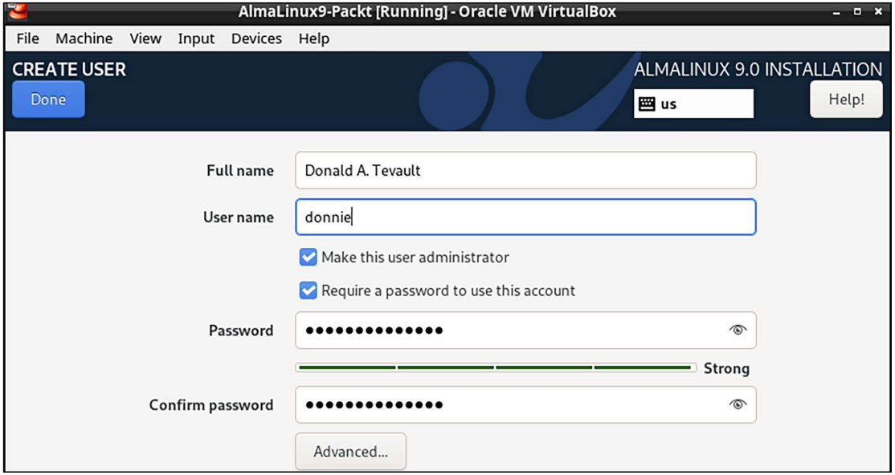
Installing a virtual machine in VirtualBox (Cont.)
For those of you who’ve never used VirtualBox, here’s a quick guide to get you going:
Hold off on updating the CentOS and AlmaLinux virtual machines because we’ll do that in the next exercise.
For Ubuntu, choose to install the OpenSSH Server on the SSH setup screen.
The user account creation screen of the AlmaLinux 9 installer—which looks the same as the one on CentOS 7 and AlmaLinux 8—is shown here:
User creation for AlmaLinux.`

Slide 17
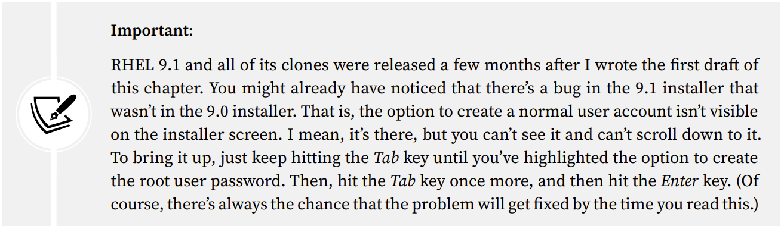
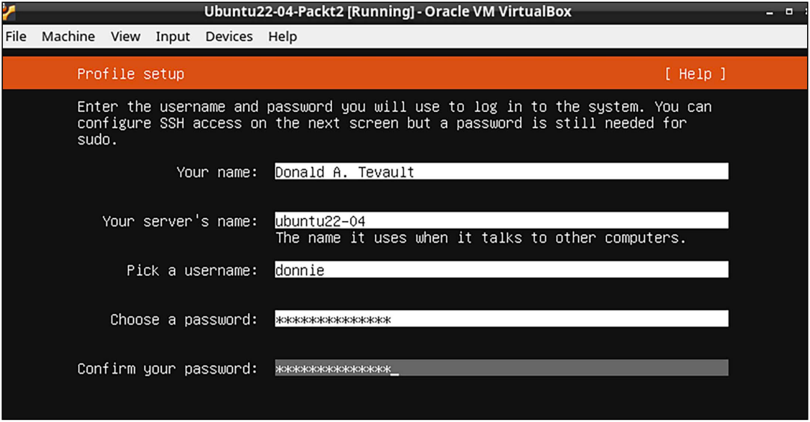
Installing a virtual machine in VirtualBox (Cont.)
For those of you who’ve never used VirtualBox, here’s a quick guide to get you going:
For Ubuntu 22.04, you’ll see just one self-explanatory screen to set up your real name, a username, and a password. The Ubuntu installer will automatically add your user account to the sudo group, which will give you full administrator privileges. Here’s the user account creation screen for Ubuntu 22.04:
Ubuntu user creation.

Slide 18
Installing the EPEL repository on the CentOS 7 virtual machine
You’ll need to install the EPEL repository for the packages of the CentOS and AlmaLinux. (The EPEL project is run by the Fedora team.)
When you install third-party repositories on Red Hat 7 and CentOS 7 systems, you’ll also need to install a priorities package and edit the .repo files to set the proper priorities for each repository.
This will prevent packages from the third-party repository from overwriting official Red Hat and CentOS packages if they just happen to have the same name.
The following steps will help you install the required packages and edit the .repo files:
The two packages that you’ll need to install EPEL are in the normal CentOS 7 repositories. To install them, just run this command:
When the installation completes, navigate to the /etc/yum.repos.d directory, and open the CentOS-Base.repo file in your favorite text editor. After the last line of the base, updates, and extras sections, add the line priority=1. After the last line of the centosplus section, add the line priority=2. Save the file and close the editor. (Cont.)

Slide 19
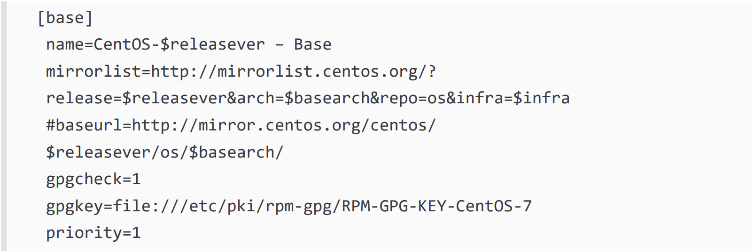
Installing the EPEL repository on the CentOS 7 virtual machine (Cont.)
The following steps will help you install the required packages and edit the .repo files:
(Cont.) Each of the sections that you’ve edited should look something like this, except with the appropriate name and priority number:
Open the epel.repo file for editing. After the last line of the epel section, add the line priority=10. After the last line of each remaining section, add the line priority=11.
Update the system and then create a list of the installed and available packages by running the following commands:

Slide 20
Installing the EPEL repository on the AlmaLinux 8/9 virtual machines
The following steps will help you install the required packages and edit the .repo files:
To Be Completed.

Slide 21
Assignment
Reading Assignment:
To Be Completed.

Slide 22
Questions?

