Slide 1
Bash Scripting Simplify Your Work with Automation
{
< Ali Rostami >
}
...

Slide 2
Bash!
}
{
“BASH”: “Borune again shell”,
“Borune Shell”: “Stehphen Borune”,
“again”: “improvement and respect”
}
*

Slide 3
Table of contents
01
02
03
Terminal
Options ???
ls =>> [‘-l’, ‘-a’, ‘-l’, ‘-d’, ‘lt’]
Bash is The default shell on most linux and unix systems
Basic Commands
Command [options] [arguments]
Basic Commands Example
[“ls”, “cd”, “pwd”, “echo”]

Slide 4
Important Topics!
Let’s Check if we are ready for real word projects.
Variables | Dynamically typed! Access with $ => “Hello $name” array= (“1” “2”) numeric system sum=$((num1+num2))
Conditional statements | It allows you to make decisions based on certain conditions!
loops | For variable in variables; do while [condition];do done done
Input output | Read echo and >>
if [condition]; then
elif []; then
else
fi
???
-gt –lt –e

Slide 5
01
Real World Examples
{
..
< finally we can see good stuffs!>
}
..

Slide 6
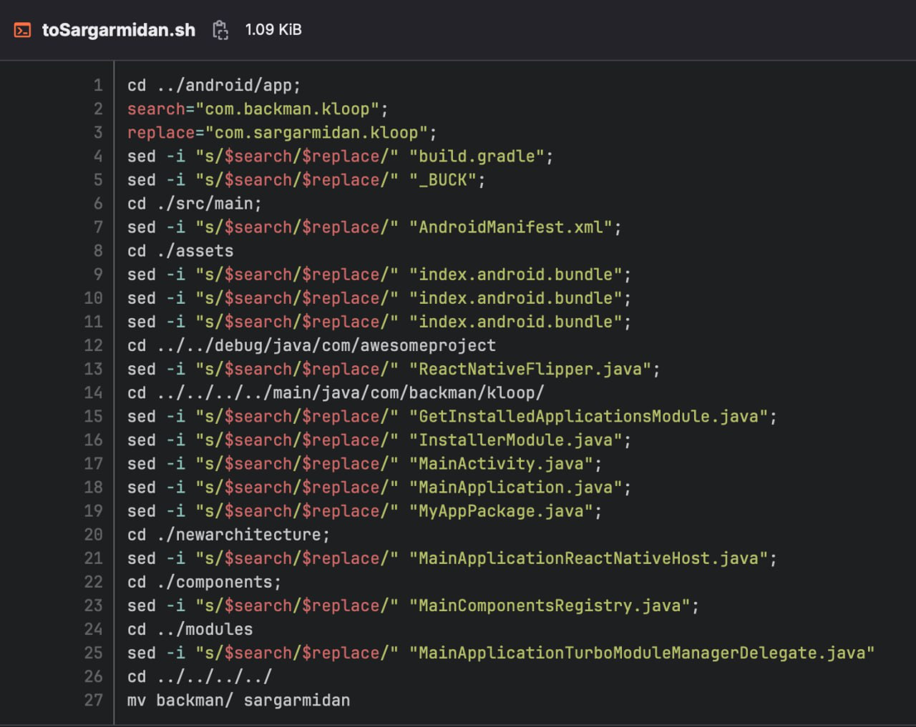
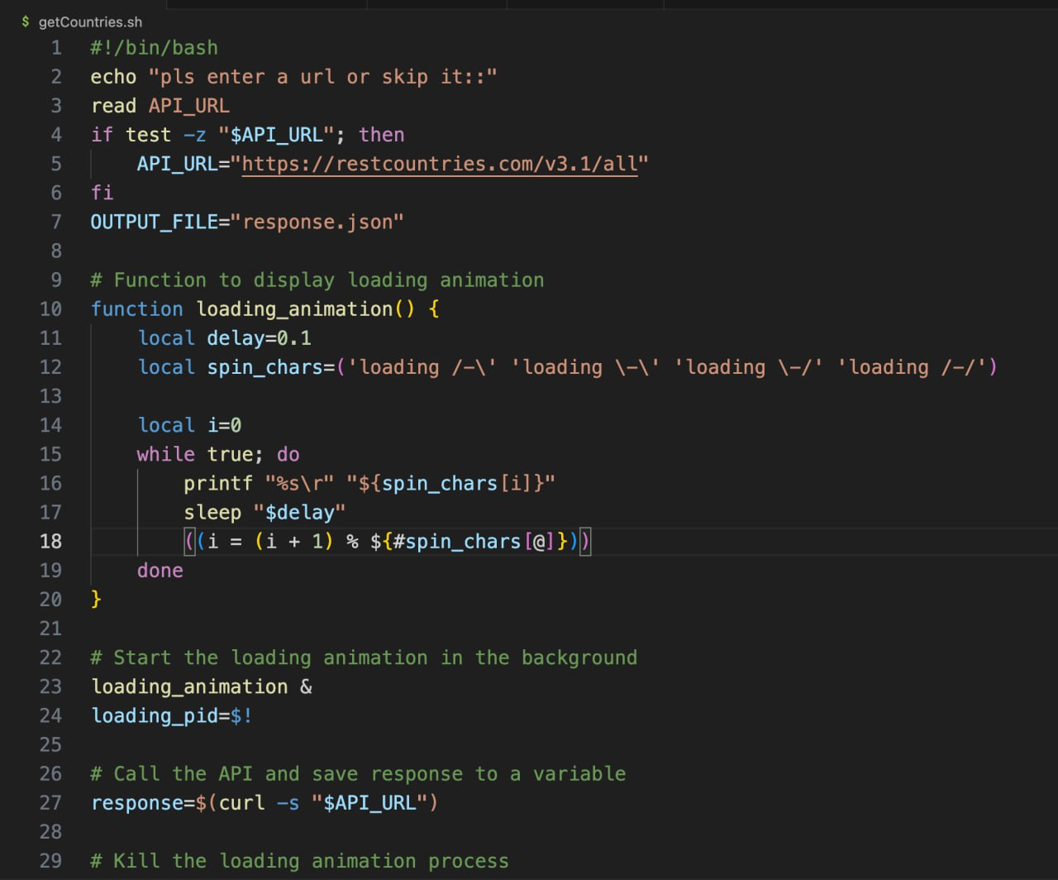
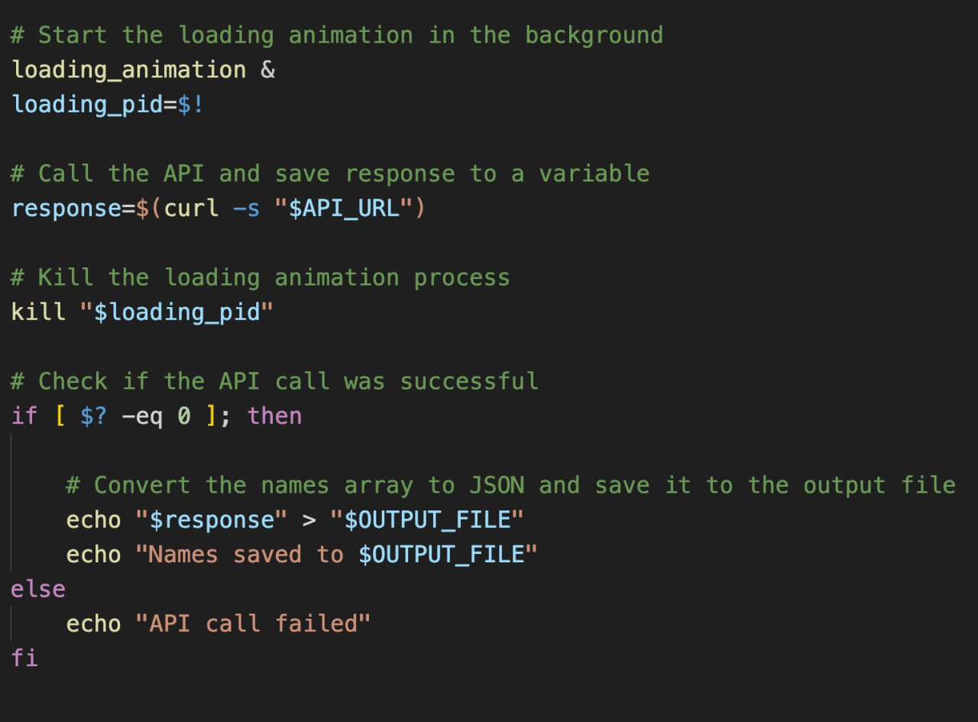
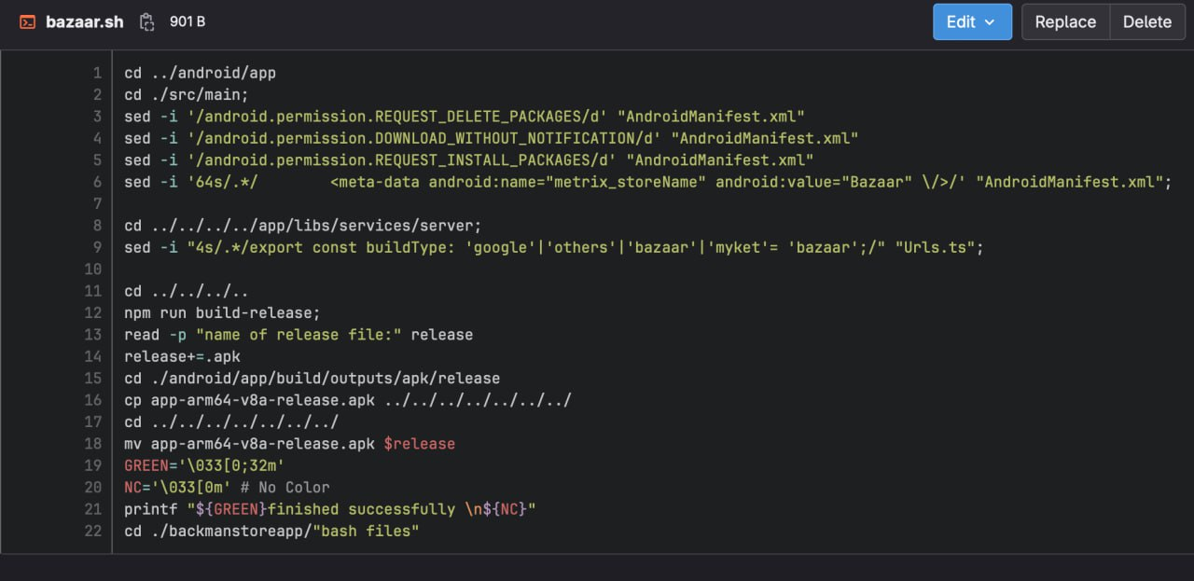
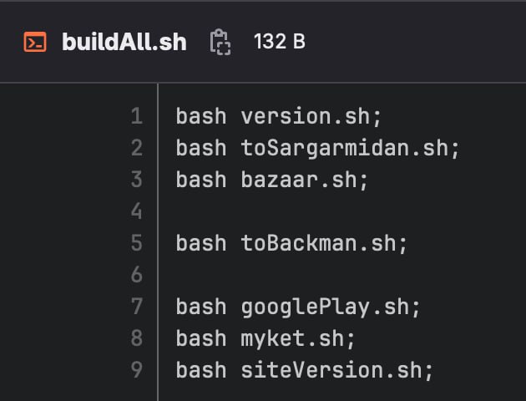
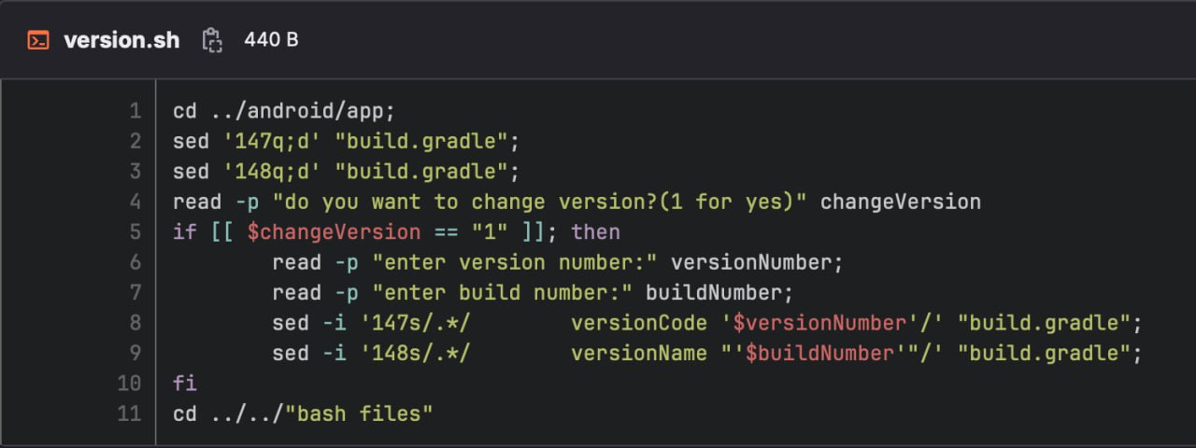
My Experiences With Bash
Name of Countries for Peyvast profile in json format!
?? %s\r ??
?? #array[@] ??
Export APKs of Kloop project based on react native!
?? Sed, /d, -i ??
}
..

Slide 7
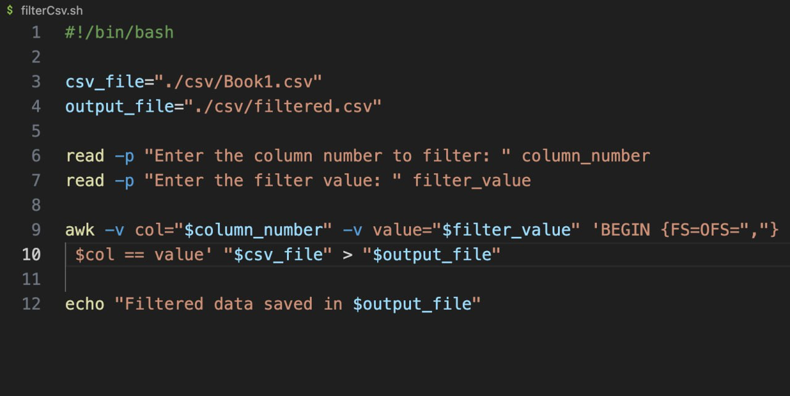
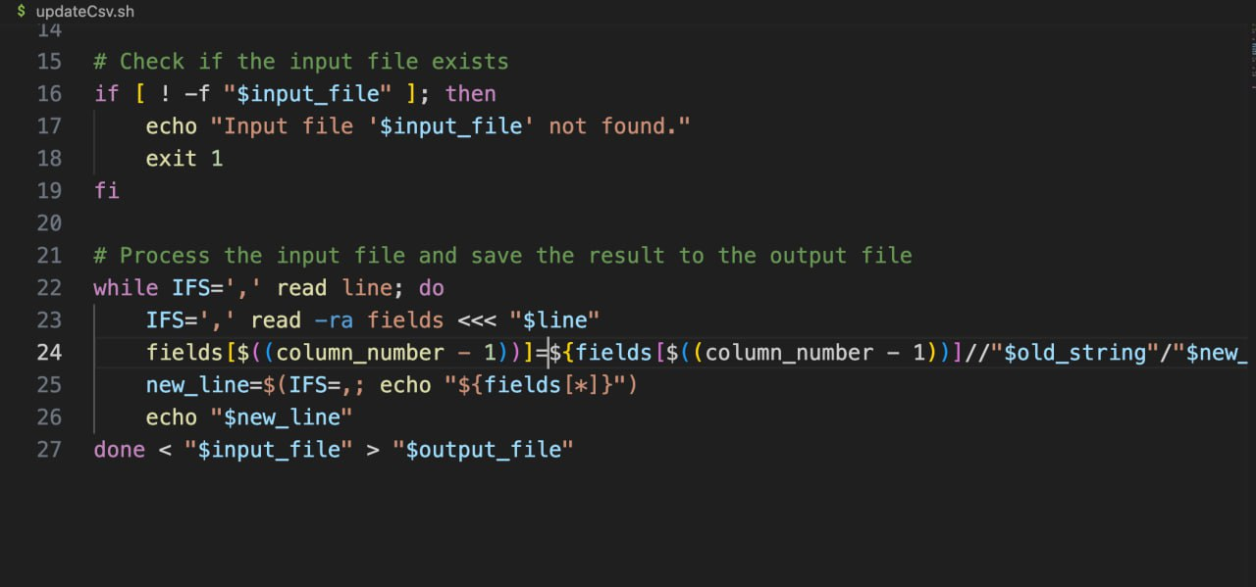
CSV Automating
{
Filter csv
Update csv
Awk??
$#??
}
*

Slide 8
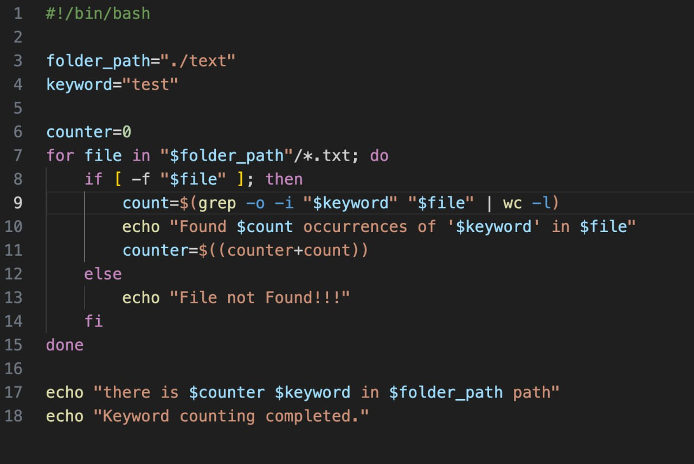
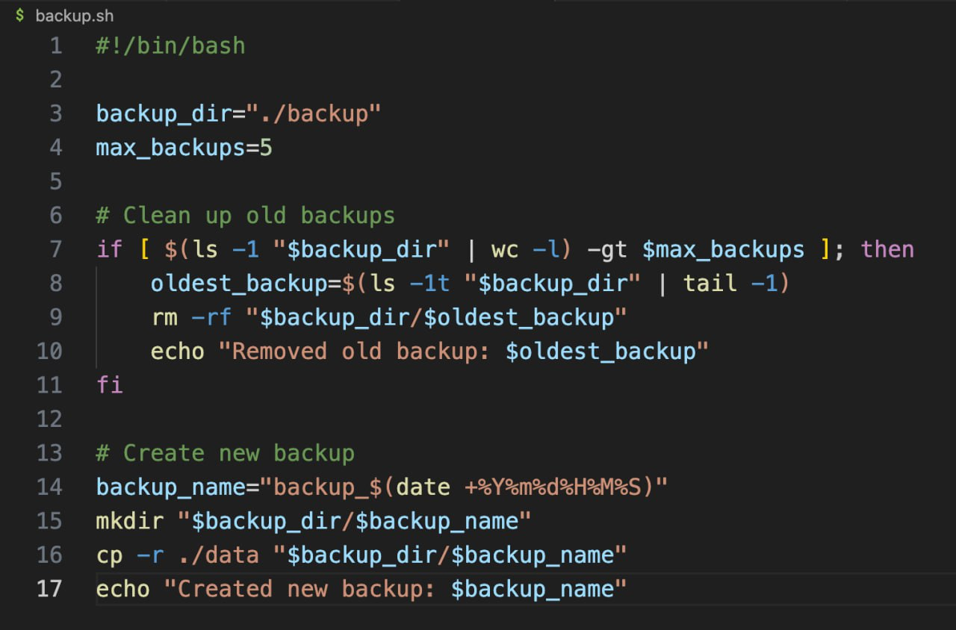
Text, Data Automating
{
Keyword Counting
Backup files
Grep part??
What does | do?
tail??
}
*

Slide 9
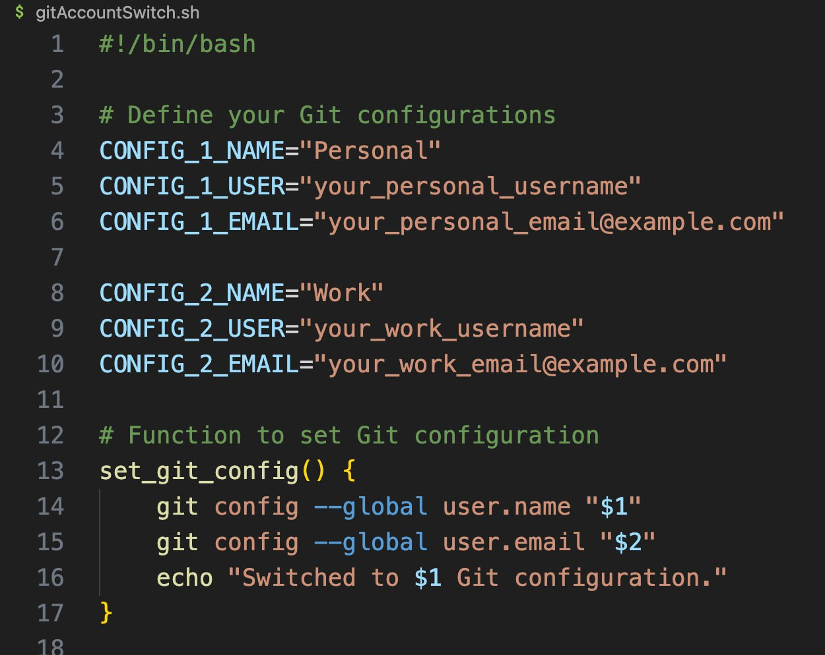
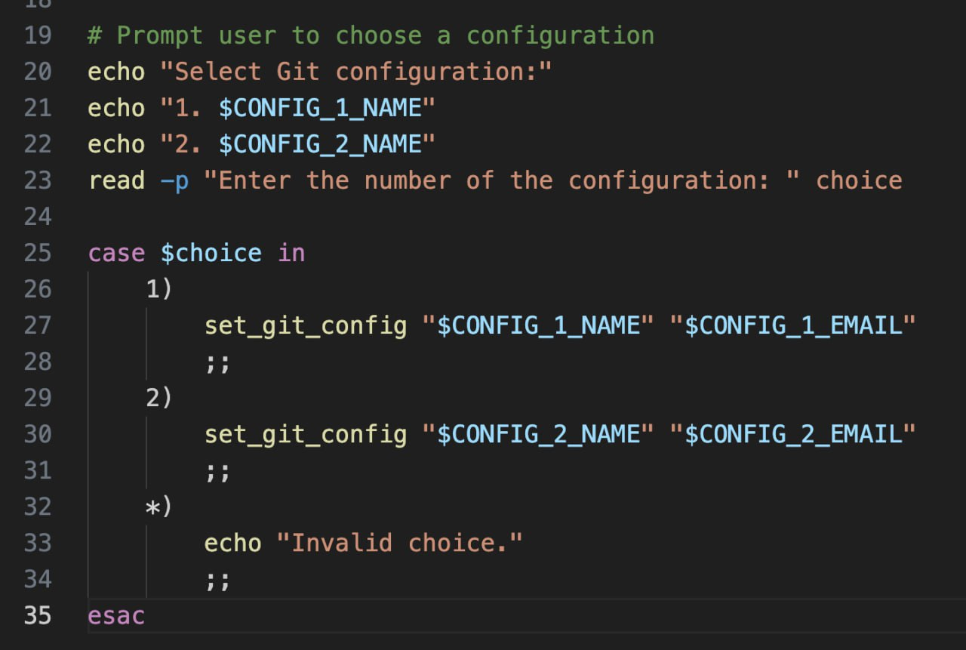
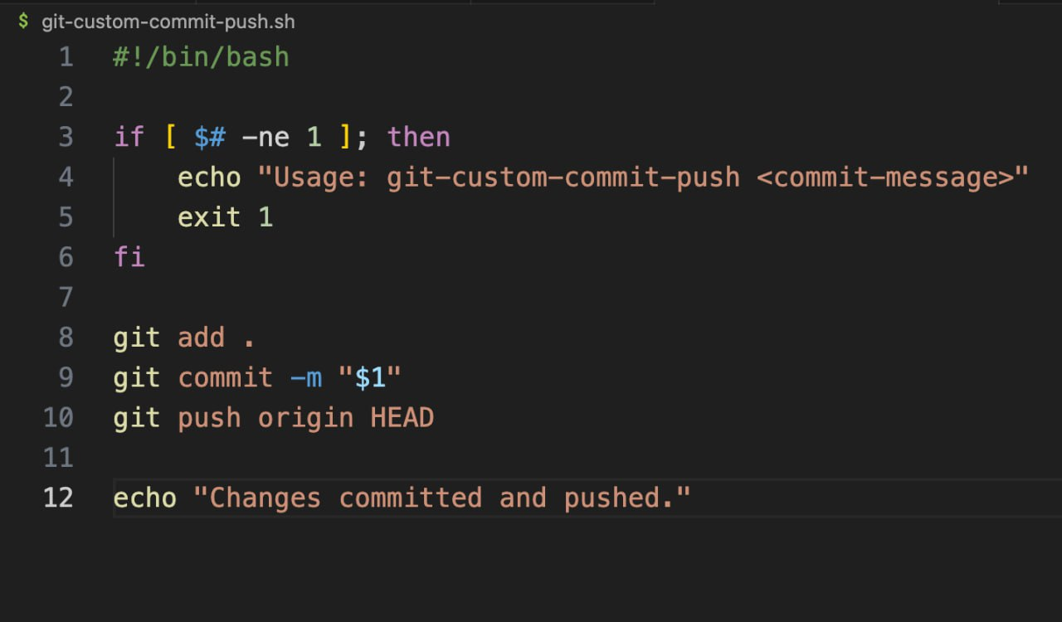
GIT Automating
{
Git pusher
Account switcher
}
*

Slide 10

Questions???

Slide 11
The end?
Echo “Thanks for joining me in this presentation”

