Slide 1
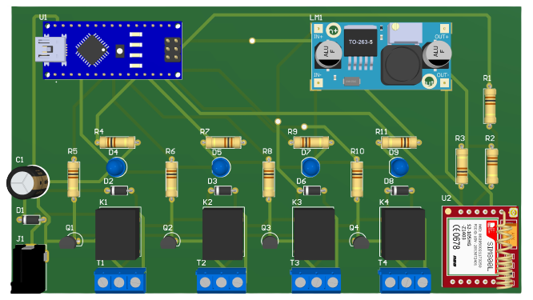
Tele Switch
SMS-based remote control & monitoring platform
Arduino Nano
SIM800L (GSM/GPRS)
LM2596 Regulator
4 Relays

Slide 2
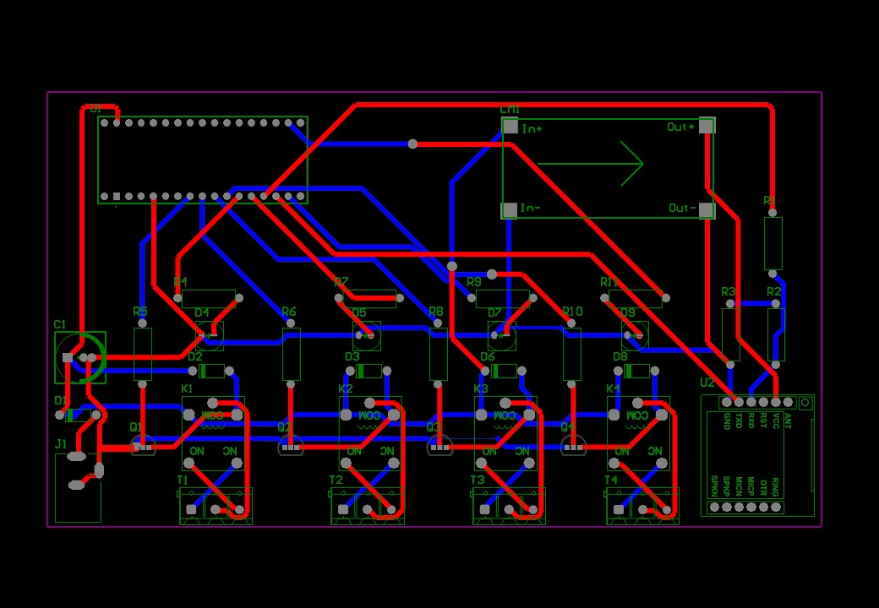
Overview
What Tele Switch is and why it matters
A compact device built around an Arduino Nano microcontroller that can communicate via SMS. It provides an easy platform for remote control and monitoring of devices and systems.
With its small size and low power consumption, Tele Switch is a practical choice for building connected, smart systems that can be controlled and monitored from anywhere.
PCB layout (routing view)
Tele Switch
2 / 17

Slide 3
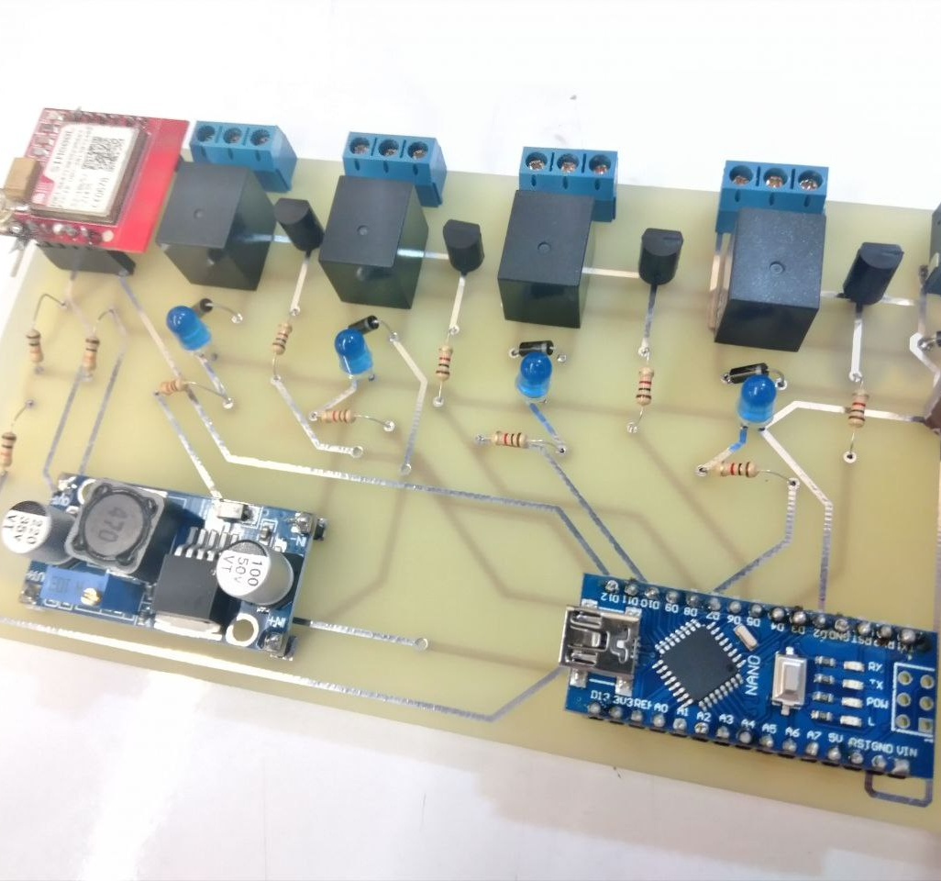
Core capabilities
Tele Switch enables remote control and monitoring for up to four devices, with an easy path to expand the number of outputs and the effective range.
Control and monitor up to 4 devices remotely
Expandable design (more devices / extended range)
Programmable behavior (Arduino / C++)
Low power consumption
Compact form factor for space‑constrained projects
Manage devices anytime, from anywhere via SMS
Prototype (assembled board)
Tele Switch
3 / 17

Slide 4
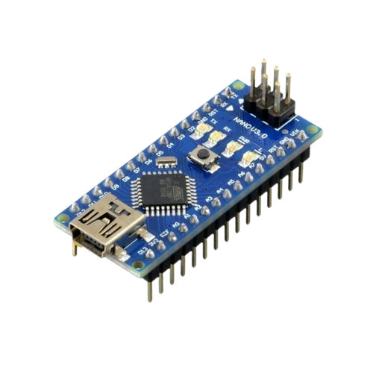
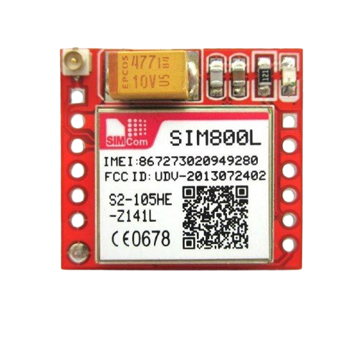
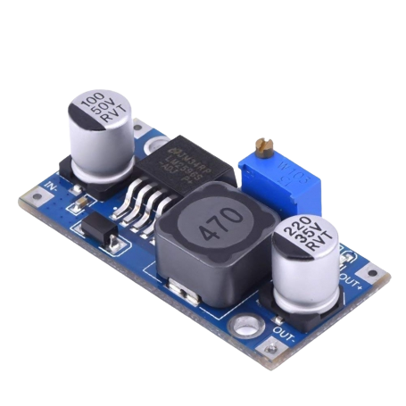
Hardware building blocks
Key components that enable SMS control and stable operation
Arduino Nano
SIM800L (GSM/GPRS)
LM2596 regulator
Together, these components form an efficient platform for remote control and monitoring of a wide variety of devices and systems.
SMS interface for control + alerts
Stable power delivery (LM2596)
Microcontroller logic (Arduino Nano)
Relay outputs + LED status indicators
Microcontroller that runs the logic and controls outputs.
Handles SMS communication, even in low‑signal areas.
Provides stable power for reliable operation.
Tele Switch
4 / 17

Slide 5
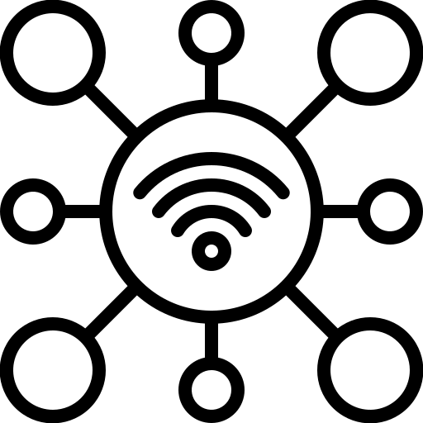
Why SMS?
Reliable control and monitoring without requiring internet access
The SIM800L GSM/GPRS module enables a dependable way to control and monitor systems via SMS — even where coverage is weak or internet access is unavailable.
Works in remote or low‑signal areas
Suitable for remote sensing and monitoring projects
Supports alerts when specific conditions are met
Helps save time and resources by enabling remote management
Improves operational efficiency across many applications
SIM800L GSM/GPRS module
Simple connectivity
Tele Switch
5 / 17

Slide 6
Power & compact design
Using an LM2596 voltage regulator, Tele Switch is designed for stable power delivery and reliable operation while keeping power consumption low.
Low power consumption
Compact footprint for projects with limited space
Great fit for small and remote applications
SMS capability makes it practical for remote monitoring/control
Versatile design suitable for many different projects
LM2596 step‑down regulator
Design focus
Stable power + compact hardware → a dependable platform for SMS‑controlled automation.
Tele Switch
6 / 17

Slide 7
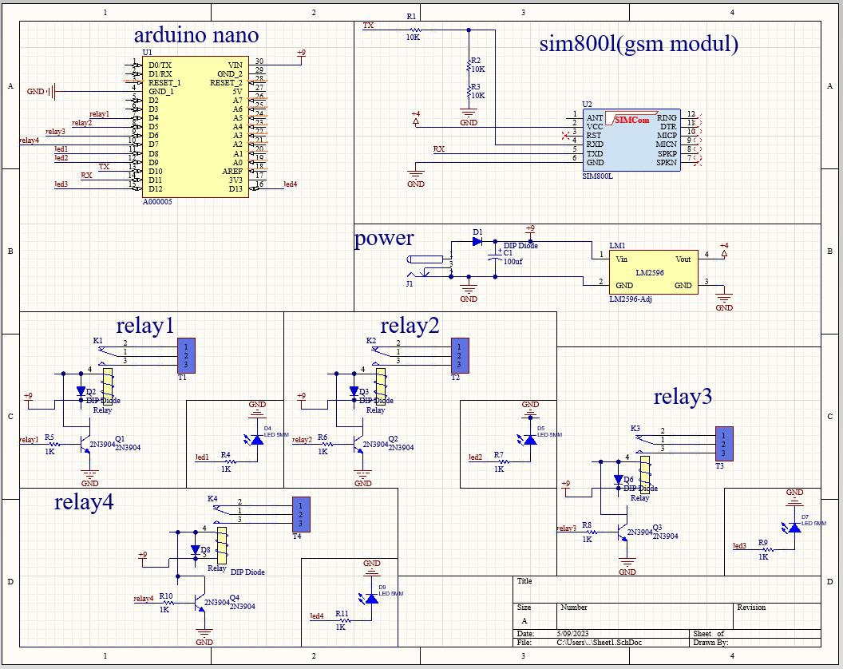
System design
Schematic view + functional blocks
How signals flow
SMS network
SIM800L
Arduino Nano
Relays + LEDs
Incoming SMS messages are decoded by SIM800L, processed by the Arduino, and mapped to relay outputs with LED status indication.
Tele Switch
7 / 17

Slide 8
Operation
From SMS message to device control
At a high level:
Receive data from the SMS module
Process it with the microcontroller
Switch four relays (outputs) and drive four LEDs (status)
Enable remote control of connected devices
SMS
Arduino logic
Relay outputs
Assembled prototype board
Tele Switch
8 / 17

Slide 9
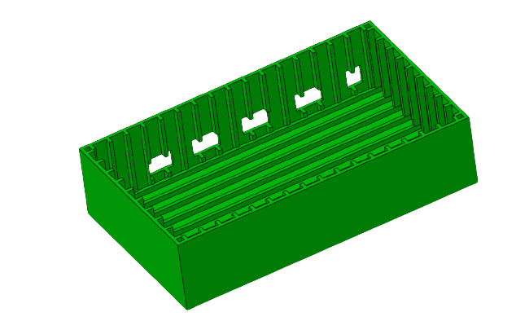
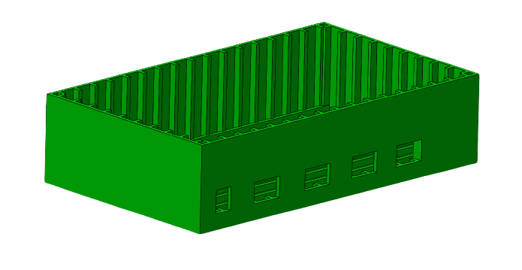
Enclosure design
Designed enclosure size: 16 × 9 × 4 cm
Internal base view
Outer box view
Tele Switch
9 / 17

Slide 10

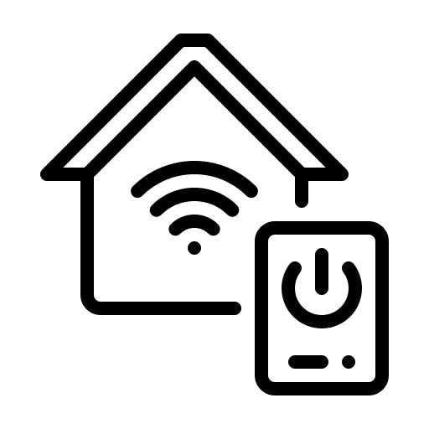



Use cases
Tele Switch is a general-purpose SMS control & monitoring platform. Typical applications include:
Environmental monitoring
Home automation
Security & surveillance
Industrial automation
Agriculture & farming
Tele Switch
10 / 17

Slide 11
Industrial automation
Industrial automation
Remote control and monitoring of industrial equipment and machinery
Send SMS alerts when specific conditions occur (equipment failure, abnormal states)
Helps reduce downtime by enabling quick response from anywhere
Circuit schematic
Tele Switch
11 / 17

Slide 12
Agriculture & farming
Agriculture & farming
Monitor and control factors such as humidity, temperature, and soil moisture
Send SMS alerts for conditions like low soil moisture or high temperature fluctuations
A practical building block for precision agriculture projects
Prototype board
Tele Switch
12 / 17

Slide 13
Security & surveillance
Security & surveillance
Monitor security devices such as cameras and motion sensors
Send SMS alerts when motion or intrusion is detected
Useful for remote or hard‑to‑reach locations where quick alerts matter
Prototype board
Tele Switch
13 / 17

Slide 14
Home automation
Home automation
Control and monitor appliances like lights and air conditioners
Send SMS commands to turn devices ON/OFF or adjust settings
Supports energy management by enabling scheduled or remote control
Prototype board
Tele Switch
14 / 17

Slide 15
Environmental monitoring
Environmental monitoring
Monitor environmental conditions such as air quality, temperature, and humidity
Send SMS alerts for conditions like high pollution levels or temperature fluctuations
Ideal for monitoring in remote regions without reliable internet connectivity
Prototype board
Tele Switch
15 / 17

Slide 16
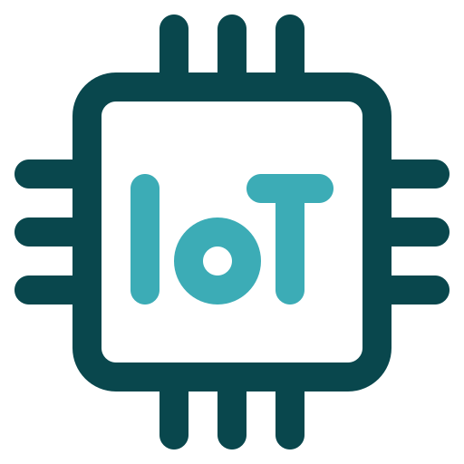
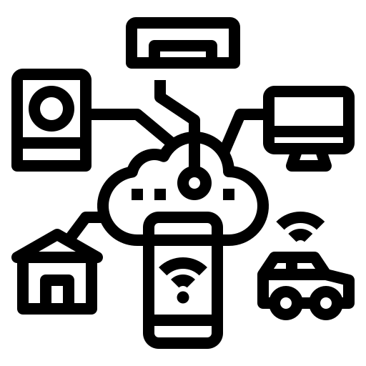
IoT integration
How Tele Switch fits into larger connected systems
IoT (Internet of Things)
By combining an Arduino-based controller with SMS communication, Tele Switch can connect and communicate with other devices and smart systems — activated by one or many users.
Integrate into larger remote‑monitoring systems
Example: a smart‑home setup that receives SMS commands to control lighting and temperature
Example: agricultural monitoring that collects sensor data and forwards it to a central database for analysis
C++ programmability enables customization for project‑specific needs
Built for connected projects
(without relying on Wi‑Fi)
Tele Switch
16 / 17

Slide 17
Thank you
Team DYAD
Tele Switch
Members
• Shayan Doroudiani
• Sahand Khojasteh Ahmadi
Date
Spring 2023 (Spring 1402)
"Spring 1402" refers to the Iranian Solar Hijri calendar.

