Slide 1
Neighborhood Analysis of San Francisco
Coursera Capstone

Slide 2
Motivation
The city of San Francisco is the second most densely populated city in US and fifth most densely populated county in US
Finding the best place to stay for a tourist or new resident in the city according to personal choice is daunting
Provide a platform that enables comparing neighborhoods easy

Slide 3
Data used
list of different neighborhoods in San Francisco city. I got this from data.sfgov.org.
I got the latitude and longitude of the midpoint of each neighborhood from maps.google.com
I am using the Foursquare API to get the details of the venues in each neighborhood
I plan to merge this data with the San Francisco house rent and price I scraped from www.bayareamarketreports.com website
I also used data from sfgov.org to find the crime rates at different neighborhood

Slide 4
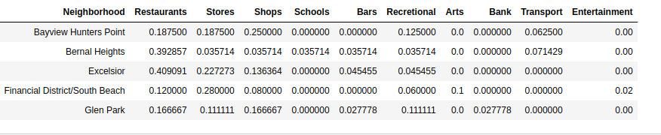
Data used
Scraped data from the data sources and four square API
Categorized into 10 broad categories

Slide 5
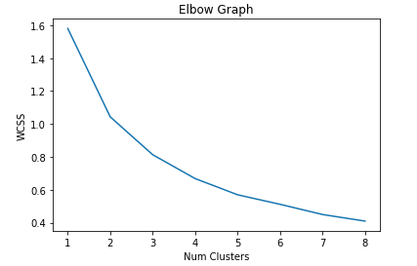
Kmeans Clustering
Used Elbow method to find the best K

Slide 6
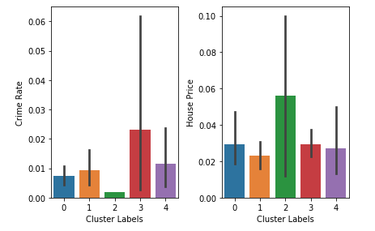
Results
Clustering data showing inverse relation between Crime Rate and House Price

Slide 7
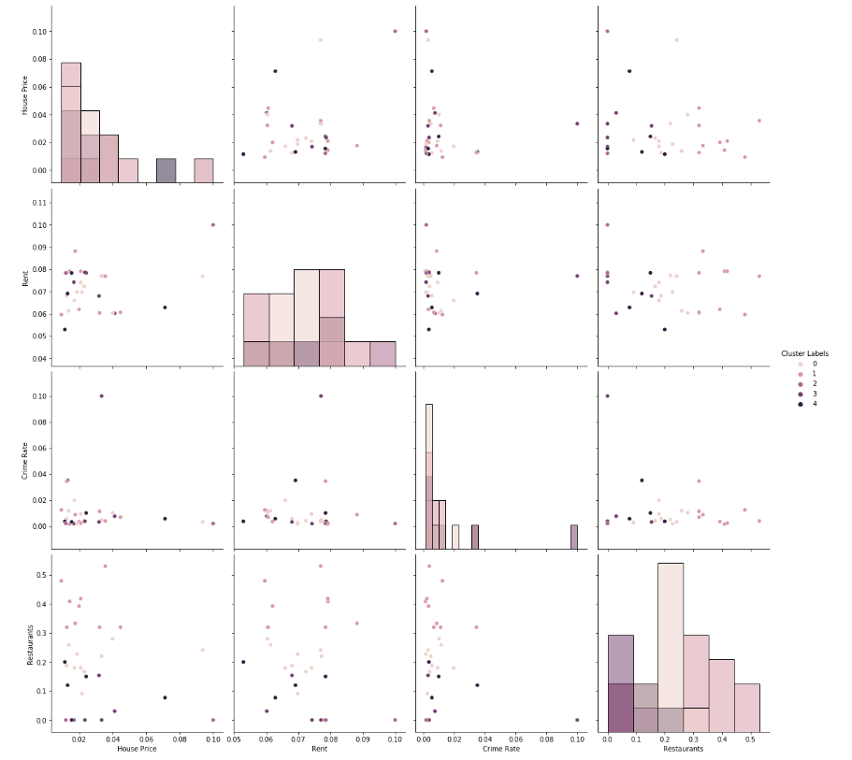
Results(2)
Pairplot to show relations between features

Slide 8
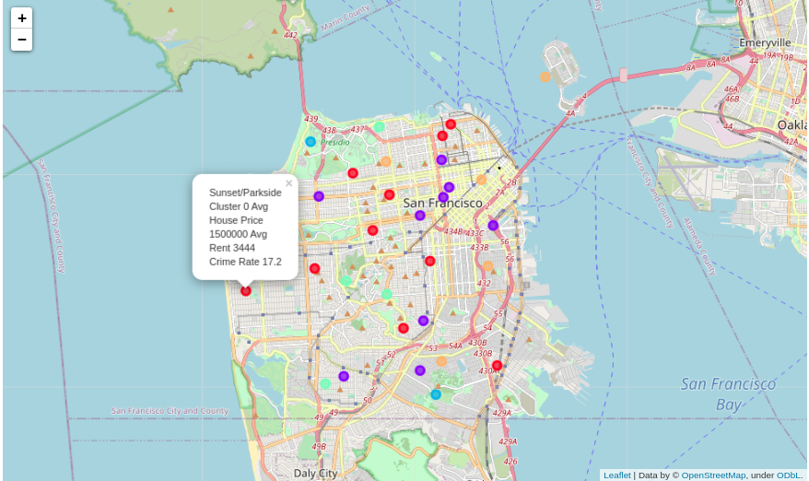
Results(3)
Folium map used to project clusters on San Francisco city

Slide 9
Conclusion
compared different neighborhoods based on key preferences like proximity to stores, restaurants and also things like crime rate, house prices, transportation, etc.
This method could give a lot of insight to realtors, new residents, tourists to find out information about different neighborhoods in San Francisco based on their preferences.

