Slide 1

MOVIE EXPLORATION PROJECT
SHAYAN ABDUL KARIM KHAN
08/24/2022

Slide 2



> 25 Million people in US & Canada
~ $12 Billion Box Office Revenue

Slide 3

WHAT TYPE OF MOVIE TO CREATE?

Slide 4





POSITIVE VIEWER RESPONSE
MOVIE REVIEWS
PROFITABLE
MOVIE PROFITS
IMPACTFUL MARKET ENTRY
GLOBAL FOOTPRINT

Slide 5




MOVIE REVIEWS
MOVIE PROFITS
WHICH GENRES TO FOCUS ON?
WHAT WOULD BE THE INITIAL INVESTMENT
WHAT SHOULD BE THE GLOBAL FOOTPRINT?

Slide 6







Slide 7


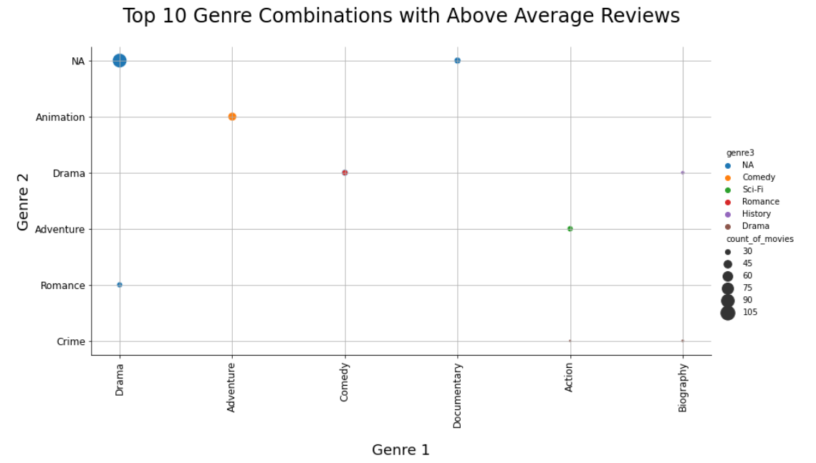
WHICH GENRES TO FOCUS ON?
Genre vs Reviews Analysis
POSITIVE VIEWER RESPONSE
PROFITABLE
IMPACTFUL MARKET ENTRY
Drama
Adventure, Animation, Comedy
Comedy, Drama
Documentary
Action, Adventure, Sci-fi

Slide 8
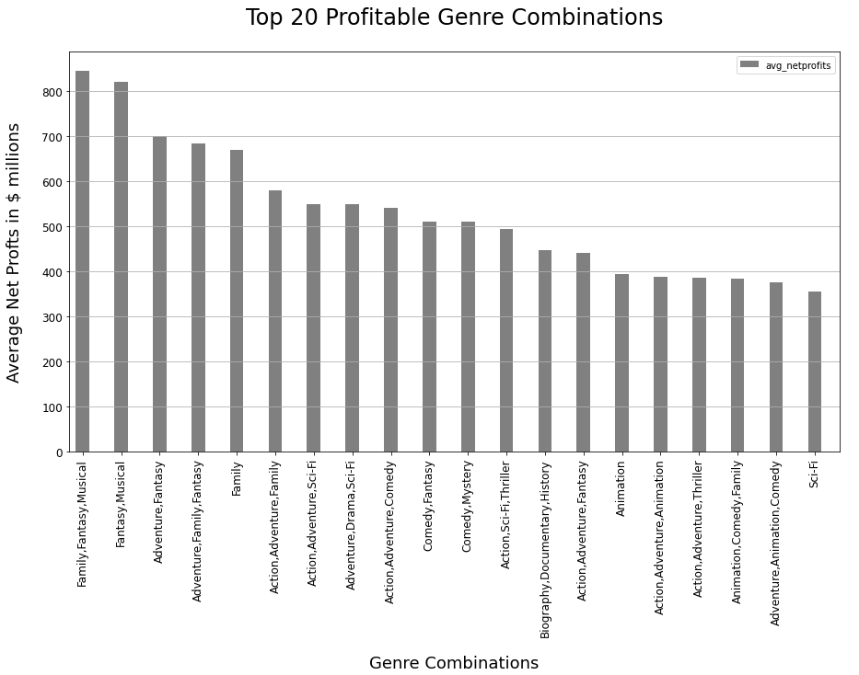
WHICH GENRES TO FOCUS ON?
Genre vs Profits Analysis
POSITIVE VIEWER RESPONSE
PROFITABLE
IMPACTFUL MARKET ENTRY
Adventure: 10 groupings
Action: 7 groupings
Fantasy: 6 groupings
Family: 5 groupings
Comedy : 5 groupings
Animation: 4 grouping
Sci-fi: 4 groupings
Musical: 2 groupings
Thriller: 2 groupings
Drama, Mystery, Documentary, History : 1 groupings each

Slide 9
WHICH GENRES TO FOCUS ON?
Positive Viewer Response
Highly Profitable
Fantasy: 6 groupings
Family: 5 groupings
Musical: 2 groupings
Thriller: 2 groupings
Drama, Mystery, Documentary, History : 1 groupings each
Adventure: 10 groupings
Action: 7 groupings
Comedy: 5 groupings
Animation: 4 groupings
Sci-fi: 4 groupings
Drama
Documentary

Slide 10
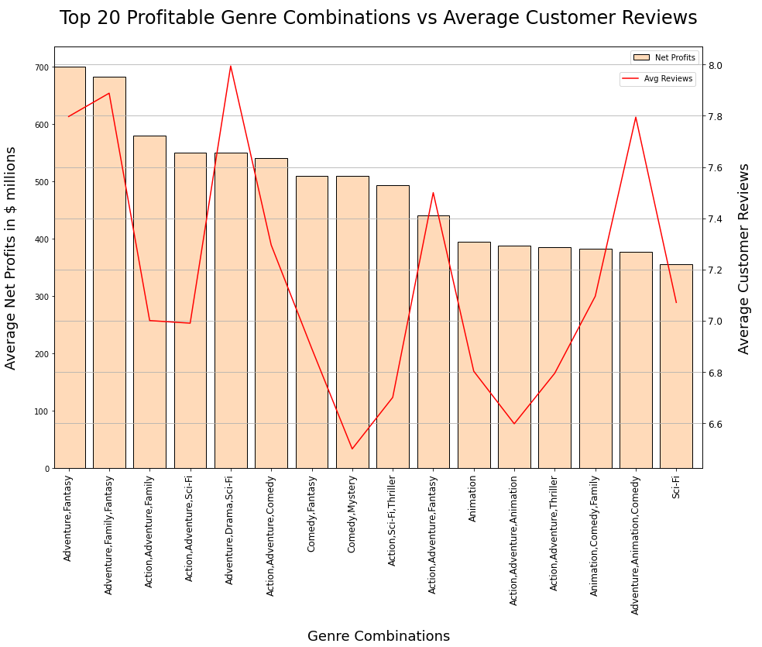
WHICH GENRES TO FOCUS ON?
Genre vs Reviews vs Profits Analysis
POSITIVE VIEWER RESPONSE
PROFITABLE
IMPACTFUL MARKET ENTRY
Best Option:
Adventure pairings with
Action
Comedy
Animation
Sci-Fi

Slide 11
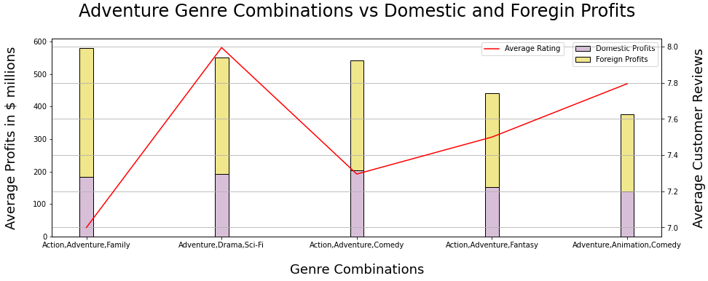
GLOBAL FOOTPRINT
Genre vs Reviews vs Domestic and Foreign Profits Analysis
POSITIVE VIEWER RESPONSE
PROFITABLE
IMPACTFUL MARKET ENTRY
Foreign Profits Dominate Net Profits

Slide 12
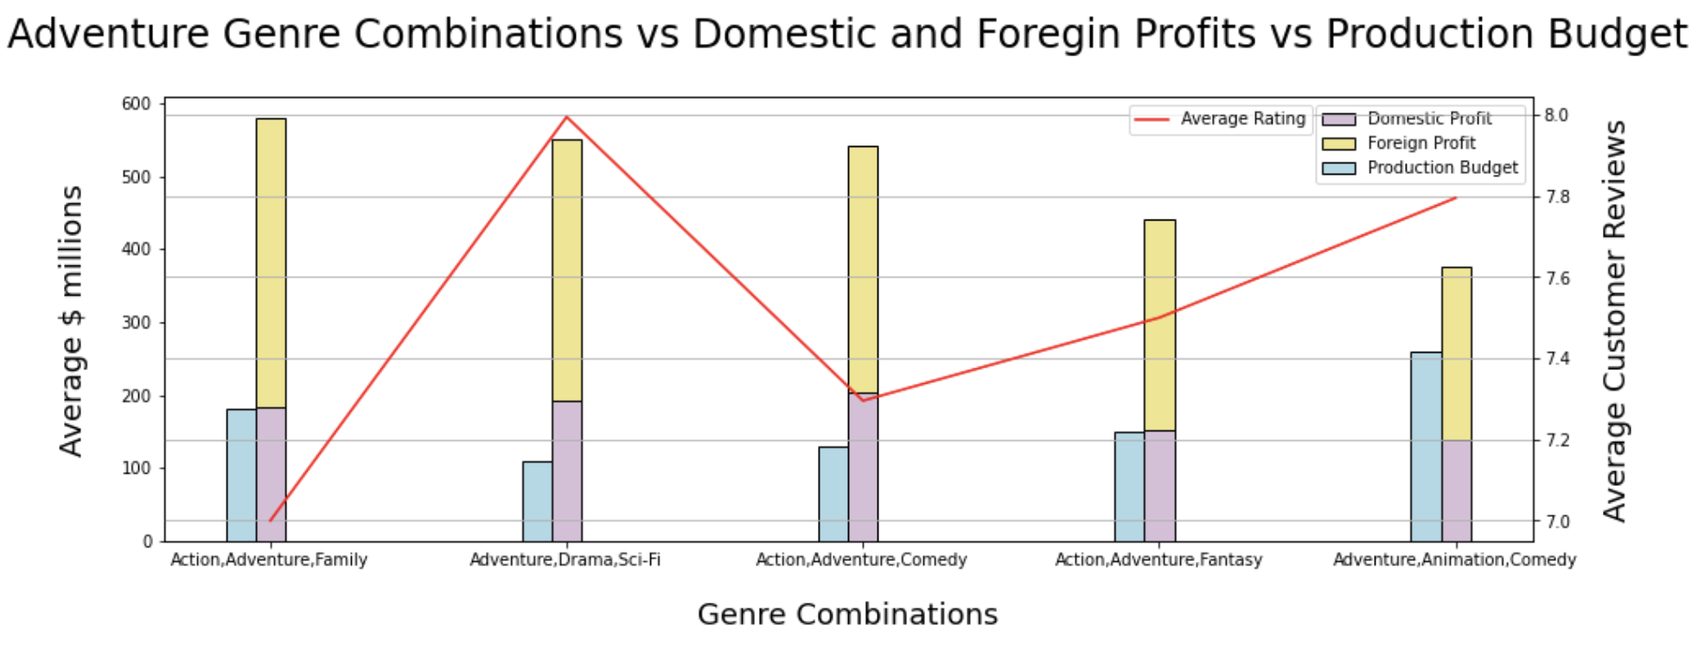


INITIAL INVESTMENT
Genre vs Reviews vs Domestic and Foreign Profits Analysis
POSITIVE VIEWER RESPONSE
PROFITABLE
IMPACTFUL MARKET ENTRY
DOMESTIC & FOREIGN ROI CRITICAL

Slide 13

RESULTS
ADVENTURE GENRE COMBINATIONS – MOST COMMON GENRE WITH HIGH REVIEWS & HIGH PROFITS
FOREIGN PROFITS DOMINATE TOTAL PROFITS
BEST ROI DOMESTIC AND FOREIGN MARKETS – ADVENTURE, DRAMA, SCI-FI
ADVENTURE, ACTION, COMEDY

Slide 14

RECOMMENDATION
ADVENTURE, ACTION, COMEDY – HIGH REVIEWS, HIGH PROFITS CONSISTENT
– DRAMA COMBINATIONS ARE RARE TO BE HIGHLY PROFITABLE
MOVIE SHOULD BE LAUNCHED INTERNATIONALLY – ENSURES HIGH PROFITS WITH HIGH EXPOSURE FOR 1ST LAUNCH
BEST ROI DOMESTIC AND FOREIGN MARKETS – DOMESTRIC LAUNCH FIRST WILL ENSURE NET POSITIVE AND CREATE HYPE

Slide 15
QUESTIONS?

Slide 16
MOVIE EXPLORATION PROJECT
SHAYAN ABDUL KARIM KHAN
08/24/2022

