Slide 1

MOVIE EXPLORATION PROJECT
SHAYAN ABDUL KARIM KHAN
08/24/2022

Slide 2



~ 265 Million people in US & Canada
~ $12 Billion Box Office Revenue in US & Canada

Slide 3

WHAT TYPE OF MOVIE TO CREATE?

Slide 4





POSITIVE VIEWER RESPONSE
MOVIE REVIEWS
PROFITABLE
MOVIE PROFITS
DOMESTIC VS FOREIGN LAUNCH
GLOBAL PROFITS

Slide 5





Slide 6
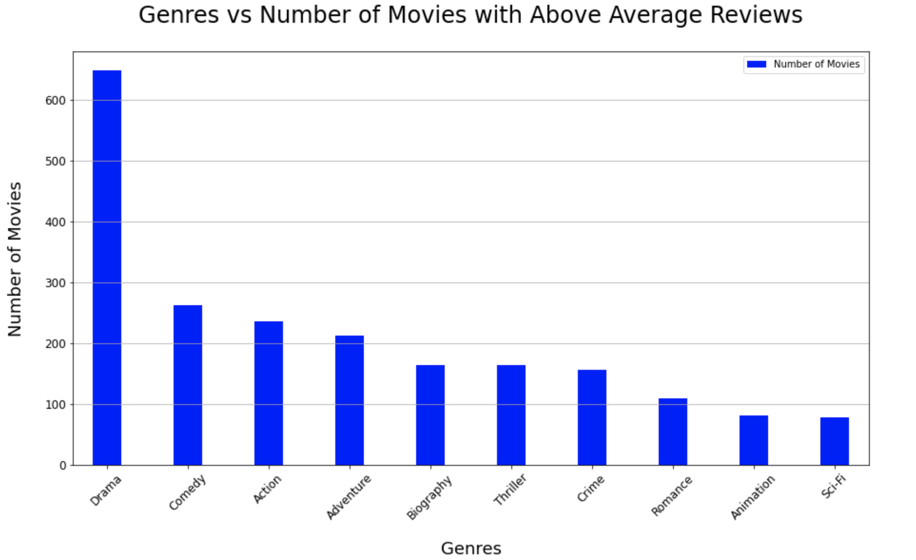
POSITIVE VIEWER RESPONSE
Top 4:
Drama
Comedy
Action
Adventure

Slide 7
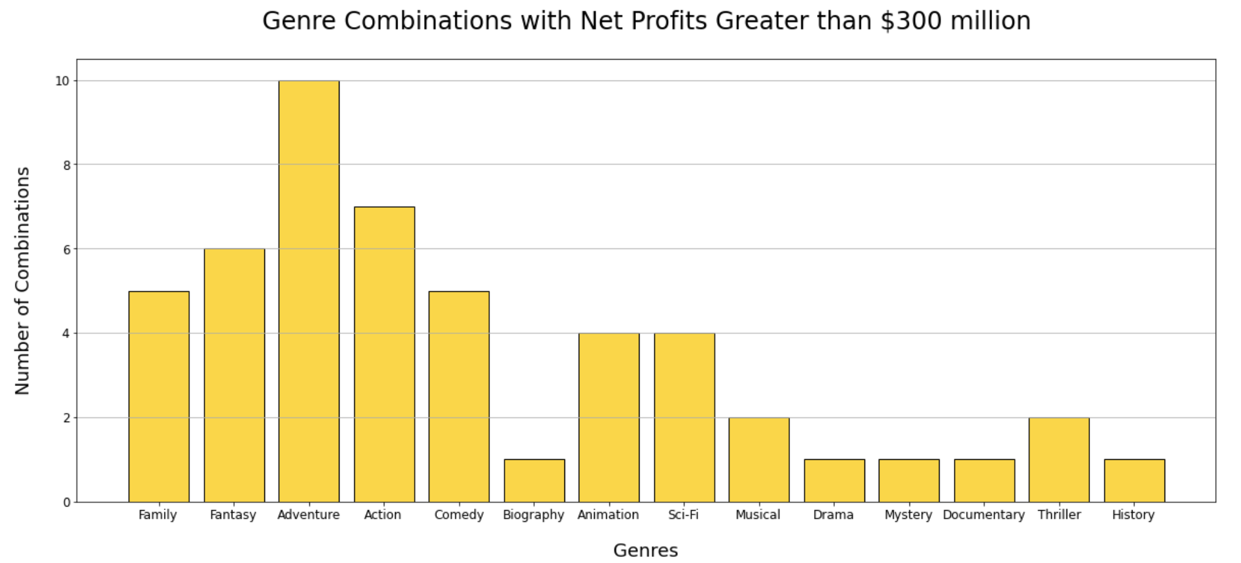
PROFITABILITY
Best Option:
Adventure pairings with
Action
Comedy
Animation
Sci-Fi

Slide 8
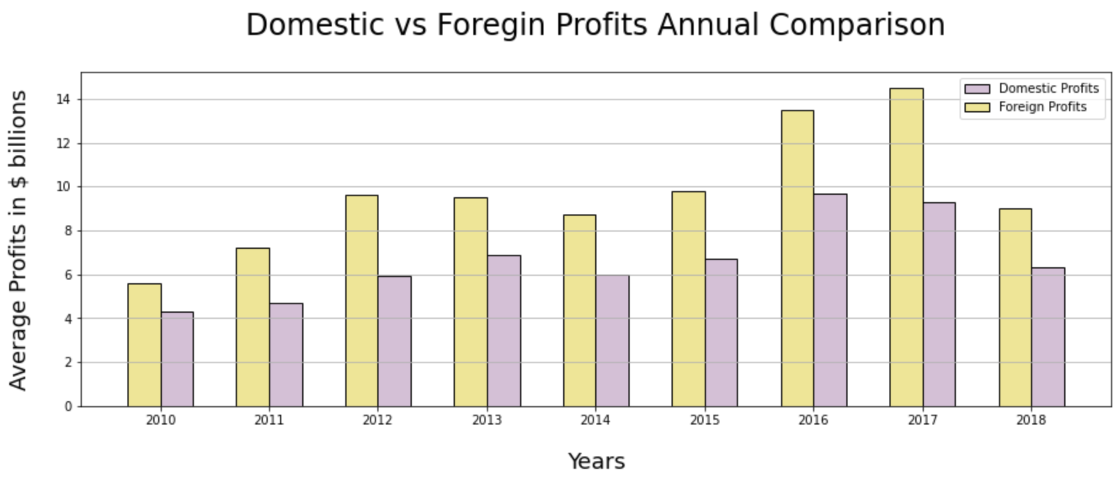
DOMESTIC VS FOREIGN LAUNCH
FOREIGN PROFITS DOMINATE NET PROFITS

Slide 9

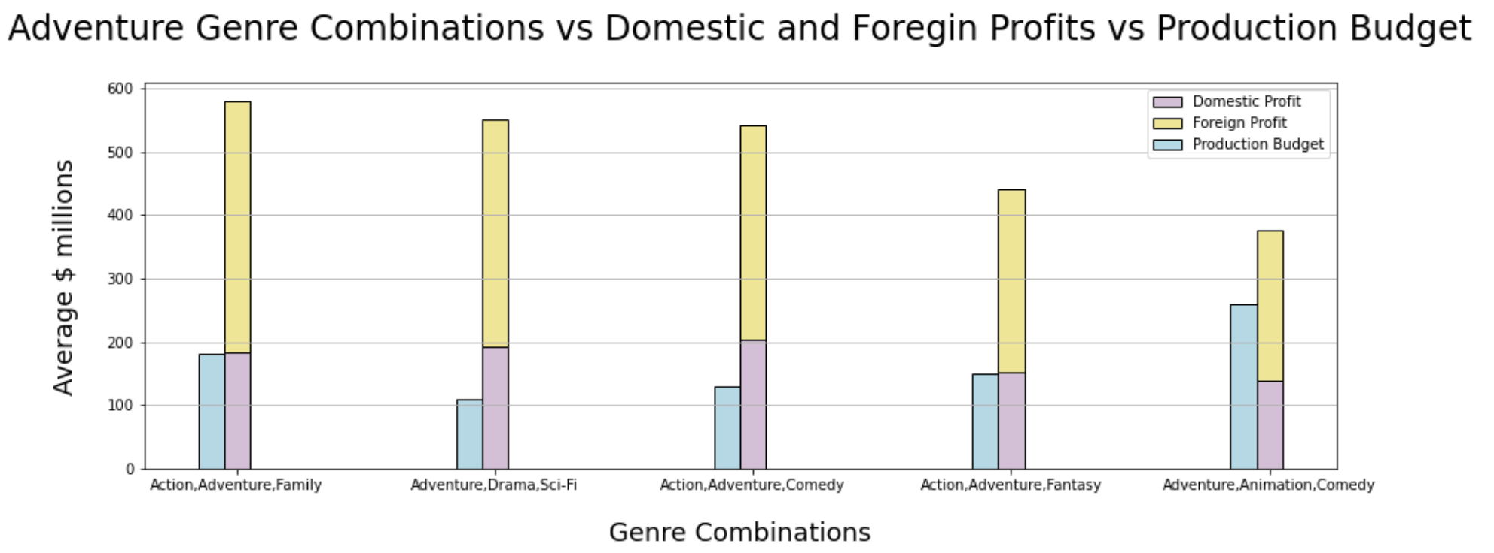


GENRE FOCUS
ADVENTURE, DRAMA, SCI-FI
ADVENTURE, ACTION, COMEDY

Slide 10



RESULTS
ADVENTURE GENRE COMBINATIONS – MOST COMMON GENRE WITH HIGH REVIEWS & HIGH PROFITS
FOREIGN PROFITS DOMINATE TOTAL PROFITS
BEST ROI DOMESTIC AND FOREIGN MARKETS – ADVENTURE, DRAMA, SCI-FI
ADVENTURE, ACTION, COMEDY

Slide 11

RECOMMENDATION
ADVENTURE, ACTION, COMEDY – HIGH REVIEWS, HIGH PROFITS CONSISTENT
– DRAMA COMBINATIONS ARE RARE TO BE HIGHLY PROFITABLE
MOVIE SHOULD BE LAUNCHED INTERNATIONALLY – ENSURES HIGH PROFITS WITH HIGH EXPOSURE FOR 1ST LAUNCH
BEST ROI DOMESTIC AND FOREIGN MARKETS – DOMESTRIC LAUNCH FIRST WILL ENSURE NET POSITIVE AND CREATE HYPE

Slide 12


NEXT STEPS
EVALUATE WHICH FOREIGN MARKETS ARE BEST
EVALUATE TRENDS IN SELECTED GENRE
IDENTIFY TARGET AUDIENCE DEMOGRAPHIC
IDENTIFY POST-PRODUCTION REVENUE STREAMS

Slide 13
QUESTIONS?

Slide 14
MOVIE EXPLORATION PROJECT
SHAYAN ABDUL KARIM KHAN
08/24/2022

Slide 15
BACK UP

Slide 16

MOVIE REVIEWS
MOVIE PROFITS
WHICH GENRES TO FOCUS ON?
WHAT WOULD BE THE INITIAL INVESTMENT
WHAT SHOULD BE THE GLOBAL FOOTPRINT?

Slide 17
WHICH GENRES TO FOCUS ON?
Positive Viewer Response
Highly Profitable
Fantasy: 6 groupings
Family: 5 groupings
Musical: 2 groupings
Thriller: 2 groupings
Drama, Mystery, Documentary, History : 1 groupings each
Adventure: 10 groupings
Action: 7 groupings
Comedy: 5 groupings
Animation: 4 groupings
Sci-fi: 4 groupings
Drama
Documentary

Slide 18
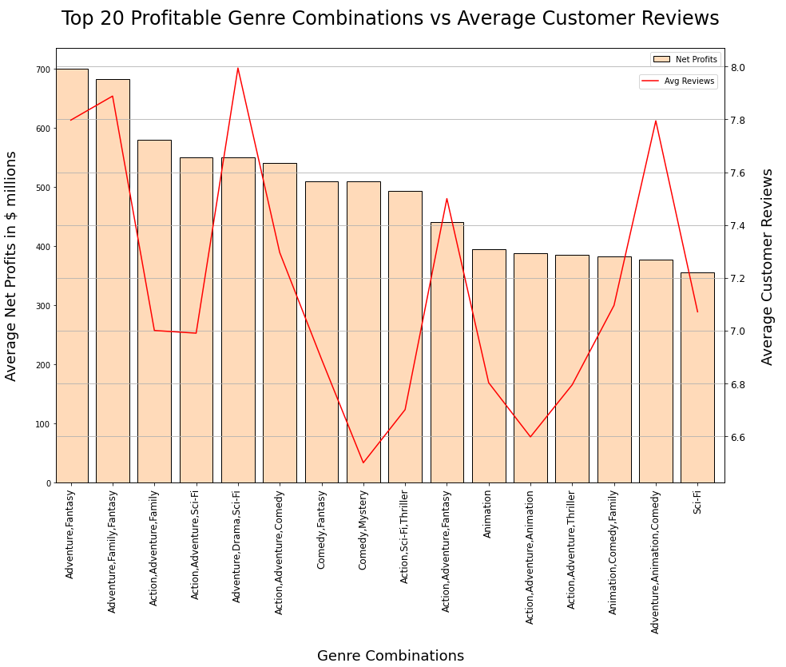


WHICH GENRES TO FOCUS ON?
Genre vs Reviews vs Profits Analysis
POSITIVE VIEWER RESPONSE
PROFITABLE
IMPACTFUL MARKET ENTRY
Best Option:
Adventure pairings with
Action
Comedy
Animation
Sci-Fi

Slide 19
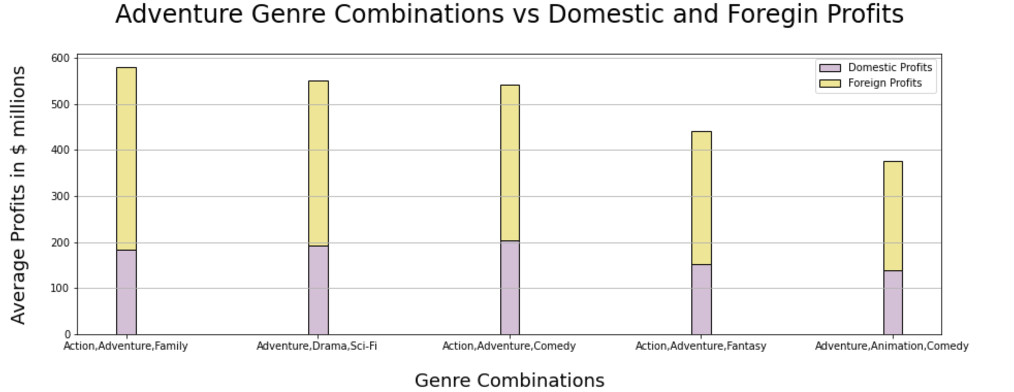
Foreign Profits Dominate Net Profits

