Slide 1

Heart Disease Prediction System
Machine Learning Project using Logistic Regression
🔬 Predicting
Presence of heart disease using medical data
📊 Approach
Supervised learning classification problem

Slide 2





Project Overview
An end-to-end machine learning pipeline designed to predict heart disease risk from patient medical attributes — from raw data to actionable predictions.
Data Collection
Medical attributes from patients
Preprocessing
Clean & normalize data
Model
Logistic Regression algorithm
Evaluation
Accuracy & performance metrics

Slide 3




PROBLEM STATEMENT
Why Heart Disease Detection Matters
Heart disease is a major global health issue and one of the leading causes of death worldwide. Early detection can save lives — yet manual diagnosis is time-consuming, complex, and prone to human error.
🌍 Global Impact
⏱️ Manual Diagnosis
🎯 Our Goal
Heart disease affects millions globally each year
Time-consuming and complex for physicians
Build a model to classify patients as diseased or healthy

Slide 4
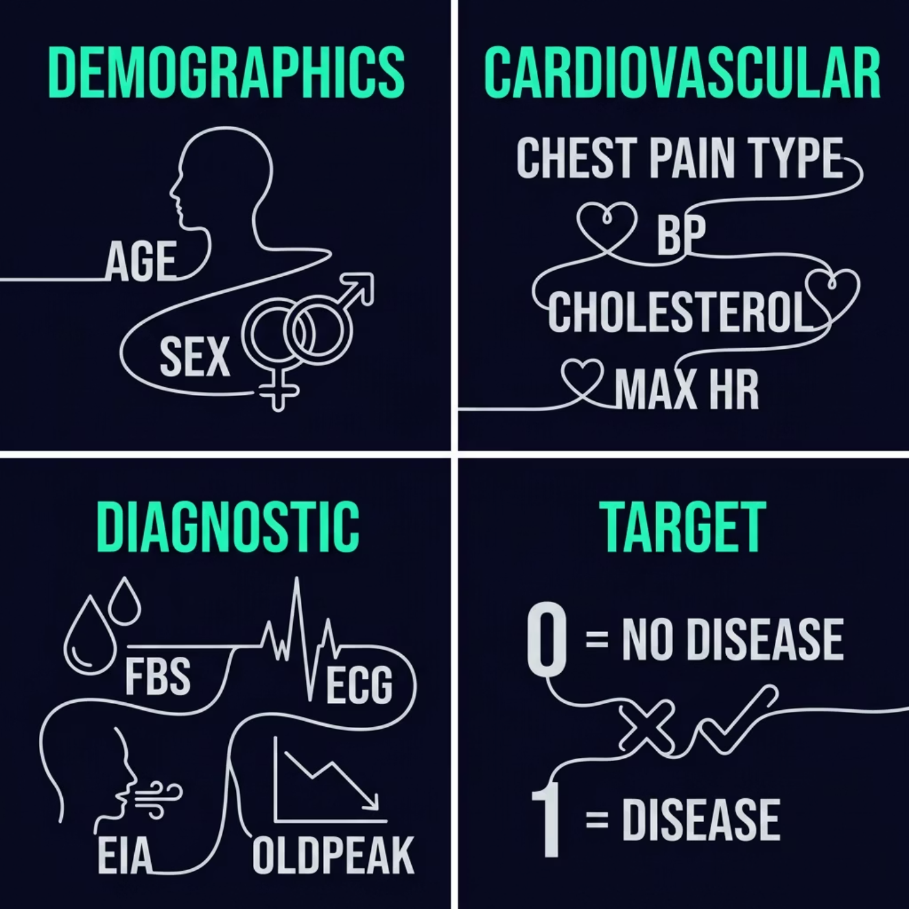
Dataset Description
The medical dataset contains 11 features capturing key patient health indicators, with a binary target variable indicating the presence or absence of heart disease.
Demographics
Cardiovascular
age, sex
cp, trestbps, chol, thalach
Diagnostic
Target
fbs, restecg, exang, oldpeak
0 = No Disease, 1 = Disease

Slide 5

Data Preprocessing
Before training the model, raw data was carefully cleaned and transformed to ensure high-quality input for the Logistic Regression algorithm.
01
Remove Duplicates
Identified and removed duplicate records from the dataset
02
Handle Missing Values
Addressed gaps in the data to prevent training errors
03
Split Features & Target
Separated input features (X) from the target variable (y)
04
Normalize with StandardScaler
Applied StandardScaler to normalize feature scales for consistent model performance

Slide 6





Exploratory Data Analysis (EDA)
EDA revealed key patterns and relationships within the data, guiding feature selection and model design decisions.
Key Findings
📈 Data Distribution
🔗 Feature Correlation
❤️ Age & Cholesterol
Analyzed feature distributions using histograms and boxplots
Checked correlations between features using heatmaps
Both show significant impact on heart disease likelihood
💡 Chest Pain Type
Strongly related to the target variable — a key predictor

Slide 7
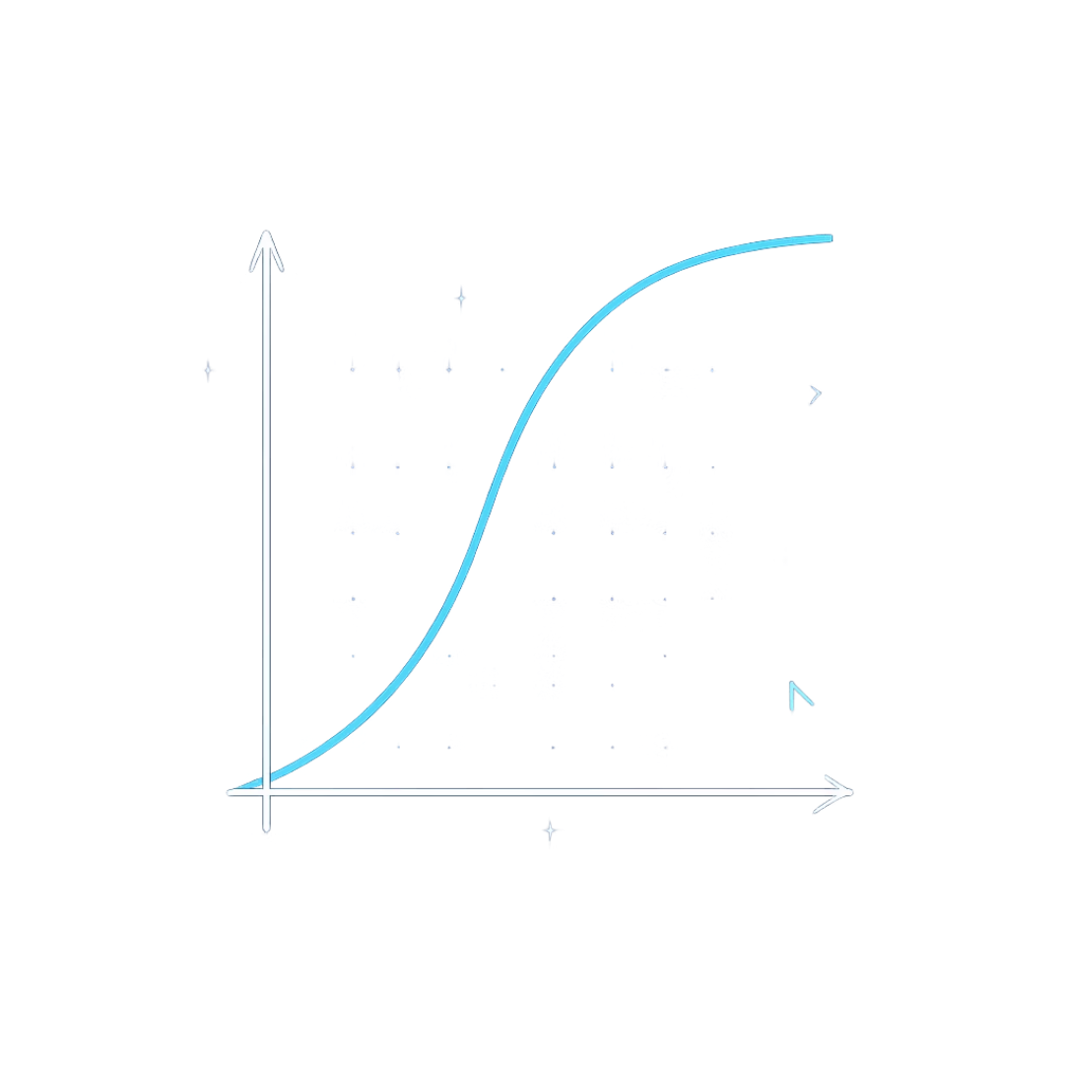
ALGORITHM
Logistic Regression Model
Logistic Regression is a binary classification algorithm that uses the sigmoid function to map input features to a probability between 0 and 1.
⚡ Fast
🔍 Interpretable
🎯 Binary Output
Computationally efficient
Clear feature weights
0 = No Disease, 1 = Disease

Slide 8
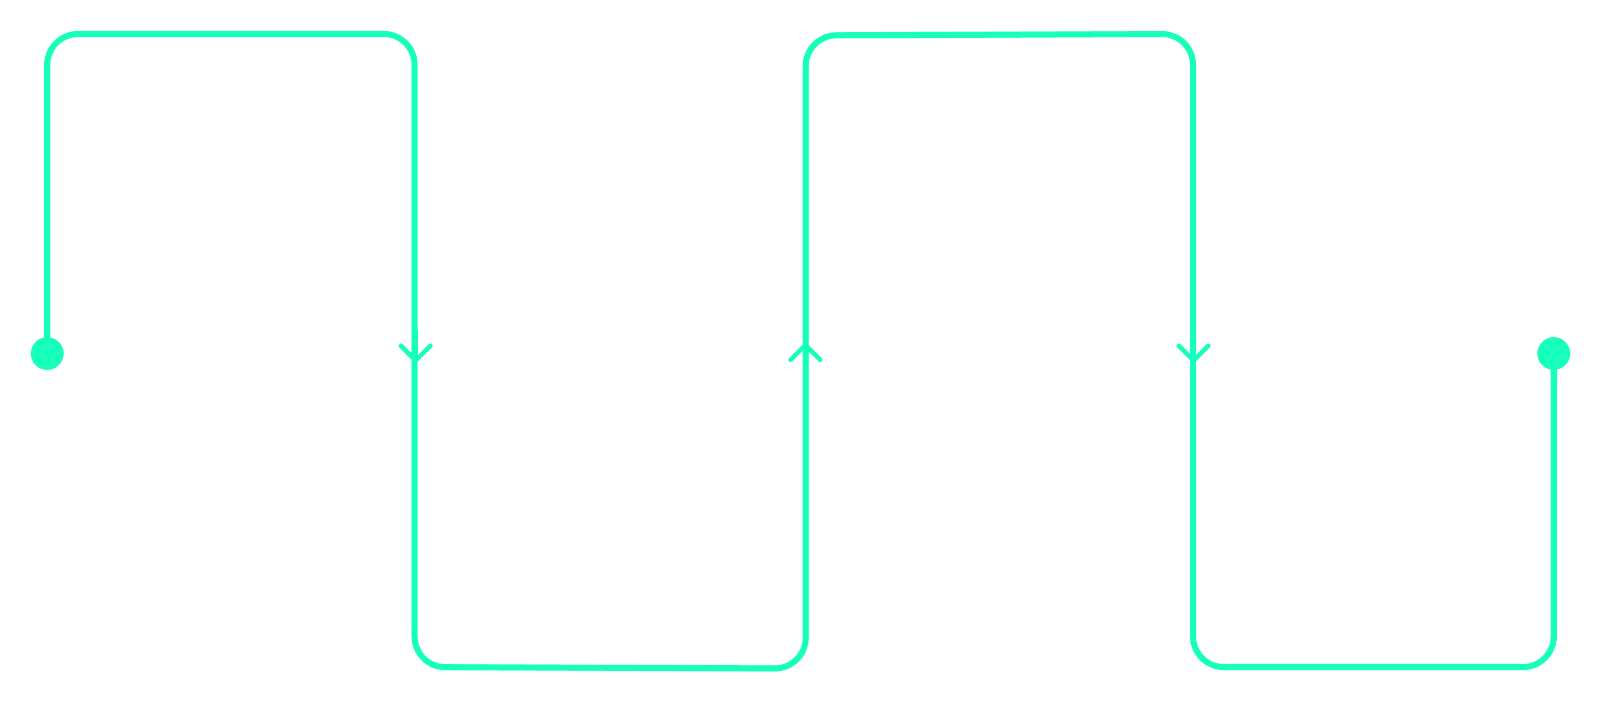
Model Training
The preprocessed dataset was split into training and testing subsets, enabling the model to learn patterns and then be evaluated on unseen data.
Split Dataset
Train Model
Train/test split of data
Fit Logistic Regression
Scale Data
Predict
Fit StandardScaler on train
Generate predictions on test
The model learned the relationship between patient features and the target variable, enabling it to generalize to new, unseen patient data.

Slide 9
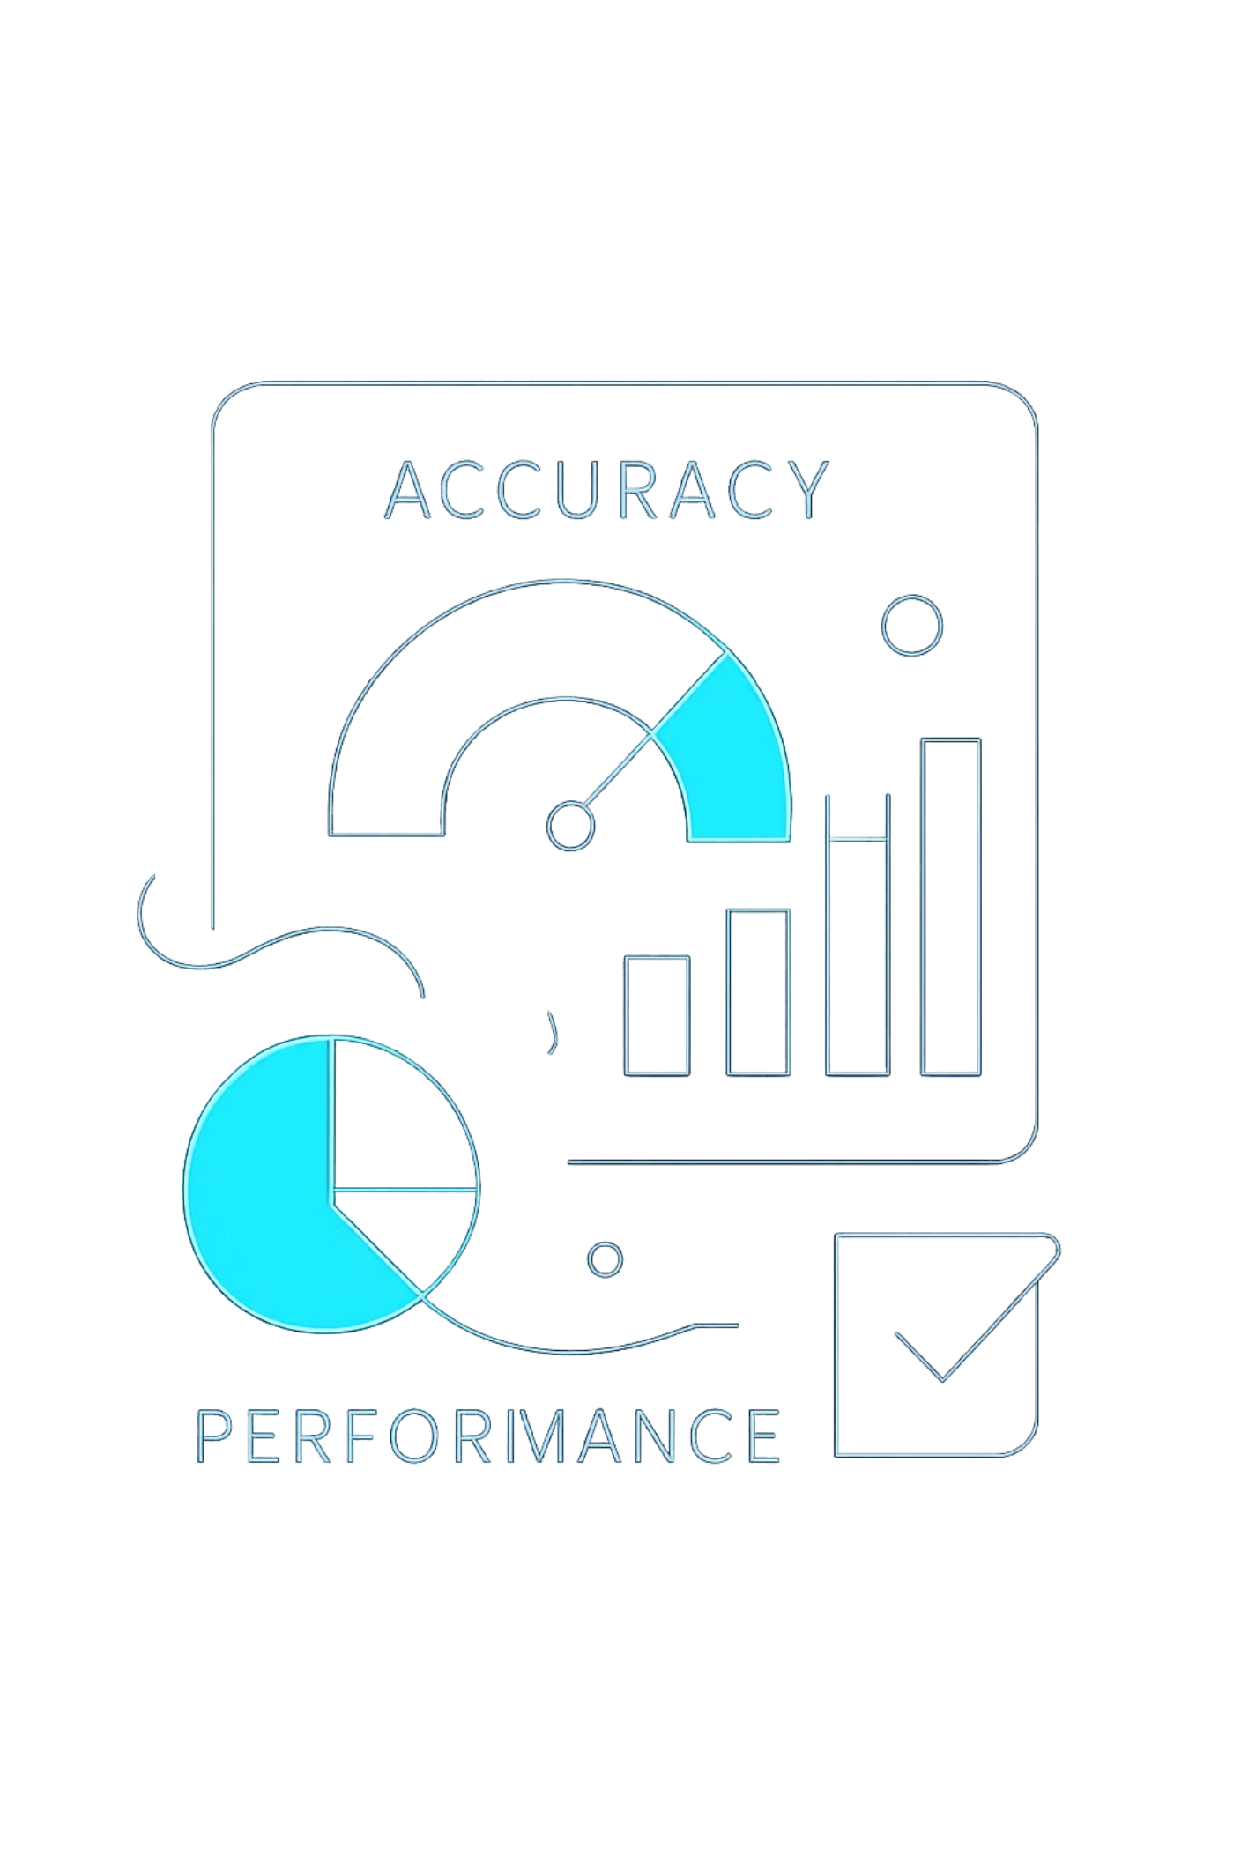




Model Evaluation
79%
Accuracy
Overall correct predictions on test data
Multiple evaluation metrics were used to assess model performance beyond simple accuracy, ensuring reliable detection of heart disease cases.
📐 Precision & Recall
Measured the model's ability to correctly identify positive cases while minimizing false positives
📊 F1-Score
Harmonic mean of precision and recall — balanced performance metric
🔲 Confusion Matrix
Analyzed to understand true positives, false positives, true negatives, and false negatives
✅ Good Recall
Strong performance in detecting actual heart disease patients — critical for medical applications

Slide 10







Conclusion & Future Work
CONCLUSION
FUTURE IMPROVEMENTS
What We Achieved
What's Next
Logistic Regression successfully predicts heart disease from medical data
Achieved ~79% accuracy on the test set
Advanced Models
Hyperparameter Tuning
Strong performance in detecting positive cases — high recall for diseased patients
Try Random Forest and XGBoost for better accuracy
Optimize model parameters using GridSearchCV
Feature Engineering
Deploy as Web App
Create new derived features to improve predictions
Build a Flask or Streamlit interface for real-world use

