Slide 1
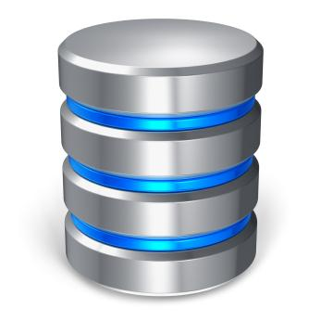

Slide 2
MySQL java tutorial
This is a Java tutorial for the MySQL database. It covers the basics of MySQL programming with Java. In this tutorial, we use the MySQL Connector/J driver. It is the official JDBC driver for MySQL. The examples were created and tested on Ubuntu Linux. You might also want to check Java tutorial, PostgreSQL Java tutorial, Apache Derby tutorial or MySQL tutorial on ZetCode.

Slide 3
JDBC
JDBC is an API for the Java programming language that defines how a client may access a database. It provides methods for querying and updating data in a database. JDBC is oriented towards relational databases. From a technical point of view, the API is as a set of classes in the java.sql package. To use JDBC with a particular database, we need a JDBC driver for that database.

Slide 4
About MySQL database
MySQL is a leading open source database management system. It is a multi user, multithreaded database management system. MySQL is especially popular on the web. It is one part of the very popular LAMP platform consisting of Linux, Apache, MySQL, and PHP. Currently MySQL is owned by Oracle. MySQL database is available on most important OS platforms. It runs on BSD Unix, Linux, Windows, or Mac OS. Wikipedia and YouTube use MySQL. These sites manage millions of queries each day. MySQL comes in two versions: MySQL server system and MySQL embedded system.

Slide 5
Before we start
For this tutorial, we need to have several libraries installed. We need to install mysql-server and mysql-client packages. The first package has the MySQL server and the second one contains, among others, the mysql monitor tool. We need to install the JDK, Java Development Kit, for compiling and running Java programs. Finally, we need the MySQL Connector/J driver. If you are using NetBeans IDE, than you have already the driver at hand. Inside the Projects tab, right click on the Libraries node and select Add Library option. From the list of options, select MySQL JDBC Driver.

Slide 6
Command in Linux
sudo apt-get install mysql-server //for install mysql
mysql –u root –p //after that whrn you enter password you will have access to sql
Now in sql you must create database
mysql> CREATE DATABASE TEST;
mysql> CREATE USER ‘testuser’@’localhost’ IDENTIFIED BY ‘test2’;
USE TEST;
GRANT ALL ON TEST.* TO ‘testuser’@’localhost’;
…..

Slide 7
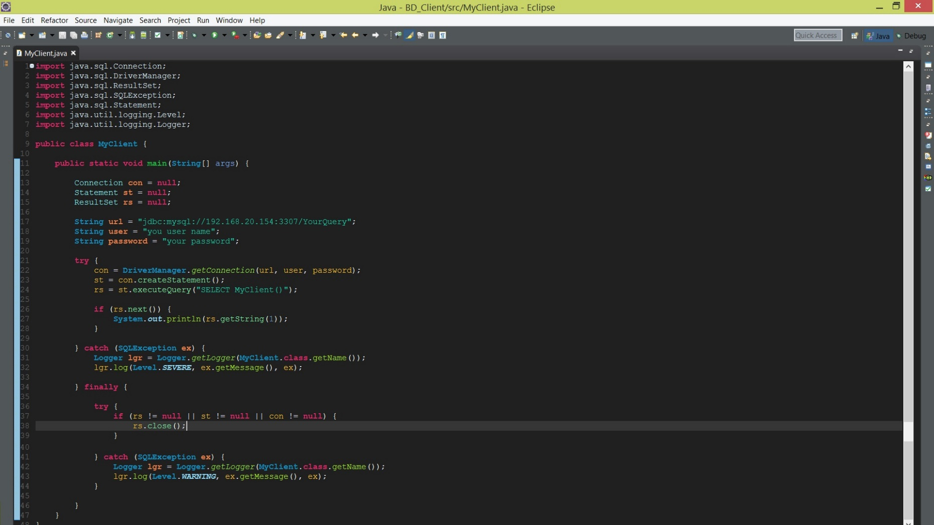
MySQL in java

Slide 8
String url = "jdbc:mysql://localhost:3306/testdb";
This is the connection URL for the MySQL database. Each driver has a different syntax for the URL. In our case, we provide a host, a port and a database name.

Slide 9
con = DriverManager.getConnection(url, user, password);
We establish a connection to the database, using the connection URL, user name, and password.

Slide 10
st = con.createStatement();
The createStatement() method of the connection object creates a Statement object for sending SQL statements to the database.

Slide 11
rs = st.executeQuery("SELECT VERSION()");
The createStatement() method of the connection object executes the given SQL statement, which returns a single ResultSet object. The ResultSet is a table of data returned by a specific SQL statement.

Slide 12
if (result.next()) { System.out.println(result.getString(1)); }
A ResultSet object maintains a cursor pointing to its current row of data. Initially the cursor is positioned before the first row. The next() method moves the cursor to the next row. If there are no rows left, the method returns false. The getString() method retrieves the value of a specified column. The first column has index 1.

Slide 13
} catch (SQLException ex) { Logger lgr = Logger.getLogger(Version.class.getName()); lgr.log(Level.SEVERE, ex.getMessage(), ex); }
In case of an exception, we log the error message. For this console example, the message is displayed in the terminal.

Slide 14
try{ … … }
Inside the finally block, we close the database resources. We also check if the objects are not equal to null. This is to prevent null pointer exceptions. Otherwise we might get a NullPointerException, which would terminate the application and leave the resources not cleaned up.

Slide 15
} catch (SQLException ex) { Logger lgr = Logger.getLogger(Version.class.getName()); lgr.log(Level.WARNING, ex.getMessage(), ex); }
We log an error message, when the resources could not be closed.

Slide 16
Any question?

Slide 17
Thanks.

