Slide 1
Analyzing Crowded Housing in Chicago Community Areas
Erica Castillo, Shane Gerami, Abdallah Hasan, Cindy Rocha, Samin Sohrabi

Slide 2
Descriptive Statistics
What is the mean, median, first, second, and third quartile of your assigned variable?
Mean: 4.91
Median: 4.2
First quartile: 2.0
Second quartile: 4.2
Third quartile: 6.8

Slide 3
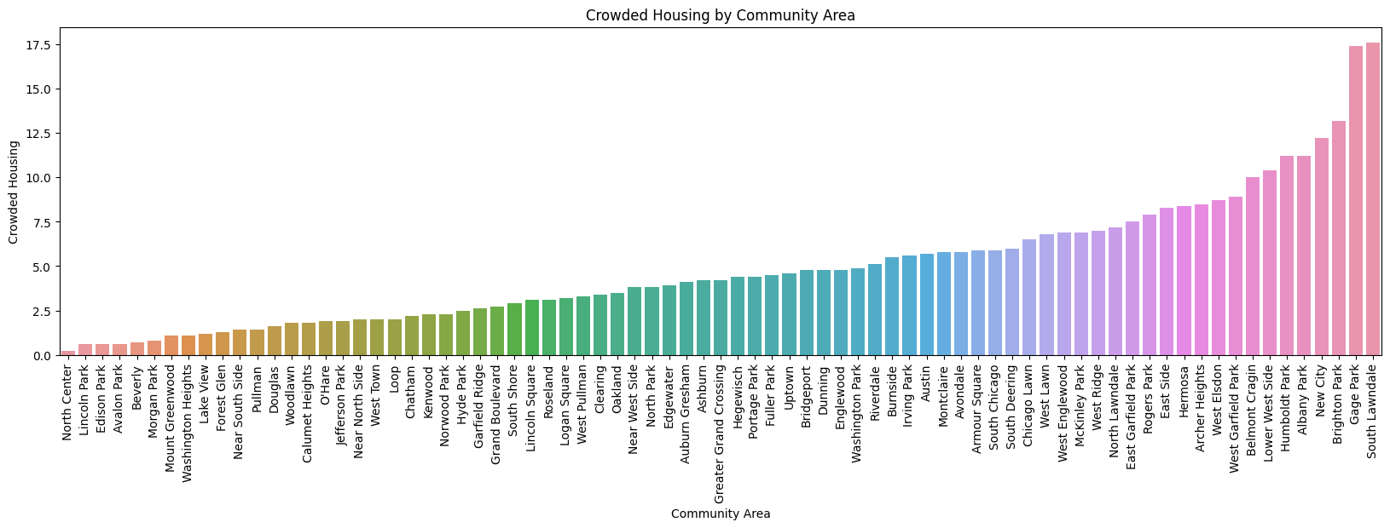
Data Visualization

Slide 4
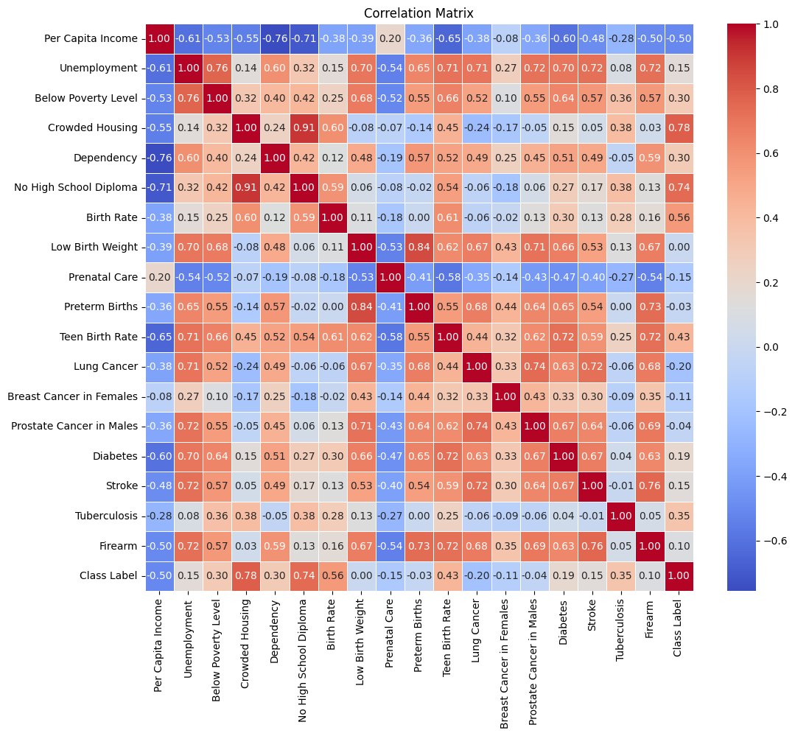
Correlation
Matrix

Slide 5
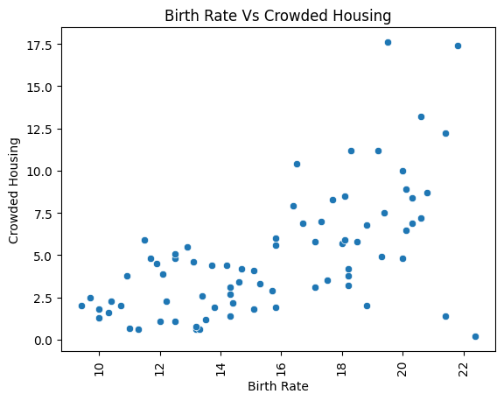
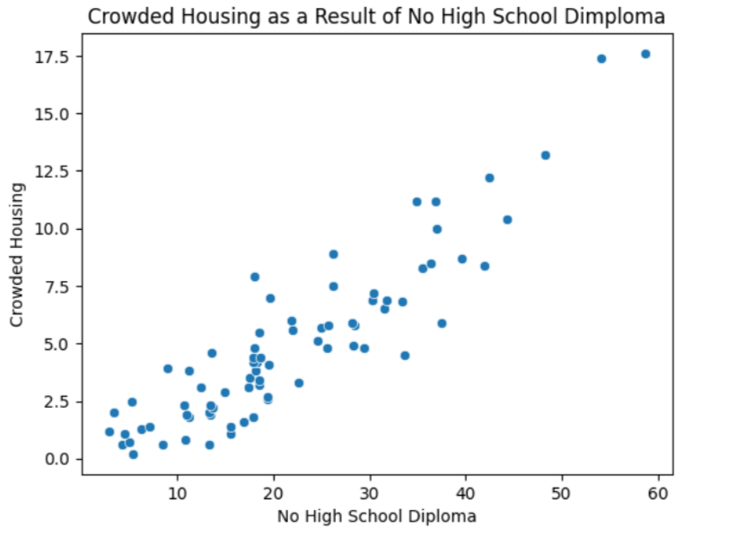
Data Visualization

Slide 6
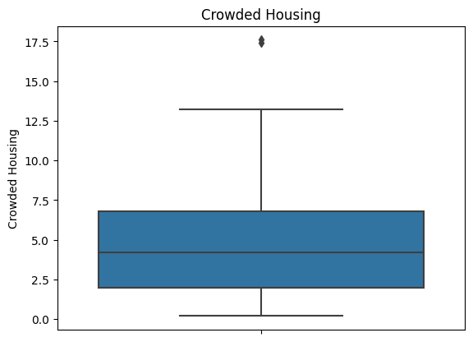
Data Visualization

Slide 7
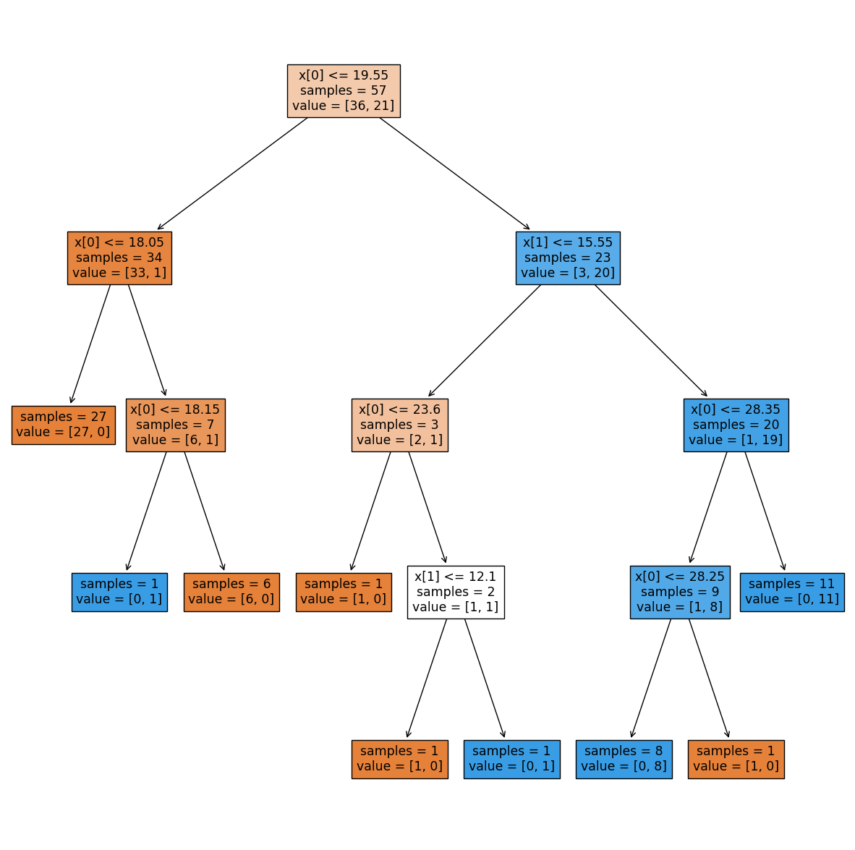
Classification
What predictors did you choose?
No High School Diploma & Birth Rate
How did you choose the predictors?
Came from our Data Visualization
The most related to our assigned variable
No High School Diploma = Less ability to afford a bigger house = Crowded Housing
Birth Rate = More people per less space = Crowded Housing
Plot the decision tree

Slide 8
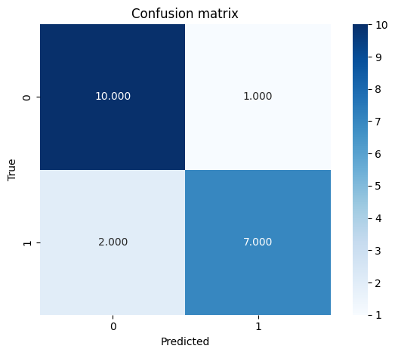
Classification
Plot the confusion matrix
What is the accuracy and error of the decision tree on the test set?
Accuracy = .85
Error = .15

Slide 9
Conclusions
What can you conclude about your assigned variable after analyzing the dataset?
Our assigned variable was Crowded Housing, and we can conclude that Crowded housing is a half decent predictor of No high school diploma and birth rate
Looking at scatterplot and correlation matrix helps find what the variable is correlated with

