Slide 1
ELE 573 · BRAIN SIGNAL PROCESSING
SPRING 2026
Alpha Wave
Detection via
Tripolar Rings.
A signal-processing pipeline comparing tEEG against conventional EEG across a six-subject cohort.
Shayan Khodabakhsh · University of Rhode Island

Slide 2
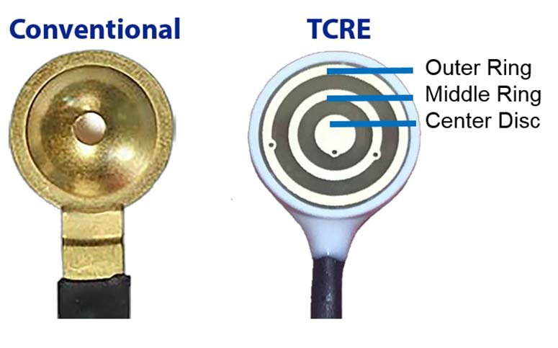
02 · METHODS
Setup, signals, and metrics.
THE SIGNALS
THE SETUP
FOUR METRICS
TCRE = three concentric rings on one sensor. The geometry computes the surface Laplacian directly at the scalp.
11 channels recorded simultaneously over occipital cortex:
I
Alpha SNR & reactivity
Closed/open ratio.
F1
Ch1 / Ch2
FELT
tEEG (odd channels) = local cortical activity via Laplacian.
eEEG (even channels) = volume-conducted, like a normal disc electrode.
F2
Ch3 / Ch4
FELT
II
FOOOF decomposition
F3
1/f vs. peaks.
Ch5 / Ch6
FELT
F4
Ch7 / Ch8
FELT
III
Spectrogram SSIM
P5
Ch9 / Ch10
PASTE
Image-similarity.
D
Ch11
DISC
IV
VEP & disc correlation
Protocol: 7 alternating eyes-open/closed epochs + 3 visual-stimulation blocks.
Per-channel agreement.
TOOLS Python · MNE · FOOOF (specparam) · SciPy · scikit-image
Khodabakhsh · ELE 573 · Spring 2026
02 / 13

Slide 3
03 · COHORT
6
Same protocol.
Same metrics.
One emerging pattern.
subjects
Subject | QC | α SNR (dB) | Reactivity | Paste r vs disc | Paste SSIM | Felt SSIM
SK1 | POOR | — | <1.0× | — | 0.40 | —
HS | POOR | 1.8 | 1.27× | 0.93–0.94 | 0.72 | 0.24–0.37
RK | POOR | 1.8 | 0.99× | 0.95–0.96 | 0.78 | 0.18–0.31
SG | POOR | 1.6 | 1.39× | 0.80–0.81 | 0.60 | 0.12–0.27
TU2 | MIXED | 2.6 | 2.63× | 0.99+ | 0.66 | 0.27–0.34
LS2 | POOR | 2.9 | 1.81× | 0.98+ | 0.79 | 0.28–0.34
Khodabakhsh · ELE 573 · Spring 2026
03 / 13

Slide 4
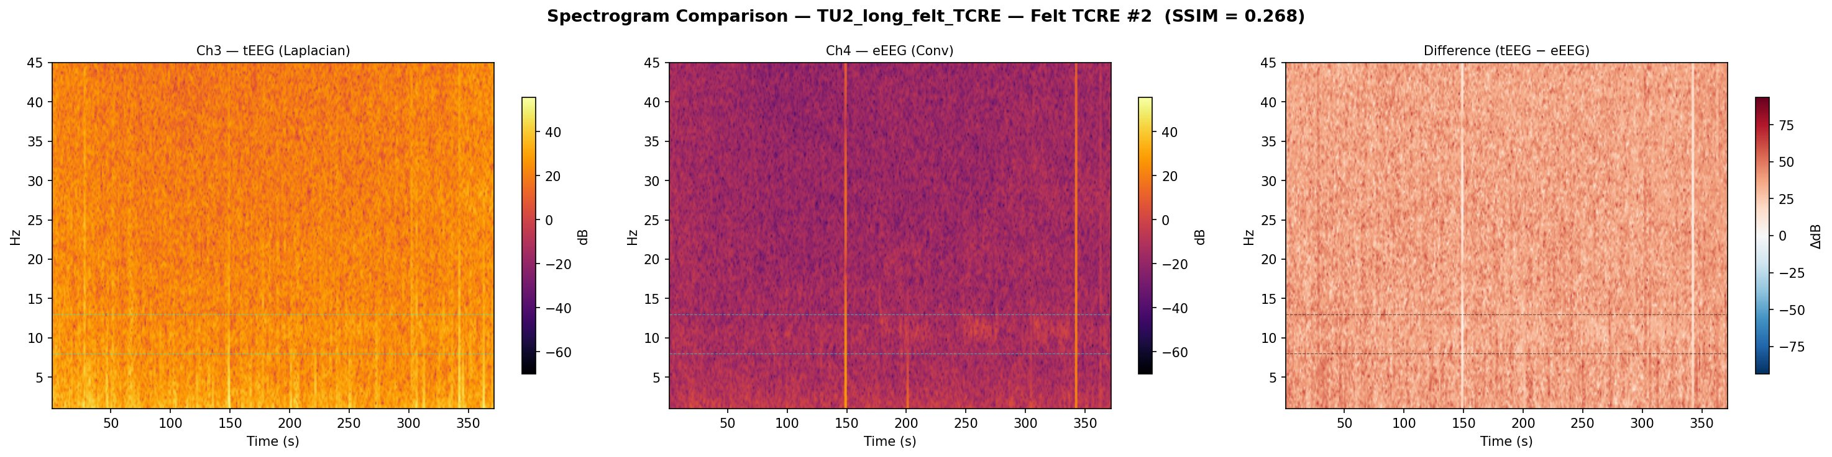
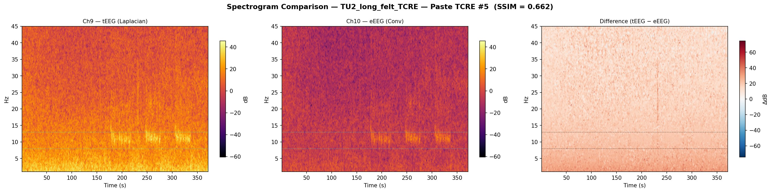
04 · FINDINGS
FELT · TCRE #2
SSIM 0.27 · LOW agreement
PASTE · TCRE #5
SSIM 0.66 · HIGH agreement
Khodabakhsh · ELE 573 · Spring 2026
04 / 13

Slide 5
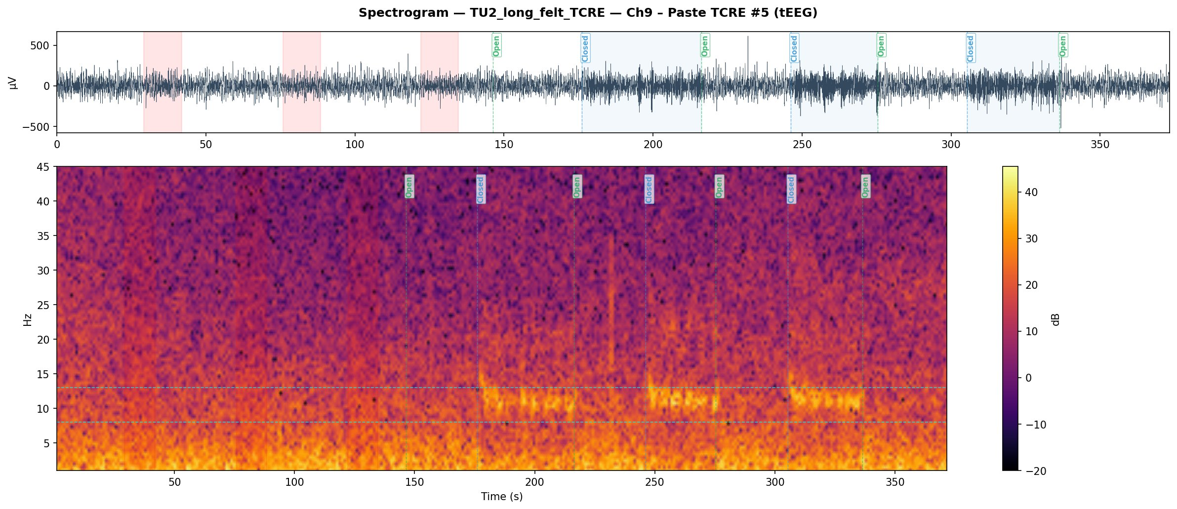
05 · WHERE ALPHA LIVES
TU2 · Ch9 (Paste tEEG). Bright stripes at 8–13 Hz fire during every Closed block, vanish during Open.
Khodabakhsh · ELE 573 · Spring 2026
05 / 13

Slide 6
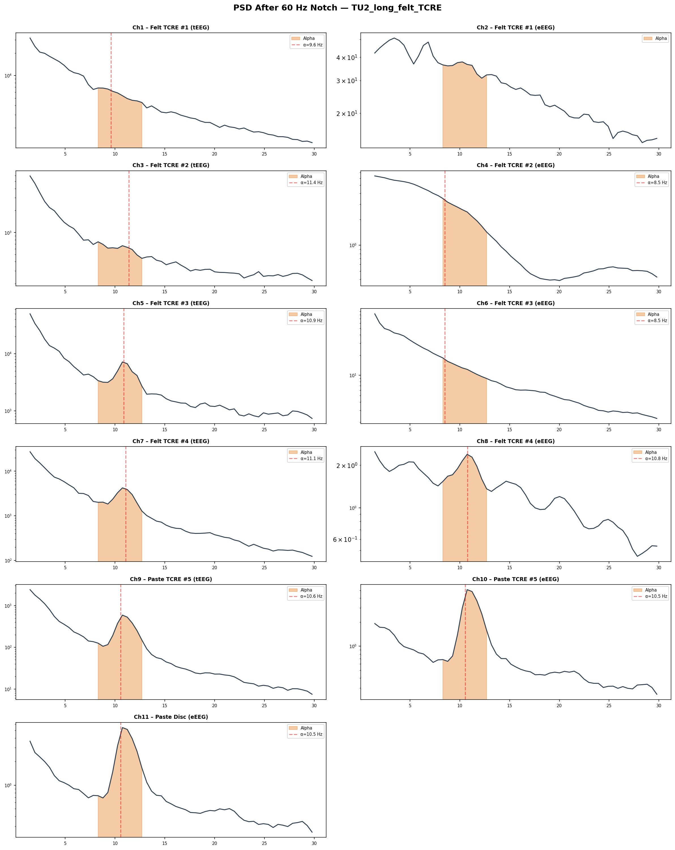
06 · SPECTRA BY SENSOR
Where the alpha peak shows up.
TU2 · PSD per channel after 60 Hz notch.
CH9, CH10, CH11
Paste channels show a sharp, well-localized peak at the canonical alpha frequency.
CH5, CH7
Felt tEEG occasionally shows a peak (≈11 Hz), but the shape is broader and lower-amplitude.
CH1–CH4, CH6, CH8
No reliable alpha peak. Mostly 1/f decay or broad noise floor.
Khodabakhsh · ELE 573 · Spring 2026
06 / 13

Slide 7
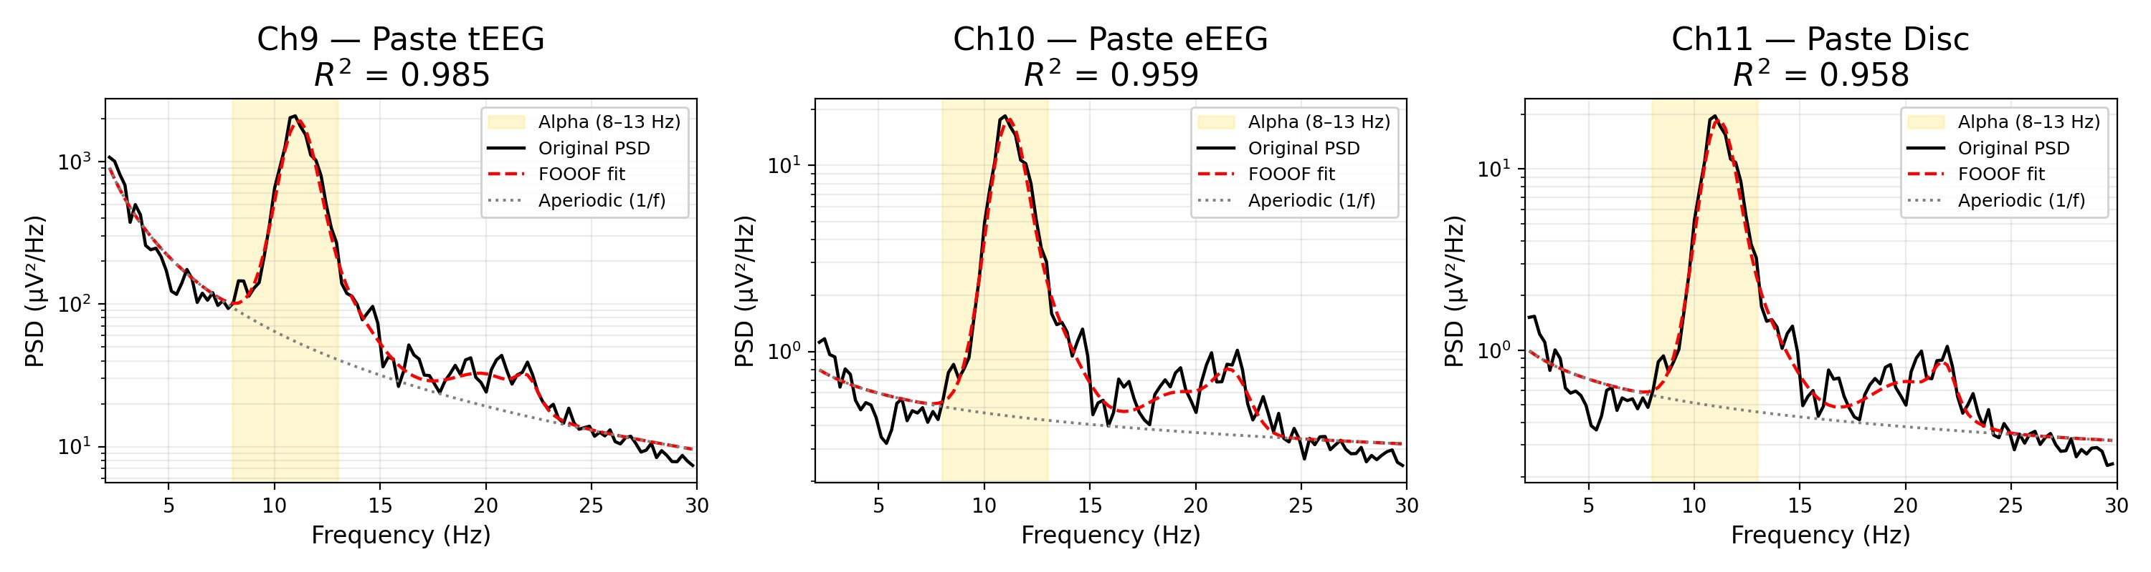
07 · FOOOF DECOMPOSITION
CH9 — PASTE TEEG
CH10 — PASTE EEEG
CH11 — PASTE DISC
R² = 0.985
R² = 0.959
R² = 0.958
Real alpha, not 1/f bias. FOOOF separates the aperiodic 1/f component (gray) from the periodic alpha peak (red). All three paste channels fit at R² > 0.95.
Khodabakhsh · ELE 573 · Spring 2026
07 / 13

Slide 8
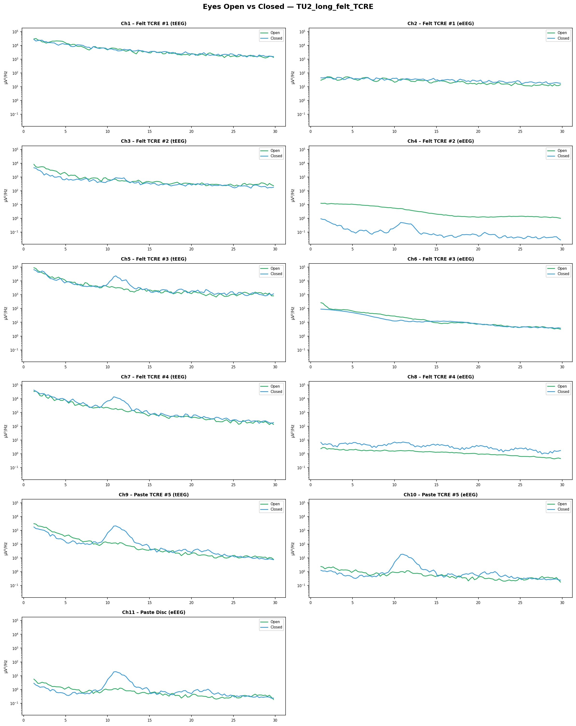
08 · OPEN VS. CLOSED
Berger, in the spectrum.
TU2 · eyes-open (green) vs. eyes-closed (blue) PSDs.
Ch9 / Ch10 / Ch11
Closed visibly higher than open at 10–12 Hz. Clean Berger signature.
Ch5, Ch7 (felt tEEG)
Modest closed > open at alpha. Berger is detectable but partial.
Ch1, Ch3 (felt tEEG)
Curves overlap completely. Clipping floods both states with broadband power.
Ch4, Ch8 (felt eEEG)
Closed sometimes lower than open — opposite of Berger. Not interpretable.
Khodabakhsh · ELE 573 · Spring 2026
08 / 13

Slide 9
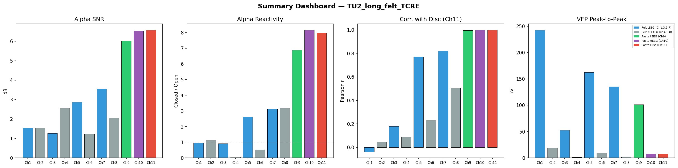
09 · TU2 IN FOUR METRICS
The cleanest run, end to end.
Across all four metrics, paste channels (Ch9, Ch10) and the disc reference (Ch11) sit at the right end of every panel.
Α SNR
REACTIVITY
DISC R
Felt tEEG sits at 1–3 dB. Paste tEEG hits 6 dB.
Paste/disc reach 7–8× closed/open. Felt rarely passes 1×.
Paste at r ≈ 1.0. Felt averages near 0.
Khodabakhsh · ELE 573 · Spring 2026
09 / 13

Slide 10
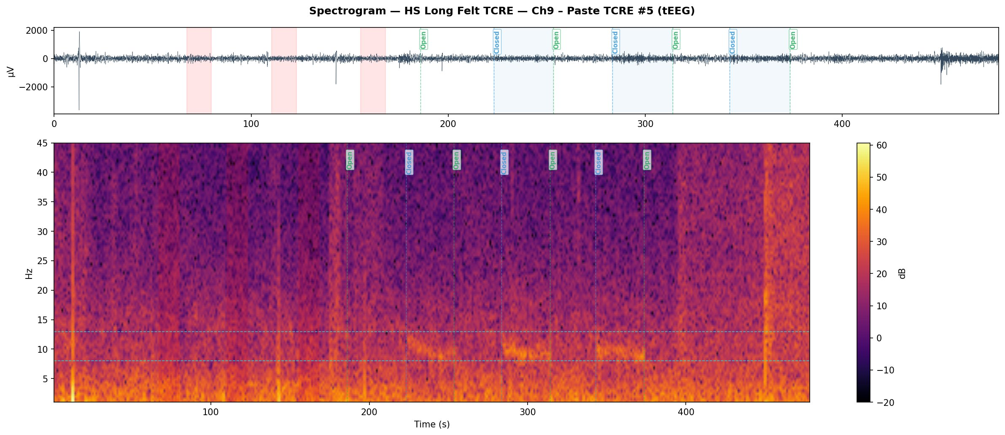
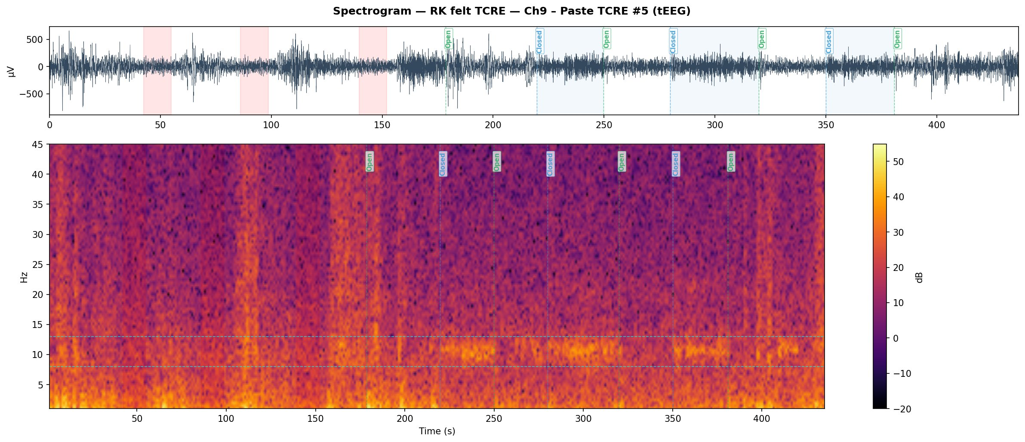
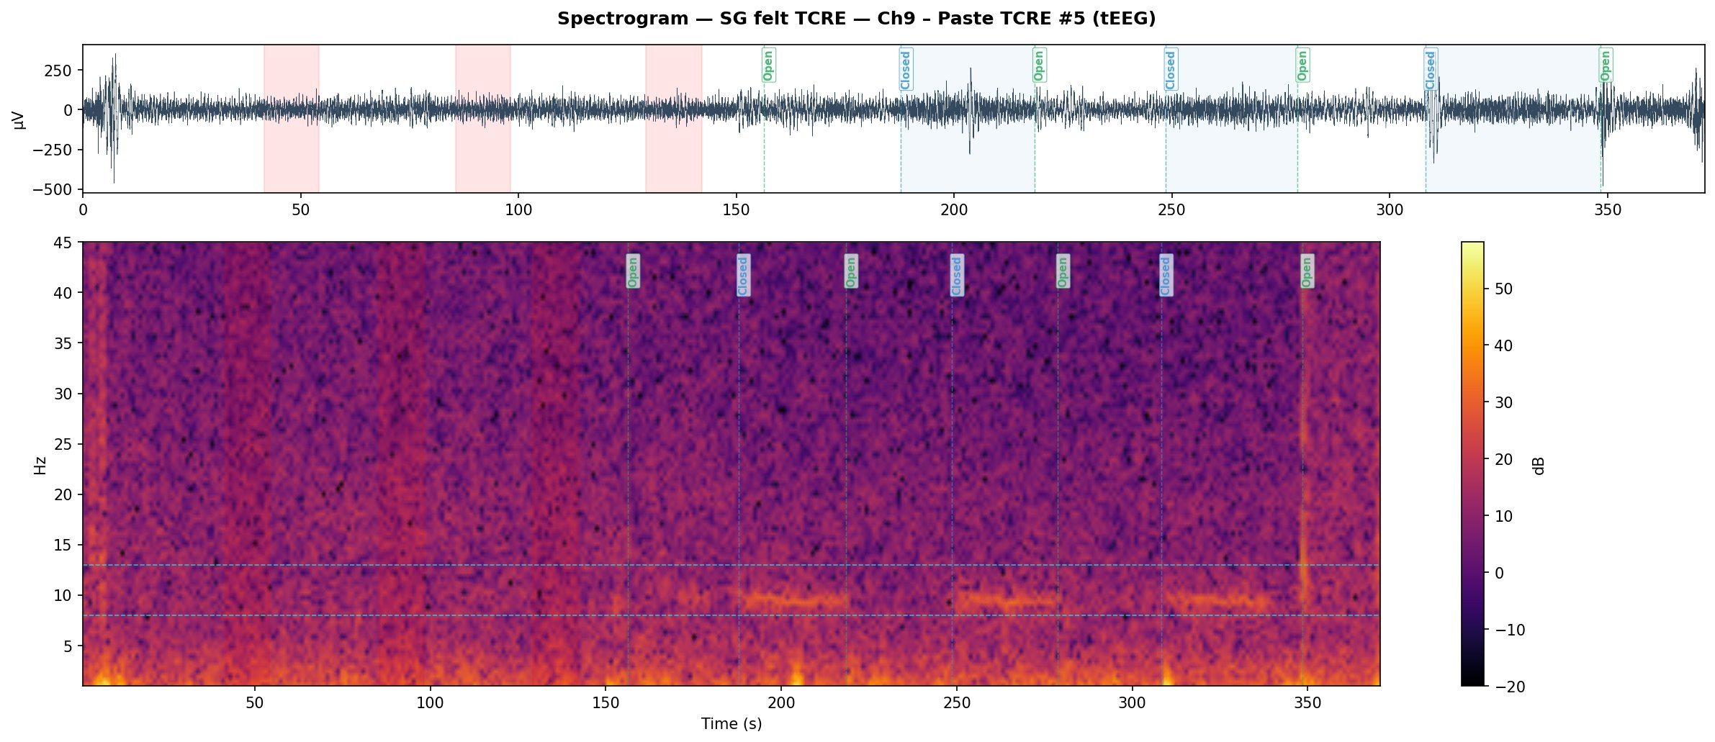
10 · ACROSS THE COHORT (1 OF 2)
Same paste sensor, every subject.
Ch9 (Paste tEEG). Bright stripes at 8–13 Hz appear during eyes-closed blocks. HS, RK, and SG.
HS
RK
SG
Khodabakhsh · ELE 573 · Spring 2026
10 / 13

Slide 11
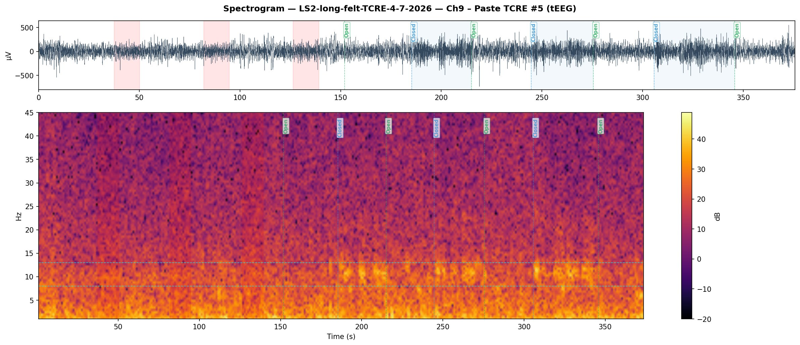
11 · ACROSS THE COHORT (2 OF 2)
Same paste sensor, every subject.
Ch9 (Paste tEEG). TU2 and LS2 — the cleanest two recordings of the cohort.
TU2
LS2
Khodabakhsh · ELE 573 · Spring 2026
11 / 13

Slide 12
12 · LIMITATIONS
Caveats for interpretation.
HIGH IMPEDANCE ON FELT CHANNELS
Observed. Felt tEEG saturated the ADC at ±3,276.7 µV in 5 of 6 subjects (worst: SG Ch1 ~34%, LS2 Ch1 ~22%, HS Ch3 ~10%).
Implication. Felt SSIM and SNR cannot be cleanly attributed to Laplacian filtering — clipping artifact contributes to the structural disagreement.
VISUAL STIMULATION OVERLAP WITH EYES-OPEN
Observed. Stimulation blocks fall within eyes-open epochs, inflating broadband power during open periods.
Implication. Reactivity ratios computed on raw epochs underestimate the Berger effect. Rest-only analysis recovers the expected pattern (TU2 ≈ 2.6×).
COHORT SIZE AND STATISTICAL INFERENCE
Observed. Six subjects; no formal hypothesis test was performed.
Implication. All cross-subject claims are observational. Pattern consistency supports the conclusion qualitatively, not statistically.
Khodabakhsh · ELE 573 · Spring 2026
12 / 13

Slide 13
13 · CONCLUSIONS
4
What we built.
What we found.
findings
I
The pipeline is reproducible.
II
Paste TCRE matches the disc.
Four metrics applied uniformly to six subjects, eleven channels each.
Pearson r = 0.93–0.99; spectrogram SSIM 0.60–0.79; FOOOF R² > 0.95 across paste channels.
III
The Berger effect is robust on paste.
IV
Felt assessment is impedance-limited.
Closed/open reactivity up to 8×, visible in single-channel spectrograms across all 5 subjects.
Clipping in 5 of 6 subjects prevents attributing felt SSIM to Laplacian filtering alone.
Thank you.
Shayan Khodabakhsh · University of Rhode Island

