Slide 1
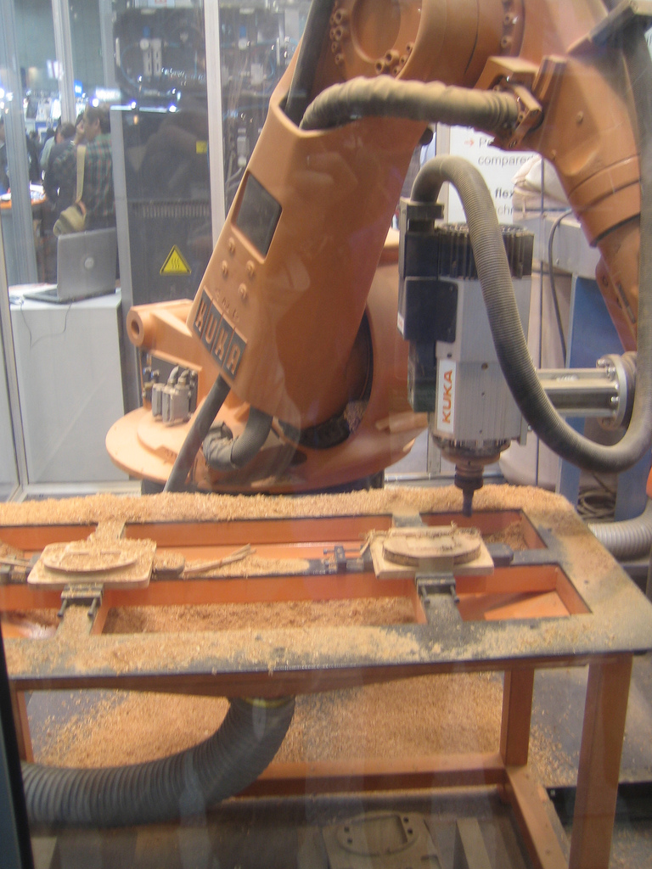
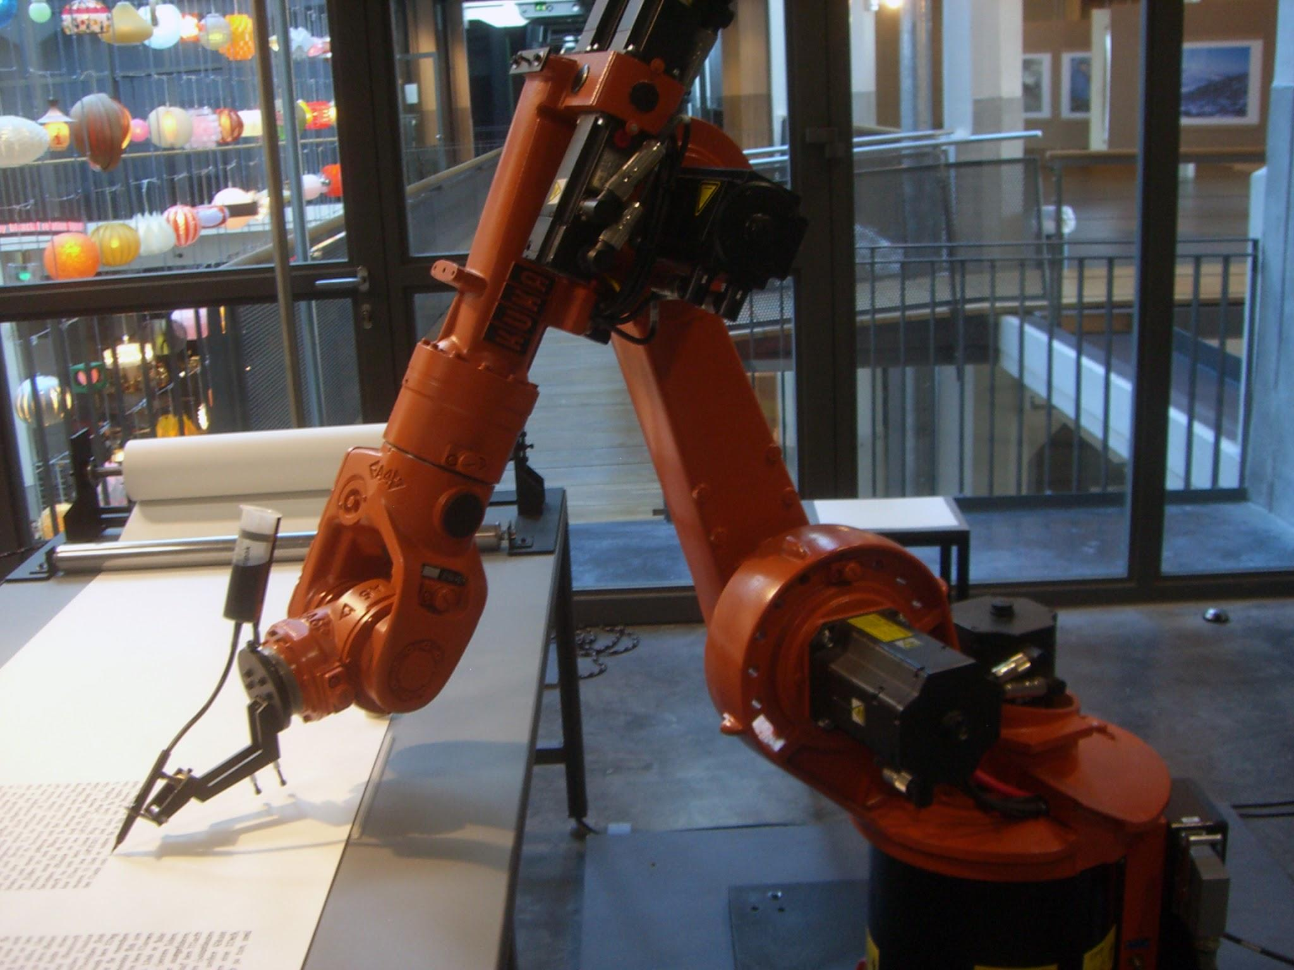
Fast and Smooth: Trajectory Optimization for a 3-DOF Robot Arm
By: Shayan Moghaddam,
Jasper Xu, and Wilson Tran

Slide 2
Goal
Path through via-points
Find the fastest smooth motion for a 3-DOF arm between a fixed start and goal pose.
Fast: minimize total motion time
Smooth: minimize joint jerk
Feasible: within physical limits
Goal
Start

Slide 3
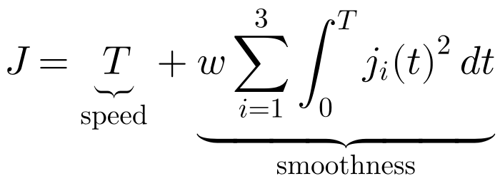
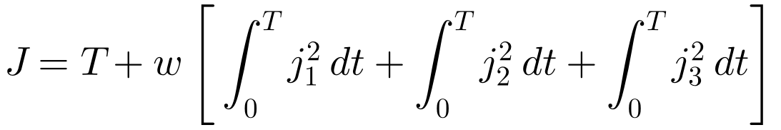
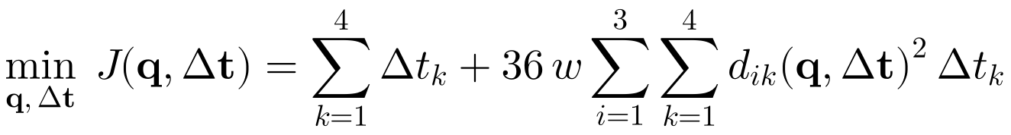
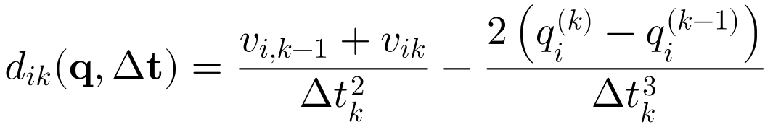
Objective Function
Minimize total motion time plus a weighted penalty on the squared jerk of all three joints, integrated over the whole motion.
Compact form
Where
q, Δt: the 13 decision variables
qᵢ⁽ᵏ⁾: angle of joint i at k
Δtₖ: duration of segment k
vᵢₖ: velocity at knot k (from spline)
dᵢₖ: cubic term, jerk = 6dᵢₖ
jᵢ = d³qᵢ/dt³: jerk of joint i
T = ΣΔtₖ: total motion time
w: smoothness weight
i, k: joint index, segment index
Red: decision variables
Expanded over the three joints
Computed form, in decision variables

Slide 4
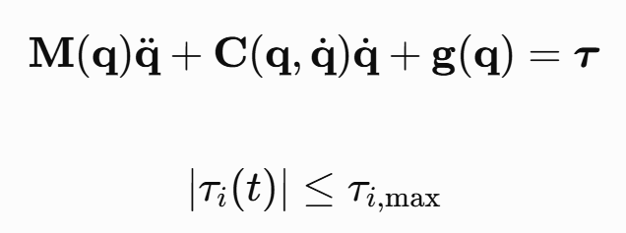
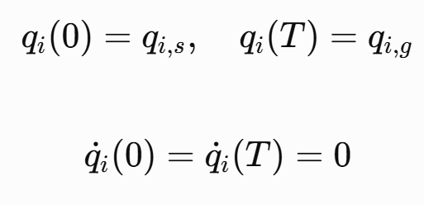
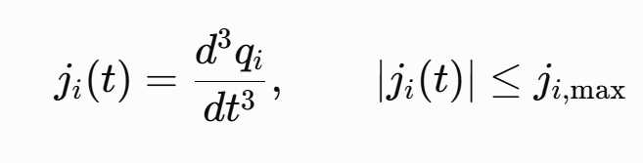
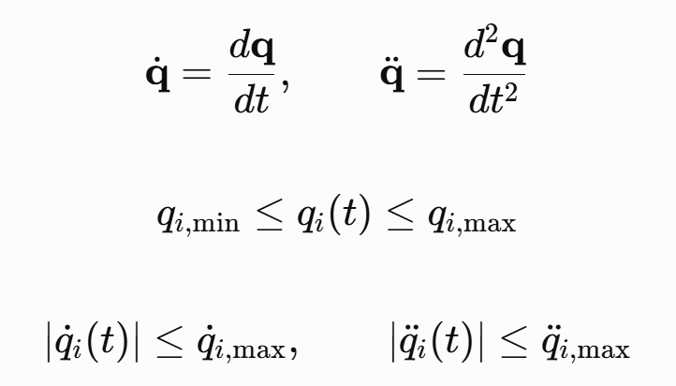
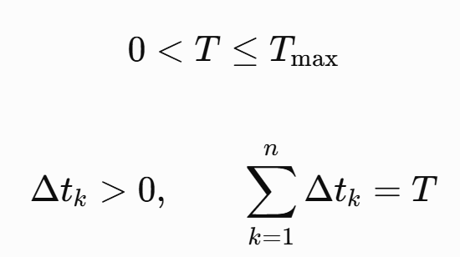
Constraints
Dynamic Constraints
Boundary Conditions
Smoothness Constraints
Kinematic Constraints
Time and Spline Constraints

Slide 5
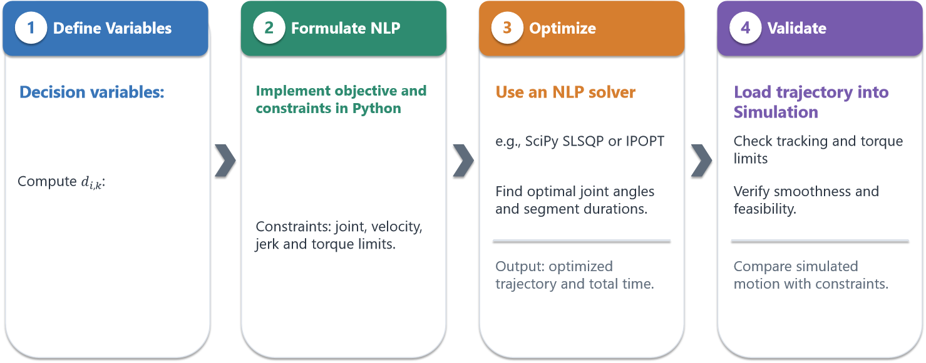


Solving Method

Slide 6
The optimal trajectory is expected to balance speed and smoothness
Assumptions
Rigid 3-DOF manipulator
Smooth cubic spline trajectories
Fixed start and end poses
No obstacle avoidance
Expected Insights
Small w | Large w
Faster motion | Smoother motion
Higher Jerk | Lower Jerk
More active constraints | Less active constraints
Different trajectories may satisfy the same task, potentially leading to multiple optima

Slide 7
Stretch Goals
Animate the optimized trajectory
Add obstacles to avoid
Simulate PID tracking of the optimized trajectory
Questions?

