Slide 1
Updating SSSP in Large-Scale Dynamic Networks
Saad Mursaleen – 22i-0835
Shayan Ahmed – 22i-0822
BIlal Raza – 22i-1325

Slide 2
Introduction
What is Single Source Shortest Path (SSSP)?
Finds shortest path from source to vertices.
Used in routing, navigation etc.
Challenges in Dynamic Network
Graphs with changing edges over time.
Recomputing SSSP every time is inconvenient.

Slide 3
Problem & Background
SSSP computes shortest paths from a source to all nodes
Dynamic networks change over time
Traditional algorithms recompute from scratch
Recomputation is costly for large graphs

Slide 4
Proposed Solution
Overview
Parallel algorithm template for updating SSSP.
Updates only affected parts of the graph.
Key Idea
Two-step process:
Identify affected subgraphs.
Update affected subgraphs to form new SSSP tree.

Slide 5
Data Structures
SSSP Tree:
Stored as adjacency list.
Vertex Attributes:
Parent
Dist : Distance from source
Affected Del: Flag for deletion.
Affected: Flag for general effects.

Slide 6
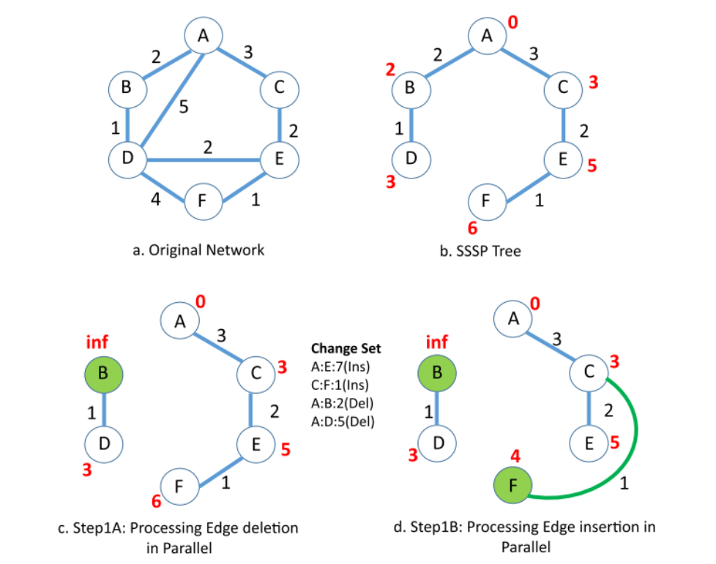
Identifying and Updating Affected Vertices

Slide 7
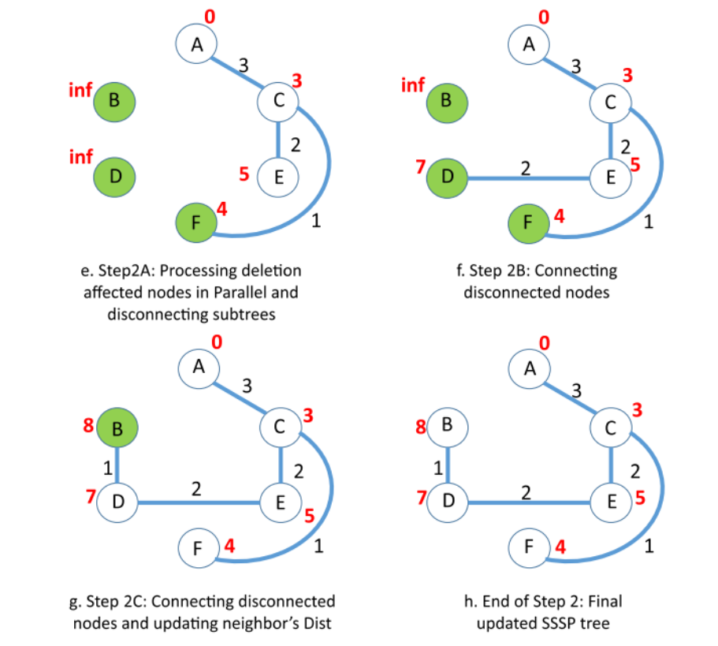
Identifying and Updating Affected Vertices(Contd.)

Slide 8
Shared Memory (OpenMP)
Parallel updates with #pragma omp for
Dynamic scheduling for load balancing
Asynchronous updates reduce synchronization overhead
Batch processing for large change sets
Scales well with thread count
Speedup up to 5x over Galois

Slide 9
GPU Implementation
CUDA-based implementation
Vertex-Marking Functional Block (VMFB)
Parallel marking and filtering of vertices
Avoid synchronization using one-directional flags
Speedup up to 8.5x over Gunrock

Slide 10
Results Summary
Update approach faster than recomputation
Best performance with high insertions
Slower when >80% nodes are affected
Good scalability on both GPU and shared memory

Slide 11
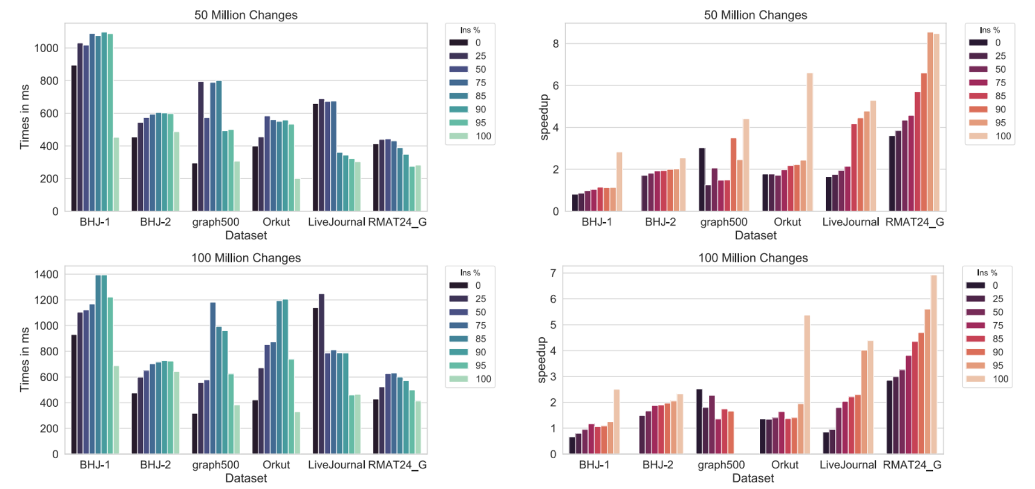

Slide 12
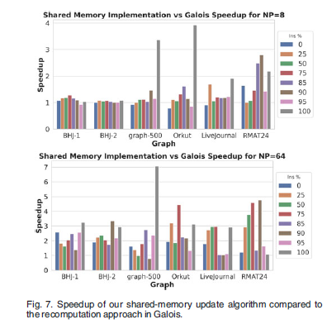

Slide 13
Parallelization Strategy
METIS for partitioning
MPI for inter-node communication
OpenMP for intra-node parallelism
Batch updates for efficiency
Use 2- Step strategy from the paper
Notes:
Slide 13: Parallelization Strategy
Good afternoon everyone. Now let's discuss the parallelization strategy we're employing to implement our dynamic SSSP update algorithm.
Our approach combines three powerful technologies to achieve high performance and scalability:
First, we use METIS for graph partitioning - this allows us to efficiently distribute the graph across multiple computing nodes.
Second, we implement MPI (Message Passing Interface) for handling communication between different nodes in our computing cluster.
Third, we utilize OpenMP for shared-memory parallelism within each node, allowing us to take advantage of multi-core processors.
These technologies work together to enable efficient batch updates and follow the 2-step strategy outlined earlier in our presentation.
Let me walk you through each component in more detail.

Slide 14
METIS
Graph Partitioning: METIS divides the input graph into balanced subgraphs to enable distributed parallel processing.
Minimized Communication: Reduces cross-partition edges, which helps lower the inter-process communication overhead in MPI.
Improved Load Balancing: Ensures that each MPI process handles a roughly equal workload, avoiding bottlenecks.
Foundation for Hybrid Parallelism: Prepares the graph for efficient execution using both MPI (inter-node) and OpenMP (intra-node) parallelism.
Notes:
METIS is our foundation for efficient parallelization. It serves several critical functions:
For graph partitioning, METIS divides our input network into balanced subgraphs. This is crucial because it enables distributed processing across multiple computing resources.
A key advantage of METIS is minimized communication. The algorithm intelligently partitions the graph to reduce the number of edges that cross between partitions. This is essential because these cross-partition edges require MPI communication, which can become a bottleneck.
METIS also significantly improves load balancing by ensuring each MPI process handles roughly the same amount of work. Without this balance, some processes would finish early and wait idle while others continue processing.
Finally, METIS provides the foundation for our hybrid parallelism approach, preparing the graph data structure for efficient execution using both MPI across nodes and OpenMP within each node.

Slide 15
OPEN MP
Intra-node Parallelism: OpenMP enables parallel processing of affected vertices within each node (CPU) using multiple threads.
Efficient Vertex Updates: Affected vertices and their neighbors are processed in parallel using #pragma omp parallel for, accelerating Step 2 of the algorithm.
Dynamic Load Balancing: OpenMP’s dynamic scheduling distributes uneven workloads (e.g., different subtree sizes) effectively among threads.
Asynchronous Updates Without Locks: Iterative updates are performed without heavy synchronization, avoiding locking overhead and ensuring scalability.
Notes:
Moving to the intra-node level, we employ OpenMP to leverage multiple CPU cores within each computing node.
For intra-node parallelism, OpenMP enables concurrent processing of affected vertices within each node using multiple threads. This is particularly important when processing dense subgraphs.
We achieve efficient vertex updates by processing affected vertices and their neighbors in parallel using directives like #pragma omp parallel for. This significantly accelerates Step 2 of our algorithm, where most of the computational work occurs.
OpenMP's dynamic load balancing is crucial when workloads are uneven. For example, when different subtrees in our SSSP tree have varying sizes, OpenMP's dynamic scheduling distributes this work effectively among available threads.
Perhaps most importantly, we implement asynchronous updates without heavy synchronization mechanisms. By carefully designing our algorithm to minimize thread contention, we avoid locking overhead that would otherwise limit scalability as thread count increases.

Slide 16
MPI
Inter-node Communication: MPI facilitates data exchange between different partitions of the graph stored on separate nodes.
Parallel Processing Across Nodes: Each MPI process works on a different graph partition, enabling distributed computation of the SSSP updates.
Synchronization of Boundary Vertices: MPI ensures that updates to vertices shared between partitions are communicated across nodes.
Scalability to Large-Scale Networks: Enables the algorithm to scale across multiple machines, making it suitable for high-performance and cluster environments.
Notes:
At the distributed computing level, we employ MPI to coordinate work across multiple computing nodes.
For inter-node communication, MPI facilitates the exchange of data between different graph partitions stored on separate physical machines. This is essential when processing graphs that are too large to fit in the memory of a single machine.
Parallel processing across nodes allows each MPI process to work on a different partition of the graph, enabling truly distributed computation of SSSP updates.
Synchronization of boundary vertices is a critical function of MPI in our implementation. When vertices are shared between different partitions, MPI ensures that updates to these vertices are properly communicated across nodes to maintain correctness.
This approach enables scalability to large-scale networks by allowing our algorithm to utilize resources across multiple machines. This makes it suitable for high-performance computing environments and clusters, where single-machine solutions would be insufficient.

Slide 17
Conclusion
The paper provides an efficient parallel framework for SSSP updates
We will implement the proposed algorithm using MPI + OPENMP + METIS.
Scalable with MPI + OpenMP + METIS
Stay true to the proposed algorithm and maintain the performance benefits
Notes:
To conclude, our paper provides an efficient parallel framework for updating Single Source Shortest Path calculations in dynamic networks.
We are implementing the proposed algorithm using a combination of MPI for distributed memory parallelism, OpenMP for shared memory parallelism, and METIS for intelligent graph partitioning.
This hybrid approach makes our solution highly scalable across both multi-core processors and distributed computing environments.
Throughout our implementation, we're staying true to the two-step algorithm proposed in the paper while leveraging these parallelization technologies to maintain and even enhance the performance benefits.
Thank you for your attention. Are there any questions about our parallelization strategy?

